Slide 1
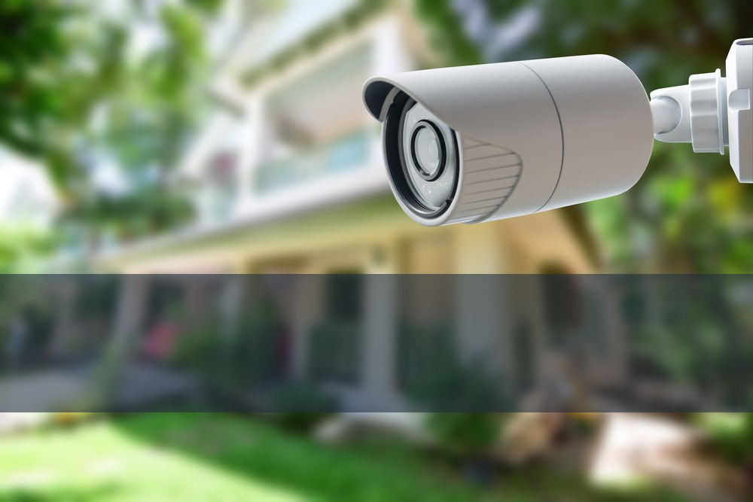

Home Security System
Capstone Project

Slide 2
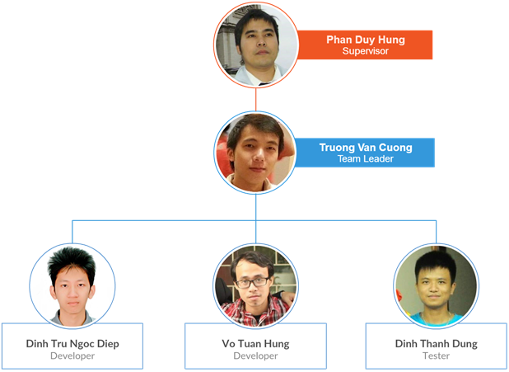
the people

Slide 3
CONTENTS
1
Introduction
Details about project Home Security System
System Requirements
2
Comprehensive description of requirements
3
System Design
How to develop ideas
Discussion & Future Works
4
Discussion about its development process
5
Demo
Run demo prototype of Home Security System
Question & Answer
6
Q&A between team and committee

Slide 4
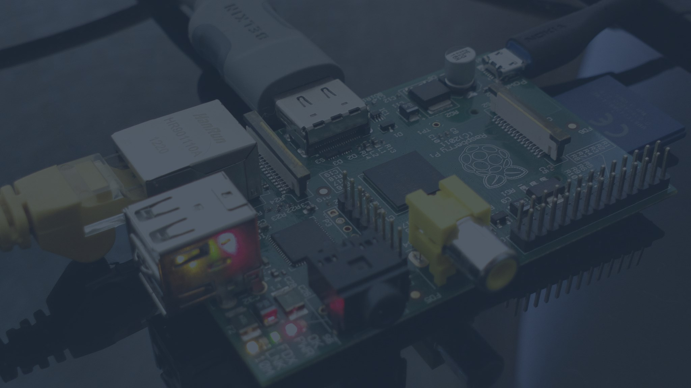
INTRODUCTION
BACKGROUND
EXISTING SYSTEMS
IDEAS AND OBJECTIVES
THE SCOPE
TOOLS AND SOFTWARE

Slide 5
BACKGROUND

Slide 6
background
The term “Internet of Things” (IoT)
System of interrelated computing devices, mechanical, digital machines and objects
IoT Requirement
Transfer data over a network without human-to-human or human-to-computer interaction
Types of IoT communication
Device-to-Device Communication
Device-to-Cloud Communication

Slide 7
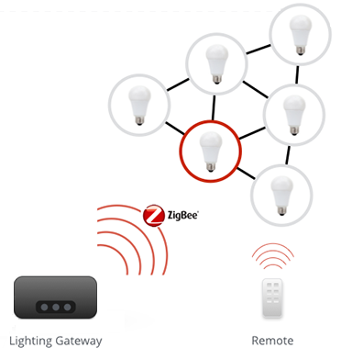
Background (Cont.)
Device-to-Device communication

Slide 8
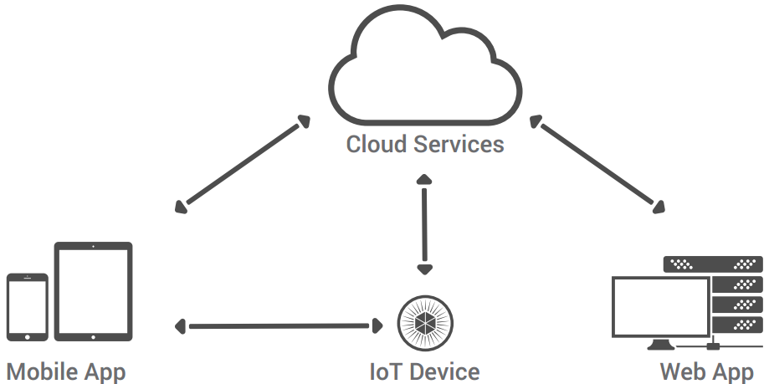
Background (Cont.)
Device-to-Cloud communication
Communication Model of HSS Project

Slide 9
EXISTING SYSTEMS

Slide 10
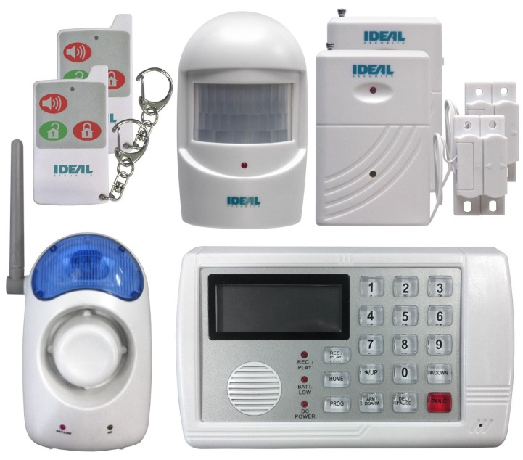


Existing systems
IDEAL Security System
$250
Working
Connect to telephone landline
Alarm by calling directly to phone
Lose memory when power failure
2 door sensors, 1 motion sensor
remote control, telephone dialer

Slide 11
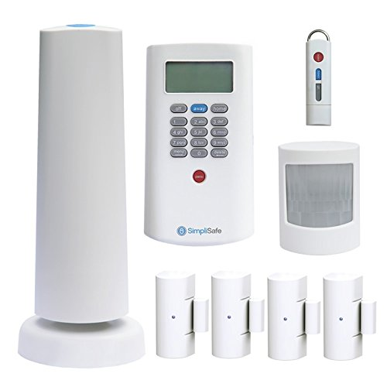
Existing systems (Cont.)
SimpliSafe House Security System
$260
$24.99/month for smartphone app
Working
Very simple to use
Plug and Play
Includes door sensors, motion detectors, CO detector, panic button for emergencies etc…

Slide 12
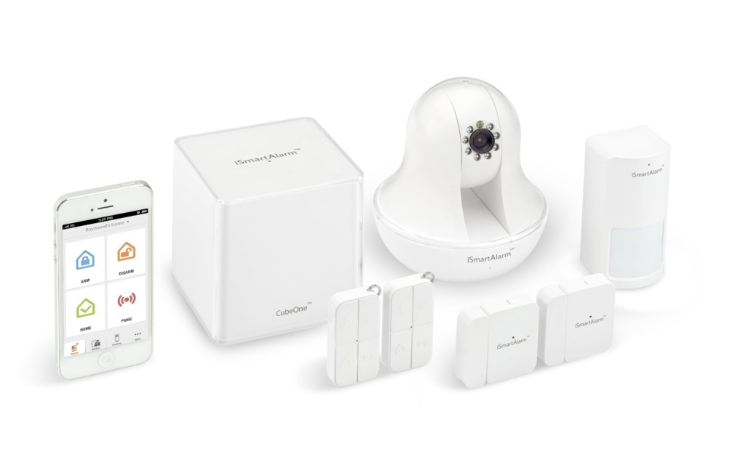
Existing systems (Cont.)
iSmartAlarm Premium Package
$199
$349 for including iCamera
Working
Smartphone application
2 door sensors, 1 motion sensor
2 remote tags
Very easy to integrate with addition sensors

Slide 13
IDEAS AND OBJECTIVES

Slide 14
IDEAS and objectives
Down-side of Existing Home Security System (maybe one or more for specific system)
Only provide entire smart-home solution packet
Hard to deploy in existing house
The cost is too high
Camera IP solution has a lot of disadvantages
Lack of active real-time technologies
Not integrated smart doorbell yet
Conclusion
Basically HSS can overcome above weaknesses

Slide 15
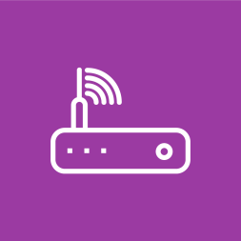



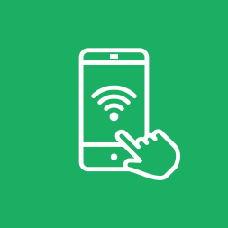

The scope
Internet
Real-time Handling
WLAN or Ethernet
Send and receive data
in real-time
Sensor
Audio Quality
Motion and Door detection
A push button as doorbell
PCMU/PCMA Audio Codec
64kbps
Connection
Image Quality
HSS-Board and HSS-App
in a same local network
JPEG @ 640x480 pixel

Slide 16








TOOLS AND Softwares
Programming Language
Tools and Software
Qt
Github
Google Drive
Astah
Arduino IDE

Slide 17
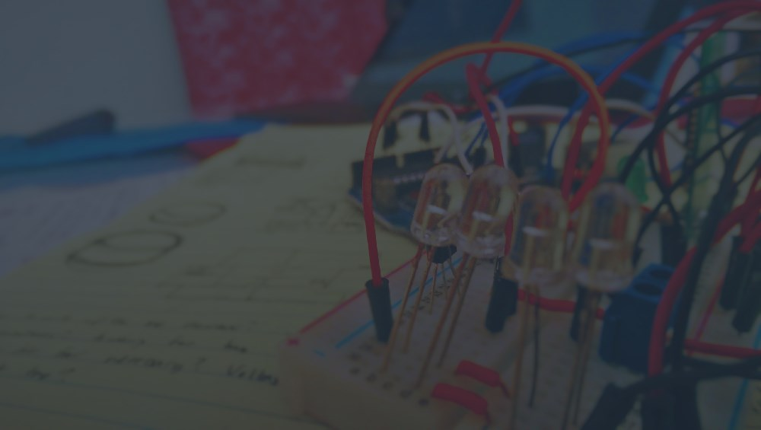
SYSTEM REQUIREMENTS
FUNCTIONAL REQUIREMENTS
NON-FUNCTIONAL REQUIREMENTS

Slide 18
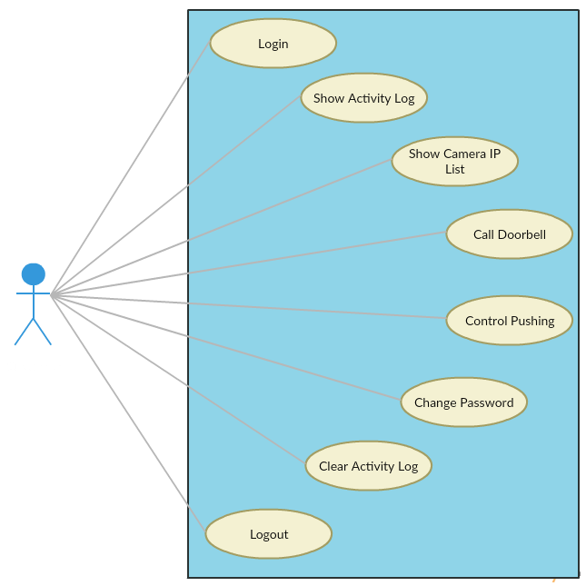
Functional requirements

Slide 19
NON-FUNCTIONAL REQUIREMENTS
Safety
The supply voltage of hardware is about 5V and totally be safe with user
Reliability
Response error popup immediately on Android application when has error
Security
Always require authenticating process

Slide 20
SYSTEM DESIGN
SYSTEM ARCHITECTURE
HARDWARE DESIGN
SOFTWARE DESIGN

Slide 21
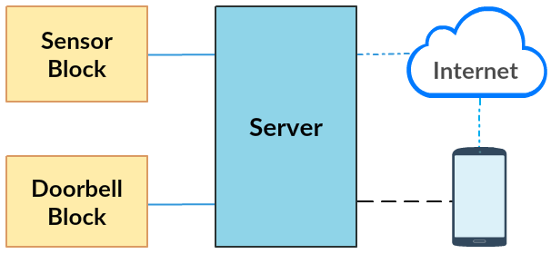
System architecture
Overview
HSS-Board: Devices in wired connection
HSS-App: Android app and third-party services

Slide 22
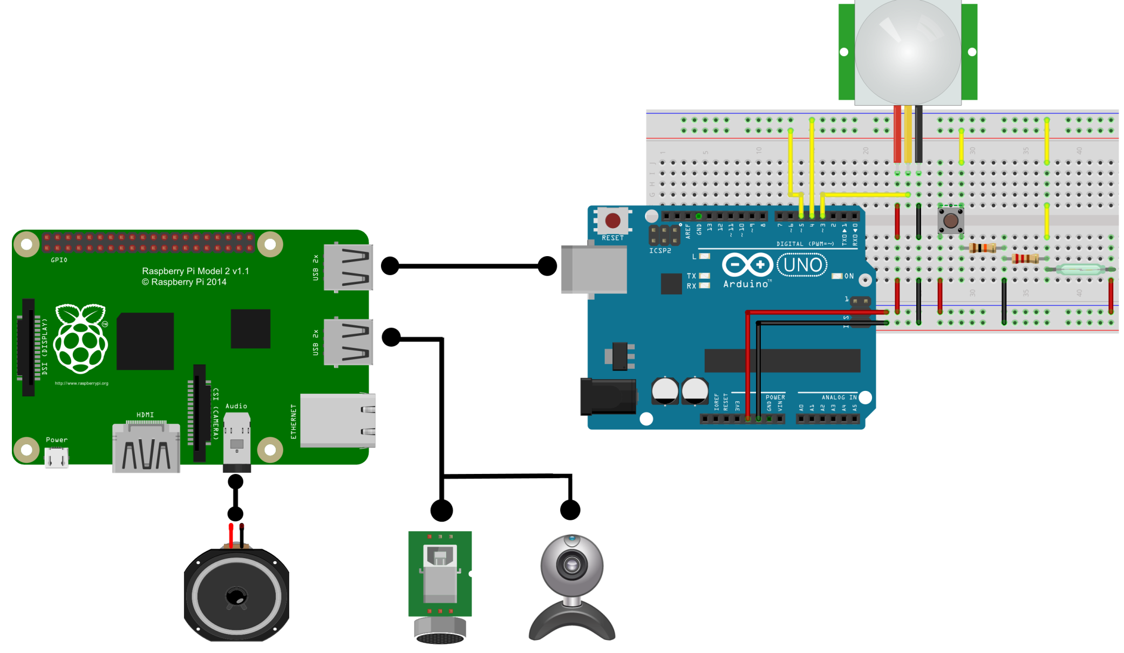
Hardware design
HSS-Board Schematic

Slide 23
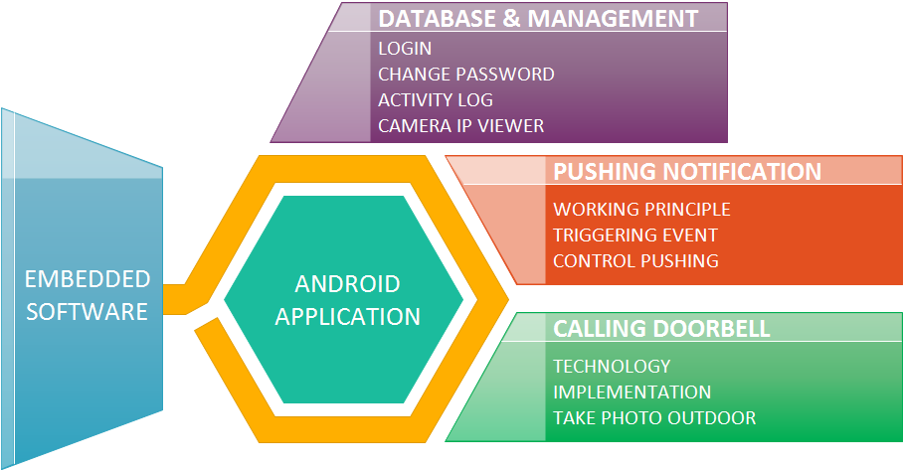
Software design

Slide 24
DATABASE
and
MANAGEMENT

Slide 25
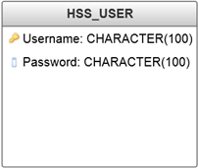
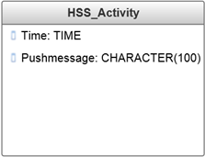
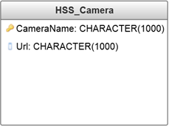
SOFTWARE DESIGN
Database
Name | Meaning
Username | Username for login
Password | Password for login
Time | Time of triggered event
Pushmessage | Message shown in Activity Log screen
CameraName | Name of Camera IP
Url | URL of Camera IP

Slide 26
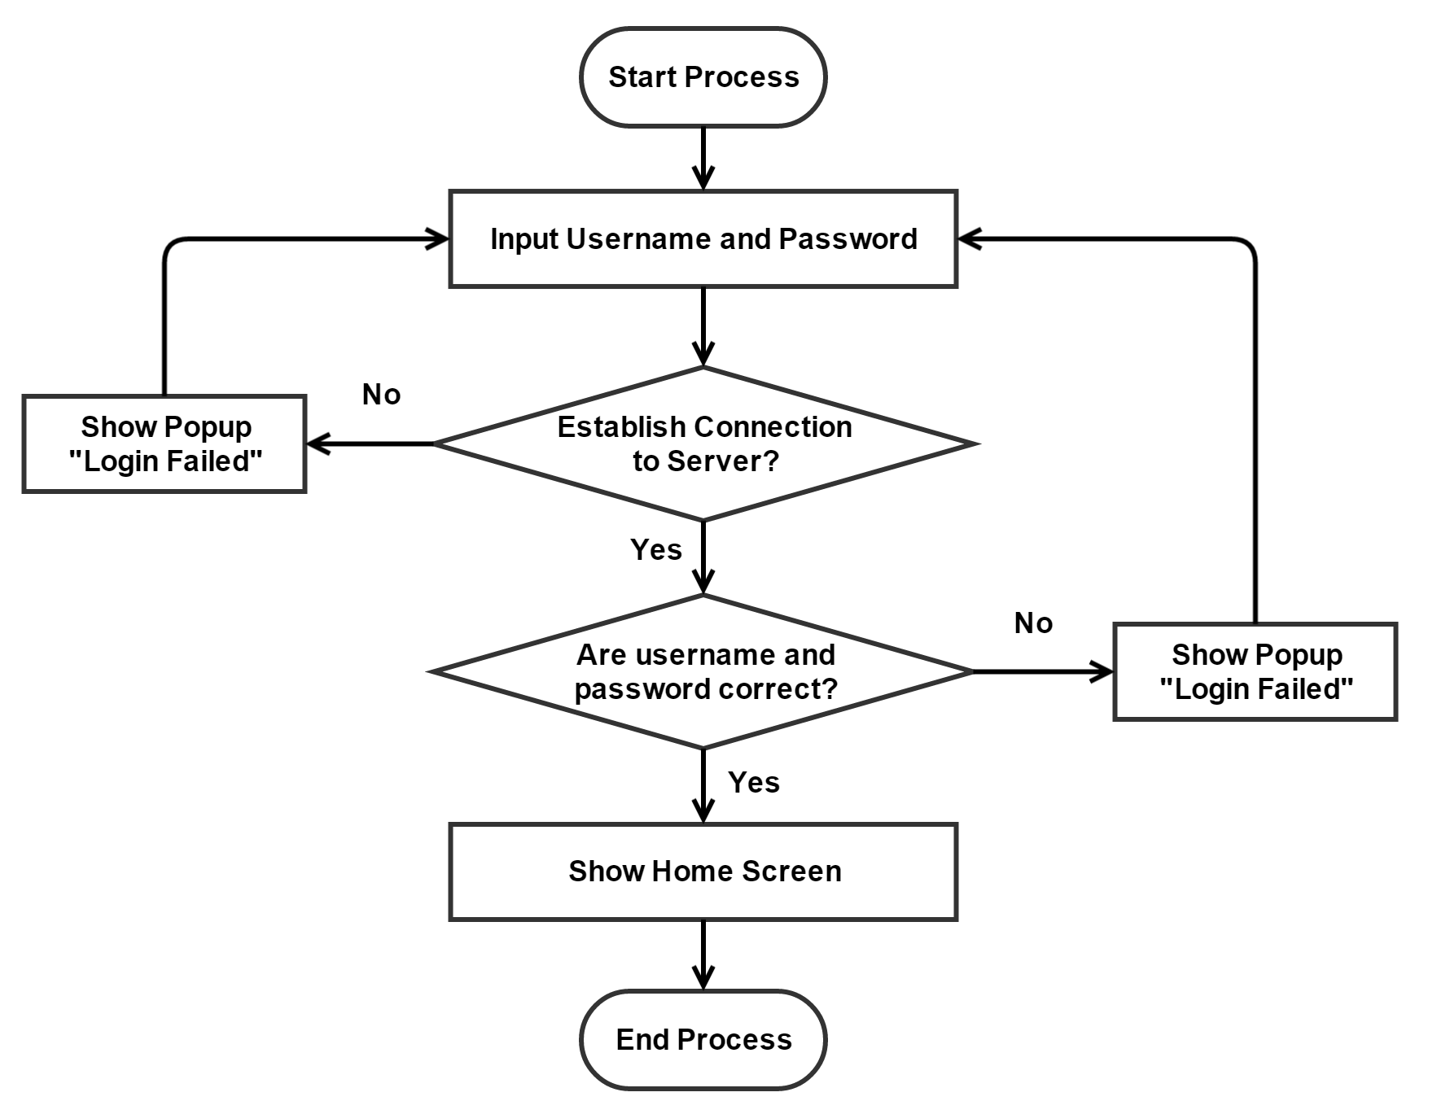
SOFTWARE DESIGN (cont.)
Login

Slide 27
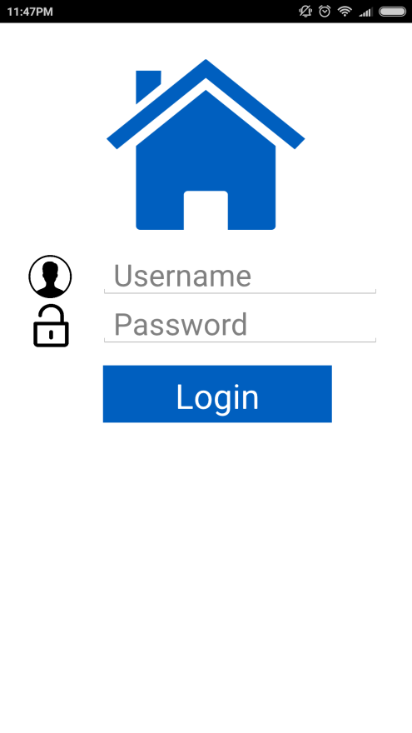
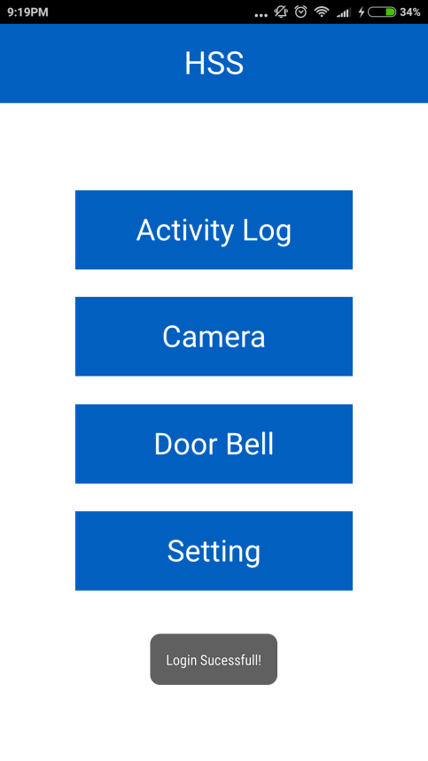
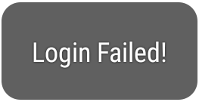

SOFTWARE DESIGN (cont.)
Login
Popup on Screen

Slide 28
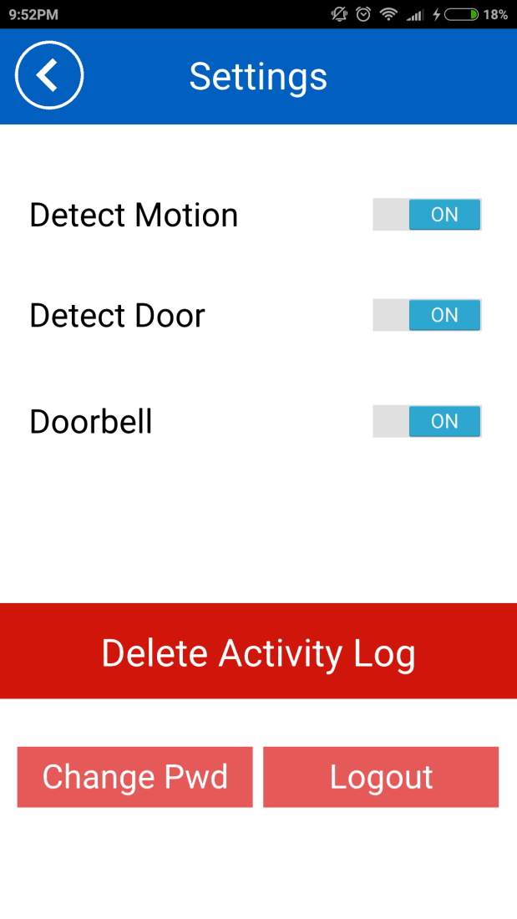

SOFTWARE DESIGN (cont.)
Change Password
Change Password Screen

Slide 29
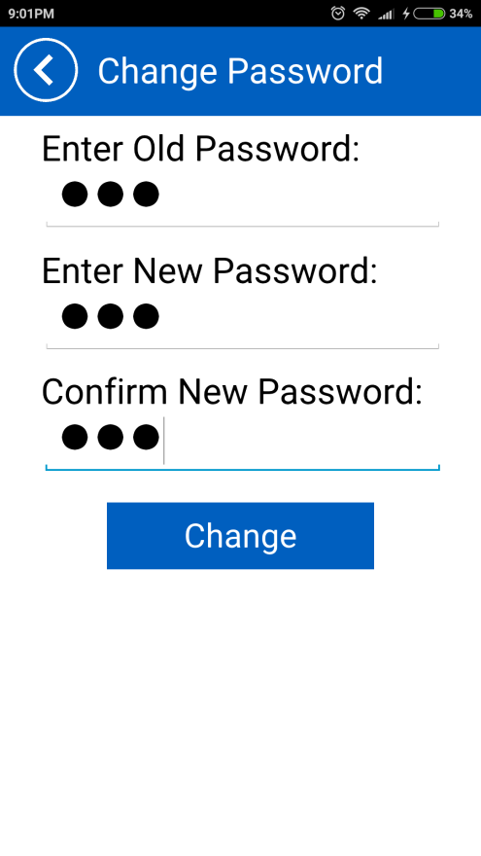
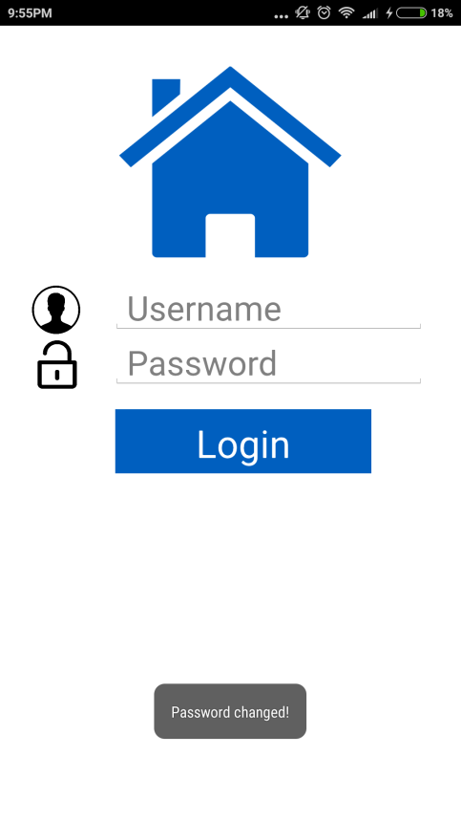
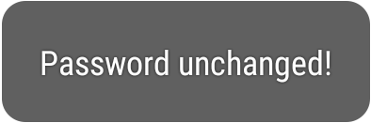
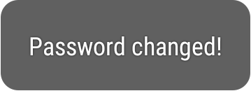
SOFTWARE DESIGN (cont.)
Change Password
Popup on Screen

Slide 30
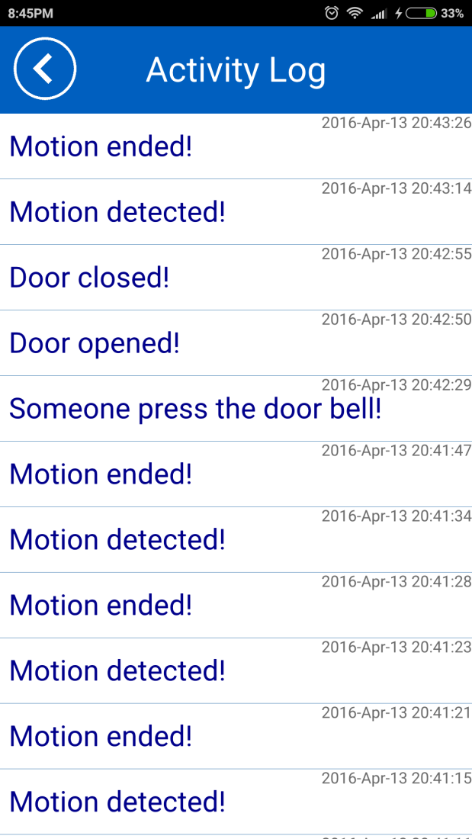
SOFTWARE DESIGN (cont.)
Get Activity Log

Slide 31


SOFTWARE DESIGN (cont.)
Delete Activity Log

Slide 32
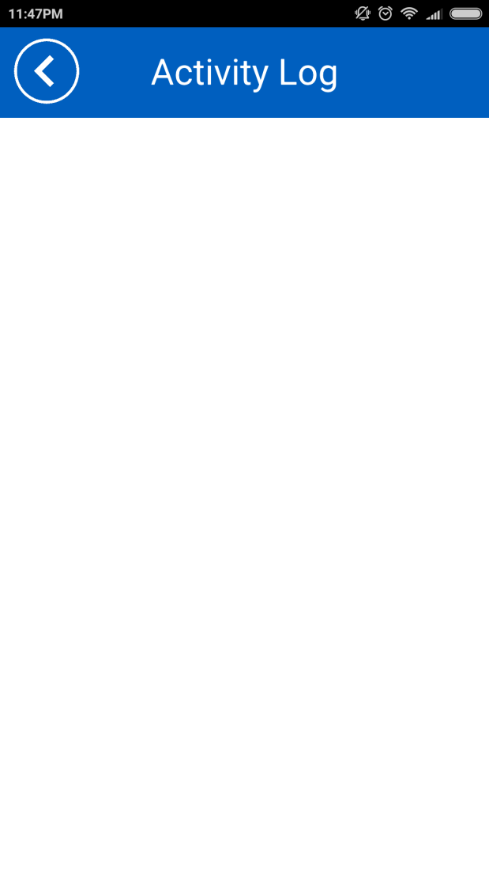
SOFTWARE DESIGN (cont.)
Delete Activity Log

Slide 33
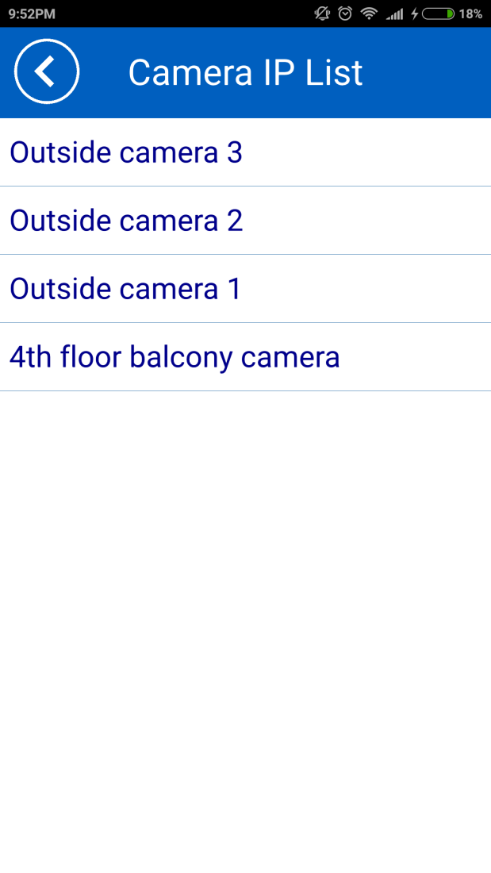
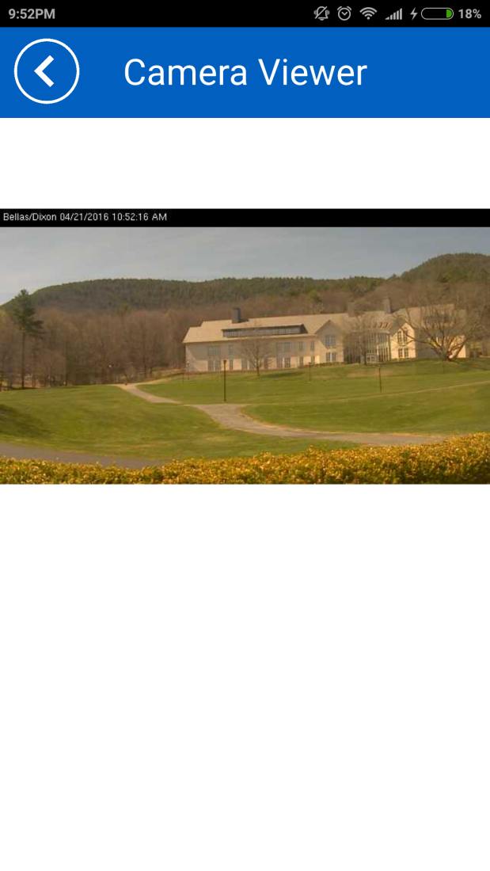
Software design (cont.)
Camera IP Viewer

Slide 34
PUSHING NOTIFICATION

Slide 35

SOFTWARE DESIGN (cont.)
Pushing Notification
Pusher
Simple hosted API
Use WebSockets for real-time bidirectional functionality over a single TCP socket
Deliver over 160 billion messages to more than 5.4 billion devices

Slide 36
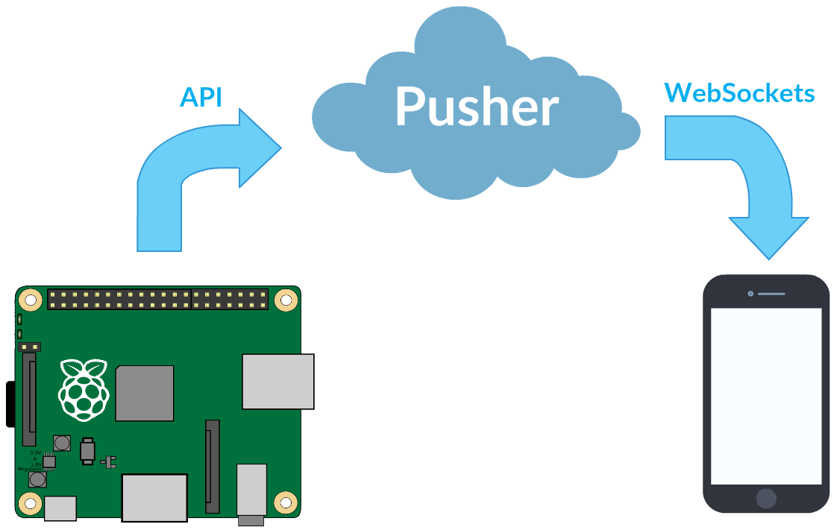
SOFTWARE DESIGN (cont.)
Pushing Notification

Slide 37
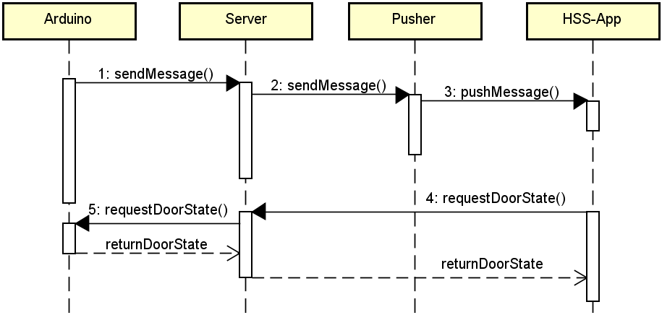
SOFTWARE DESIGN (cont.)
Pushing Notification

Slide 38
SOFTWARE DESIGN (cont.)
Pushing Notification
On Raspberry Pi
Create a connection
Triggering event to channel
Send message to Pusher
On HSS-App
Create a connection
Subscribe to public channel
Listen for event

Slide 39
SOFTWARE DESIGN (cont.)
Pushing Notification: Triggering Event
Sensor | Trigger | Push Action | Message
Button | Press or hold once | Push to HSS-App | Someone press the doorbell
Door | Initial state: Closing | Show on screen when change Door Switch state | Door is being closed
 | Initial state: Opening | Show on screen when change Door Switch state | Door is being opened
 | Change state from closing to open | Push to HSS-App | Door has been opened
 | Change state from open to close | Push to HSS-App | Door has been closed
PIR | Detecting motion | Push to HSS-App once every 5s | Motion detected
 | Motion ends | Push to HSS-App after 5s without any motion detected | Motion ended

Slide 40
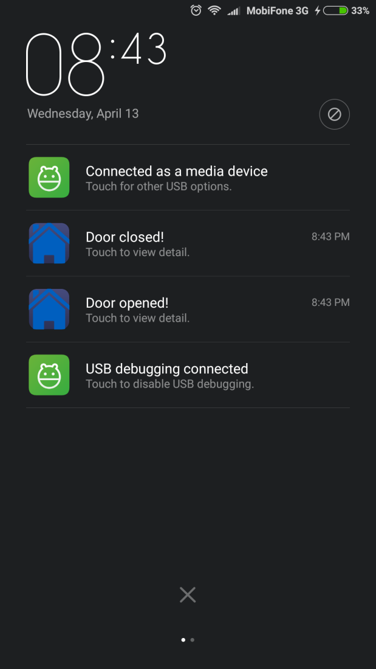
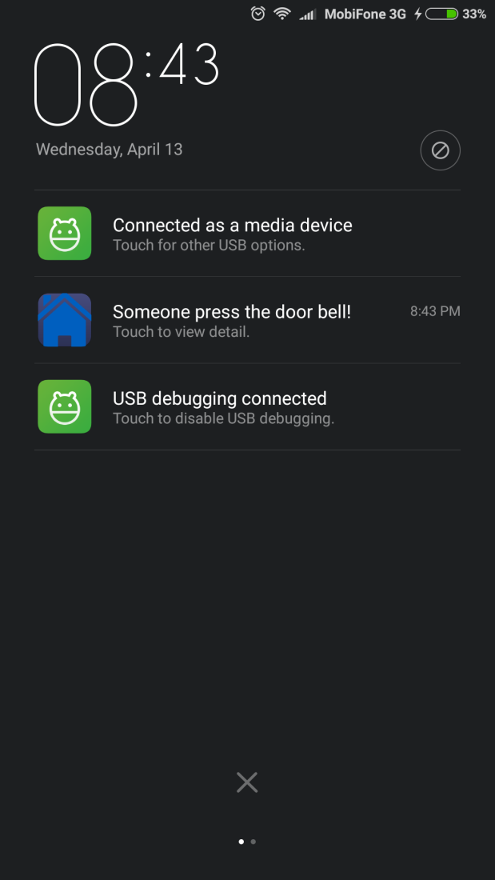
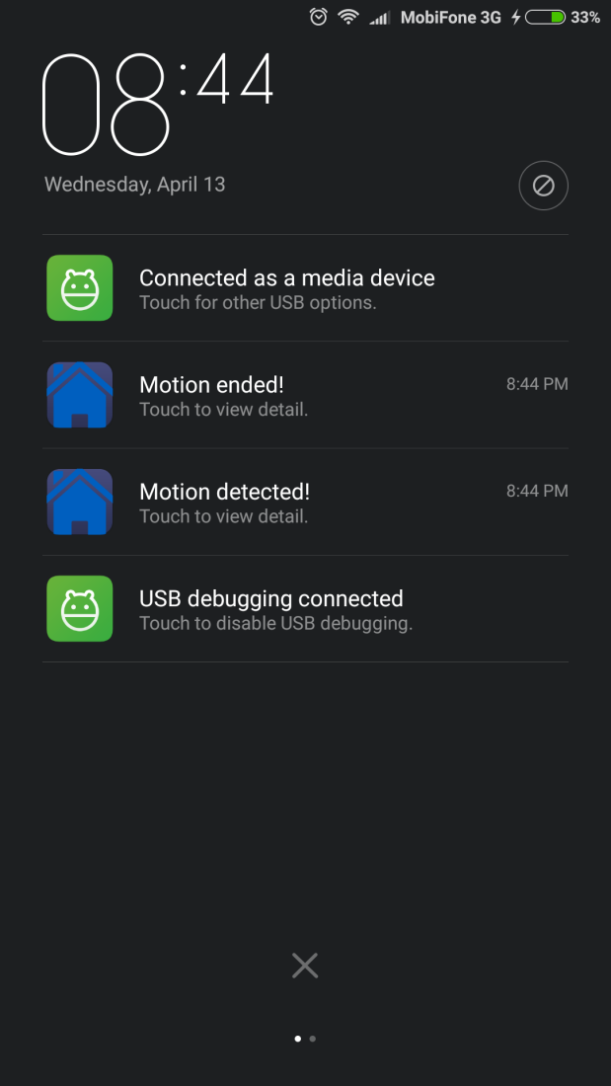
SOFTWARE DESIGN (cont.)
Pushing Notification: Sample Screen

Slide 41
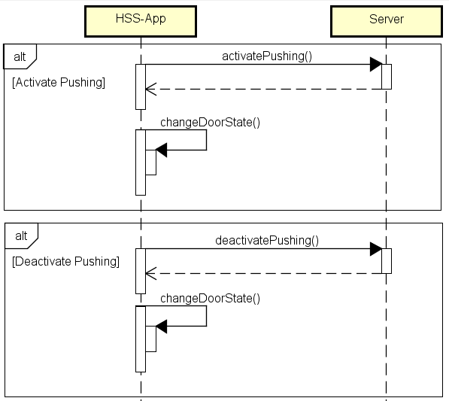
SOFTWARE DESIGN (cont.)
Control Pushing Notification

Slide 42
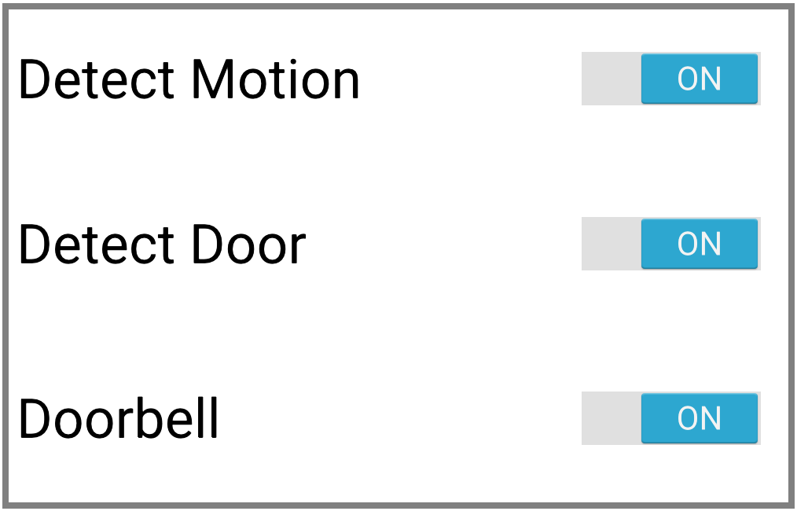
SOFTWARE DESIGN (cont.)
Control Pushing Notification

Slide 43
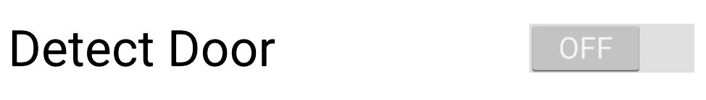
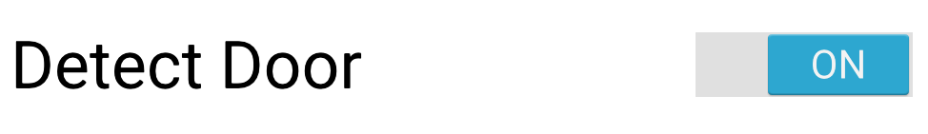
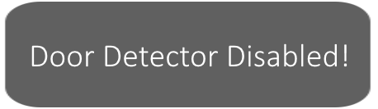
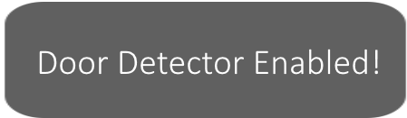
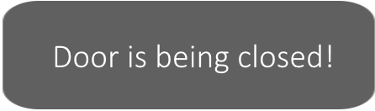
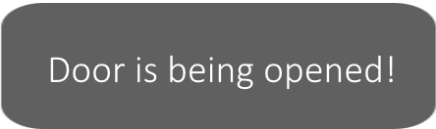
SOFTWARE DESIGN (cont.)
Control Pushing Notification
Read the current state of door sensor
or

Slide 44
CALLING DOORBELL

Slide 45
Software design (cont.)
Calling Doorbell
Voice over IP Technology (VoIP)
Delivery of voice communications and multimedia sessions over IP network
Providers usually offer lower rates than traditional phone
SIP Server (Session Initiation Protocol Server)
Signaling and controlling communication sessions
Linphone SIP Server
Free SIP service based on Flexisip proxy server (famous open source VoIP server)

Slide 46
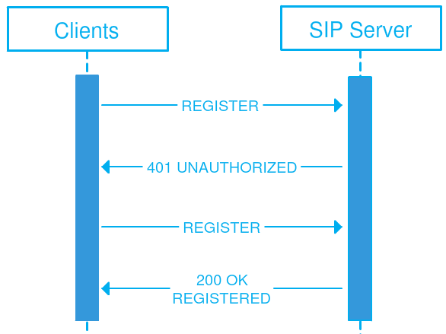
Software design (cont.)
Calling Doorbell
SIP Server in HSS
Responsible for keep registering with clients in both 2 sides: Raspberry Pi and HSS-App; then routing the connection when initiating a VoIP call (Calling to Doorbell)

Slide 47
Software design (cont.)
Calling Doorbell
On Raspberry Pi
Install Linphone module package for Python
Setting in code:
Parameter | Value
SIP Server | sip.linphone.org
STUN Server | stun.linphone.org
Auto Answer Call | Yes
Audio Codec | PCMU or PCMA
Sound Input | ALSA: USB PnP Sound Device
Sound Output | Default

Slide 48
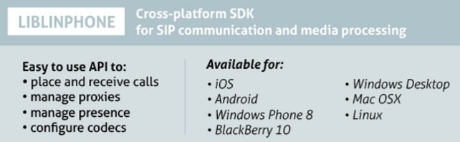
Software design (cont.)
Calling Doorbell
On HSS-App, Linphone Library and API were used for developing VoIP feature

Slide 49
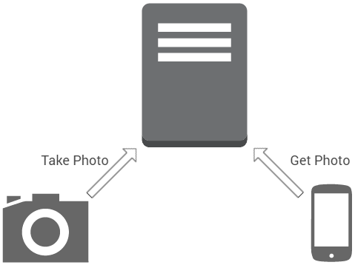
Software design (cont.)
Calling Doorbell
Take photo when someone press the doorbell
fswebcam
Apache HTTP Server

Slide 50
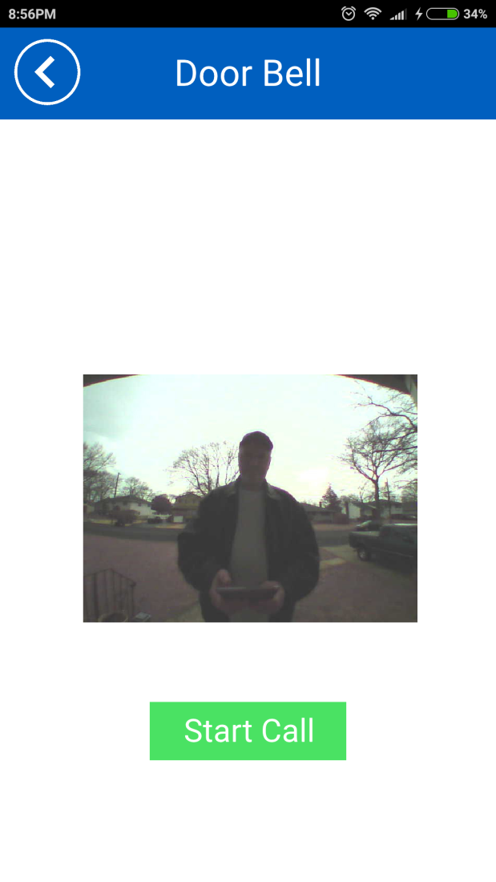
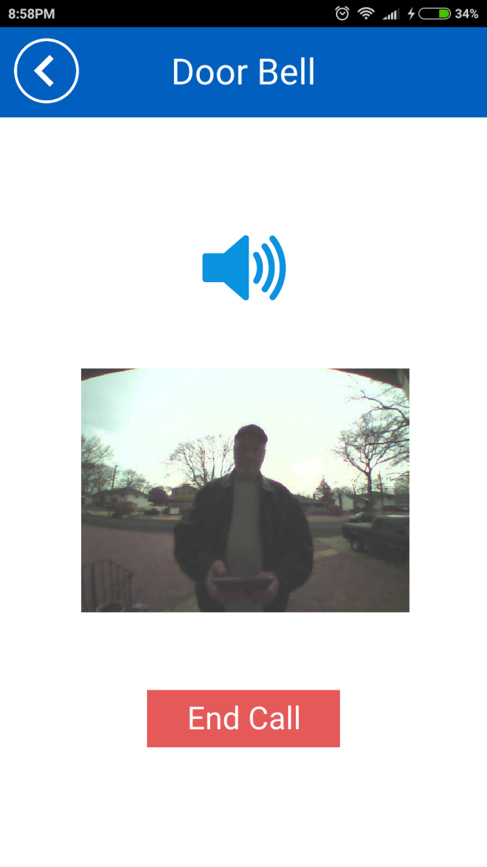
Software design (cont.)
Calling Doorbell

Slide 51
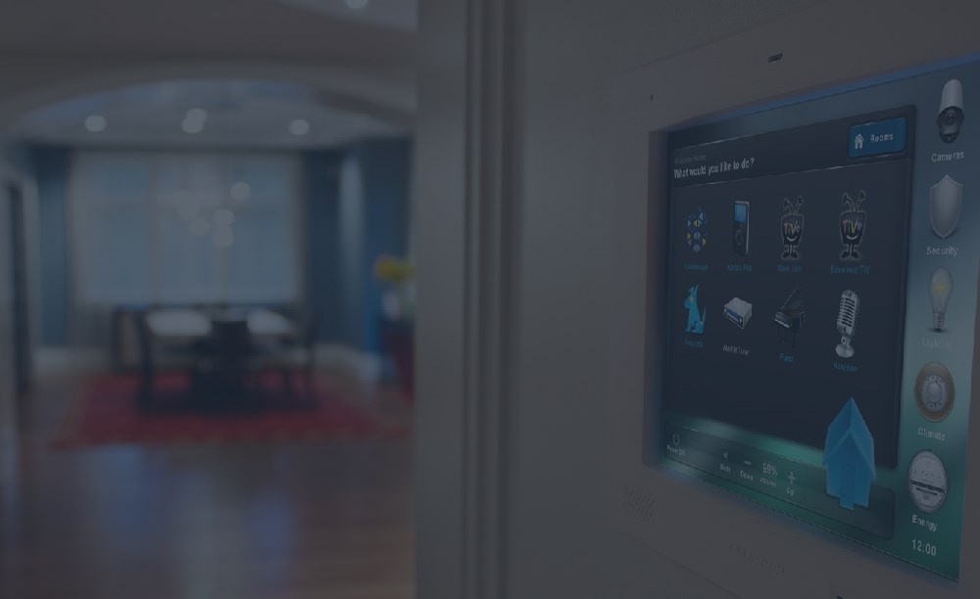
DISCUSSION & FUTURE
DIFFICULITIES
FUTURE WORKS

Slide 52
DIFFICULITIES

Slide 53
DIFFICULITIES
Lack of memory when compiling
The SDRAM of Raspberry Pi is only 512MB
Login mechanism makes work harder
Take more system resources, time and be slower
Hardware components suddenly break
Moonsoon weather, wet or quality of components

Slide 54
FUTURE WORKS

Slide 55
Future works
Add more sensors
CO detector, glass break sensor, etc…
Support video for calling doorbell
Track your visitor in real-time, not only static image
Self-manage existing Camera IP
Full of features to manage viewing every camera IP
Self-setup at first
Fully automatic synchronization at first setup

Slide 56

DEMO

Slide 57

QUESTION & ANSWER

Slide 58
THANK YOU

