Slide 1


Discussion Paper for GCS Meeting
03/Oct/2017
Hitachi, Ltd.

Slide 2


1. About File Sharing Method (You are staying in Japan/October)
We have any question about file(=Development Output) sharing.
HCGSJ@Oomori-OFFICE
HITACHI@Marunouchi-OFFICE
Shared File server
Shared File server (Hitachi Internal Use Only)
Question1
Question2
Deliverables
Kondo & Kamata
Access using LDAP
Diep-san
Khang-san
Question1
Question
Does HCGSJ have a shared file server? Or, Have you a way to share files between Khang-san and Diep-san?
Does Kang-san have LDAP of Hitachi Group?(Please put deliverables on hitachi's file sever.)

Slide 3
2. About Work estimate
For after October, please let me order as follows..
Item | Oct | Nov | Dec | SUM
Simulator Development | 2MM (\700,000 *2) In Japan | 2MM (\320,000*2) In Vietnam | 2MM (\320,000*2) In Vietnam | 6MM \2,680,000
Survey in Vietnam | 1MM (\320,000) In Vietnam |  |  | 1MM \320,000
TOTAL |  |  |  | \3,000,000
Regarding market survey, we received a proposal at 11.5MM, but please accept with total of 5MM, together with orders for September

Slide 4
3. Working process
Key Activities |  | 2017
 | Who | Sep | Oct | Nov | Dec | Comments
Learn &Training R platform | G
Work package agreed | H, G
Development environment set-up | G
Review of functional and GUI requirement | H, G
Review of Specification and GUI design | H, G
Implementation | G
Review and test | H, G
Final review, Closing | H, G
Agile

Slide 5



4. UI sample and request
Overall UI design
Insurance Risk Simulator
Switching tabs according to function
Medical cost comparison
Medical cost
Prediction
Data processing
Hospitalization risk
RE-insurance
analysis
Data Setting Panel
XXXX
Self-payment
Create SQL according to selected items
\100,000
▼
-
-
-
-
-
-
-
-
-
-
-
Insurance
YYYY
combo box etc.
▼
\50,000
Interactive!
(Plotly)
Deliver SQL
RUN
ZZZZ
\0
| | | | | | | | | | | | | | | | | | | | | | | | | | | | | | | | | | | | | | | | | | |
DATA RANGE
Message area
----------------------------------------------------------------------------------------------------------------------------------------------
R version 3.4.2 (Short Summer) has been released on Thursday 2017-09-28.
The R Journal Volume 9/1 is available.
R version 3.3.3 (Another Canoe) has been released on Monday 2017-03-06.
The R Journal Volume 8/2 is available.
useR! 2017 (July 4 - 7 in Brussels) has opened registration and more at http://user2017.brussels/
Tomas Kalibera has joined the R core team.
0~1000
The plot is different depending
on the purpose
--bar graph
--Line graph
--pie chart
--histogram
--Scatter plot
etc…
1001~5000
5001~10000
Draw analysis results
Analysis logic
(Prepared by Kondo , or Please create dummy logic)

Slide 6
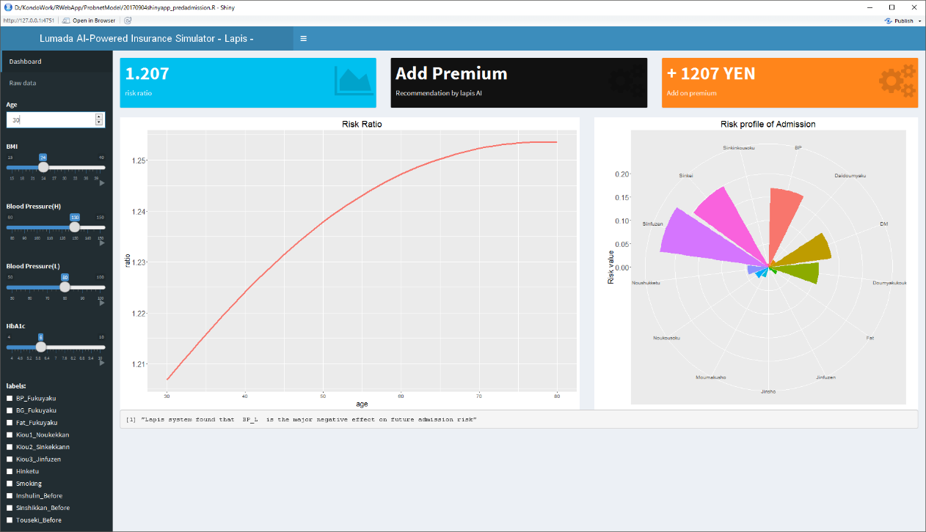
5.What you want us to do first
Understanding of simulator environment prototyped by Hitachi
I will pass you the database schema information. Please build it.
Please generate dummy data and import it
I will pass the above prototype source code. Please start up and understand the contents

Slide 7
6. Deliverables
# | Item | Format | memo
1 | Program source code | .R etc.. | Including R-code, HTML, CSS, JS, SQL, …etc.
2 | Database configuration file | .mdf etc.. | SQL server configuration file(.mdf) Data Export file (.csv)
3 | Simple specification Document | Microsoft Office (.xlsx/.docx/.pptx) | Regarding R source code, please summarize about processing outline, processing order, meaning of notes,

