Slide 1
FirstCheck24
THE VC OPERATING SYSTEM
Find the founder
before the round.
24:00
Autonomous discovery surfaces hidden builders early.
Explainable intelligence shows exactly why they matter.
One investor.
An entire organisation's reach.
FIRST SIGNAL → EVIDENCE → $100K DECISION
Hack-Nation × MIT Clubs × Maschmeyer Group
Notes:
Great founders often leave meaningful signals long before they raise a round, but traditional VC teams usually find them only after fundraising begins. FirstCheck24 finds these founders earlier and makes every investment judgment evidence-backed, explainable, and traceable.

Slide 2
THE PROBLEM
VC discovers founders
after the signal is obvious.
Discovery starts too late. Diligence restarts from zero. Scores hide their reasoning.
TODAY
FIRSTCHECK24
Pitch deck
GitHub
Weeks
24h
private context
execution trail
to collect, reconcile and
understand one opportunity
from a valid application
to an evidence-backed decision
Website
Social
product claim
weak signal
Capital flows through networks,
not merit.
Find them before
the market does.
FirstCheck24
02
Notes:
Today's VC workflow is reactive. Valuable information is scattered across GitHub, product launches, research, company websites, and social networks. Teams discover opportunities too late, repeat the same research, and often receive an AI score that behaves like a black box rather than a decision tool.

Slide 3
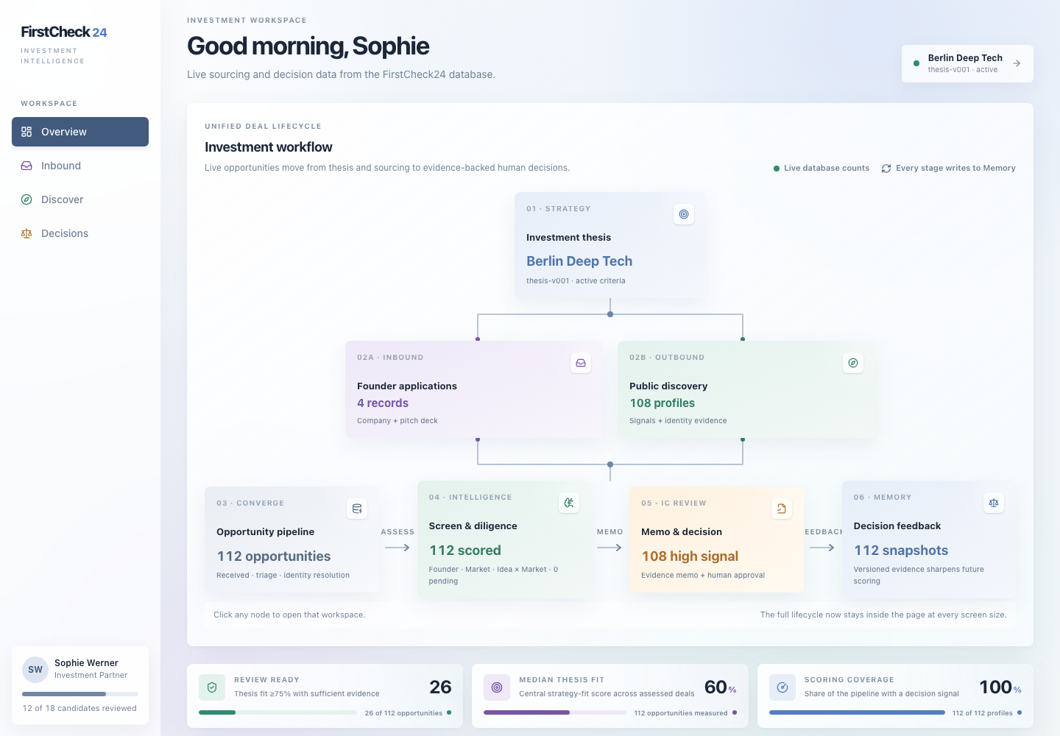
THE PRODUCT THESIS
Autonomous discovery.
Explainable decisions.
Find hidden founders early — then show
every step behind the score.
CORE 01 · AUTONOMOUS DISCOVERY
Public signals → ranked founders
CORE 02 · EXPLAINABLE INTELLIGENCE
Source → claim → score → decision
One investor approves outreach and capital.
Memory learns from every correction.
LIVE PRODUCT
FirstCheck24
03
Notes:
FirstCheck24 is built around two ideas: autonomous discovery and explainable intelligence. The system proactively identifies promising founders and turns public signals into verifiable evidence. Investors see not only the score, but exactly why the score exists.

Slide 4
CORE 01 · AUTONOMOUS DISCOVERY
Always on.
Thesis directed.
Ten collectors continuously scan execution, research, launches and community signals.
GITHUB
PRODUCT HUNT
HACKER NEWS
ARXIV
HACKATHONS
YOUTUBE
WEB
TAVILY
LINKEDIN
PODCASTS
01
02
03
04
Collect
→
Resolve
→
Score
→
Activate
immutable snapshots
one persistent identity
thesis + momentum
human-approved outreach
Cold outreach, never cold investment — every activated founder enters the same application funnel.
FirstCheck24
04
Notes:
The first capability is autonomous discovery. Based on the fund's investment thesis, the system continuously scans sources such as GitHub, Product Hunt, Hacker News, research papers, and hackathons. It collects signals, resolves identities, scores opportunities, and leaves outreach approval with the investor.

Slide 5
CORE 02 · EXPLAINABLE INTELLIGENCE
Every score
shows its work.
SOURCE SNAPSHOT
Immutable deck, repo, page or post
EXPLAINABILITY CONTRACT
Every claim answers
four questions.
OBSERVATION
Timestamped extraction with provenance
CLAIM
Reconciled assertion + contradiction state
01
Where did it come from?
AXIS SCORE
Versioned result linked to supporting claims
02
When was it observed?
03
How confident are we?
DECISION MEMO
Investor conclusion with a complete audit trail
04
What contradicts it?
CLICK SCORE → SOURCE
MISSING DATA ≠ BAD FOUNDER
FirstCheck24
05
Notes:
The second capability is explainability. Every conclusion follows a transparent chain: source, observation, claim, score, and decision. An investor can open any score to see its origin, discovery date, confidence level, and any conflicting evidence.

Slide 6
EXPLAINABILITY, NOT A BLACK BOX
A score is not
an answer.
Three independent axes preserve disagreement — each with evidence, confidence and trend.
Founder
82
Market
68
Idea × Market
74
BULLISH
Improving
NEUTRAL
Stable
BULLISH
Improving
AXIS SCORE
AXIS SCORE
AXIS SCORE
TREND · LAST 5 UPDATES
TREND · LAST 5 UPDATES
TREND · LAST 5 UPDATES
Click any axis → inspect evidence, confidence, contradictions and trend.
INDEPENDENT · NOT AVERAGED
FirstCheck24
06
Notes:
We do not average everything into one misleading number. Founder, Market, and Idea–Market Fit remain independent dimensions. Each has its own score, trend, evidence, and confidence. For an investor, disagreement between the dimensions is often the most important signal.

Slide 7
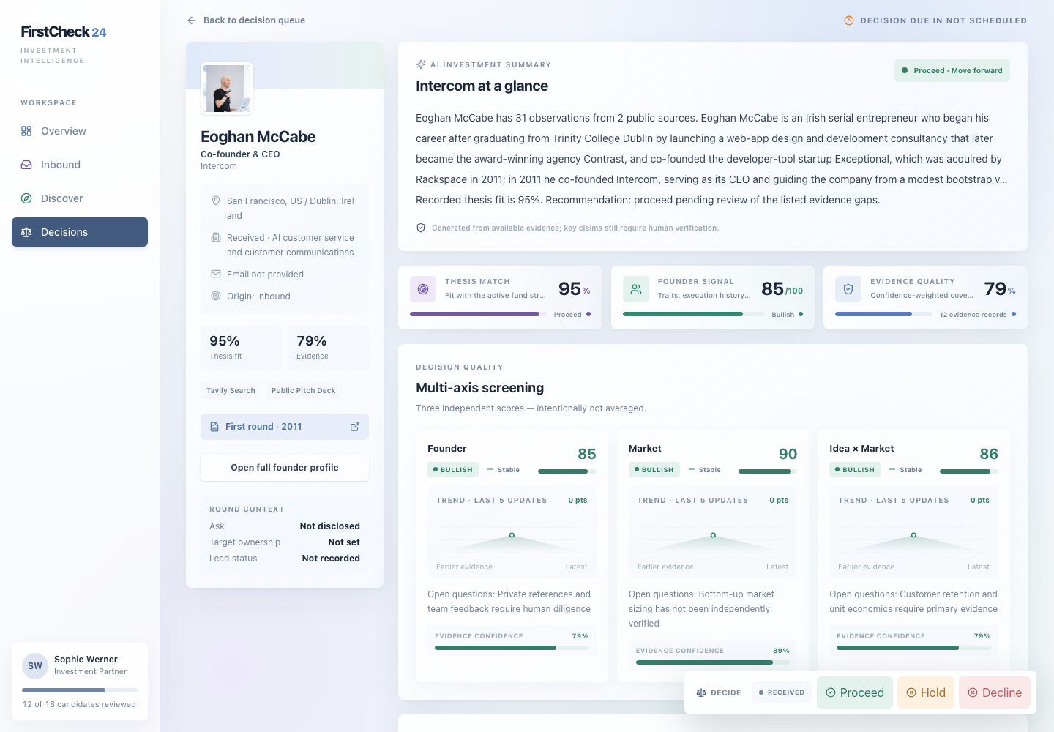
LIVE DECISION CASE · EOGHAN MCCABE
A decision, not
a dashboard.
AI compresses the evidence.
The investor can challenge every claim.
AI SUMMARY + CITATIONS
Every sentence traces to evidence
SCORE EXPLANATION
Score → claim → source
HUMAN CONTROL
Challenge · override · decide
FirstCheck24
LIVE PRODUCT · EOGHAN MCCABE
07
Notes:
This is a live example for Eoghan McCabe. The system summarizes his track record and the evidence around Intercom, then separates Thesis Match, Founder Signal, and Evidence Quality. Investors can trace every claim, challenge or override the analysis, and choose to proceed, hold, or decline.

Slide 8
AGENT ARCHITECTURE
Two entry paths. One evidence pipeline.
Outbound discovers hidden founders. Inbound turns applications and decks into structured evidence.
OUTBOUND · PROACTIVE
01
02
03
04
05
06
DISCOVER
SIGNAL SCORE
PROMISING
FOOTPRINTS
3-AXIS SCORE
OUTREACH
Thesis + public signals
Fast triage
Human gate
Identity + evidence
Founder · Market · Fit
Draft + approve
INBOUND · RESPONSE
11
10
09
08
07
RECOMMEND
RE-SCORE
EVIDENCE GRAPH
DECK AGENT
INBOUND
Proceed · Hold · Decline
Axes + SWOT + trend
Claims + provenance
Extract + challenge
Application + pitch deck
HUMAN DECISIONS + OUTCOMES
→
MEMORY
→
SHARPER THESIS + FUTURE SCORING
React + TypeScript
FastAPI
ARQ + Redis
Postgres + pgvector
MinIO + Docker
VERSIONED EVIDENCE
FirstCheck24
08
Notes:
FirstCheck24 is built as one evidence pipeline with two entry paths. Outbound starts from an investor thesis: discovery agents scan public sources, create a signal score, promote promising founders, enrich their digital footprints, and draft approved outreach. Inbound starts with an application or pitch deck: a deck agent extracts claims and adds them to the same evidence graph. Both paths converge on our explainable three-axis engine, which scores Founder, Market, and Idea–Market Fit independently, with SWOT, trends, confidence, and source-level provenance. React and TypeScript power the investor workflow. FastAPI orchestrates agent services, while ARQ and Redis run asynchronous collection jobs. Postgres and pgvector store identities, evidence, memory, and scores; MinIO preserves source artifacts, and Docker makes deployment reproducible. Finally, the system recommends proceed, hold, or decline, while every human decision feeds memory and improves future discovery and scoring.

Slide 9
PROOF, NOT PROMISE
Built, tested,
and decision-ready.
Real data, live state transitions, reproducible scores and an investor-ready interface.
10
112
106
24h
public-source
collectors
persistent founder
identities
automated
tests passed
decision
north star
Autonomous discovery
Explainable scoring
Actionable output
Learning memory
Signals before fundraising
Per-claim provenance + confidence
Memo + next step + human approval
Every outcome sharpens future scoring
SOURCING → SCREENING → DILIGENCE → DECISION
FirstCheck24
09
Notes:
This is more than a polished interface. The system already integrates ten types of public data sources, stores 112 persistent founder identities, and passes 106 automated tests. Our north star is to compress the journey from first signal to an investment decision into 24 hours.

Slide 10
FirstCheck24
THE OUTCOME
Find first.
Explain everything.
Decide in 24h.
From a fragmented public signal to an evidence-backed
$100K decision — with one human in control.
FIRSTCHECK24
Autonomous discovery. Explainable decisions.
Notes:
FirstCheck24 can be summarized in one line: find first, explain everything, and decide in 24 hours. We help exceptional founders get discovered earlier and help investors make every decision on transparent, verifiable evidence.

