Slide 1
$ mojito start
Diego Ferreiro Val
Fabian Frank

Slide 2
Yahoo! Mojito
MVC Framework for device-independent applications
running on the client and server
written 100% in JavaScript

Slide 3


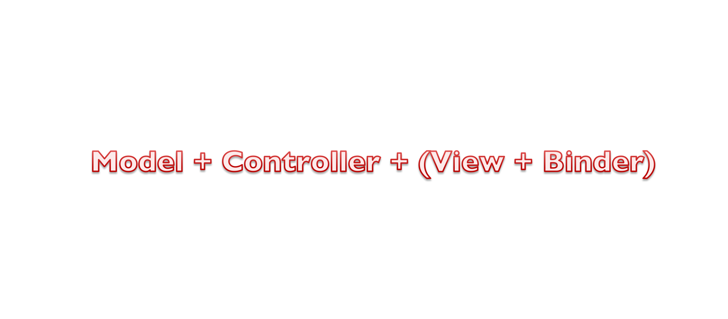

Slide 4






Mojit
Assets
Model
YUI Module
View
Binders
Controller
MojitProxy

Slide 5

Where to run:
Affinity
Every piece defines where it runs
It can run on the server, on the client or both
controller.server.js
controller.common.js
controller.client.js

Slide 6
https://github.com/dferreiroval/trainingMojito
Let’s start:

