Slide 1
Course Information and Introductions
Intro to Computer Science
CS1510
Dr. Sarah Diesburg
University of Northern Iowa

Slide 2
Instructors
Dr. Sarah Diesburg (me!)
  Lecture instructor for M/W/F
Prof. Mark Jacobson
  Lab instructor on Thursdays in CEE 016A
  Know you time! (8am, 10am, or 3:30pm)
University of Northern Iowa

Slide 3
Other Faces
Teaching Assistants
  More senior CS students that assist in lab
The Learning Center (TLC) tutors
  Walk-in tutoring on the ground floor in the Rod Library
University of Northern Iowa

Slide 4
Planning your schedule
This class is quick-paced. How much time should you put aside to work on this class?
University of Northern Iowa

Slide 5
Planning your schedule
This class is quick-paced. How much time should you put aside to work on this class?
2-3 hours outside of each hour of class per week
University of Northern Iowa

Slide 6
Planning your schedule
This class is quick-paced. How much time should you put aside to work on this class?
2-3 hours outside of each hour of class per week
  This is a 4 hour class
  Spend 4 hours in class, plus 4x2=8 hours outside of class
  Total of 12 hours devoted to this class per week
University of Northern Iowa

Slide 7
Today
Class objectives
  What is computer science?
Logistics
University of Northern Iowa

Slide 8
What is computer science??
Computer science is a discipline that involves the understanding and design of computers and computational processes
  And it’s a REALLY diverse discipline
University of Northern Iowa

Slide 9
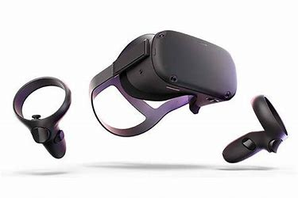
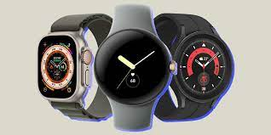
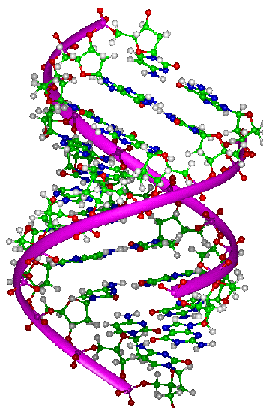
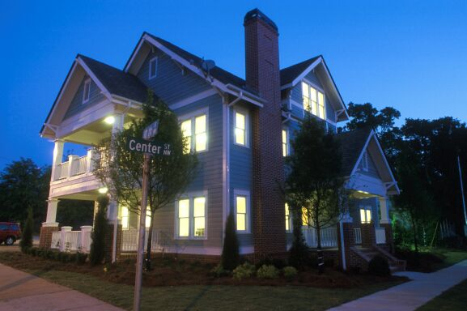


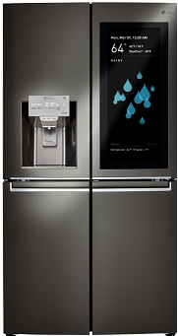
Virtual
Environments
Wearable Computing
Bioinformatics
Ubiquitous Computing
Internet
of
Things
IoT
Artificial Intelligence
and Data Science
University of Northern Iowa

Slide 10


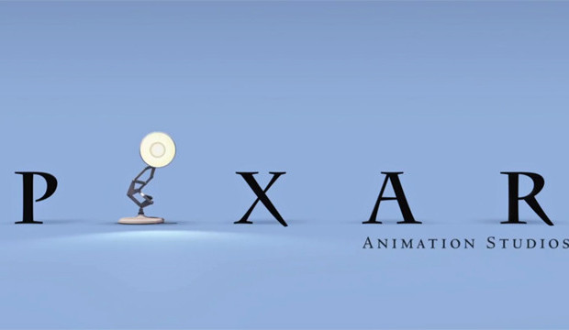
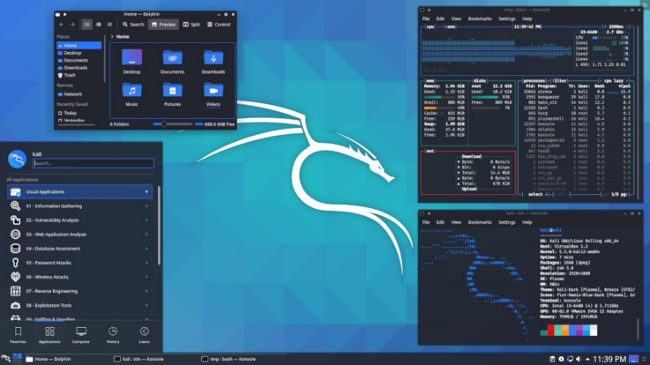
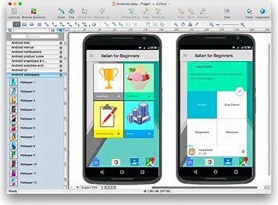
Digital Special Effects
Game Development
Databases
Human Computer
Interface Design
Information Security
University of Northern Iowa

Slide 11
What do these things have in common?
They all treat the computer as only part of a bigger picture
They all treat the computer as a tool!
University of Northern Iowa

Slide 12
Programming!
Programming is the process of writing, testing, and maintaining the source code of computer programs
Humans still need to understand it
  LLMs can increase productivity of experienced programmers by 30%
  Using LLMs without understanding the code can result in “AI Slop”, or fragile, breakable, old, overly-complicated, hallucinated, insecure code
  Employers care and still want programmers
University of Northern Iowa

Slide 13
How to use LLMs in this class
Use it for learning, not in place of learning
  You must be able to code all solutions by yourself that you turn in for homework
  Most of points earned for class where LLMs not allowed
Will introduce an AI coding helper later
  Gives hints so you figure things out on your own
  This is where the learning takes place
University of Northern Iowa

Slide 14
Starting Lines and Expectations
Where do you identify?
  I’ve never programmed before
  I’ve done some web programming (html/css/java script)
  I’ve done some robotics programming (Lego robots)
  I’ve worked with a full programming language (python, C/C++/C#, java)
University of Northern Iowa

Slide 15
What will I be doing this semester?
Doing interactive activities in the zyBooks
  Paces along and goes deeper than class lectures
Programming labs
  Get hands-on help with new concepts
Programming homework
  Do something bigger with the new concept
Programming exams
  Must pass these without the use of AI!
  Worth most of the points in the class
University of Northern Iowa

Slide 16
What’s my homework today?
Get the online textbook
  Readings begin this week and are graded
Where do I find information on this class
  eLearning
  Let’s take a tour of class resources!
University of Northern Iowa

