Slide 1
Algorithms and DeMorgan’s Laws
Intro to Computer Science
CS1510, Section 2
Dr. Sarah Diesburg

Slide 2
Opposites
Sometimes we need to find the opposites of conditions
An example is error checking to prompt the user for the correct value
  We know what kind of value we want
  But we have to loop on a condition for the values we don’t want…
Other examples, too

Slide 3
Thought Puzzle
What is the opposite of:
if small<middle and middle<large :
A: if small<middle or middle<large :
B: if small>=middle and middle>=large :
C: if small>=middle or middle>=large :

Slide 4
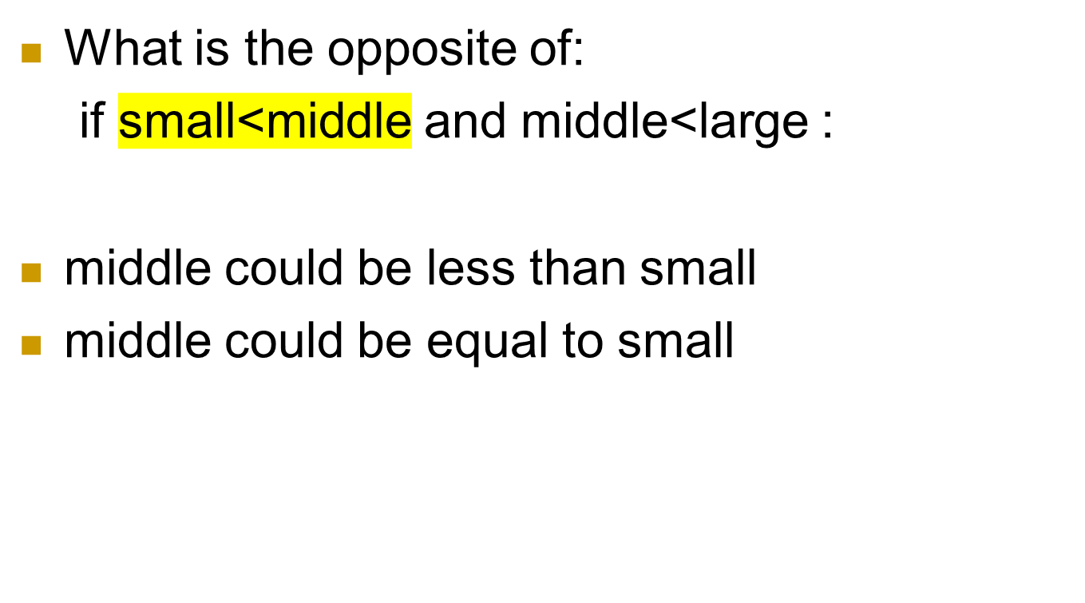
Thought Puzzle

Slide 5
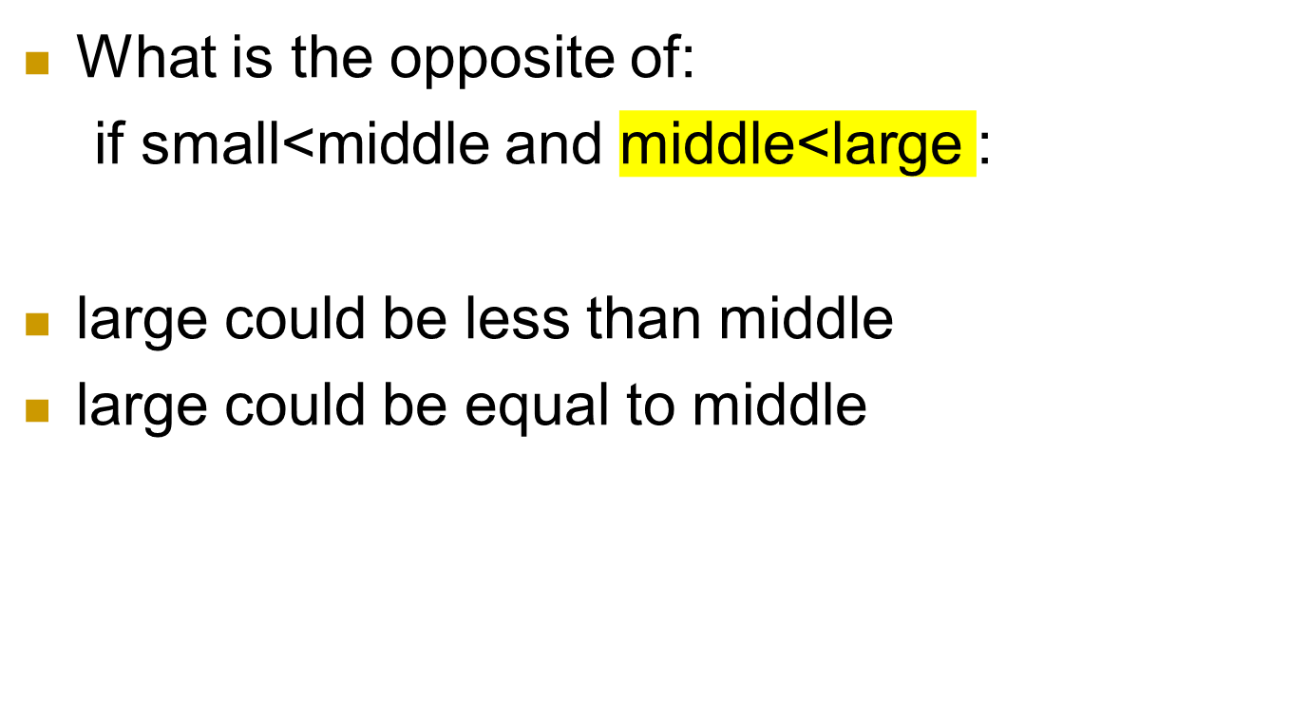
Thought Puzzle

Slide 6
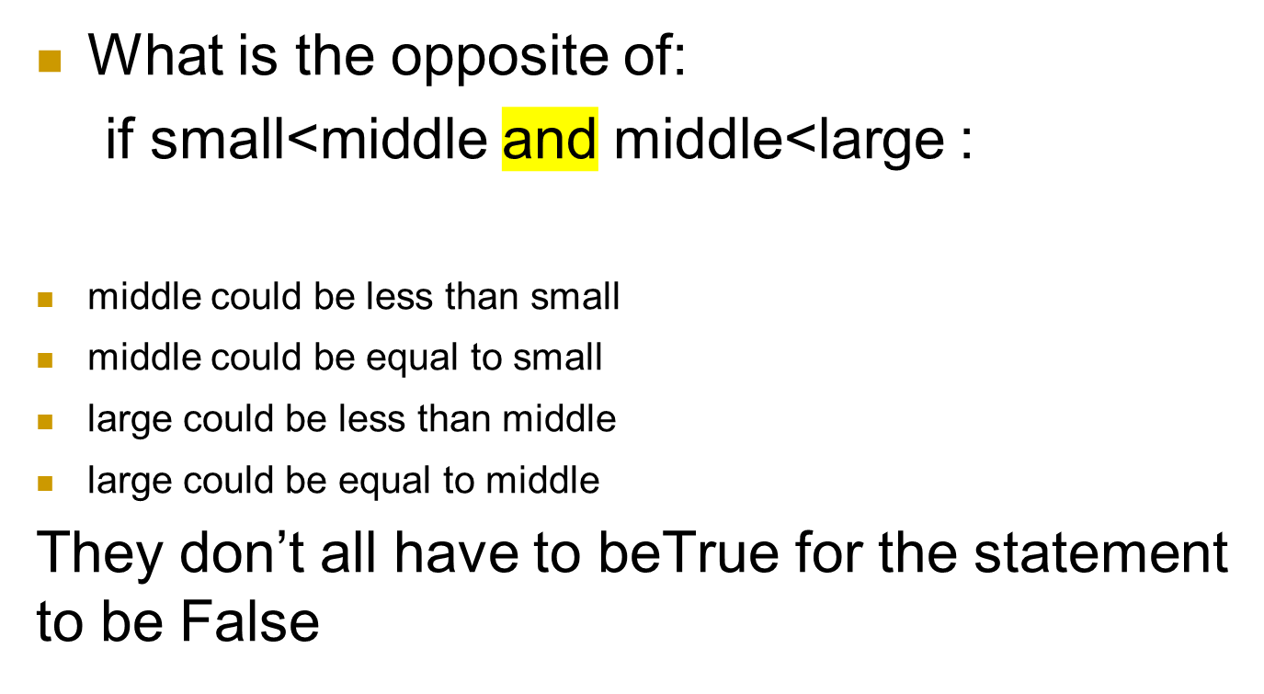
Thought Puzzle

Slide 7
Thought Puzzle
What is the opposite of:
if small<middle and middle<large :
For that whole statement to be false, at least
  (small>=middle) == true
  or
  (middle>=large) == true

Slide 8
DeMorgan’s Laws
The opposite of:
A and B
Is
opposite (A and B) =
opposite(A) or opposite(B)

Slide 9
So how do you go the other way?
The opposite of:
A or B
Is
opposite (A or B) =
opposite(A) and opposite(B)

Slide 10
Reverse these
num > 0 and num <= 10
status==“student” and amountOwed<500.00
0 < inputNum < 100

Slide 11
What is an Algorithm?
Process or a set of rules to be followed in calculations or other problem-solving operations
Or, more informally…
A recipe for solving a problem

Slide 12
Algorithm vs. Program
An algorithm is a description of how to solve a problem
A program is an implementation of an algorithm in a particular language to run on a computer (usually a particular kind of computer)
Difference between description of what we want to do and what we actually did

Slide 13
Algorithm vs. Program
So which do we write first?
  Algorithm?
  Program?

Slide 14
What’s the Difference, Really?
We can analyze the algorithm independent of its implementation.
  Is this the most efficient way to solve a problem?
We can examine how easily, or with what difficulty, a language allows us to realize an algorithm
  Some languages allow us to more easily solve certain types of problems than others

Slide 15
Aspects of an Algorithm
Detailed: Provide enough detail to be implementable. Can be tricky to define completely, relies on “common sense”
Effective: the algorithm should eventually halt, and halt in a “reasonable” amount of time. “reasonable” might change under different circumstances (faster computer, more computers, etc.)

Slide 16
Aspects of an Algorithm (2)
Specify Behavior: the algorithm should be specific about the information that goes in (quantity, type, etc.) and the information that comes out.
General Purpose: algorithms should be idealized and therefore general purpose. A sorting algorithm should be able to sort anything (numbers, letters, patient records, etc.)

Slide 17
A Lot to Do!
That is a lot to do for the burgeoning programmer.
Get better as we go along, but good to know what the standards are!

Slide 18
Aspects of a Program
Readability
Robustness
Correctness

Slide 19
Aspects of a Program: Readability
We will emphasize, over and over, that a program is an essay on problem solving intended to be read by other people, even if “other people” is you in the future!
Write a program so that you can read it, because it is likely that sometime in the future you will have to read it!
So what makes a program readable…

Slide 20
Readability(2): Naming
The easiest thing to do that affects readability is good naming
  use names for the items you create that reflect their purpose
  to help keep straight the types used, include that as part of the name. Python does not care about the type stored, but you do!

Slide 21
What Does this Do?
a = int(input("give a number: "))
b=1
c = 0
while b <= a :
c = c + b
b = b + 1
print (a,b,c)
print( "Result: ", c/(b – 1))

Slide 22
What Does this Do?
# average of a sum of integers in a given range
limit_str = input(“range is 1 to input:”)
limit_int = int(limit_str)
count_int = 1
sum_int = 0
while count_int <= limit_int:
sum_int = sum_int + count_int
count_int = count_int + 1
average = sum_int/(count_int – 1)
print(“Average of sum of integers from 1 to”,\
limit_int,”is”,average)

Slide 23
Readability(3): Comments
info at the top, the goal of the code
purpose of variables (if not obvious by the name)
purpose of other functions being used
anything “tricky”. If it took you time to write, it probably is hard to read and needs a comment

Slide 24
Readability(4): Indenting
indenting is a visual cue to say what code is “part of” other code.
This is not always required as it is in Python, but Python forces you to indent.
This aids readability greatly.

Slide 25
Aspects of Programming (2)
Robust: As much as possible, the program should account for inputs that are not what is expected.

Slide 26
Aspects of Programming (2)
Correct: Our programs should produce correct results. Much harder to ensure than it looks!

Slide 27
The Problem is “Problem-Solving”
Remember, two parts to our goal:
  Understand the problems to be solved
  Encode the solution in a programming language, e.g. Python

Slide 28
Mix of Both
The goal in each class is to do a little of both: problem solving and Python
Terribly important that we impress on you to try and understand how to solve the problem first before you try and code it.
  Develop the algorithm first!
  Then develop the program.

Slide 29
So which is harder?
Writing the algorithm?
Writing the program?
It’s a lot like French poetry when you don’t know much about French or poetry…

Slide 30
Bonus Slides
If I don’t get to these in class, please read these on your own!

Slide 31
Steps to Problem Solving
From “PProblem SSSolving”,
DeFranco & Vinsonhaler
Be Proactive
See it
Simplify it
Stir it up
Pause and Reflect
Notes:
Actual: Be Proactive
See it
Simplify it
Stir it up
Pause and Reflect

Slide 32
Steps to Problem Solving
Engage/Commit
Visualize/See
Try it/Experiment
Simplify
Analyze/Think
Relax
Notes:
Actual: Be Proactive
See it
Simplify it
Stir it up
Pause and Reflect

Slide 33
Engage
You need to commit yourself to addressing the problem.
Don’t give up easily
Try different approaches
Set the “mood”
Just putting in time does not mean you put in a real effort!!!

Slide 34
Visualize/See the Problem
Find a way that works for you,
some way to make the problem tangible.
draw pictures
layout tables
literally “see” the problem somehow
Everyone has a different way, find yours!

Slide 35
Try It/Experiment
For some reason, people are afraid to just “try” some solution. Perhaps they fear failure, but experiments, done just for you, are the best way to figure out problems.
Be willing to try, and fail, to solve a problem. Get started, don’t wait for enlightenment!

Slide 36
Simplify
Simplifying the problem so you can get a handle on it is one of the most powerful problem solving tools.
Given a hard problem, make is simplier (smaller, clearer, easier), figure that out, then ramp up to the harder problem.

Slide 37
Think it Over/Analyze
If your solution isn’t working:
stop
evaluate how you are doing
analyze and keep going, or start over.
People can be amazingly “stiff”, banging their heads against the same wall over and over again. Loosen up, find another way!

Slide 38
One More Thing: Relax
Take your time. Not getting an answer right away is not the end of the world. Put it away and come back to it.
You’d be surprised how easy it is to solve if you let it go for awhile. That’s why starting early is a luxury you should afford yourself.

