Slide 1
DeMorgan’s Laws
Intro to Computer Science
CS1510
Dr. Sarah Diesburg

Slide 2
Opposites
Sometimes we need to find the opposites of conditions
An example is error checking to prompt the user for the correct value
  We know what kind of value we want
  But we have to loop on a condition for the values we don’t want…
Other examples, too

Slide 3
Thought Puzzle
What is the opposite of:
if small<middle and middle<large :
A: if small<middle or middle<large :
B: if small>=middle and middle>=large :
C: if small>=middle or middle>=large :

Slide 4
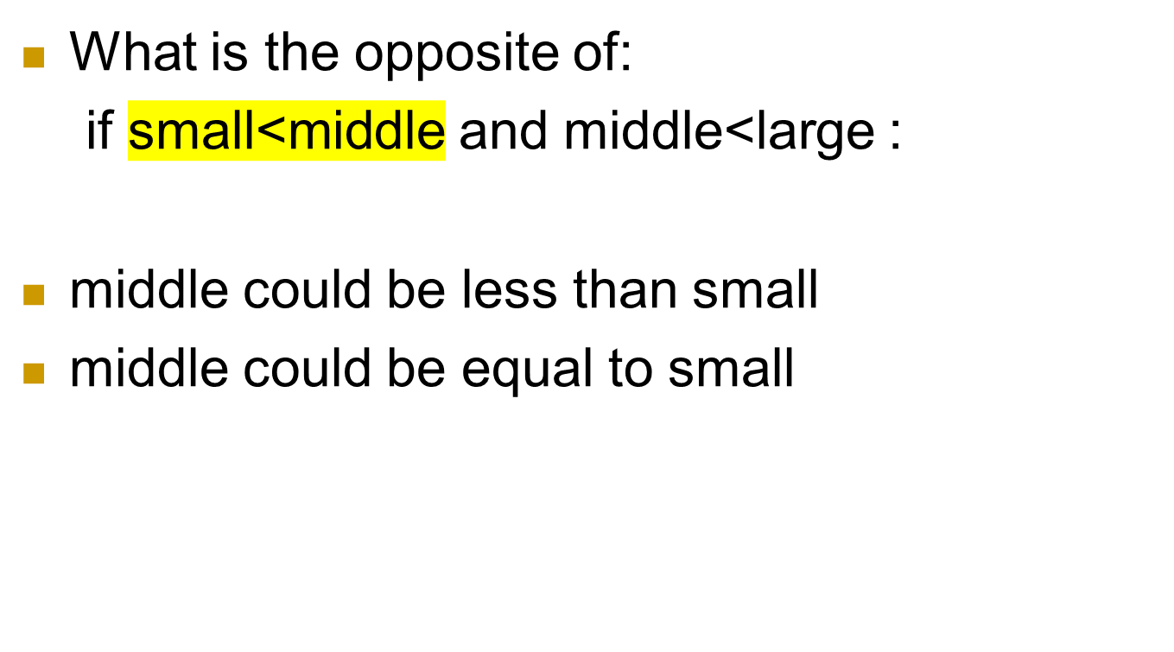
Thought Puzzle

Slide 5
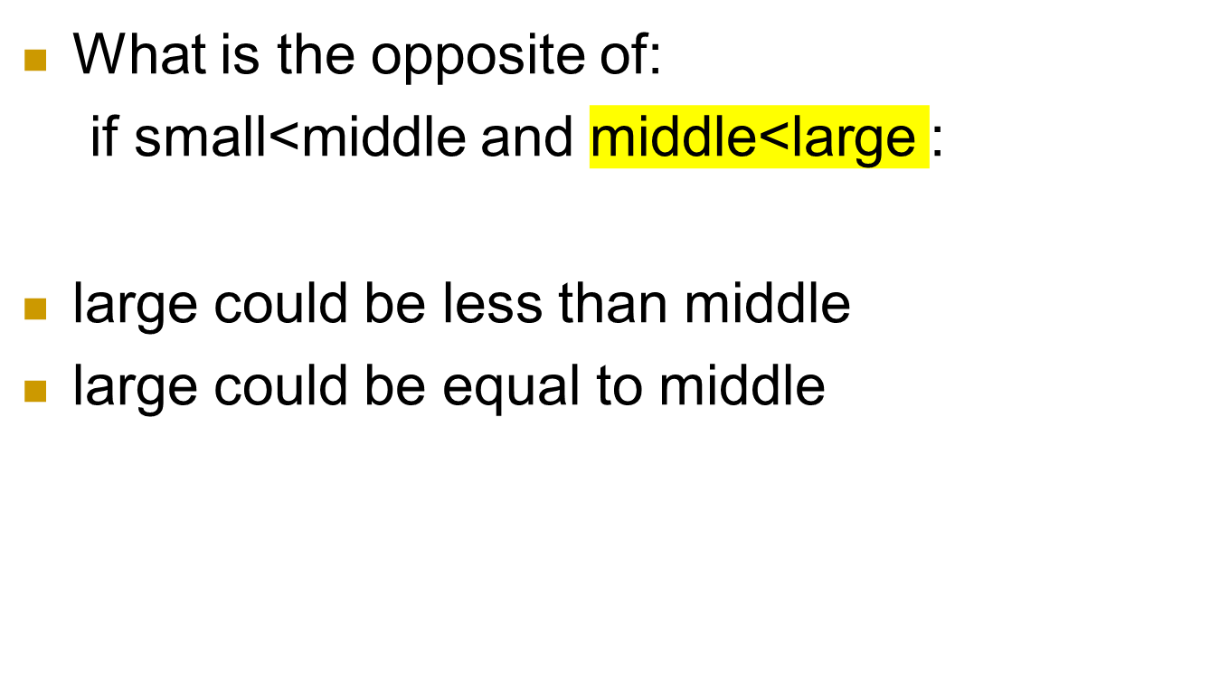
Thought Puzzle

Slide 6
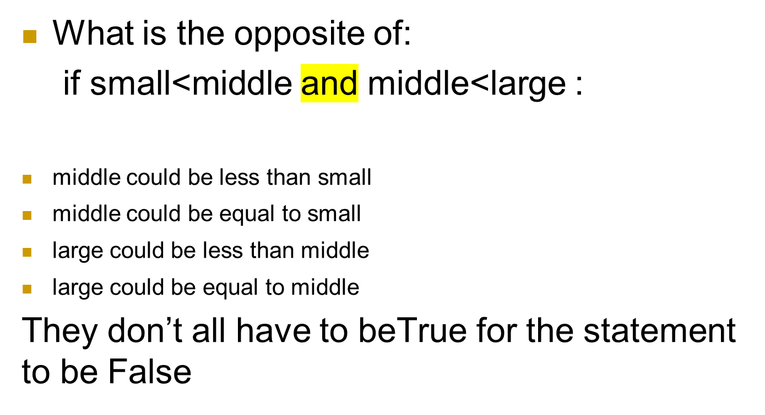
Thought Puzzle

Slide 7
Thought Puzzle
What is the opposite of:
if small<middle and middle<large :
For that whole statement to be false, at least
  (small>=middle) == true
  or
  (middle>=large) == true

Slide 8
DeMorgan’s Laws
The opposite of:
A and B
Is
opposite (A and B) =
opposite(A) or opposite(B)

Slide 9
So how do you go the other way?
The opposite of:
A or B
Is
opposite (A or B) =
opposite(A) and opposite(B)

Slide 10
Reverse these
num > 0 and num <= 10
status==“student” and amountOwed<500.00
0 < inputNum < 100

Slide 11
What is an Algorithm?
Process or a set of rules to be followed in calculations or other problem-solving operations
Or, more informally…
A recipe for solving a problem

Slide 12
Algorithm vs. Program
An algorithm is a description of how to solve a problem
A program is an implementation of an algorithm in a particular language to run on a computer (usually a particular kind of computer)
Difference between description of what we want to do and what we actually did

Slide 13
Algorithm vs. Program
So which do we write first?
  Algorithm?
  Program?

Slide 14
What’s the Difference, Really?
We can analyze the algorithm independent of its implementation.
  Is this the most efficient way to solve a problem?
We can examine how easily, or with what difficulty, a language allows us to realize an algorithm
  Some languages allow us to more easily solve certain types of problems than others

Slide 15
Aspects of a Program: Readability
We will emphasize, over and over, that a program is an essay on problem solving intended to be read by other people, even if “other people” is you in the future!
Write a program so that you can read it, because it is likely that sometime in the future you will have to read it!
So what makes a program readable…

Slide 16
Readability(2): Naming
The easiest thing to do that affects readability is good naming
  use names for the items you create that reflect their purpose
  to help keep straight the types used, include that as part of the name. Python does not care about the type stored, but you do!

Slide 17
What Does this Do?
a = int(input("give a number: "))
b=1
c = 0
while b <= a :
c = c + b
b = b + 1
print (a,b,c)
print( "Result: ", c/(b – 1))

Slide 18
What Does this Do?
# average of a sum of integers in a given range
limit_str = input(“range is 1 to input:”)
limit_int = int(limit_str)
count_int = 1
sum_int = 0
while count_int <= limit_int:
sum_int = sum_int + count_int
count_int = count_int + 1
average = sum_int/(count_int – 1)
print(“Average of sum of integers from 1 to”,\
limit_int,”is”,average)

