Slide 1
The Study of Computer Science
Intro to Computer Science
CS1510

Slide 2
Today’s Topics – Setting the Stage
Basic components of computers
  What is necessary to run programs?
Why computers use binary
Basic units of measure

Slide 3
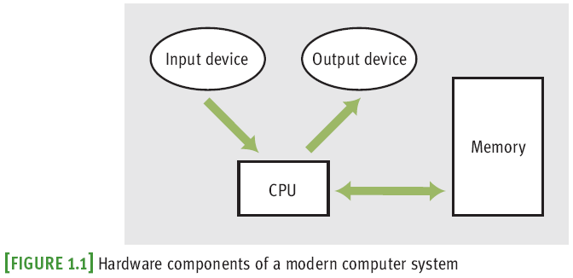
Hardware
Most computers consist of:
  central processing unit (CPU)
  storage/memory
  input/output (I/O) devices

Slide 4
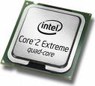
CPU – Brain of the Computer
Coordinates all computer operations
Control Unit
  Reads instructions from memory and decodes and executes them using the ALU
Arithmetic/Logic Unit (ALU)
  Does math and logic calculations on numbers in registers
345
Add register A
to register B
263
608
Store the value
in register C into
memory location
320843202
Notes:
Example: add two numbers and store them in working memory. ALU does not store things for long

Slide 5
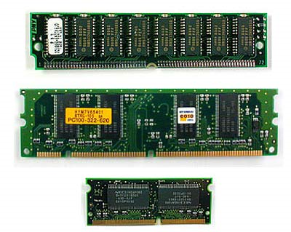
Storage/Memory
“Comes with 8 GB of RAM”

Slide 6
Visualizing Memory
X
75.62
…
STO 005
ADD 003
RTV 001
H
-26
0.005
354
-27.2
Memory is an ordered sequence of storage locations (memory cells)
Each memory cell has a unique address
Millions of these cells
999
998
…
7
6
5
4
3
2
1
0

Slide 7



Storage/Memory
The smallest unit of memory is a bit (Binary digIT)
A bit can be off (no voltage) or on (has voltage) which we interpret to be 0 or 1
Memory is organized into 8 bit contiguous groups called bytes.
Notes:
See http://computer.howstuffworks.com/bytes1.htm.

Slide 8
It’s All About the Switch
The basic component of most digital circuitry is nothing more complicated than a simple switch.
A switch’s function is pretty obvious, said in a number of different ways
  On or Off
  True or False
  1 or 0

Slide 9
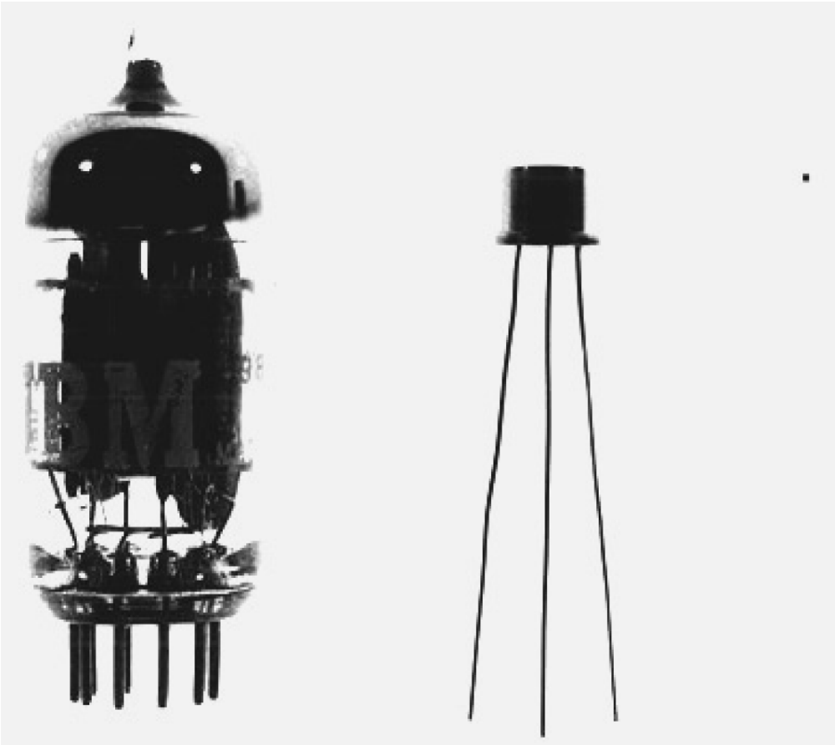
Electronic Switch
Early computers used vacuum tubes as switches
Later, transistors were used as substitutes

Slide 10
Visualizing Memory
X
75.62
…
STO 005
ADD 003
RTV 001
H
-26
0.005
354
-27.2
Thus, while we might visualize the computer with all sorts of data in the memory slots…
999
998
…
7
6
5
4
3
2
1
0

Slide 11
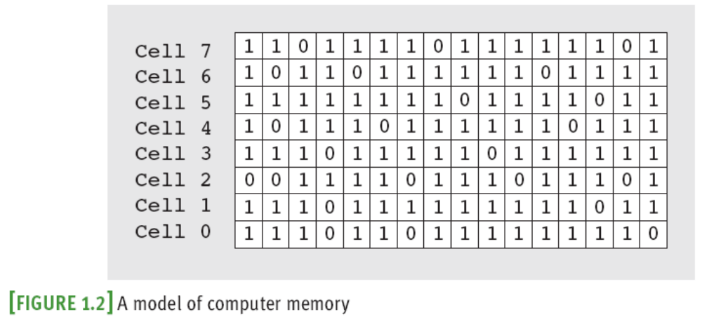
Visualizing Memory
… It really consists of an arrangement of 1s and 0s

Slide 12
Visualizing Memory
The more binary numbers you can put in a cell, the more things you can represent
  Formula: 2^(number of bits)
8 bit cell could hold 2^8 = 256 different things
  Letters, colors, instructions, sounds, coordinates, etc
What about 64 bit computers?

Slide 13
Encoding
Binary numbers can represent more things than just integers
Another example is ASCII
  American Standard Code for Information Interchange
  Character encoding scheme based on the English alphabet
  Read more here

Slide 14
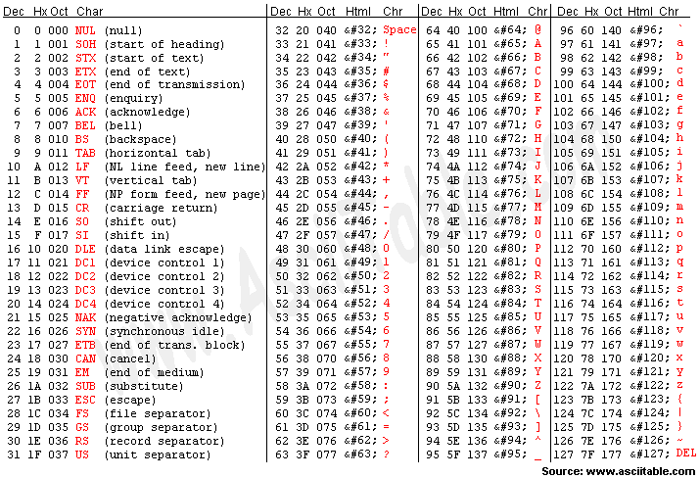

Slide 15
Computer Units
The Bit (Binary Digit) – one digit that is either a 1 or a 0
A Byte – 8 bits
  When we reserve memory for our programs, they will be in multiples of 8 bits
A “Nibble” is 4 bits
  [Insert bad joke here]

Slide 16
Larger Units of Measure
2¹⁰ bytes = 1024 bytes = 1KB (1 Kilobyte)
2¹⁰ KB = 1024 KB = 1 MB (1 Megabyte)
2¹⁰ MB = 1024 MB = 1 GB (1 Gigabyte)
2¹⁰ GB = 1024 GB = 1 TB (1 Terabyte)
Know what comes next?
Lets say we have 2MB. How many bytes is that?

