Slide 1
Securing Data From Risk
Unit 2: Data at Rest

Slide 2
Learning Objectives
When you finish this unit you will:
2.1 Understand the importance of physically securing data;
2.2 Understand how computers implement protections on files;
2.3 Understand the basis for cryptographic encryption schemes;
2.4 Know how encrypting files and disks on various systems works;
2.5 Understand what data compression is and how it interacts with
encryption;
2.6 Know what a digital signature is and how it is used; and
2.7 Understand the general techniques for ensuring availability of data.

Slide 3
What Does “At Rest” Mean?
Focus on data sitting on your computer or a portable hard drive
Attackers need access to the storage medium to get the data
Assumptions:
Attacker has access to the storage medium
Attacker does not have authorization to access the data
Notes:
The assumptions mean that the attacker can log into the system, but is not the user who controls the data.
This lets us focus on protecting the data, and not worrying about preventing break-ins (because in that case the focus would be on the system or storage holding the data and not the data)

Slide 4
Who Cares?
Anyone who stores data on a computer that is used by other people
  School computer, office computer
Anyone who uses a portable computer
  If stolen, the thief can read the stored data; and passwords won’t protect you
  The ubiquity of smartphones makes this a serious issue!
Anyone who puts data onto a portable medium
  Like a memory stick or portable hard drive
Notes:
This deals with the broader impacts of cybersecurity on the web
If storing data on a shared computer, the controls need to prevent different users from reading (or changing!) your data and programs, This protects you from accidents as well as maliciousness.
For portable devices, thieves can often simply remove the storage medium (disk, etc.) and read it directly, rather than try to guess your password. This also goes for flash drives and portable disks like hard drives. Also, note the wording: a smartphone is a computing device.

Slide 5
Systems vs. Storage Media
The storage media is what the data resides on
May be internal disk or solid state disk (SSD)
May be external medium like flash drive, memory stick, portable hard drive
May be a network drive (like a Network Appliance system)
The system is what manipulates the data
It may have the data on internal disks
You may have to connect the storage medium to the system
Notes:
The distinction between a “system” and “storage media” is crucial. Data on a storage medium is passive, not taking any action or doing anything. A system is a computer, network, or infrastructure that uses the data stored on a storage medium in a computation or data transfer.
Here, we are dealing with data on storage media. We are not dealing with data when it is being used in a computation.

Slide 6
Physical Controls
Make disk containing data inaccessible unless user is physically present
Attacker must get into room with disk, or otherwise acquire access to it
Warning: must be sure there are no other copies of the data
Otherwise attacker can go for those copies!
Backups may be an issue here
Notes:
This is physical isolation.
If someone can get access to the media, he can make a copy of it. That’s why someone stealing a laptop is so serious – even if she can’t guess your password, she can remove the hard drive and copy the data on it. That’s why encrypting your laptop’s hard drive is so important. We’ll get to that in a bit.
Stealing backups is a time-honored approach to gathering information as they often are not encrypted.

Slide 7
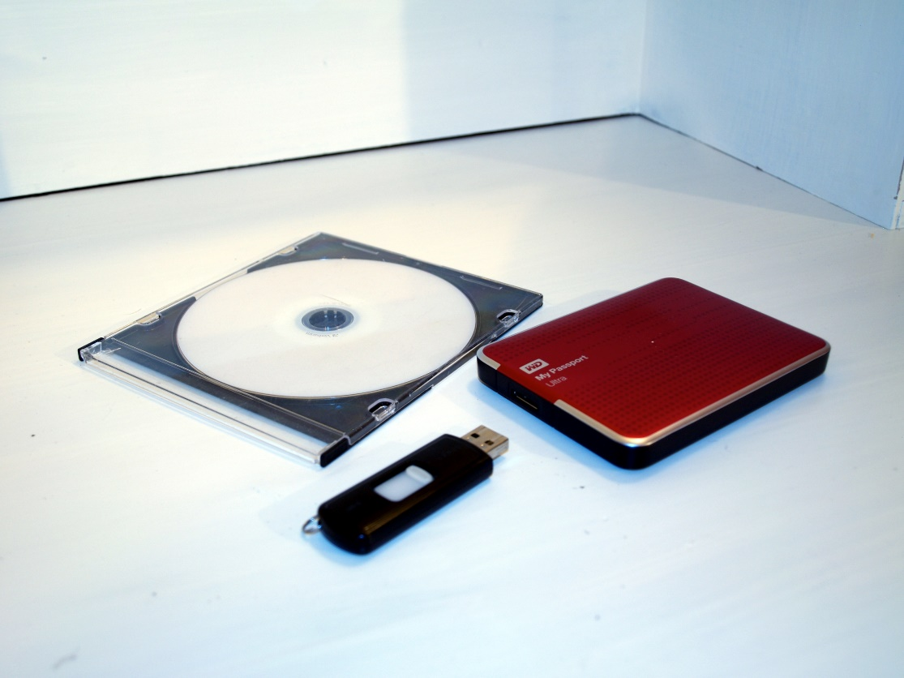
Example
Sensitive files carried on a portable hard drive or DVD
Attacker needs to get access to the disk
While disk disconnected, attacker must physically take it
While disk connected, attacker can access disk through the computer
Image by Santeri Viinamäki
From Wikimedia Commons
Used under Creative Commons Attribution Share-Alike 4.0 International license
Notes:
If the contents of the disk are encrypted, the attacker physically taking the disk is not enough; the attacker must be able to decrypt the disk

Slide 8
Virtual Controls
These protect the data while it is on the system
Access control lists
Encryption
Digital signatures
Replication
Notes:
All these are in software. They can be done in hardware, but usually are not.
Access control lists are discussed in other places. They allow the owner of the file containing the data to control who can access the file and how; the basic modes are reading, writing, and executing, although what these mean depends upon the type of object. For example, writing a directory object means you can create or delete files in the directory. There may be other rights as well; for example, Windows 10 has the rights Read & Execute and Read, so you have to have read permission in order to run an app.
Encryption and digital signatures are cryptographic. The first provides confidentiality; the second, integrity.
Replication speaks to availability. There are lots of replication algorithms, including some that will detect when one of the copies is incorrect (changed) and will use a voting procedure to compensate (usually by finding the correct value).

Slide 9
How Do We Think About Protection?
An access control matrix describes who can do what to what
Rows have actors, such as users, who will act on permissions
Columns have passive entities like files and resources that will be acted upon
Rights are a set of symbols representing what actions an actor can take over a passive entity
Used as the basis for many access control mechanisms
Notes:
More formally, an access control matrix (ACM) has:
A set S of subjects (corresponding to actors in the above)
A set O of objects (corresponding to passive entities in the above)
A set R of rights (same as above)

Slide 10
Example
 | paper | wall | ground | whiteboard
Jane | draw | draw, paint | write | write
Kimi | paint | wallpaper |  | clean
Louise | write |  | draw | draw
Actors: Jane, Kimi, Louise
Passive entities: paper, wall, ground, whiteboard
Rights: clean, draw, paint, wallpaper, write
Notes:
This says:
Jane can draw on the paper, draw and paint on the wall, and write on the ground and on the whiteboard
Kimi can paint on the paper, put wallpaper on the wall, and clean the whiteboard; she can’t do anything on the ground
Louise can write on the paper and draw on the ground and whiteboard; she can do nothing to the wall
If a matrix entry is empty, that means “no rights”

Slide 11
Example (continued)
 | paper.pdf | moon.avi | report.docx
Theodora | orwd | r | rw
Ursula | r | orwd
Wendy | rwd |  | r
Xanthippe | r | d | orwd
Actors: Theodora, Ursula, Wendy, Zanthippe
Passive entities: paper.pdf, moon.avi, report.docx
Rights: d (delete), o (own), r (read), w (write)
Notes:
This says:
Theodora owns the file “paper.pdf” and can read, write, and delete it; and she can read the other two files and write “report.docx”
Ursula owns the file “moon.avi” and can read, write, and delete it; and she can read the file “paper.pdf”
Wendy can read, write, and delete the file “paper.pdf” and can read “report.docx”
Xanthippe can read “paper.pdf”, delete “moon.av”, and owns the file “report.docx” and can read, write, and delete it

Slide 12
Access Control Lists (ACLs)
Lists made by going down the columns of access control matrix
 | paper.pdf | moon.avi | report.docx
Theodora | orwd | r | rw
Ursula | r | orwd
Wendy | rwd |  | r
Xanthippe | r | d | orwd
paper.pdf: ((Theodoras, orwd), (Ursula, r), (Wendy, rwd), (Xanthippe, r))
moon.avi: ((Theodora, r), (Ursula, orwd))
Report.docx: ((Theodora, rw), (Wendy, r), (Xanthippe, orwd))
Notes:
An access control matrix is typically too big to store (because most of the entries are empty), so we store it in other ways.
The most common one is the access control list, which is obtained by going down the columns.
Each element of the list is an (actor, rights of the actor over the passive entity) pair.

Slide 13
Example: Linux
Uses abbreviated form of ACLs
Divide everyone into three sets:
“user” of the file: one user (called the owner)
“group” of the file: a set of users
“other”: everyone not the user or in the group of the file
Advantage: much more compact than a full ACL!
Notes:
“User” is sometimes called “owner”. He or she can change any of the access permissions.
Each of these 3 sets have “read”, “write”, and “execute” permissions associated with them. They can be set or cleared independently.

Slide 14
Example: Linux (continued)
r w x r - x - - x
rights for “other”
rights for “group”
rights for “user”
Notes:
Linux represents rights as “r” for “read”, “w” for “write”, and “x” for “execute”; “-” means no rights
The first triple is the rights for the user, and says the user can read, write, and execute the file
The second triple is the rights for the group, and says the user can read and execute the file
The third triple is the rights for everyone else, and says the user can execute the file

Slide 15
Example: Changing Linux Permissions
Do this from the terminal
  The command ls –l gives information about the file, including the protection bits
  chmod (change protection mode) changes those protection modes
  sh-4.3$ ls -l xxx
  -r-xrwx--- 1 bishop user 0 May 12 12:38 xxx
  sh-4. 3$ chmod u+w, g-w, o=rx xxx
  sh-4 .3$ ls -l xxx
  -rwxr-xr-x 1 bishop user 0 May 12:38 xxx
Notes:
xxx on the command line is the name of the file
For the ls, the fields are:
protection mode (as in previous slide)
number of links to the file (ie, how many aliases it has)
user (owner) name
group name
size of file in bytes
date and time of last file modification
file name
The chmod command first argument says:
add write rights (w) to the user (u),take away write rights (w) from the group (g), set other (o) rights to read and write (rw)
Try this on some of your files/directories!!!

Slide 16
Example: Windows 10
Full control: you can do anything
Modify: you can’t delete subfolders and files, change permission, or take ownership but can do anything else
Read & execute: you can’t modify or write (including changing permissions or ownership), but you can do anything else
Read: you can read but do nothing else
Write: you can alter the file or attributes (but not permissions or owner), and read permissions
Special permissions: these underlie the others and, with appropriate rights, you can set them individually

Slide 17
Encryption (continued)
Using a piece of information (a key), transform the data (the plaintext) using an algorithm to another form (the ciphertext)
Idea: encipher the data
If you use a strong cipher, the attacker will be unable to “crack” it
  Be sure you use a strong cryptographic key, too!
AND-encryption: so 2 people must work together to encrypt and decrypt
Ann picks a cryptographic key, enciphers the data
Bertram picks another cryptographic key, enciphers the result
Now to decrypt, Bertram deciphers first, then Ann
Notes:
The data now can be stored, and if the attacker copies it, he or she will have to spend a lot of time to find the corresponding plaintext

Slide 18
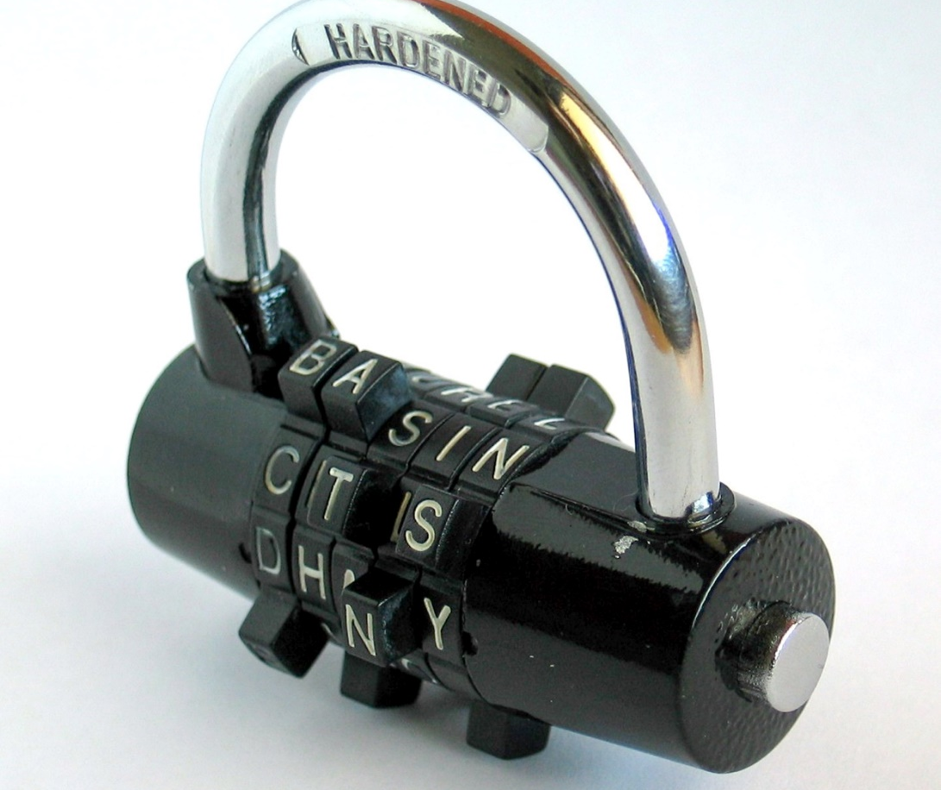
Symmetric Key Encryption
One key used to encrypt, decrypt file
Common symmetric key algorithms
  3DES (Triple DES), TWOFISH, AES192, AES256
Image by Mysid from Wikimedia Commons
Released by the author into the public domain
Notes:
The lock is an analogy to how this works.
I put the lock on something. Then I tell my friend the combination to open it. The combination I used to lock it is the same as the combination she uses to open it.
Of the common symmetric key algorithms, the AES ones are the most common.

Slide 19
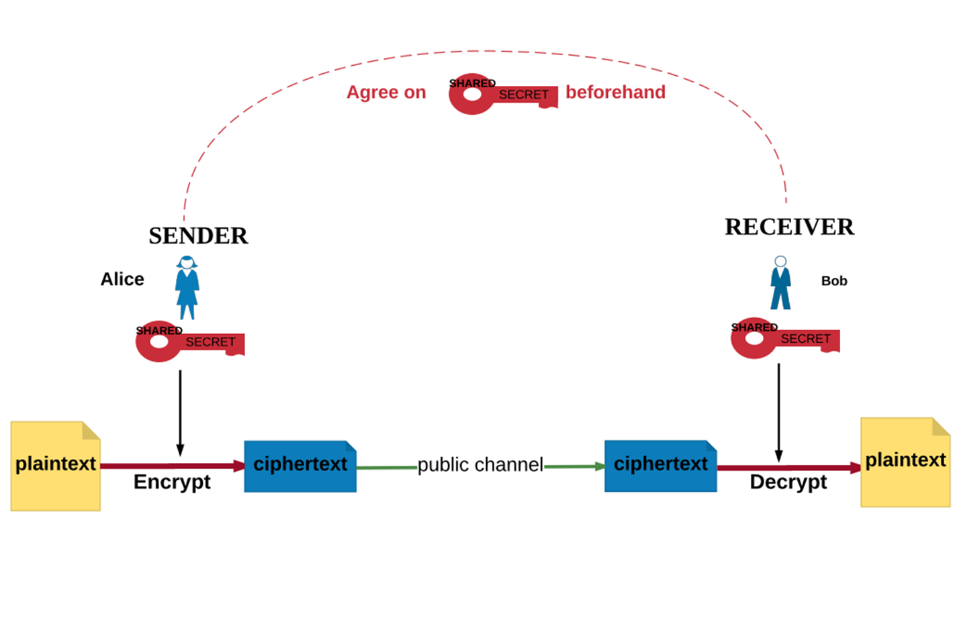
How It Works (Symmetric Key Cryptography)
“Symmetric Encryption" by Yesem Kurt-Peker, licensed under CC BY 4.0
Notes:
This is from Applied Cryptography, 02.AC_Unit1_SymmetricKeyCryptography_Presentation.pptx slide #7
The key has to be agreed upon before any messages can be sent and read. This is the “key distribution problem”.
Alice and Bob are the two classic names of people used when explaining cryptography problems. Alice and Bob work with each other, and they wish to have an affair. Juicy, right? They do not wish for anyone to “eavesdrop” on their juicy conversations, so they use encryption. This problem also often introduces a bad actor called Eve, and she likes to “eavesdrop”. Get it?

Slide 20

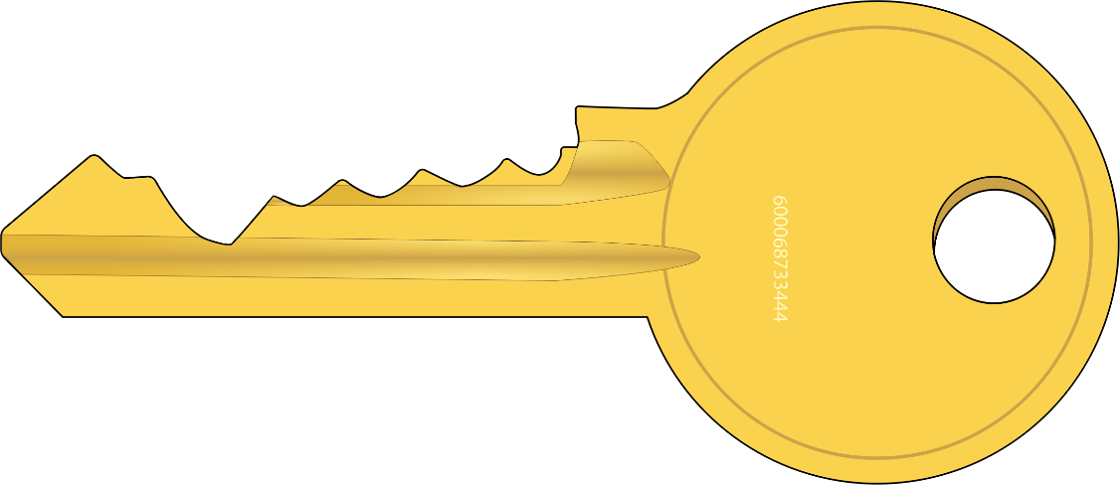
Public Key Encryption
One key to encrypt
  This one is made public (public key)
A different key to decrypt
  This one is kept secret (private key)
Chosen such that the private key cannot be derived from the public key
Also, private key can’t be derived no matter how many messages you encipher
Top image mi_brami, bottom from Fred the Oyster
from OpenClipArt
Released by the authors into the public domain
Notes:
The actual criteria are:
With the public key, encryption should be computationally easy
Deriving the private key from the public key should be computationally infeasible
The cipher is immune to a chosen plaintext attack
The lock is used to protect the information; as everyone can see it, it’s the public key
The key is used to reveal the information; as only the possessor can use it to open the lock, it’s the private key

Slide 21
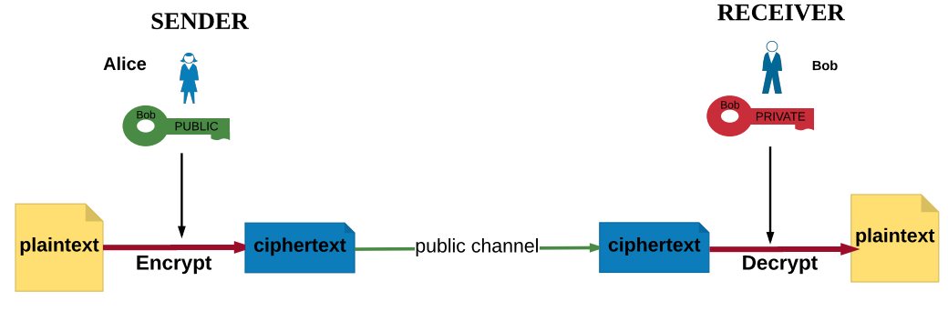
How It Works (Public Key Cryptography)
“Asymmetric Encryption" by Yesem Kurt-Peker licensed under CC BY 4.0
Note that no communication is necessary beforehand to agree on a common, shared key
Notes:
This is from Applied Cryptography, 04.AC_Unit2_ PublicKeyCryptography_Presentation.pptx slide #10
Point out that this solves the “key distribution problem”.

Slide 22
Some Common Terms
Key size: number of units (letters or bits) in the key
  Caesar cipher has key length of 1 letter
Block size: how many units (letters or bits) can be encrypted at once
  Caesar cipher has a block size of 1 letter
Notes:
The block size is usually expressed in bits. Here are the key lengths and block sizes for some ciphers:
AES: block size 128 bits, key lengths of 128, 192, or 256 bits
Twofish: block size 128 bits, key lengths of 128, 192, or 256 bits
Serpent: block size 128 bits, key lengths of 128, 192, or 256 bits
DES: block size 64 bits, key length 56 bits (usually given as 64 bits, but 8 bits are ignored)

Slide 23
Data Compression
This reduces file size by combining sequences that repeat.
Example: The string “aaaaaaaaaa” (10 characters) is replaced by “r10a” (4 characters); the “r” is a command to “replicate”
  Complication: what happens with the string “r10a”?
  Answer: use an escape character to indicate the “r” is an ordinary character, so this becomes “rr10a”
You can replicate multiple characters like “rabrabrabrabrabrab” (18 characters) as, for example, “r6(rab)” (7 characters)
Important: the file must have patterns in it; a file of random characters can’t be compressed (and because of the need to escape characters, will probably be slightly larger)
Notes:
The more common kinds of compression are Lempel-Ziv compression and Huffman compression. Both are considerably more complex than what is on this slide!
This technique is also used for audio and video. The standards there are H.264/MPEG-4 AVC (a vendor and standards group standard used for Blu-Ray, some DVDs, and other streaming video) and MPEGH-3 and MPEG-4 for audio

Slide 24
Integrity
Goal: detect changes to files
Easy way: make copies of all files to write-once media
  Like a CD-R or DVD-R
  Very expensive in terms of both storage and validation
  There has to be an easier way!
    … and of course there is!
Notes:
It’s expensive to do this because you have to send the copy to anyone who wants to check that the file hasn’t changed … so why send the file at all? Just send the media.
But if an attack occurs and you need to recover the files from the media, you can be sure the contents of the media have not been altered.
Also, to validate that the file has not changed, you need to read both the stored file and the actual one, and do a byte-by-byte comparison; for large files, this can take quite a bit of time.

Slide 25
Integrity Continued
and
was
a
stormy
It
dark
night
Compute a cryptographic hash or one-way hash of the data in the file
  Really, just a sophisticated math function that crunches the contents to a much shorter set of bits
Two sets of data should produce two different checksums
  Not all will, but you should not be able to find two sets of data that produce the same checksum
98f0d024a25…
Notes:
See Applied Cryptography, 06.AC_Unit3_HashFunctions_Presentation.pptx Slide #7
The actual requirements for a hash function h(x) are:
Given x, easy to compute h(x)
Given y, computationally infeasible to find x such that h(x) = y
Given h(x), it is computationally infeasible to find a y such that h(x) = h(y)
Sometimes 3 is stated as:
Given x, it is computationally infeasible to find a y such that h(x) = h(y)
The drawing is mine, and is released into the public domain.

Slide 26
How Do You Use This?
Save the cryptographic hashes
To see if the file has changed:
Recompute the cryptographic hash of the file
Compare this to the stored cryptographic hash associated with the file
If they match, the file’s contents produced the cryptographic hash
Problem: attacker changes the file’s contents and the stored cryptographic hash
Notes:
The problem here is that the cryptographic hashes are usually stored somewhere on the disk. So if the attacker has enough privileges to change the fie’s contents, she can also change the cryptographic hash corresponding to the file’s contents. So we need to handle this.
First way: store the hash on write-once media … but this is hard to update if the file changes in an authorized manner by an authorized user.
Second way: make sure the attacker cannot change the cryptographic hash

Slide 27
Digital Signatures
and
was
a
stormy
It
dark
night
Solution: public key cryptography!
Encipher the cryptographic hash with your private key
Now anyone can find the original hash
  Just decipher it using the public key, which everyone knows
But no-one can change it
  They would need to know your private key, which only you know
Private key
98f0d024a25…
7ed3920a71…
store this
Notes:
Here is an example of the use of public key cryptography
Remind the class that the public key is known, and is itself protected against changes (usually with a certificate)
But the private key is, by assumption, known or available only to the person digitally signing a hash

Slide 28
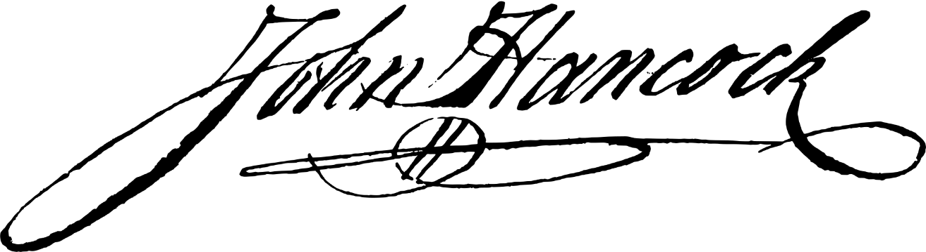
Important Note
A digital signature is cryptographically based
  The usual way to do it is with public key cryptography, as in the previous slide
A digitized signature is a scan of your paper signature
  Usually in a GIF or something like that
7ed3920a71…
Notes:
These often get confused, especially by non-technical people.
John Hancock’s signature is from the United States Declaration of Independence. It is digitized from a facsimile on velum, one of 201 produced in 1823 by William J. Stone from a copper plate engraving of the original 1776 manuscript. This signature is believed to be ineligible for copyright and therefore in the public domain because it falls below the required level of originality for copyright protection in the United States.
Source: https://commons.wikimedia.org/wiki/File:JohnHancocksSignature.svg

Slide 29
Availability
Keep enough resources operational to meet quality of service requirements
Redundancy: resources are duplicated (or triplicated, or more) so if one fails, the others can detect it and take over
  In the Space Shuttle, all avionics systems were redundant, in some cases having as many as 4 or 5 duplicate devices
Replication: duplicate resources are scattered throughout a set of systems or devices
  So if the underlying device fails, the resource is still accessible (although elsewhere)
Notes:
Think of redundant resources being in one place (like when you make a copy of a file before you edit it), and replicated resources as being in several places.
For example, data is replicated if copies of it are stored on several devices. It is redundant if copies are all on the same device.
Computations can be replicated in space if several different computation engines carry out that computation.
Computations can be replicated in time if the computation is executed repeatedly on the same device.

Slide 30
Replication
Make 2 copies of your home key, so if you misplace one, you still have another
  You replicated the keys
Gmail
  Copies of your mail are kept on servers around the world
  If one server fails, you are seamlessly switched to another
  Your mail is replicated for this purpose
Notes:
For gmail, another reason this is done is to minimize Google’s power costs. If servers run at night, the power to run the coolers (air conditioners) is less than during the day, so Google can switch you to servers where it’s night.
Contractual obligations may limit this; for example, if someone were using Google to handle personal medical information, they would need a contract that said the data would need to stay in the U.S., so while the data might be moved, it would always remain in the U.S.

Slide 31
Vendor Encryption
You upload the data to the cloud provider.
As the cloud provider receives the data, it encrypts the data and stores it.
When you request the data, the provider decrypts the data as it sends it to you.
The data is encrypted when stored on the cloud provider’s storage.
You must trust the cloud provider as it has the key and so can read your data!
Notes:
The advantage of this is the cloud provider manages everything so you don’t have to worry about keeping track of the keys. Also, if you connect with the cloud over a secure link (like https; we’ll cover that in Unit 3), the the data is unencrypted only on your system.
Some providers do the encryption on your system using their keys; others use TLS or another secure transmission protocol to encrypt the data in transit, and then re-encrypt it when it arrives at the cloud.

Slide 32
User Encryption
You encrypt the data and then send it to the cloud provider.
As the cloud provider receives the data, it stores it.
When you request the data, the provider sends it to you and you decrypt it.
The data is encrypted when stored on the cloud provider’s storage.
You have the key, so you need not trust the cloud provider to keep your data secret.
But you have to manage the key you use.
Notes:
Now, you have to keep track of the keys. You may have a cloud client that does this for you, but the cloud provider will not know of the keys and not be able to recover them if you lose them.
But the data is encrypted from the time it leaves your system to the time it is retrieved.

Slide 33
Legal Considerations
Sometimes the law constrains where you can store data and how it is protected
  You must make sure the cloud providers honor these requirements
  Medical data is controlled by the Health Information Protection Act of America (HIPAA) at the federal level; individual states have additional requirements
The law on a third party (law enforcement, etc.) accessing records on a cloud is unclear
  If the cloud provider has servers all around the world, which nation’s laws apply?
Notes:
Some types of data must be stored in the United States in order to ensure that U.S. laws and regulations about protecting that data can be enforced. So, for example, if that data is to be stored in Microsoft’s cloud, Microsoft must ensure the data never leaves that part of its cloud that is in the United States. If the cloud provider cannot guarantee that, you have to find another provider who can, or not put the data into the cloud.
The question of legal jurisdiction has come up in United States courts. In 2013, U.S. authorities obtained a warrant to access emails they believed were inked to a crime. The emails were stored in Microsoft’s cloud, and physically the emails resided on a server in Ireland. The U.S. District Court ruled that Microsoft had to comply with the warrant; on appeal, a 3 judge panel of the Second Circuit Court of Appeals overruled the judge, saying the U.S. warrant did not apply to data stored outside the United States. The government asked the full appeals court to reconsider, and the court split evenly, meaning the 3 judge panel’s ruling stood. The government is expected to appeal the decision to the U.S. Supreme Court.
Sources:
W. Ashford, “Microsoft’s Cloud Privacy Battle May Go to the US Supreme Court”, Computer Weekly (Jan. 26, 2017); url: http://www.computerweekly.com/news/450411690/Microsofts-cloud-privacy-battle-may-go-to-US-Supreme-Court

Slide 34
Conclusion
Data at rest is best protected by some form of cryptography
  So if an attacker accesses it, she can’t read it
Physical protection of the media on which the data resides is critical
  Even if encrypted, the data can be taken by removing the media
If you use the cloud, understand who can see your data and how it is protected
  If you don’t want the provider to be able to read it, encrypt it yourself before you send it to the cloud

