Slide 1
Course Information and Introductions
Intro to Computer Science
CS1510
Dr. Sarah Diesburg
University of Northern Iowa

Slide 2
Instructors
Dr. Sarah Diesburg (me!)
  Lecture instructor for M/W/F
Prof. Mark Jacobson
  Lab instructor on Thursdays in WRT 112
  Know you time! (8am, 10am, or 3:30pm)
University of Northern Iowa

Slide 3
Other Faces
Teaching Assistants
  More senior CS students that assist in lab
The Learning Center (TLC) tutors
  Walk-in tutoring on the ground floor in the Rod Library
University of Northern Iowa

Slide 4
Planning your schedule
This class is quick-paced. How much time should you put aside to work on this class?
University of Northern Iowa

Slide 5
Planning your schedule
This class is quick-paced. How much time should you put aside to work on this class?
2-3 hours outside of each hour of class per week
University of Northern Iowa

Slide 6
Planning your schedule
This class is quick-paced. How much time should you put aside to work on this class?
2-3 hours outside of each hour of class per week
University of Northern Iowa

Slide 7
Planning your schedule
This class is quick-paced. How much time should you put aside to work on this class?
2-3 hours outside of each hour of class per week
  This is a 4 hour class
  Spend 4 hours in class, plus 4x2=8 hours outside of class
  Total of 12 hours devoted to this class per week
University of Northern Iowa

Slide 8
Today
Class objectives
  What is computer science?
Logistics
University of Northern Iowa

Slide 9
What is computer science??
Computer science is a discipline that involves the understanding and design of computers and computational processes
  And it’s a REALLY diverse discipline
University of Northern Iowa

Slide 10
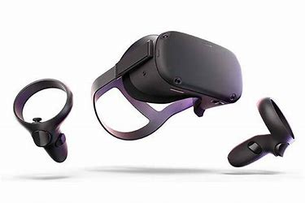
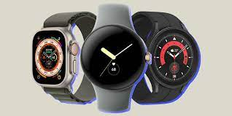
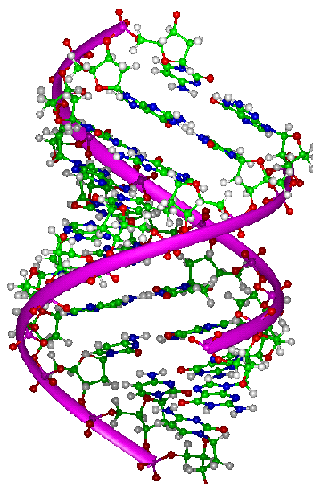
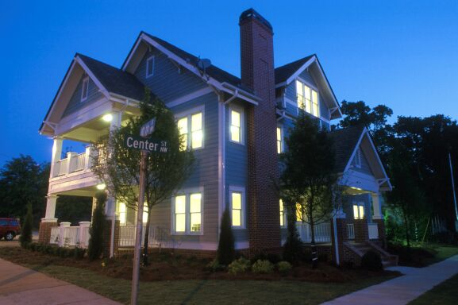


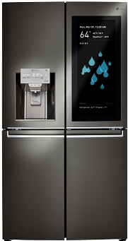
Virtual
Environments
Wearable Computing
Bioinformatics
Ubiquitous Computing
Internet
of
Things
IoT
Artificial Intelligence
and Data Science
University of Northern Iowa

Slide 11
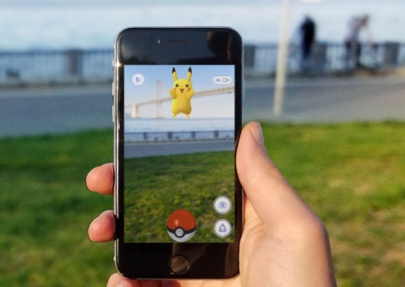

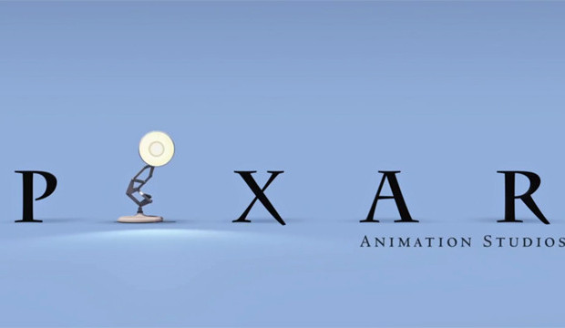
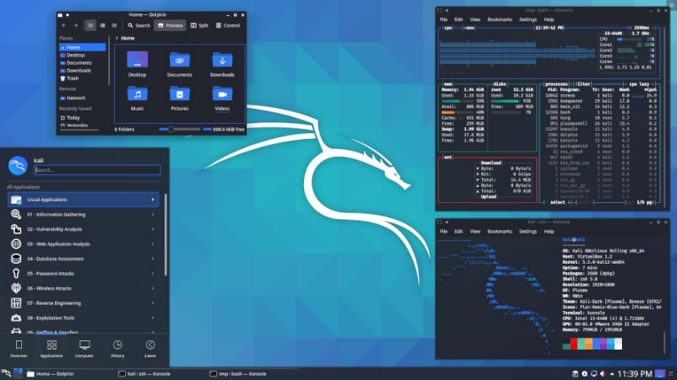
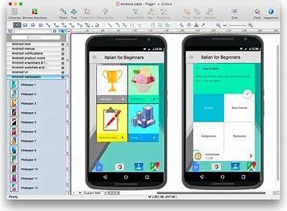
Digital Special Effects
Game Development
Databases
Human Computer
Interface Design
Information Security
University of Northern Iowa

Slide 12
What do these things have in common?
They all treat the computer as only part of a bigger picture
They all treat the computer as a tool!
University of Northern Iowa

Slide 13
Programming!
Programming is the process of writing, testing, and maintaining the source code of computer programs
  Collection of instructions that describe a task, or set of tasks, to be carried out by a computer
While this course is an introduction to computer science, it focuses on how we can program the computer to be the tool we need!
University of Northern Iowa

Slide 14
Starting Lines and Expectations
Where do you identify?
  I’ve never programmed before
  I’ve done some web programming (html/css/java script)
  I’ve done some robotics programming (Lego robots)
  I’ve worked with a full programming language (python, C/C++/C#, java)
University of Northern Iowa

Slide 15
What’s my homework today?
Get the online textbook
  Readings begin this week and are graded
Where do I find information on this class
  eLearning
  Let’s take a tour of class resources!
University of Northern Iowa

