Slide 1
The Study of Computer Science
Intro to Computer Science
CS1510

Slide 2
What is Computer Science?
Computer science is a discipline that involves the understanding and design of computers and computational processes.

Slide 3
Our Goals
While a primary goal of this course is to learn to program (in Python), our goals include:
  increase our problem solving skills
  design good solutions to problems
  test (somehow) how well they are indeed solutions to the problem
  provide the solution as a readable document

Slide 4
But this is HARD!
I cannot precisely explain why it is hard, only that it is indeed hard.
  I like to use an analogy

Slide 5
An Analogy
Let us say that you have signed up to study French poetry in the original language.
You have two problems:
  You don’t speak French
  You don’t know much about poetry

Slide 6
How Does this Apply?
You have two related problems:
  the “syntax” of French is something you have to learn
  the “semantics” of poetry is something you have to learn
You have two problems you have to solve at the same time.

Slide 7
Programming, Syntax and Semantics
You have to learn the “syntax” of a particular programming language
  many details about the language, how to debug and use it
You have to learn about “problem solving” and how to put it down on “computer.”
There probably is no better way. It’s hard!

Slide 8
Programming language?
Why do we need to use specialized programming languages in the first place?
Sentences are ambiguous
"Did you see the guy with the telescope?"

Slide 9
But we are getting a bit ahead of ourselves…
We have been talking about programming quite a bit
What is programming?
  The act of translating a sequence of general actions to a sequence of specific actions, in a specific language, and often for a specific computer.
BUT, before we can get too far with programming we have to talk briefly about the computer…

Slide 10
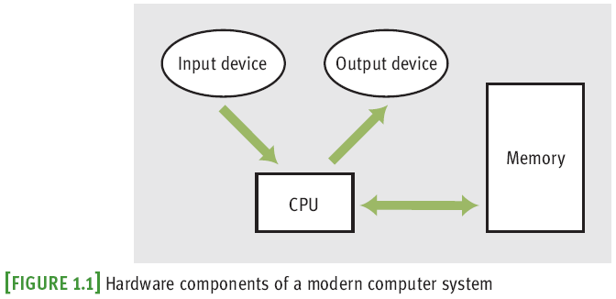
Hardware
Most computers consist of:
  central processing unit (CPU)
  storage/memory
  input/output (I/O) devices

Slide 11
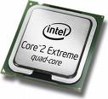
CPU – Brain of the Computer
Coordinates all computer operations
Control Unit
  Reads instructions from memory and decodes and executes them using the ALU
Arithmetic/Logic Unit (ALU)
  Does math and logic calculations on numbers in registers
345
Add register A
to register B
263
608
Store the value
in register C into
memory location
320843202
Notes:
Example: add two numbers and store them in working memory. ALU does not store things for long

Slide 12
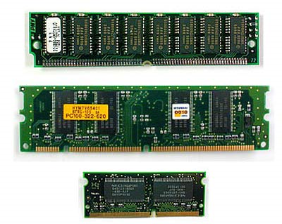
Storage/Memory
“Comes with 8 GB of RAM”

Slide 13
Visualizing Memory
X
75.62
…
STO 005
ADD 003
RTV 001
H
-26
0.005
354
-27.2
Memory is an ordered sequence of storage locations (memory cells)
Each memory cell has a unique address
Millions of these cells
Every memory cell has some contents although the contents may not be meaningful.
999
998
…
7
6
5
4
3
2
1
0

Slide 14



Storage/Memory
The smallest unit of memory is a bit (Binary digIT)
A bit can be off (no voltage) or on (has voltage) which we interpret to be 0 or 1
Memory is organized into 8 bit contiguous groups called bytes. A megabyte is 1 million bytes. A gigabyte is 1 billion bytes.
Notes:
See http://computer.howstuffworks.com/bytes1.htm.

Slide 15
It’s All About the Switch
The basic component of most digital circuitry is nothing more complicated than a simple switch.
A switch’s function is pretty obvious, said in a number of different ways
  On or Off
  True or False
  1 or 0

Slide 16
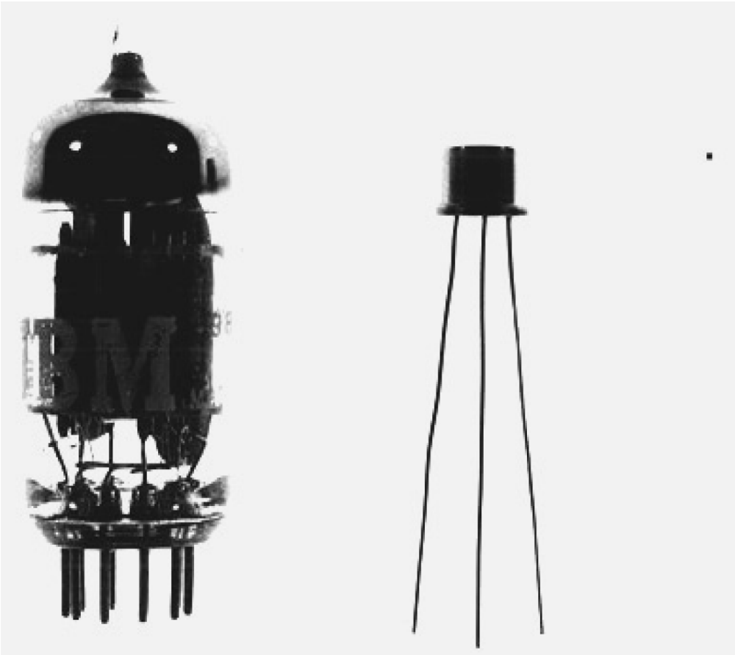
Electronic Switch
Early computers used vacuum tubes as switches
Later, transistors were used as substitutes

Slide 17
Visualizing Memory
X
75.62
…
STO 005
ADD 003
RTV 001
H
-26
0.005
354
-27.2
Thus, while we might visualize the computer with all sorts of data in the memory slots…
999
998
…
7
6
5
4
3
2
1
0

Slide 18
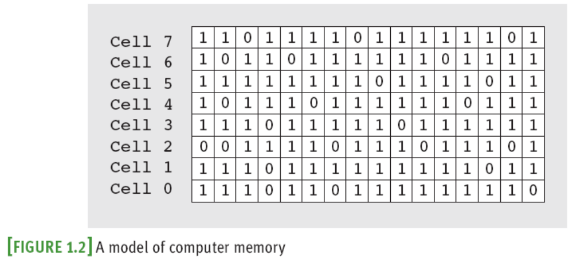
Visualizing Memory
… It really consists of an arrangement of 1s and 0s

Slide 19
Visualizing Memory
So…what does having a 32-bit computer mean?
  64-bit computer?
Notice that they are multiples of 8…the byte!

Slide 20
Why are there so many types of memory?
The faster memory is the more it costs
  So we reduce the cost by using small amounts of expensive memory (registers, cache, and RAM) and large amounts of cheaper memory (disks)

Slide 21
But we are still missing something
  How does the computer translate from groups of 0’s and 1’s to something more meaningful?
    Binary number system!
  Each binary number can translate to a base 10 number
    01 is 1
    10 is 2
    11 is 3…

Slide 22
Binary Numbers
The “switch” nature of transistors make storing numbers in binary a natural fit.
Binary is a change of base for our number system, base 2
In a number, its position represents powers of 2

Slide 23
Encoding
Binary numbers can represent more things than just integers
Another example is ASCII
  American Standard Code for Information Interchange
  Character encoding scheme based on the English alphabet
  http://en.wikipedia.org/wiki/ASCII

Slide 24
Computer Units
The Bit (Binary Digit) – one digit that is either a 1 or a 0
A Byte – 8 bits
  When we reserve memory for our programs, they will be in multiples of 8 bits
A “Nibble” is 4 bits
  [Insert bad joke here]

Slide 25
Larger Units of Measure
2¹⁰ bytes = 1024 bytes = 1KB (1 Kilobyte)
2¹⁰ KB = 1024 KB = 1 MB (1 Megabyte)
2¹⁰ MB = 1024 MB = 1 GB (1 Gigabyte)
2¹⁰ GB = 1024 GB = 1 TB (1 Terabyte)
Know what comes next?
Lets say we have 2MB. How many bytes is that?

