Slide 1
Numerical Representation
Intro to Computer Science
CS1510
Dr. Sarah Diesburg

Slide 2
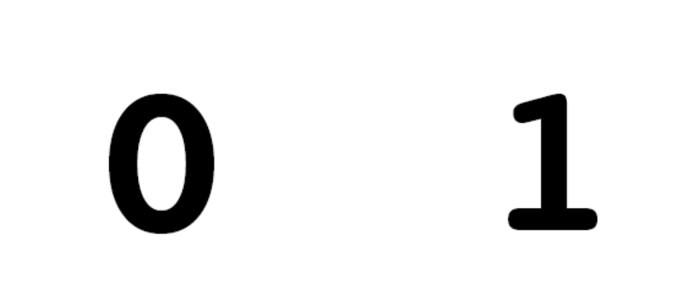
Review: What does a computer know?
Switches!
What does a switch represent??
Keep this in mind as you learn the semantics of programming

Slide 3
Visualizing Memory
X
75.62
…
STO 005
ADD 003
RTV 001
H
-26
0.005
354
-27.2
Thus, while we might visualize the computer with all sorts of data in the memory slots…
999
998
…
7
6
5
4
3
2
1
0

Slide 4
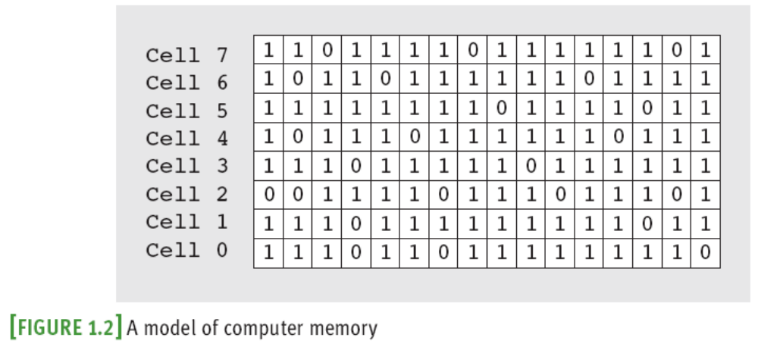
Visualizing Memory
… It really consists of an arrangement of 1s and 0s

Slide 5
Visualizing Memory
So…what does having a 32-bit computer mean?
  64-bit computer?
Notice that they are multiples of 8…the byte!

Slide 6
Computer Units
The Bit (Binary Digit) – one digit that is either a 1 or a 0
A Byte – 8 bits
  When we reserve memory for our programs, they will be in multiples of 8 bits

Slide 7
How big is a byte?
If a byte is 8 bits, how big is that?
How many different numbers are stored in a byte?
  2⁸ = 256 possible permutations

Slide 8
Larger Units of Measure
2¹⁰ bytes = 1024 bytes = 1KB (1 Kilobyte)
2¹⁰ KB = 1024 KB = 1 MB (1 Megabyte)
2¹⁰ MB = 1024 MB = 1 GB (1 Gigabyte)
2¹⁰ GB = 1024 GB = 1 TB (1 Terabyte)
Know what comes next?
Lets say we have 2MB. How many bytes is that?

Slide 9
But we are still missing something
  How does the computer translate from groups of 0’s and 1’s to something more meaningful?
    Binary number system!
  For today, we will talk about how binary numbers are translated into unsigned integers

Slide 10
Binary Numbers
The “switch” nature of transistors make storing numbers in binary a natural fit.
Binary is a change of base for our number system, base 2
In a number, its position represents powers of 2

Slide 11
Numeric representation
We usually work with decimal numbers with digits from 0 to 9 and powers of 10
  7313 = (7 * 1000 + 3 * 100 + 1 * 10 + 3 * 1)
  Or (7 * 10³ + 3 * 10² + 1 * 10¹ + 3 * 10⁰)
The binary number system uses digits 0 and 1 and powers of 2
  0101 = (0 * 8 + 1 * 4 + 0 * 2 + 1 * 1)
  Or (0 * 2³ + 1 * 2² + 0 * 2¹ + 1 *2⁰)
  = 5
Notes:
See http://computer.howstuffworks.com/bytes1.htm for more information on number systems and binary numbers.

Slide 12
Thinking about this…
A nibble is half a byte
  0110 is one example
How many numbers can a nibble store?
Which numbers can a nibble store?
  Largest nibble/smallest nibble?

Slide 13
Your turn #1
What unsigned decimal numbers are represented by the following binary numbers?
Example: 00000101 = 5
01000100
00001101
10110011

Slide 14
Your turn #2
How would you write the following numbers in binary?
  Example: 14 = 8 + 4 + 2 -> 00001110
  3
  121
  143

Slide 15
Encoding
Binary numbers can represent more things than just integers
Another example is ASCII
  American Standard Code for Information Interchange
  Character encoding scheme based on the English alphabet
  http://en.wikipedia.org/wiki/ASCII

