Slide 1
Types, Truth, and Expressions (Part 2)
Intro to Computer Science
CS1510
Dr. Sarah Diesburg

Slide 2
Review : Python if Statement
if <expression> :
suite
Evaluate the expression to a boolean value (True or False)
if True, execute all statements in the suite

Slide 3
Review : Warning About Indentation
Elements of the “suite” must all be indented the same number of spaces/tabs
Python only recognizes suites when they are indented the same “distance”
You must be careful to get the indentation right to get suites right.

Slide 4
Python Selection, Round 3
if boolean expression1:
suite1
elif boolean expression2:
suite2
#(as many elif’s as you want)
else:
suiteLast

Slide 5
if, elif, else, the Process
Evaluate boolean expressions until:
  The boolean expression returns True
  None of the boolean expressions return True
If a boolean returns True, run the corresponding suite. Skip the rest of the if
If no boolean returns True, run the else suite, the default suite

Slide 6
Compound Expressions
Logical Operators (lower case)
  and
  or
  not

Slide 7
Let’s test your knowledge
Problems #10-11 : Which letters are printed?
  A
  B
  A and B
  Neither

Slide 8
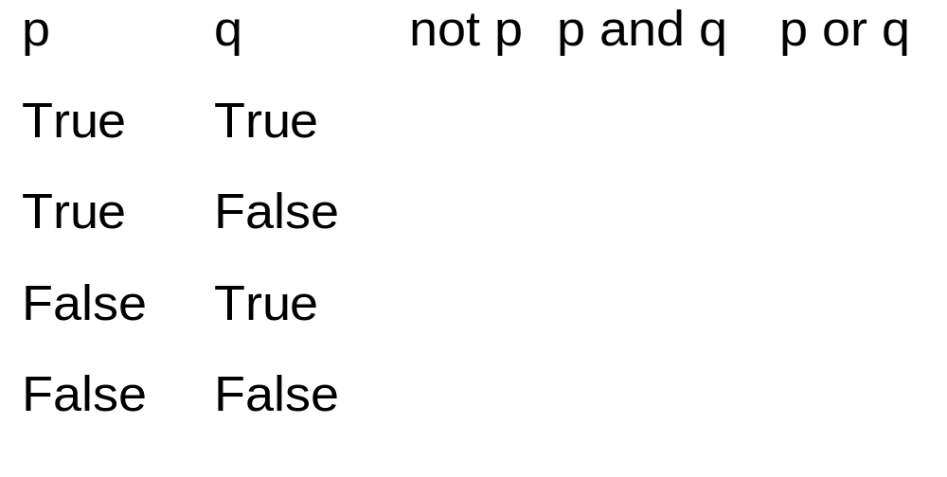
Truth Tables

Slide 9
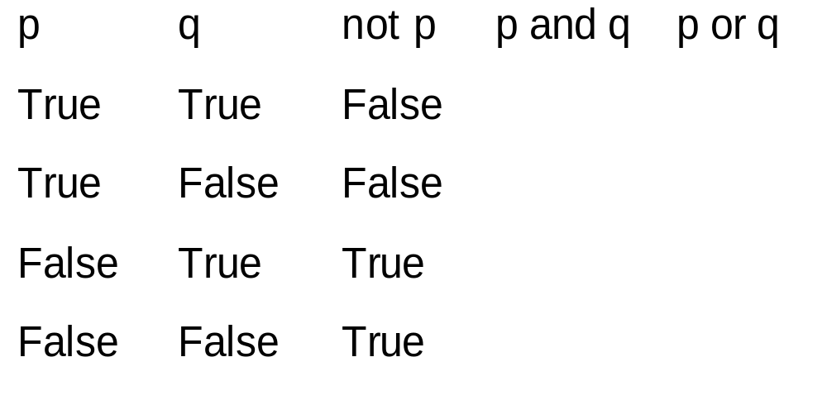
Truth Tables

Slide 10
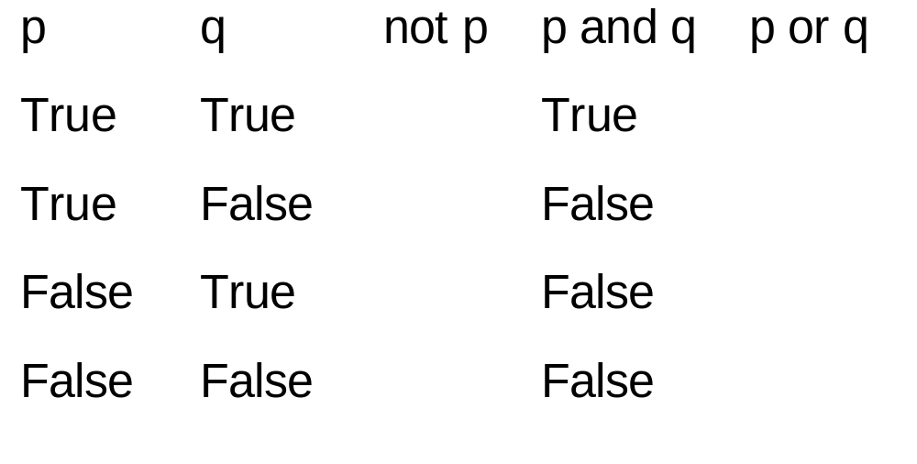
Truth Tables

Slide 11
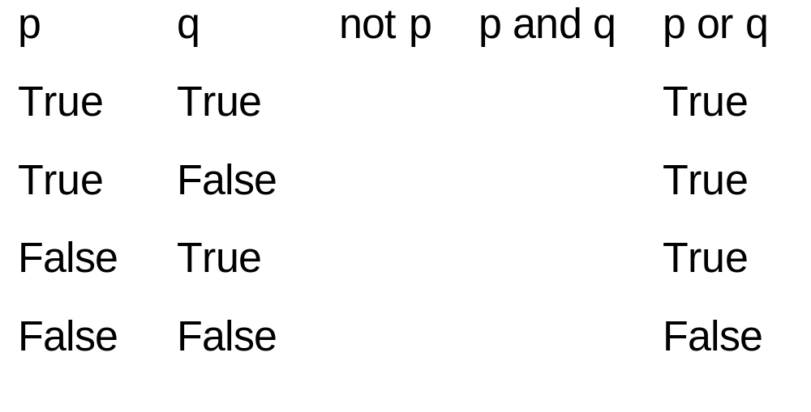
Truth Tables

Slide 12
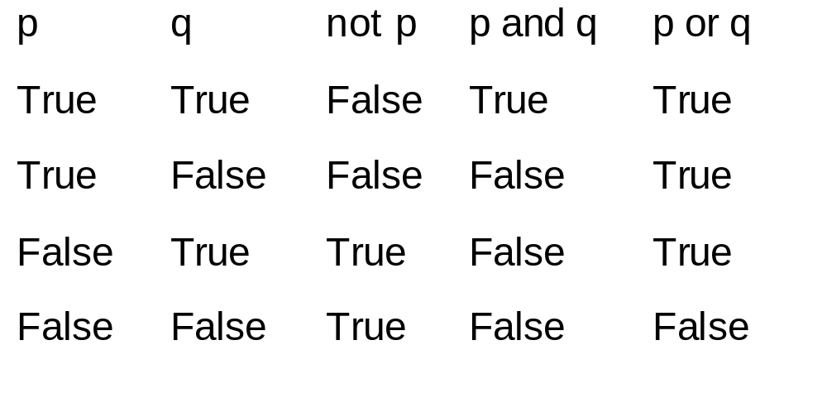
Truth Tables

Slide 13
Chained Comparisons
You are going to be tempted to write:
  0 <= myInt <= 5
But you will need to be very careful

Slide 14
Compound Evaluation
Logically 0 < X < 3 is actually
(0 < X) and (X < 3)
Evaluate using X with a value of 2:
(0< X) and (X< 3)
Parenthesis first: (True) and (True)
Final value: True
(Note: parentheses are not necessary in this case.)

Slide 15
Compound Evaluation
BUT, I’ve seen students write:
3 < X < 0
Meaning they want to know if x is outside of that range.
But this is actually
(3 < X) and (X < 0)
Evaluate using X with a value of 5:
(3< X) and (X< 0)
Parenthesis first: (True) and (False)
Final value: False

