Slide 1
Introduction to Strings
Intro to Computer Science
CS1510
Dr. Sarah Diesburg

Slide 2
Introduction to Strings
A string is a sequence of characters.
A string is indicated between ‘ ‘ or “ “
The exact sequence of characters is maintained.

Slide 3
The Index
Because the elements of a string are a sequence, we can associate each element with an index, a location in the sequence:
  Non-negative values count up from the left, beginning with index 0
  Negative values count down from the right, starting with -1

Slide 4
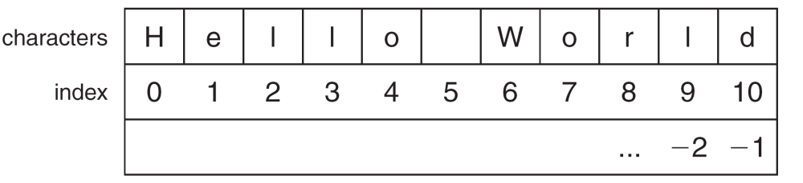

Slide 5
Accessing an Element
A particular element of the string is accessed by the index of the element surrounded by square brackets [ ]
helloStr = ‘Hello World’
print (helloStr[1]) => prints ‘e’
print (helloStr[-1]) => prints ‘d’
print (helloStr[11]) => ERROR

Slide 6
Slicing: the Rules
Slicing is the ability to select a subsequence of the overall sequence
Uses the syntax [start : finish], where:
  start is the index of where we start the subsequence
  finish is the index of one after where we end the subsequence
If either start or finish are not provided, it defaults to the beginning of the sequence for start and the end of the sequence for finish

Slide 7
Half Open Range for Slices
Slicing uses what is called a half-open range
The first index is included in the sequence
The last index is one after what is included

Slide 8
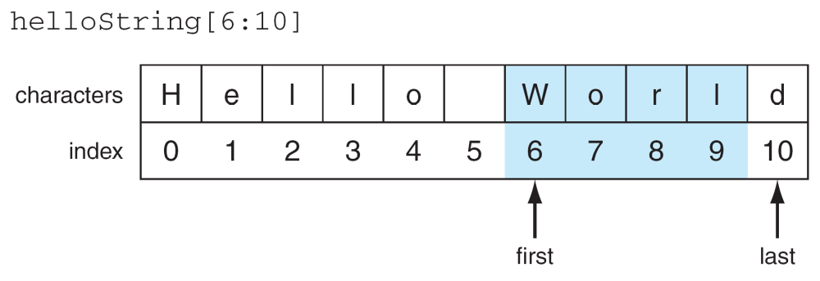

Slide 9
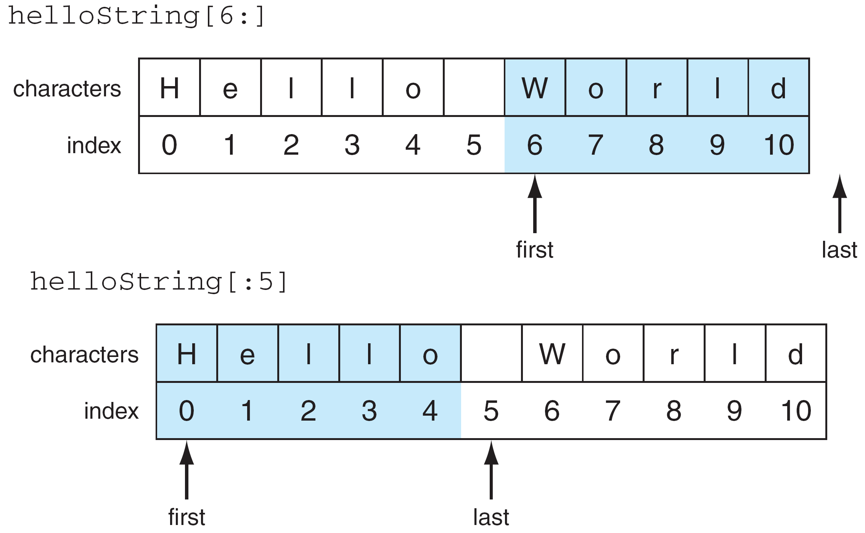

Slide 10
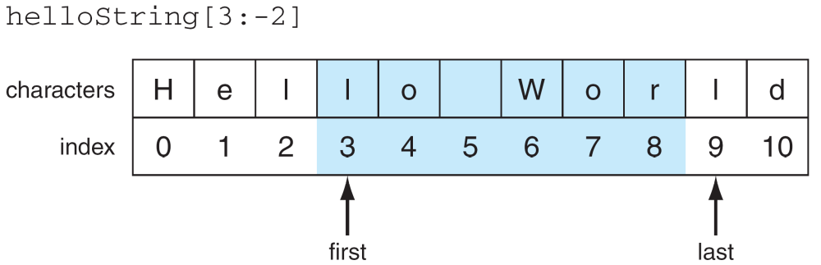
© 2011 Pearson Addison-Wesley. All rights reserved.

Slide 11
Basic String Operations
s = ‘spam’
length operator len()
len(s) ⇒ 4
+ is concatenate
newStr = ‘spam’ + ‘-’ + ‘spam-’
print (newStr) ⇒ spam-spam-
* is repeat, the number is how many times
newStr * 3 ⇒
spam-spam-spam-spam-spam-spam-

Slide 12
Some Details
Both + and * on strings make a new string, but does not modify the arguments.
Order of operation is important for concatenation and repetition.
The types required are specific. For concatenation you need two strings; for repetition, a string and an integer.

Slide 13
What Does A + B Mean?
What operation does the above represent? It depends on the types!
  two strings, concatenation
  two integers addition
The operator + is overloaded.
  the operation + performs depends on the types it is working on

Slide 14
The type function
You can check the type of the value associated with a variable using type
myStr = ‘hello world’
type(myStr) ⇒ yields <type ‘str’>
myStr = 245
type(myStr) ⇒ yields <type ‘int’>

Slide 15
Strings are Immutable
Strings are immutable, that is you cannot change one once you make it:
  aStr = ‘spam’
  aStr[1] = ‘l’ ⇒ ERROR
However, you can use it to make another string (copy it, slice it, etc).
  newStr = aStr[:1] + ‘l’ + aStr[2:]
  aStr ⇒ ‘spam’
  newStr => ‘slam’

Slide 16
Iteration Through a Sequence
To date, we have seen the while loop as a way to iterate over a suite (a group of python statements)
We briefly touched on the for statement for iteration, such as the elements of a list or a string

Slide 17
for Statement
We use the for statement to process each element of a list, one element at a time:
for item in sequence:
suite

Slide 18
What for means
myStr=‘abc’
for myVar in myStr:
print (myVar)
first time through, myVar=‘a’ (myStr[0])
second time through, myVar=‘b’ (myStr[1])
third time through, myVar=‘c’ (myStr[2])
no more sequence left, we quit

Slide 19
Power of the for Statement
Sequence iteration as provided by the for statement is very powerful and very useful in Python.
Allows you to write some very “short” programs that do powerful things.

Slide 20
String Function: len
The len function takes as an argument a string and returns an integer, the length of a string.
myStr = ‘Hello World’
len(myStr) ⇒ 11 # space counts

Slide 21
Another version of the for loop
myStr=‘abc’
for index in range(len(myStr)):
print (myStr[index])
first time through, index=0 (myStr[0])
second time through, index=1 (myStr[1])
third time through, index=2(myStr[2])
no more numbers left, so we quit

Slide 22
Let’s use this to solve a problem
Compute the number of times a given digit D appears in a given number N.
  The number of times 5 appears in 1550 is 2.
  The number of times 0 appears in 1550 is 1.
  The number of times 3 appears in 1550 is 0.

