Slide 1
Advanced Strings
Intro to Computer Science
CS1510, Section 2
Dr. Sarah Diesburg

Slide 2
Review of the base operators for strings
myStr[3]
myStr[3:6]
Addition
Multiplication
in

Slide 3
Another Operator
Can check to see if a substring exists in the string using the in operator.
Returns True or False
myStr = ‘aabbccdd’
‘a’ in myStr ⇒ True
‘abb’ in myStr ⇒ True
‘x’ in myStr ⇒ False

Slide 4
String Methods and Functions

Slide 5
Functions
What is a function?
Name several we have worked with.

Slide 6
Functions, First Cut
A function is a program that performs some operation(s). Its details are hidden (encapsulated), only its interface provided.
A function takes some number of inputs (arguments) and returns a value based on the arguments and the function’s operation.

Slide 7
String Method
A method is a variation on a function
  like a function, it represents a program
  like a function, it has input arguments and an output
Unlike a function, it is applied in the context of a particular object.
This is indicated by the ‘dot notation’ invocation

Slide 8
Example
upper is the name of a method. It generates a new string that has all upper case characters of the string it was called with.
myStr = ‘Python Rules!’
myStr.upper() ⇒ ‘PYTHON RULES!’
The string myStr called the upper() method, indicated by the dot between them.

Slide 9
More Dot Notation
In generation, dot notation looks like:
  object.method(…)
It means that the object in front of the dot is calling a method that is associated with that object’s type.
The methods that can be called are tied to the type of the object calling it. Each type has different methods.

Slide 10
Find
myStr = ‘hello’
myStr.find(‘l’) # find index of ‘l’ in myStr
⇒ 2
Note how the method ‘find’ operates on the string object myStr and the two are associated by using the “dot” notation: myStr.find(‘l’).
Terminology: the thing(s) in parenthesis, i.e. the ‘l’ in this case, is called an argument.

Slide 11
Chaining Methods
Methods can be chained together.
Perform first operation, yielding an object
Use the yielded object for the next method
myStr = ‘Python Rules!’
myStr.upper() ⇒ ‘PYTHON RULES!’
myStr.upper().find(‘O’)
⇒ 4

Slide 12
Optional Arguments
Some methods have optional arguments:
if the user doesn’t provide one of these, a default is assumed
find has a default second argument of 0, where the search begins
aStr = ‘He had the bat’
aStr.find(‘t’) ⇒ 7 # 1st ‘t’,start @ 0
aStr.find(‘t’,8) ⇒ 13 # 2nd ‘t’

Slide 13
Nesting Methods
You can “nest” methods, that is, the result of one method as an argument to another.
Remember that parenthetical expressions are done “inside out”: do the inner parenthetical expression first, then the next, using the result as an argument.
aStr.find(‘t’, aStr.find(‘t’)+1)
Translation: find the second ‘t’.

Slide 14
How to Know?
You can use IDLE to find available methods for any type. You enter a variable of the type, followed by the ‘.’ (dot) and then a tab.
Remember, methods match with a type. Different types have different methods.
If you type a method name, IDLE will remind you of the needed and optional arguments.

Slide 16
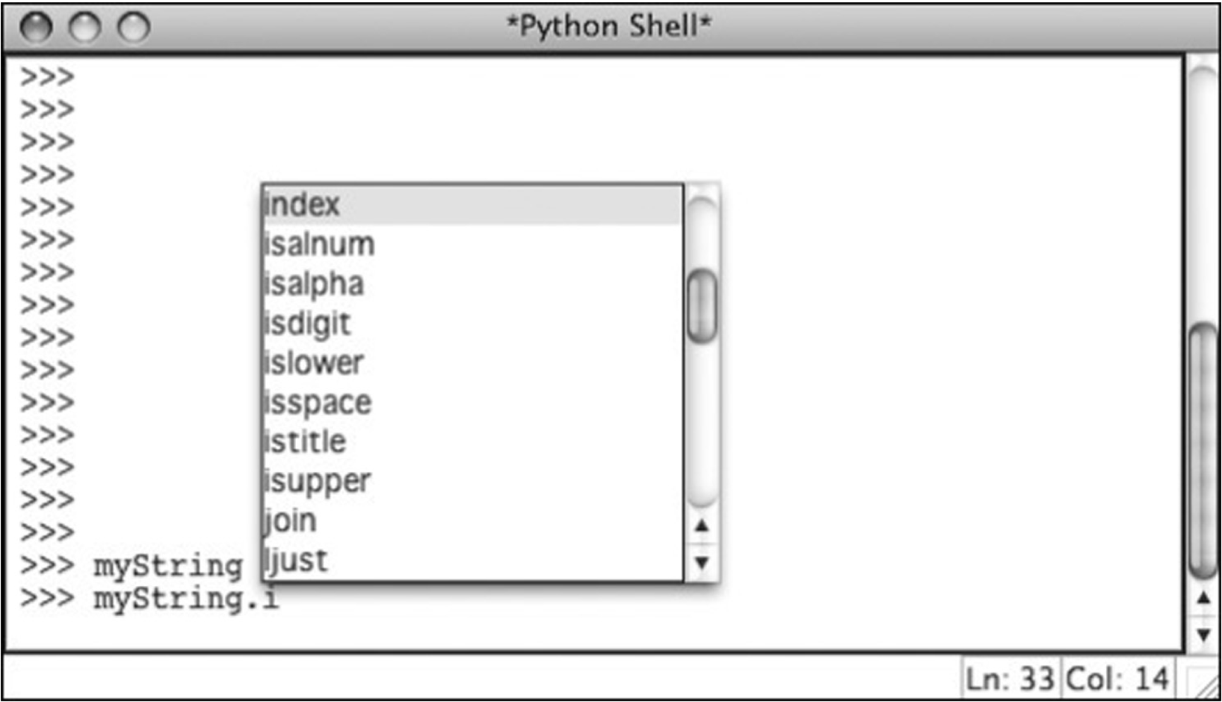

Slide 17
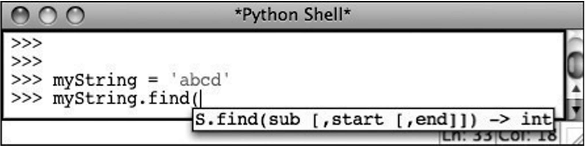

Slide 18
More Methods
(Even more exist: https://docs.python.org/3/library/stdtypes.html#string-methods)
s.capitalize
s.center(width)
s.count(sub,[,start [,end]])
s.ljust(width)
s.lower()
s.upper()
s.lstrip()
s.rfind(sub, [,start [,end]])
s.splitlines([keepends])
s.strip()
s.translate(table [, delchars])

Slide 19
String Comparisons, Single Char
There are two systems for representing characters: ASCII and Unicode
ASCII takes the English letters, numbers and punctuation marks and associates them with an integer number
Single character comparisons are based on that number

Slide 20
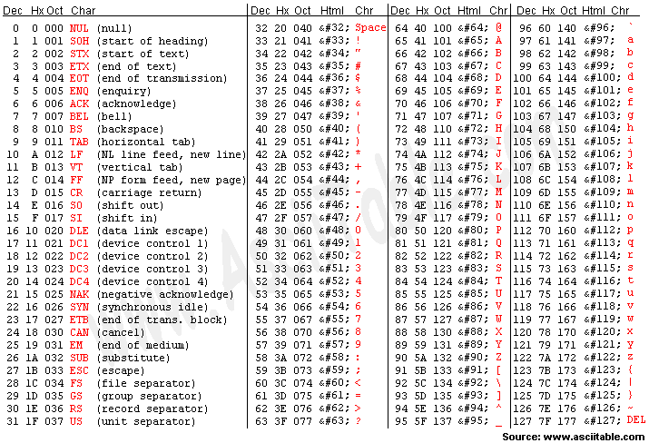

Slide 21
Comparisons Within Sequence
It makes sense to compare within a sequence (lower case, upper case, digits).
  ‘a’ < ‘b’ True
  ‘A’ < ‘B’ True
  ‘1’ < ‘9’ True
Can be weird outside of the sequence:
  ‘a’ < ‘A’ False
  ‘a’ < ‘0’ False

Slide 22
Whole Strings
Compare the first element of each string:
  if they are equal, move on to the next character in each
  if they are not equal, the relationship between those to characters are the relationship between the string
  if one ends up being shorter (but equal), the shorter is smaller

Slide 23
Examples
‘a’ < ‘b’ True
‘aaab’ < ‘aaac’
  First difference is at the last char. ‘b’<‘c’ so ‘aaab’ is less than ‘aaac’. True.
‘aa’ < ‘aaz’
  The first string is the same but shorter. Thus it is “smaller”. True.

