Slide 1
String Encodings and Penny Math
Intro to Computer Science
CS1510
Dr. Sarah Diesburg

Slide 2
Questions about PA05?

Slide 3
String Encodings
There are two systems for representing characters: ASCII and Unicode
ASCII takes the English letters, numbers and punctuation marks and associates them with an integer number

Slide 4
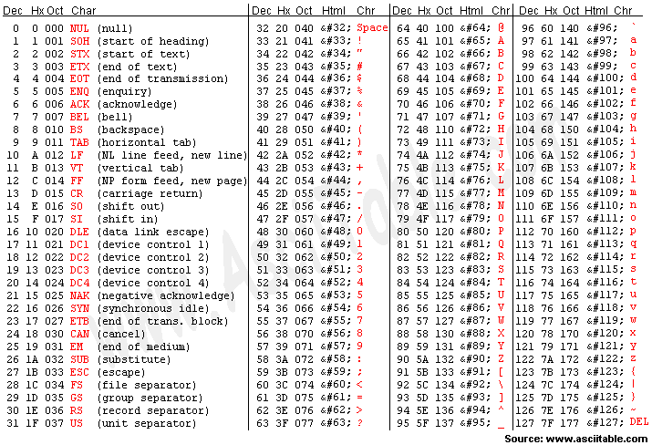

Slide 5
String Encodings
We can get the encodings from characters using the ord function
  >>> ord(‘x’)
  Humans can look this number up in the ASCII table
We can get the characters back from the encoding using the chr function
  >>>chr(120)

Slide 6
Comparisons Within Sequence
It makes sense to compare within a sequence (lower case, upper case, digits).
  ‘a’ < ‘b’ True
  ‘A’ < ‘B’ True
  ‘1’ < ‘9’ True
Now comparisons make sense, because we are really comparing the ord() encodings of each character

Slide 7
Penny Math
Penny Math is a simple formula
  A (or a) costs 1 penny
  B (or b) costs 2 pennies
  …
  Z (or z) costs 26 pennies
  Everything else is FREE
Thus
  “Sarah” costs 19+1+18+1+8=47 cents
  “Diesburg” costs 4+9+5+19+2+21+18+7=85 cents
  “Sarah Diesburg!!!” costs 47+85=132 cents, or $1.32
  “@#$!!” is free

Slide 8
Our next task
Write a script called pennyMath that reads in a String and prints the integer value corresponding to the “cost” of the String.

