Slide 1
Lab 07: Caesar Cypher
Intro to Computer Science
CS1510

Slide 2
Caesar Cypher
Method named after Julius Caesar
  Used in his private correspondence
One of the simplest and most widely-known encryption techniques

Slide 3
Caesar Cypher
We can start understanding the Caesar Cypher by writing out each letter of the alphabet

Slide 4
Caesar Cypher
To encode, we apply a rotation value to the alphabet
Before encoding with rotation of 3: “hello”
After encoding (shift 3 to right): “khoor”
After decoding (shift 3 to left): “hello”

Slide 5
Caesar Cypher
Two ways to solve the problem
  Mathematically using ord() and chr() functions
  Create a shifted string, use the str.find() method

Slide 6
Mathematical Solution
This solution hinges around knowing the ASCII/Unicode values of letters
We only encode lowercase letters and leave all other letters the same

Slide 7
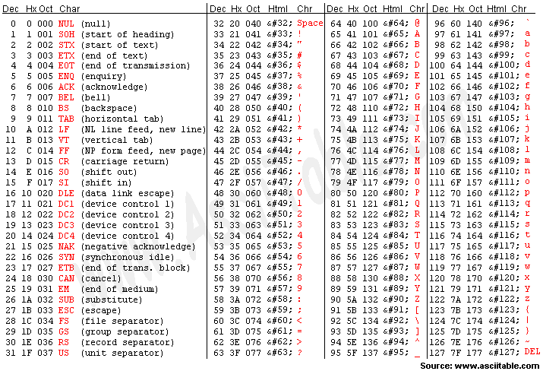

Slide 8
Mathematical Solution
‘a’=97
‘z’=122
As we go through the string to encrypt, each ord() of each character must be >= 97 and <= 122 for us to apply a shift
We then add the rotation value (say 3) to the ord() of each character to create a shifted character
We can then take the chr() of the shifted character to get the encoded character

Slide 9
Mathematical Solution
But what if shifting the character brings us beyond our bound of z?
  ord(y) + 3 = 124
  chr(124) = “|”
We must check that’s not the case by using an “if” statement
  if shiftedChar > 122:
    shiftedChar = shiftedChar - 26

Slide 10
Mathematical Solution
Let’s create the solution

Slide 11

Shifted String Solution
The other solution involves using two strings
Alphabet
Shifted alphabet, based on rotation value (say 3)

Slide 12
Shifted String Solution
We can go through the string to be encoded character by character
For each character, we use the str.find() method to get the index of the character in the regular alphabet
origIndex = input.find(“h”)
  Is 7

Slide 13
Shifted String Solution
Once we have the index of the character in the alphabet, we can look up what character is at that index in the shifted alphabet
shiftedChar = shiftedAlphabet[7]
  Remember, origIndex = 7
  shiftedChar is now “k”

Slide 14
Shifted String Solution
Let’s create the solution

Slide 15
Cracking the Code
We don’t know the rotation value, but we do know one word in the decoded string
We need to start decoding with all possible rotation values, starting at 1
  If we can find the one word we know in the decoded string, we are done
  Otherwise, we keep decoding with different rotation values (2,3,4,…)

Slide 16
Advice for the Tests
These two things can make the difference of whether you pass or fail this class before taking the exams
  Go through each class days notes and example programs on the website
  Practice coding over and over!!! This is the only way to really learn.
Review by reading the book and notes!!

Slide 17
Advice for Tests
In-class review on Monday
  This is not a substitute for studying and practicing on your own
In-class exam on Wednesday
  Open book, open notes, online
  Timed to 50 minutes during your lecture period
In-lab exam on Thursday
  Can zoom in virtually, must turn on camera
  Can use one page of hand-written notes to help

