Slide 1
Introduction to Functions
Intro to Computer Science
CS1510
Dr. Sarah Diesburg

Slide 2
Assorted Topics
Issues about reading files?
Homework assignment

Slide 3
Review
So far, most of our programs have retrieved data from the keyboard and written data to the screen
  Data must be entered on every program run
  Programs have no way to write permanent output
Text files provide convenient input/output storage
  e.g. programs can read configuration data or input files to process, and can write output to files

Slide 4
Question #1
A program is designed to retrieve some data from a file, process it, and output the revised data to another file. Which of the following functions/methods will not be called in the program?
  A. open
  B. A loop or method for reading (e.g. read)
  C. write
  D. close
  E. All should be called

Slide 5
Review
Several methods for reading text from files:
  readline: reads and returns next line; returns empty string at end-of-file
  read: reads the entire file into one string
  readlines: reads the entire file into a list of strings
All of these leave a trailing '\n' character at the end of each line.

Slide 6
Review
A file is a sequence of lines. Can be read with a for-loop
    f = open(‘data.txt‘,”r”)
    for line in f:
    print(line.strip())
…or using a while-loop:
    f = open(‘data.txt‘,”r”)
    line = f.readline()
    while line:
      print(line.strip())
      line = f.readline()

Slide 7
Question #2 – What is the last thing printed?
data.txt
program
Reading Assignments
#Each line lists the reading
#assignment for that date
Sep, 17, Section 1.1-1.3
Sep, 19, Section 1.4-1.8
Sep, 21, Section 2.1-2.4
line = f.readline()
line = f.readline()
while line.startswith('#'):
line = f.readline()
print(f.readline())

Slide 8
Question #3 – What is the last thing printed?
data.txt
program
Reading Assignments
#Each line lists the reading
#assignment for that date
Sep, 17, Section 1.1-1.3
Sep, 19, Section 1.4-1.8
Sep, 21, Section 2.1-2.4
line = f.readline()
line = f.readline()
while line.startswith('#'):
line = f.readline()
print( line )

Slide 9
What is a Function?

Slide 10
Functions
From mathematics we know that functions perform some operation and return one value.
They “encapsulate” the performance of some particular operation, so it can be used by others (for example, the len() function).

Slide 11
Why Have Them?
Abstraction of an operation
Reuse: once written, use again
Sharing: if tested, others can use
Security: if well tested, then secure for reuse
Simplify code: more readable
Support divide-and-conquer strategy

Slide 12
Mathematical Notation
Consider a function which converts temperatures in Celsius to temperatures in Fahrenheit:
  Formula: F = C * 1.8 + 32.0
  Functional notation: F = celsisus2Fahrenheit(C) where
  celsius2Fahrenheit(C) = C*1.8 + 32.0

Slide 13
Python Invocation
Math: F= celsius2Fahrenheit(C)
Python, the invocation is much the same
F = celsius2Fahrenheit(C)
Terminology: argument “C”

Slide 14
Function Definition
Math: g(C) = C*1.8 + 32.0
Python
def celsius2Fahrenheit (C):
return C*1.8 + 32.0
Terminology: parameter “C”

Slide 15
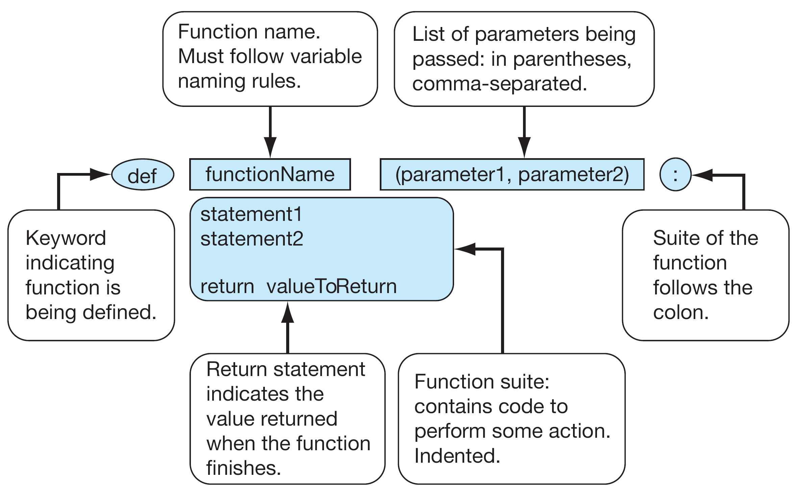

Slide 16
Return Statement
The return statement indicates the value that is returned by the function.
The statement is optional (the function can return nothing). If no return, the function is often called a procedure.

Slide 17
Code Listing 6.1
Temp Convert

Slide 18
Code Listing 6.1
# Temperature conversion
def celsius2fahrenheit(celsius):
""" Convert Celsius to Fahrenheit."""
return celsius*1.8 + 32

Slide 19
Triple Quoted String in Function
A triple quoted string just after the def is called a docstring
docstring is documentation of the function’s purpose, to be used by other tools to tell the user what the function is used for.

Slide 20
Operation
1. Call copies argument C to parameter celsius
F = celsius2Fahrenheit(C)
2. Control transfers to function “celsius2Farenheit”
def celsius2Fahrenheit (celsius):
return celsius*1.8 + 32.0

Slide 21
Operation (con’t)
F = celsius2Fahrenheit(C)
3. Expression in celsius2Farenheit is evaluated
4. Value of expression is returned to the invoker
def celsius2Fahrenheit (celsius):
return celsius*1.8 + 32.0

Slide 22
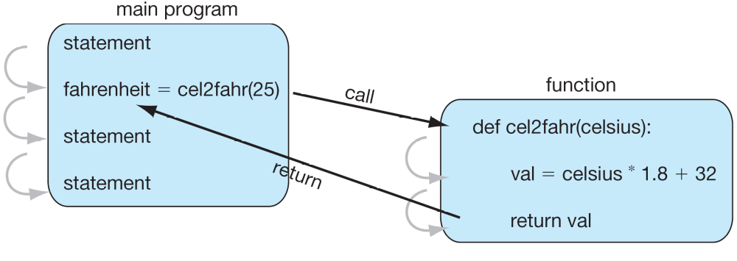

Slide 23
Code Listing 6.3
Implement len

Slide 24
Code Listing 6.3
def length(S):
"""Return the length of S."""
count = 0
for s in S:
count += 1
return count

Slide 25
Code Listing 6.4
Count Letters in String

Slide 26
Check Membership in lowercase
import string
use string.lowercase, string of lowercase
  ‘abcdefghijklmnopqrstuvwxyz’
check if each letter is a member (using the in operator) of string.lowercase

Slide 27
Code Listing 6.4
import string
def letterCount(S):
"""Return the count of letters in S."""
count = 0
for s in S:
if s.lower() in string.ascii_lowercase:
count += 1
return count

Slide 28
How to Write a Function
Does one thing. If it does too many things, it should be broken down into multiple functions (refactored).
Readable. How often should we say this? If you write it, it should be readable.
Reusable. If it does one thing well, then when a similar situation (in another program) occurs, use it there as well.

Slide 29
More on Functions
Complete. A function should check for all the cases where it might be invoked. Check for potential errors.
Not too long. Kind of synonymous with “does one thing”. Use it as a measure of doing too much.

Slide 30
Procedures
Functions that have no return statements are often called procedures.
Procedures are used to perform some duty (print output, store a file, etc.)
Remember, return is not required.

Slide 31
Multiple Returns in a Function
A function can have multiple return statements.
Remember, the first return statement executed ends the function.
Multiple returns can be confusing to the reader and should be used judiciously.

