Slide 1
Introducing Lists
Intro to Computer Science
CS1510
Dr. Sarah Diesburg

Slide 2
Last Time
We wrapped up using files and functions
  We will revisit them soon

Slide 3
Data Structures
Data structures are particular ways of storing data to make some operations easier or more efficient.
  That is, they are tuned for certain tasks.
Data structures are suited to solving certain problems.

Slide 4
Kinds of Data Structures
Roughly two kinds of data structures:
Built-in data structures - data structures that are so common as to be provided by default.
User-defined data structures - (classes in object oriented programming) designed for a particular task.

Slide 5
Python Built-in Data Structures
Python comes with a general set of built-in data structures:
  string
  lists
  tuples
  dictionaries
  sets
  others...
Today we are going to look at lists

Slide 6
The Python List Data Structure
A list is very simple - it is just an ordered sequence of items.
You have seen such a sequence before in a string. A string is just a particular kind of list. What kind?

Slide 7
Example with the split method
Remember how we used the split method in the last assignment?
>>>myStr = “Alabama,4833722,50744”
>>>state,population,area = myStr.split(“,”)
The split string method returned the string split up into exactly 5 pieces

Slide 8
Example with the split method
But what if we didn’t have exactly 5 pieces?
>>>myStr = “Sarah,Diesburg,0”
>>>first,last,team,yards,td = myStr.split(“,”)
What will happen?

Slide 9
Example with the split method
We need to do something more general when we want to break up a string into smaller pieces
  And we don’t know the exact number of pieces!

Slide 10
Using split to give us a list
We can use the split method to give us a list of an unknown amount of pieces
>>>myStr = “I like to eat cookies”
>>>pieces = myStr.split(“ “)
What is in pieces?

Slide 11
Using split to give us a list
We can use the split method to give us a list of an unknown amount of pieces
>>>myStr = “I like to eat cookies.”
>>>pieces = myStr.split(“ “)
What is in pieces?
>>>pieces
[‘I’, ‘like’, ‘to’, ‘eat’, ‘cookies’]

Slide 12
Using split to give us a list
The split method gives me an ordered sequence of items!
  Is an iterable data structure
How can I get each piece out of a list?
  Use a for loop!

Slide 13
Make a List
Like all data structures, lists have a constructor, named the same as the data structure. It takes an iterable data structure and adds each item to the list.
It also has a shortcut: the use of square brackets [ ] to indicate explicit items.

Slide 14
More List Making
>>> aList = list(‘abc’)
This creates the list that looks like this:
  [‘a’, ‘b’, ‘c’]
>>>newList = [1, 3.14159, ‘a’, True]
We can also create a list with this shortcut
This list contains a lot of data structures of different types – what are they?

Slide 15
Similarities with Strings
concatenate/+ (but only of lists)
repeat/*
indexing (the [ ] operator)
slicing ([:])
membership (the in operator)
len (the length operator)

Slide 16
Operators
[1, 2, 3] + [4] ⇒ [1, 2, 3, 4]
[1, 2, 3] * 2 ⇒ [1, 2, 3, 1, 2, 3]
1 in [1, 2, 3] ⇒ True
[1, 2, 3] < [1, 2, 4] ⇒ True
Compare index to index, the first difference determines the result.

Slide 17
Differences Between Lists and Strings
Lists can contain a mixture of any python object; strings can only hold characters.
  1,”bill”,1.2345, True
Lists are mutable; their values can be changed while strings are immutable.
Lists are designated with [ ], with elements separated by commas; strings use “”.

Slide 18
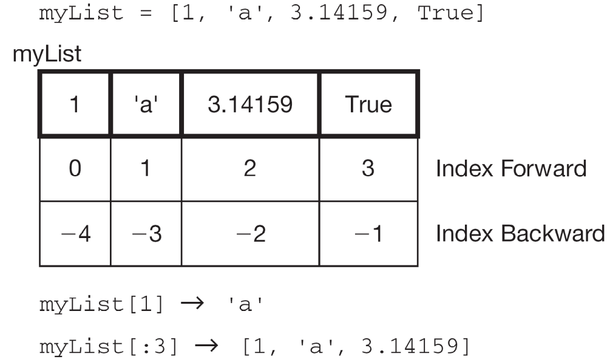

Slide 19
Adding to lists
Lists have many of the same methods as strings
We can use the list method append() to add on to the end of a list
>>>myList = [‘I’, ‘like’]
>>>myList.append(‘cookies’)
>>>myList
[‘I’, ‘like’, ‘cookies’]

Slide 20
More list methods
https://docs.python.org/3/tutorial/datastructures.html#more-on-lists
Bookmark this!

Slide 21
List Functions
len(lst): Number of elements in list (top level). len([1, [1, 2], 3]) ⇒ 3
min(lst): Minimum element in the list. If list of lists, looks at first element of each list.
max(lst): Max element in the list.
sum(lst): Sum the elements, numeric only.

