Slide 1
Introduction to Functional Decomposition
Intro to Computer Science
CS 1510
Dr. Sarah Diesburg

Slide 2
Programs are getting larger…
Our programs are starting to get large enough that we can’t hold all the details of the implementation in our heads
We need a toolset to help us break down large programming problems into smaller, more manageable sub-problems

Slide 3
Breaking up our programs
When should break up our programs into small problems?
  …before we try to write them!
Why?
  We can create re-usable, debuggable pieces that save us time
This means that we should integrate this notion into our early design process

Slide 4
Functional Decompostion
Functional decomposition* works to break up a large programming assignment into smaller sub-problems
  Working from the abstract to the concrete
This is also known as top-down design
* Special thanks to Dr. McCormick for the use of his materials from the book: Dale, Weems, and McCormick. Programming and Problem Solving with ADA 95.

Slide 5
Design
Abstract step – a list of major steps in our solution
Concrete step – algorithmic steps that can be translated directly into Python code
  …or, the code of any programming language!

Slide 6
Design
What is the easiest way to solve a problem?

Slide 7
Design
What is the easiest way to solve a problem?
  Give the problem to someone else and say “Solve it!”
Since we need to solve our own problems, let’s see if we can break this down further…

Slide 8
Design
We need to break down a solution from a series of very high-level abstract steps into concrete algorithmic steps that can be implemented in code
Each of the major steps becomes an independent sub-problem that we can work on independently

Slide 9
Design
Why would we want to do this?
  It’s much easier to focus on one problem at a time.
  Can get lost in large specifications without a plan

Slide 10
Design
We can create a hierarchical solution tree that goes from the most abstract steps to the concrete steps
Each level of the tree is a complete solution to the problem that is less abstract than the level above it
  This is known as functional equivalence

Slide 11
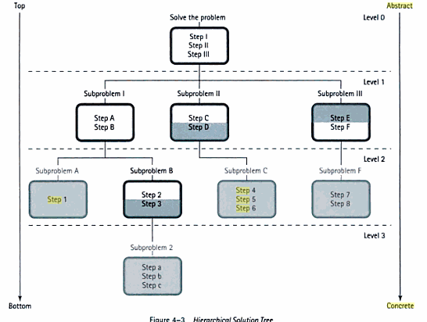
Hierarchical Solution Tree
Concrete steps are shaded

Slide 12
Modules
Each box represents a module
Modules are a self-contained collection of steps that solves a problem or subproblem
  They can contain both concrete and abstract steps
  Concrete steps are often written in pseudocode

Slide 13
Design Warm Up – mileage.py
Dr. Mobile asks you to write a program that asks for the starting and ending mileage as well as the total gasoline consumed.
It then calculates the MPG and prints a nice message regarding the MPG of the car.
  Recall, mpg = (ending mileage – start mileage) / gas consumed
It must also print out if the car can be legally driven as-is in California by 2020 (>= 35 MPG)

Slide 14
Mileage Solution Tree
Level 0 Solve the Problem
No steps are shaded, so these are all abstract steps (must be broken down more to solve in code
Get Data
Calculate MPG
Print Data

Slide 15
Mileage Solution Tree
Level 1 Get Data
All steps are shaded, so these are all concrete steps that we can translate directly into Python code
Ask for starting mileage
Ask for ending mileage
Ask for gas consumed

Slide 16
Get Data
startMileage = int(input(“Please enter the starting mileage: “))
endMileage = int(input(“Please enter the ending mileage: “))
gasConsumed = int(input(“Please enter the gas consumed: “))

Slide 17
Mileage Solution Tree
Level 1 Calculate MPG
This is a concrete step that we can translate directly into Python code
Mpg = (end-start)/gas consumed

Slide 18
Calculate MPG
mpg = (endMileage – startMileage) / gasConsumed

Slide 19
Mileage Solution Tree
Level 1 Print Data
We still need to break down step 2 into something more concrete
Print mpg
Print if car can be driven in California

Slide 20
Mileage Solution Tree
Level 2 Drive in California
These are concrete
if mpg < 35:
  print cannot drive
  else
  print can drive

Slide 21
Print Data
# Print mpg
print(“The total mpg is: “, mpg)
#Drive in California
If mpg < 35:
print(“Cannot drive in California.”)
else
print(“Can drive in California!”)

Slide 22
Total Table
Level 0
Solve the Problem
Get Data
Calculate MPG
Print Data
Level 1
Get Data
Calculate MPG
Print Data
Ask for starting mileage
Ask for ending mileage
Ask for gas consumed
Mpg = (end-start)/gas consumed
Print mpg
Print if car can be driven in California
Level 2
Drive in California
if mpg < 35:
  print cannot drive
  else
  print can drive

Slide 23
Something cool
Each module in our solution tree could be broken into a function

