Slide 1
Namespaces and
Memory Realities
Intro to Computer Science
CS1510
Dr. Sarah Diesburg

Slide 2
Namespaces
You can think of a namespace as where a name is valid and can be used
  Two functions can use a variable with the same name. These are two separate variables.
  Let me show you a short demo.
  Explaining the “separate ” part requires a bit more explanation

Slide 3
How Python stores information
(HEAVY)
Objects are Python’s abstraction for data.
All data in a Python program is represented by objects or by relations between objects.
Every object has:
  an identity (Where it is in memory. Unchangeable)
  a type (How to interpret memory. Unchangeable)
  a value (What is in memory. May (not) be changeable)

Slide 4
Reminder: Assignment
Assignment takes an object (the final object after all operations) from the right-hand-side and associates it with a variable on the left-hand side.
When you assign one variable to another, you share the association with the same object.

Slide 6
Immutables
Object sharing, two variables associated with the same object, is not a problem since the object cannot be changed.
Any changes that occur generate a new object.

Slide 8
Mutability Changes an Object
If two variables associate with the same object, then both reflect any change to that object.

Slide 9
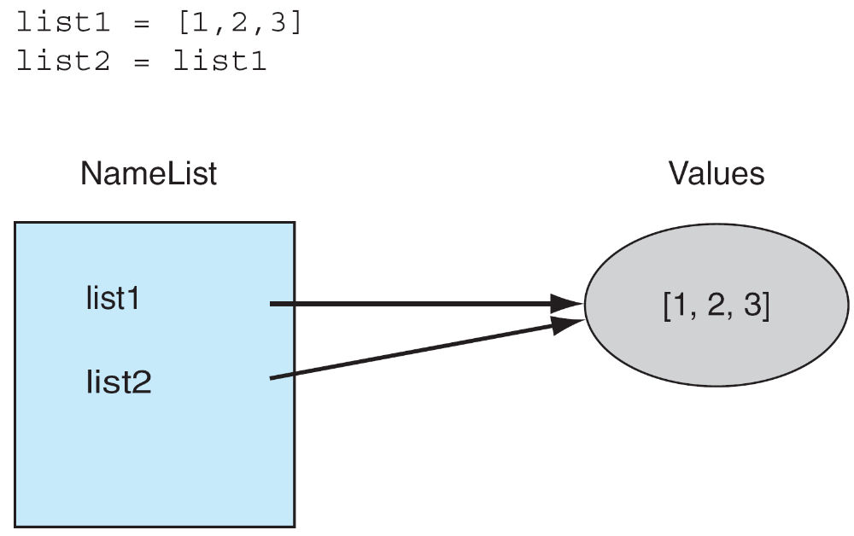

Slide 11
Copying
If we copy, does that solve the problem?
myLst = [1, 2, 3]
newLst = myLst[:]

Slide 12
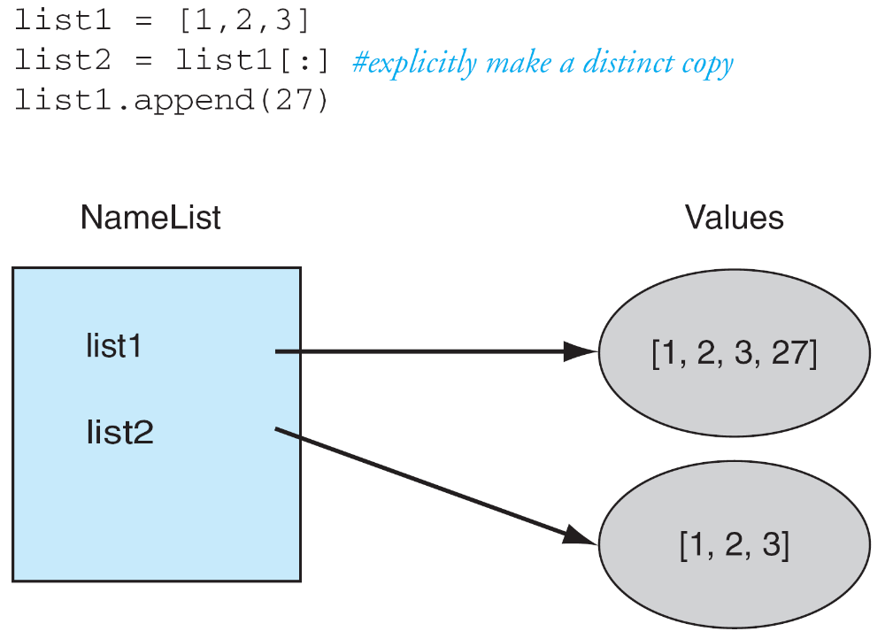

Slide 13
The Problem is What Gets Copied…
The elements of the list are copied, but sometimes the elements of the list themselves are references (or associations).
If the list has nested lists or uses other associations, the association gets copied. This is termed a shallow copy.

Slide 14
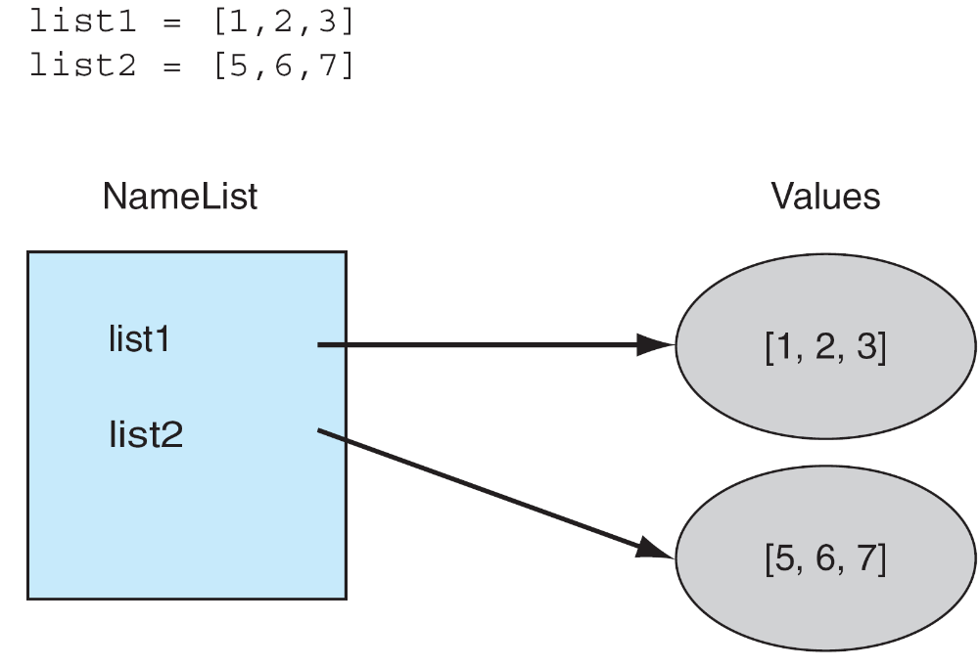

Slide 15
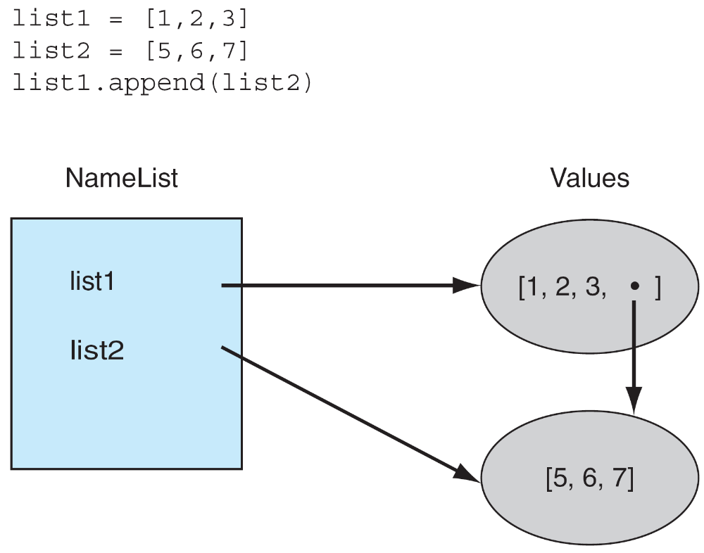

Slide 16
