Slide 1
More on Functions
Intro to Computer Science
CS1510
Dr. Sarah Diesburg

Slide 2
Functions
From mathematics we know that functions perform some operation and return one value.
They “encapsulate” the performance of some particular operation, so it can be used by others (for example, the sqrt() function).

Slide 3
How to Write a Function
Does one thing. If it does too many things, it should be broken down into multiple functions (refactored).
Readable. How often should we say this? If you write it, it should be readable.
Reusable. If it does one thing well, then when a similar situation (in another program) occurs, use it there as well.

Slide 4
More on Functions
Complete. A function should check for all the cases where it might be invoked. Check for potential errors.
Not too long. Kind of synonymous with “does one thing”. Use it as a measure of doing too much.

Slide 5
Two Parts to a Function
Definition – creates the function
Invocation – is the application of a function within a program
A function must be defined before it is invoked

Slide 6
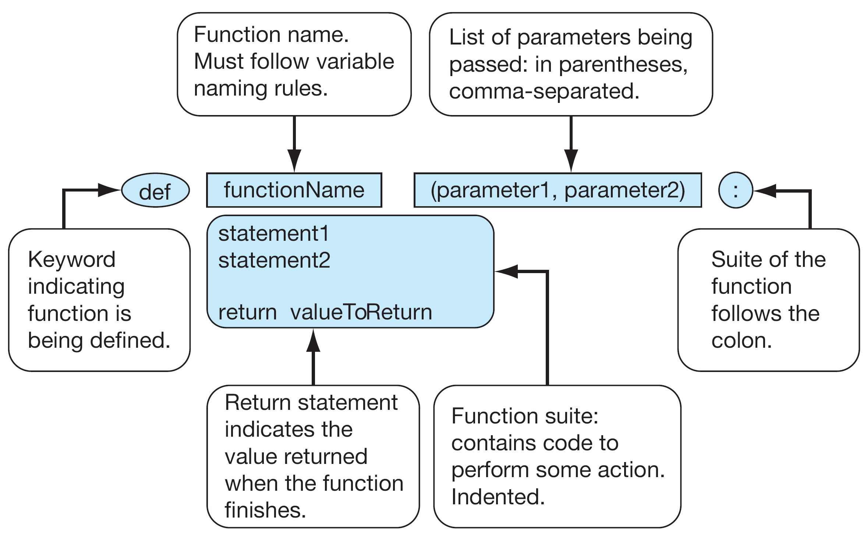
Function Definition

Slide 7
Function Invocation Example
In your program (after the function definition), we can invoke/call the function fahrenheit2Celsius by:
originalTemp=90
convertedTemp = fahrenheit2Celsius(originalTemp)
print(originalTemp,”in Celsius is”,convertedTemp)

Slide 8
Returning None
None is a special value in Python that represents nothing
  The first letter of None must be capitalized – it will turn orange
Use it when you have nothing to return
  Like if one of the parameters was invalid

Slide 9
Multiple Returns in a Function
A function can have multiple return statements.
Remember, the first return statement executed ends the function.
#doing function stuff
return result
print(“Hello!”) #This line will never happen

Slide 10
Multiple Returns in a Function
When you use if/elif/else statements, be sure to return a value for every branch!
if result < 0:
return None
elif result == 1:
return 1
else:
return 42 #the answer to everything else

Slide 11
Procedures
Functions that have no return statements are often called procedures.
Procedures are used to perform some duty (print output, store a file, etc.)
Remember, return is not required.

Slide 12
Example
def printRPSRules():
print("Please select from one of the following choices:")
print(" Enter r for rock")
print(" Enter p for paper")
print(" Enter s for scissors")
print(" Enter q to quit")
print()
#run program
printRPSRules()

Slide 13
Triple Quoted String in Function
A triple quoted string just after the def is called a docstring
docstring is documentation of the function’s purpose, to be used by other tools to tell the user what the function is used for.

Slide 14
Functions can call each other!
Let’s take a look at the example functionFun.py

Slide 15
Future Programming Assignments
I will ask you to write python files with only functions in them
That’s ok – you can call functions directly from IDLE
  Step 1: Run your python file (F5)
  At interpreter, type your function name with parameters

Slide 16
Example
Take functionFun.py and deleted all the code starting at
# Running the main part of the program
Save
Run the file
Type
>>> mySum = addNumToSelf(4)
>>>print(mySum)

Slide 17
Bigger Example
Let’s take a look at rps.py
  Functions simplify the program greatly!

