Slide 1
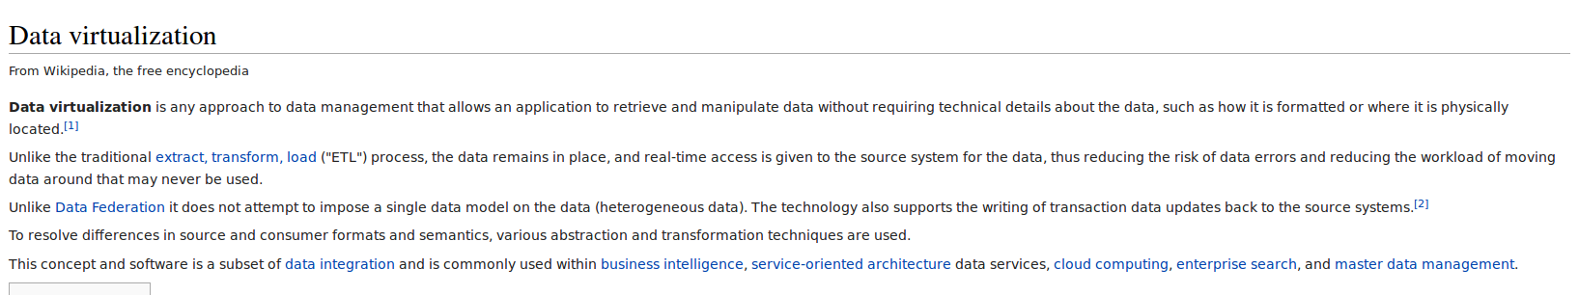
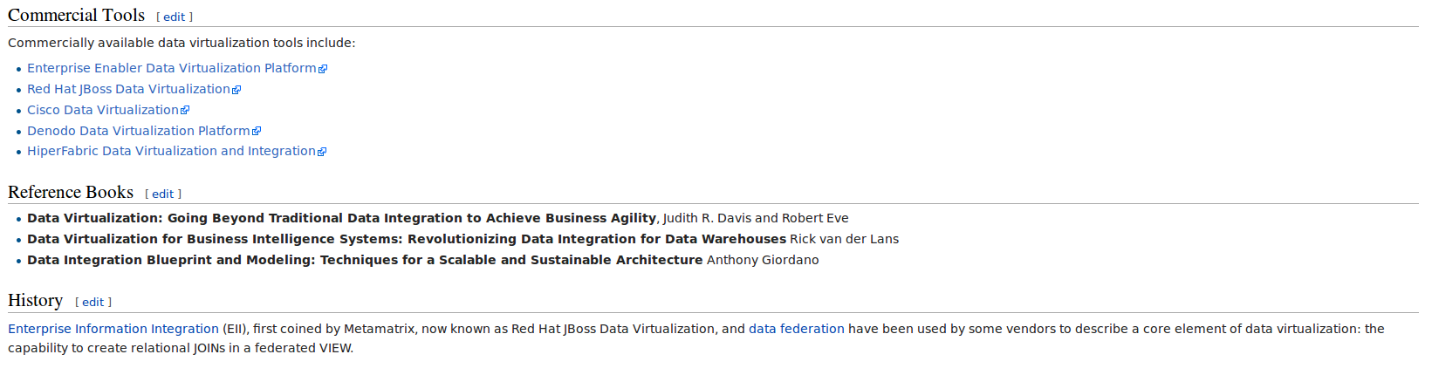
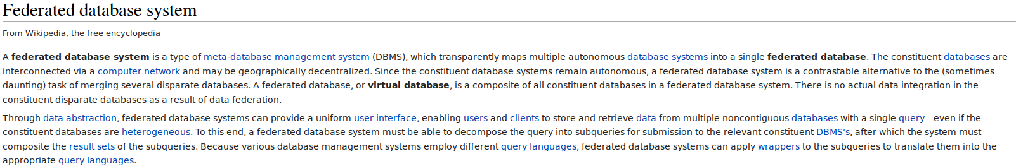
Traditional ETL: not where we want to be ! Highly Uncool

Slide 2

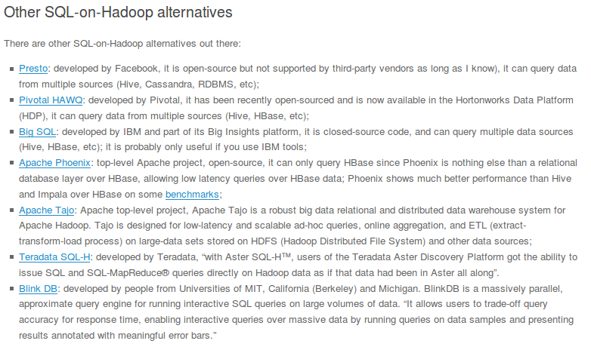
http://statrgy.com/2015/05/20/best-sql-on-hadoop-tool/
Well, SQL seems to be cool again!

Slide 3
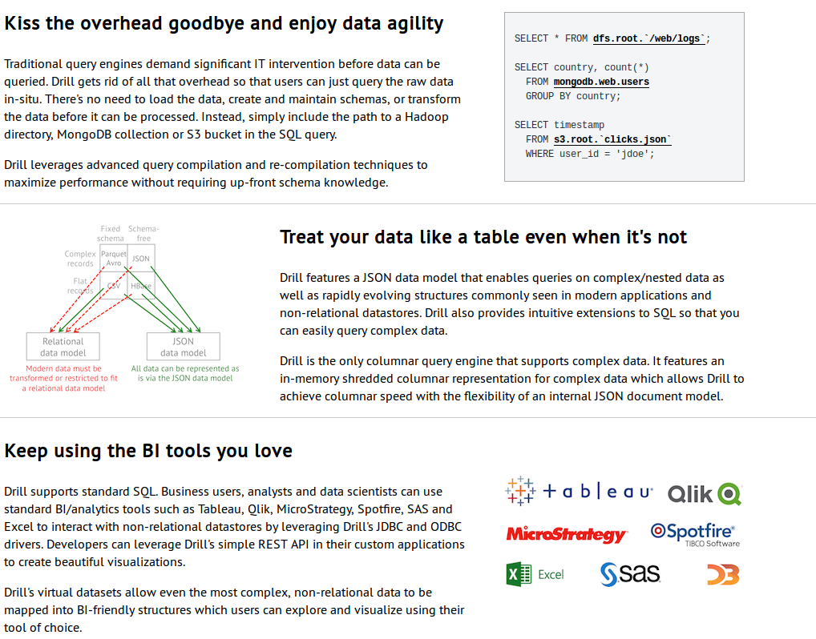
Oh, mamma, interpretation problems ahead!

Slide 4
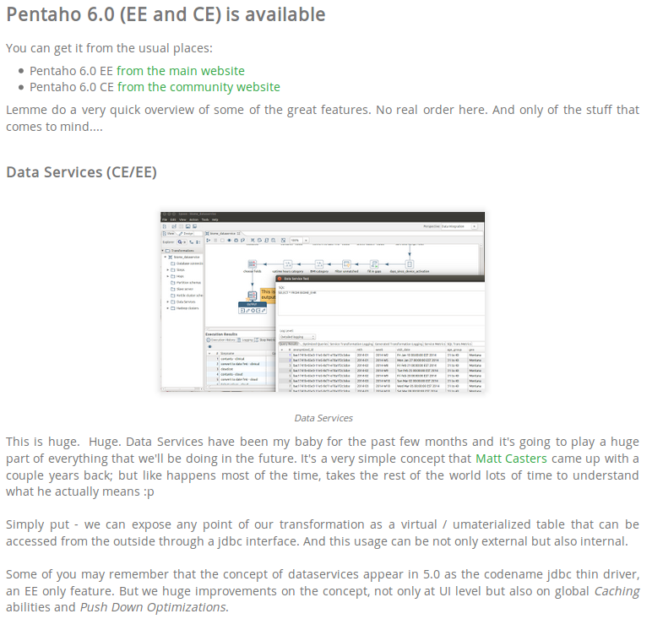
http://pedroalves-bi.blogspot.nl/2015/10/pentaho-60-ee-and-ce-is-available.html

Slide 5
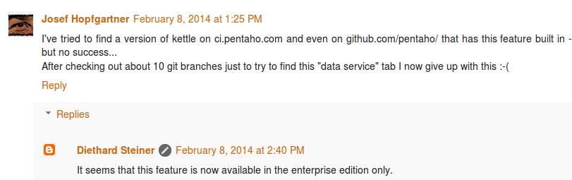
Data Federation with PDI CE
http://diethardsteiner.blogspot.nl/2013/01/creating-federated-data-service-with.html
This was in a 5.0.4 RC I believe

Slide 6
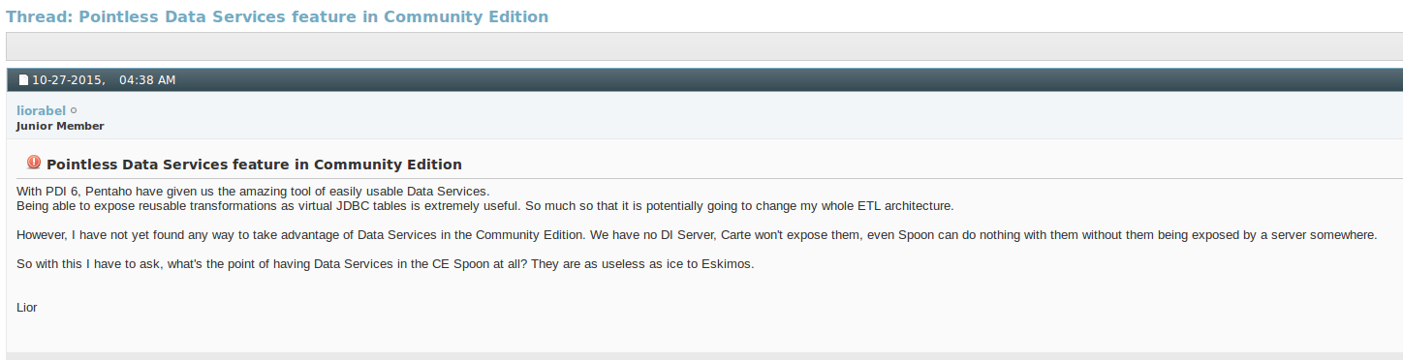
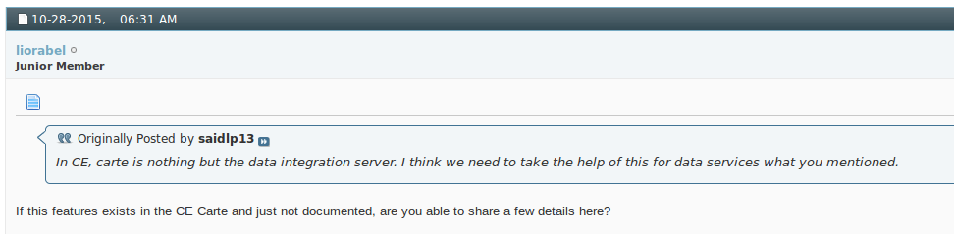

Slide 7
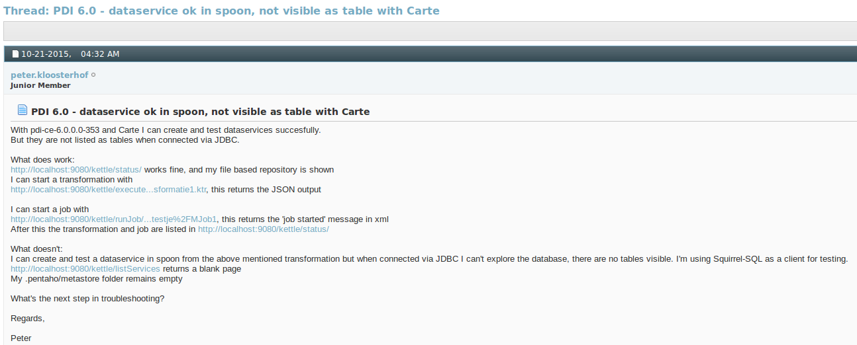
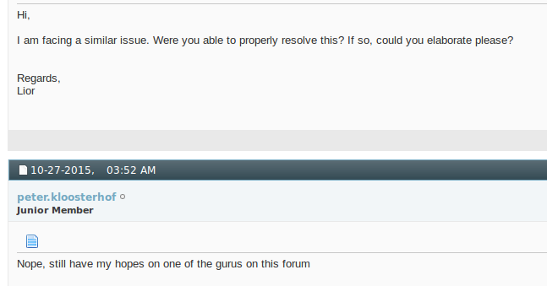

Slide 8

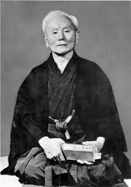

Goal: get this stuff to work, and even join Data Services with SQL
Example: karate ranks in Shotokan
When not figuring out data, I do this.
So what was your objection to my solution again ..?

Slide 9
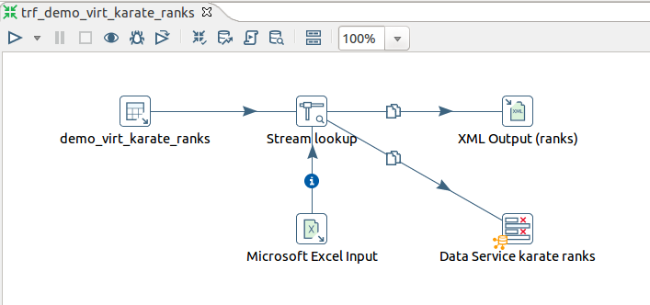
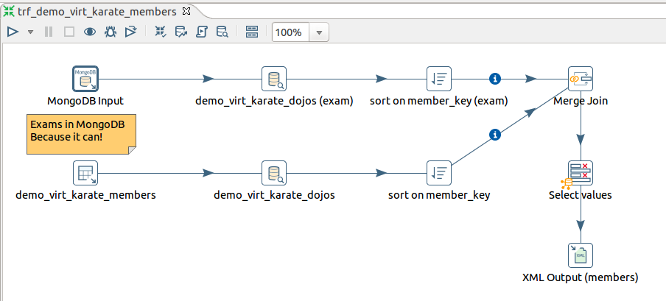
Web Services
Data Services

Slide 10
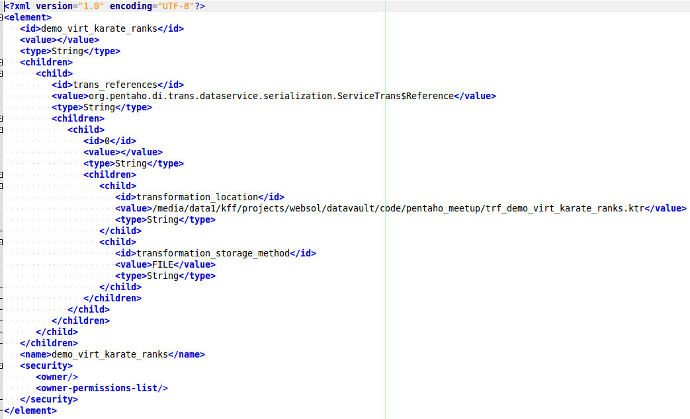

/home/edwin/.pentaho/metastore/pentaho/Data Service Transformation
demo_virt_karate_ranks.xml
Does not get created when working
In File Repository!
Can do it easily by hand though.
.type.xml

Slide 11
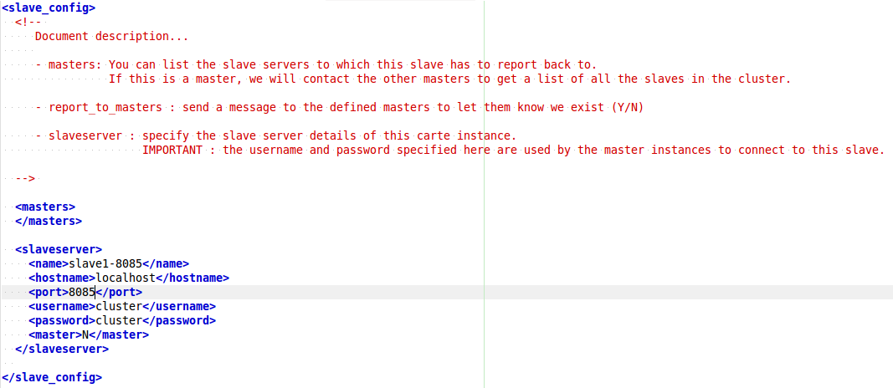
Carte configuration: nothing special

Slide 12
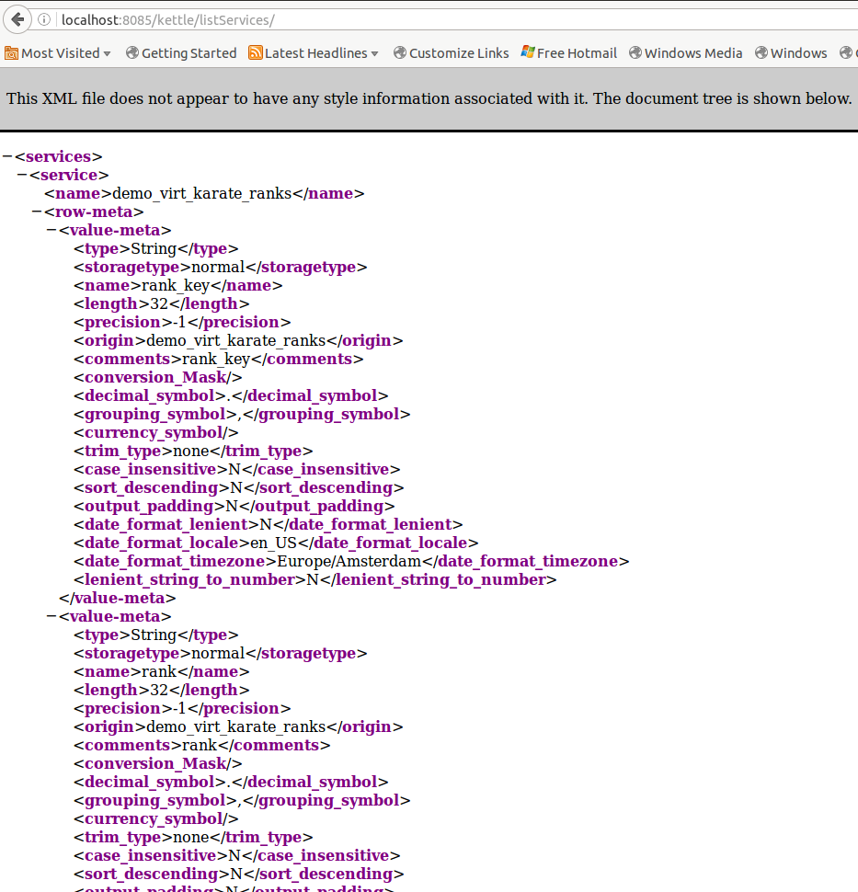

Slide 13
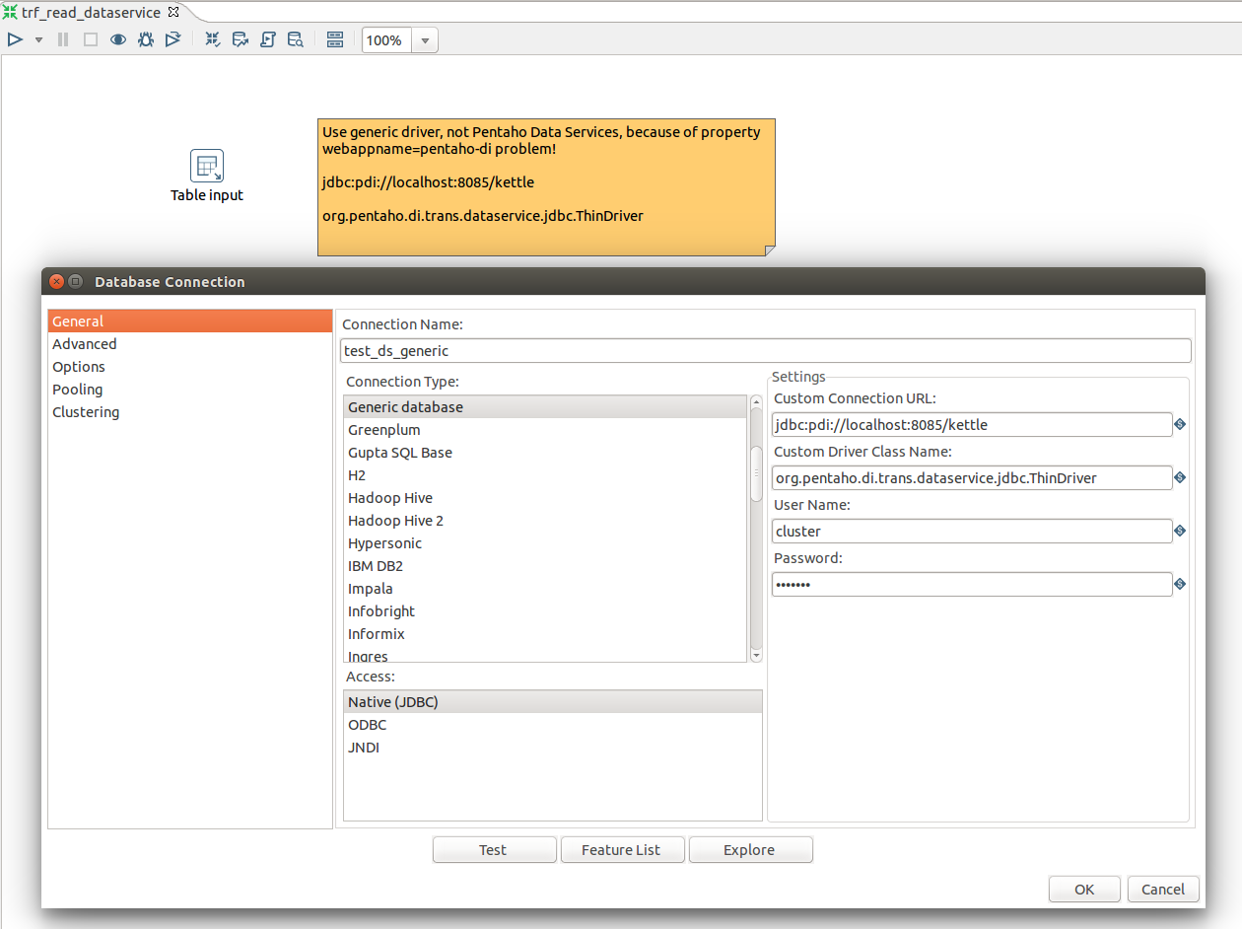

Slide 14
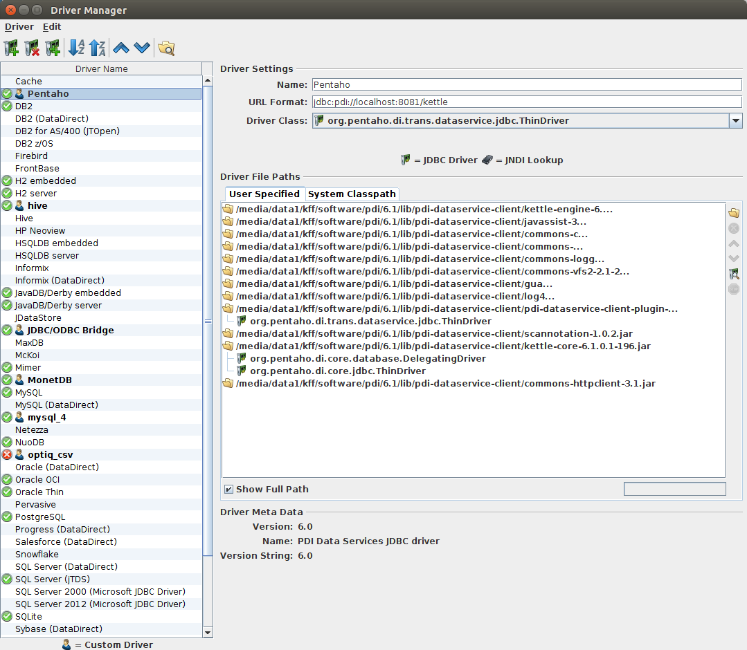

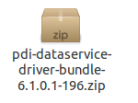

Slide 15
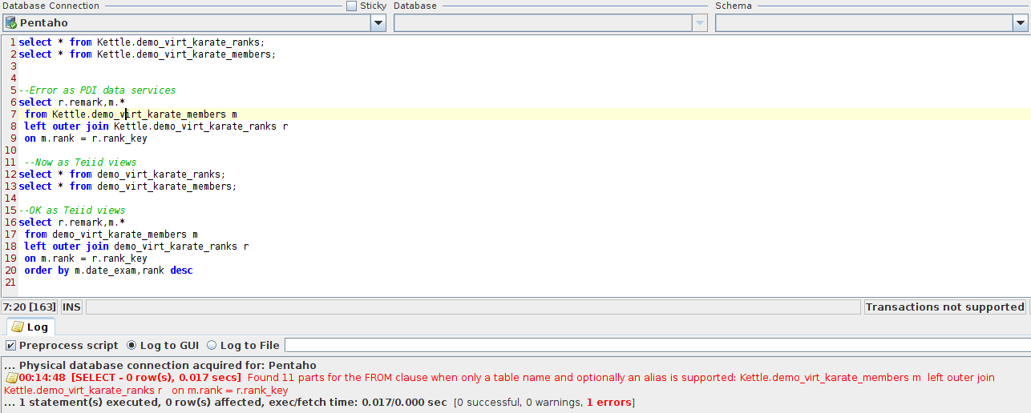
Queries in DBVisualizer
Table can only occur once in a query in Teiid in this setup

Slide 16
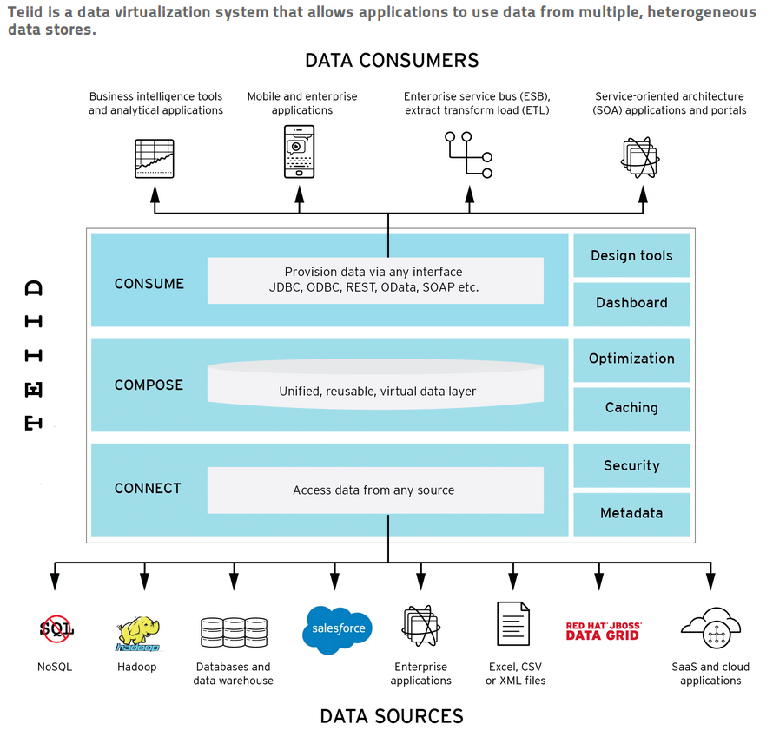


Slide 17
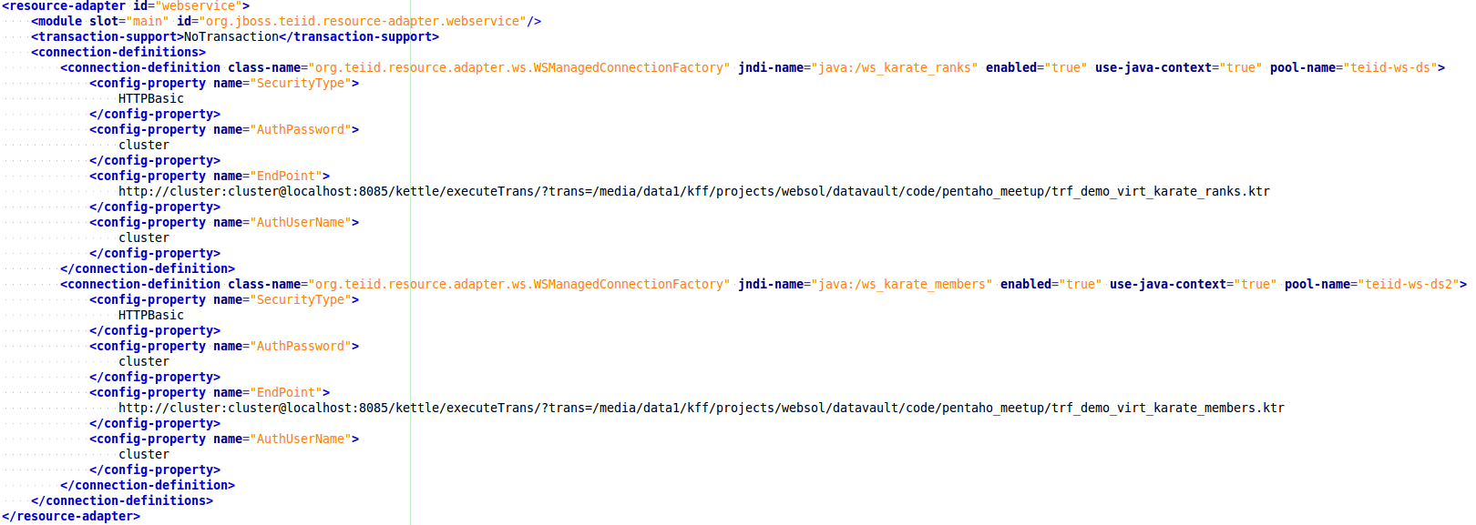
/media/data1/software/teiid-8.13.3/standalone/configuration
Standalone-teiid.xml
cd /media/data1/software/teiid-8.13.3/bin
./standalone.sh -c standalone-teiid.xml

Slide 18
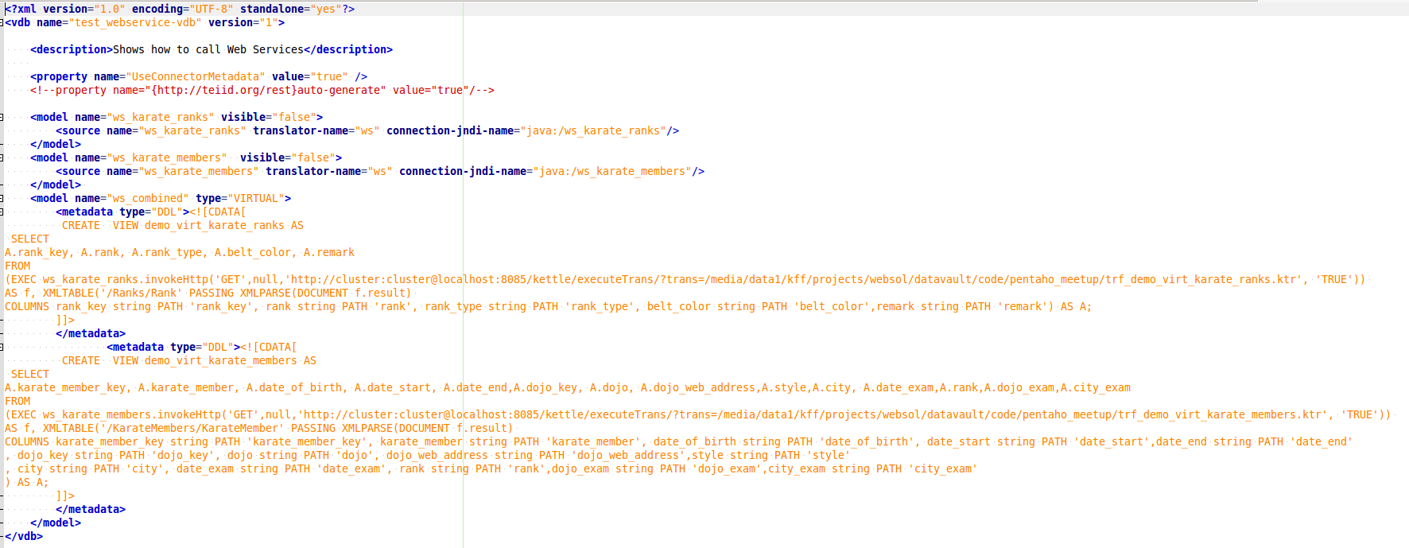
/media/data1/software/teiid-8.13.3/standalone/deployments
test_webservice-vdb.xml
Virtual database definition

Slide 19
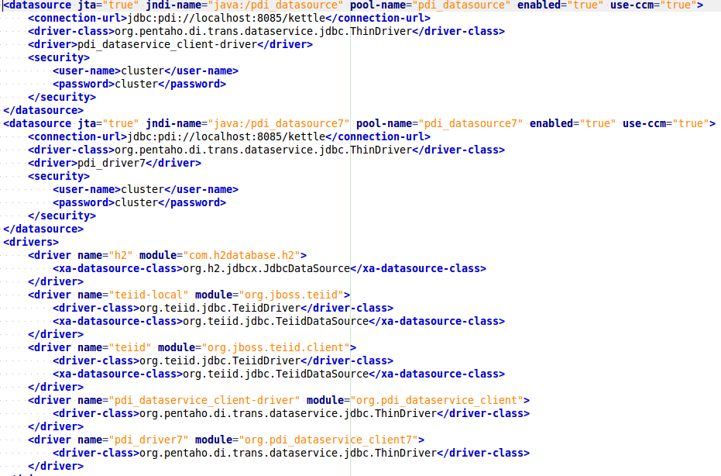
PDI Data Service as JDBC source in Teiid ?
Standalone-teiid.xml

Slide 20
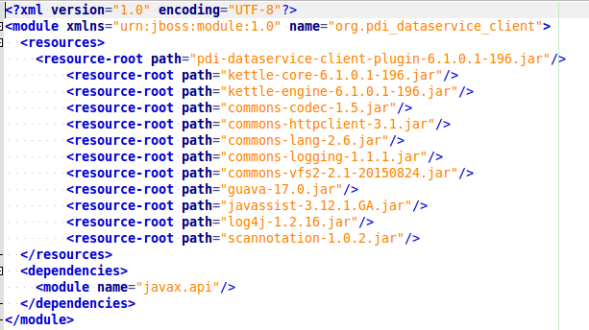
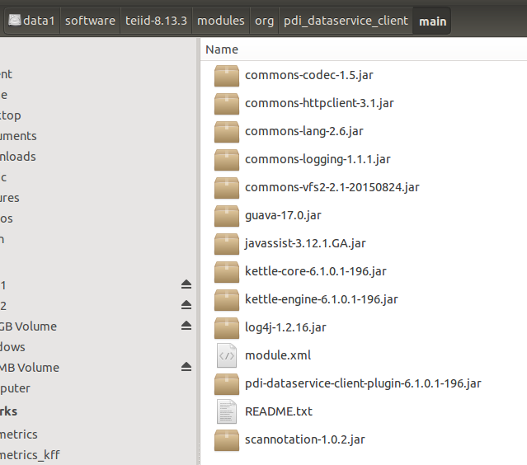

Slide 21
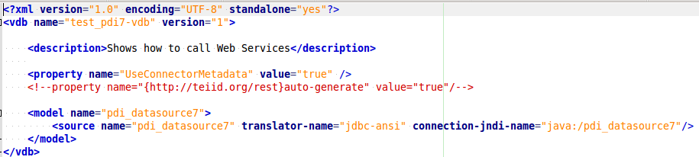
test_pdi7-vdb.xml

Slide 22
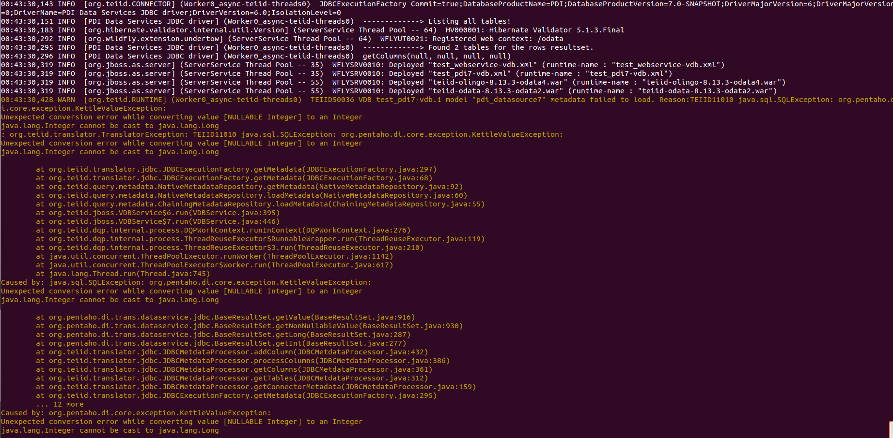
That goes boom!
Something with getColumns() to get JDBC info. (Roland, help!)

Slide 23
DEMO
Dockers to start: docker_percona
docker_mongodb
Servers to start: carte
Teiid
Queries: DbVisualizer

