Slide 1
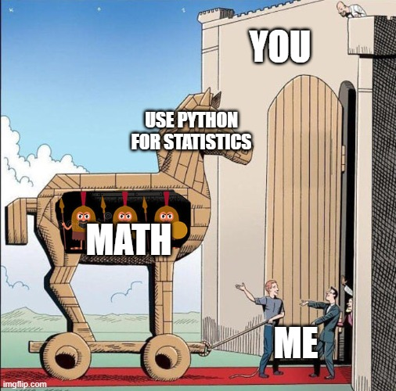

FUN with Flags STATS
Jan van Grimbergen, Jonathan Bobak
06.01.2025

Slide 2











Random Variables and Density Functions
Some Very
Important Parameter
Sample Space
(e.g. all cells that were treated with drug A)
Density
$$f\left(x\right)$$
Drug A
0.98
0
1
0
$$X\left( \right)=$$
0.03
Drug B
0.03
0.45
Some Very Important Parameter
0.53
0.61
0.65
0.58
0.71
Control Group
0.99
Our experiment can be described with three random variables
$$P\left(a<X<b\right)=\int_{a}^{b}{f\left(x\right)dx}$$
$$X,$$
$Y$and
$$Z$$

Slide 3
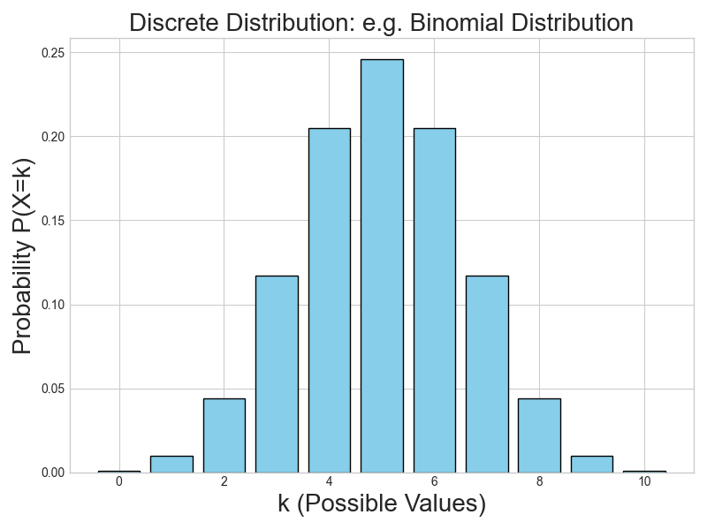
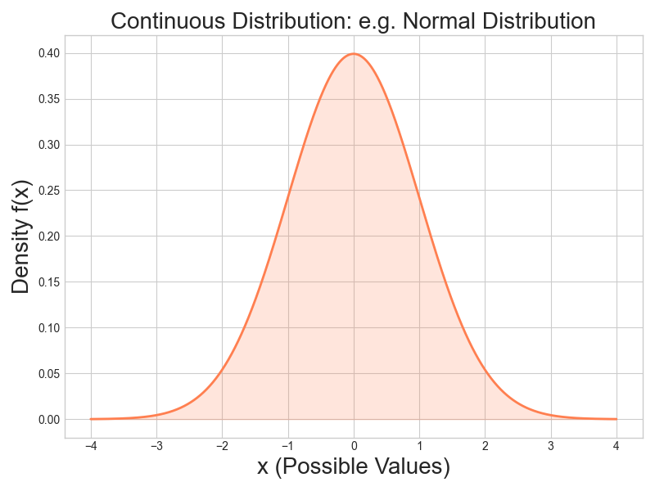
Distributions
Discrete Distributions
Continous Distributions

Slide 4

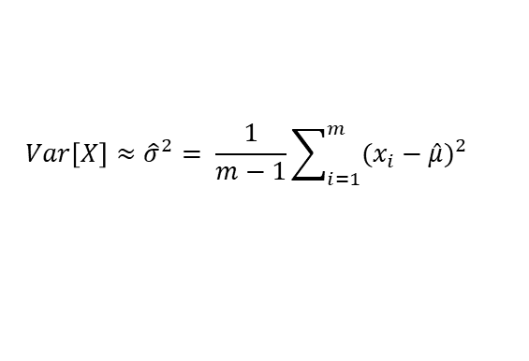
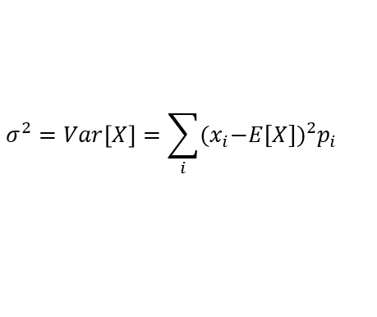
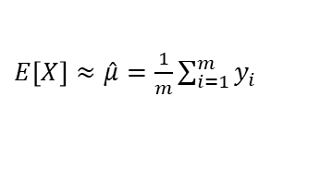
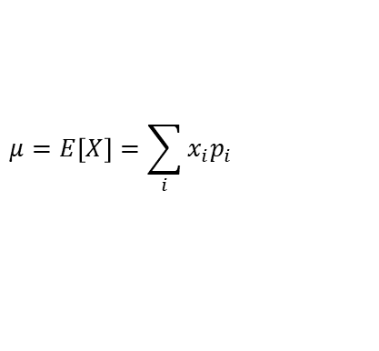
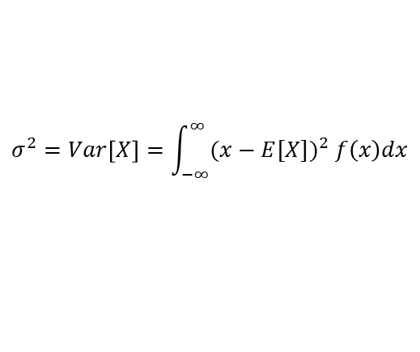

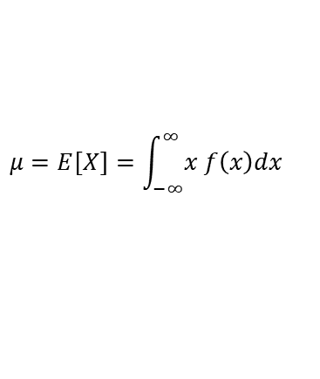

Distributions And Descreptive Statistic
Discrete
Continous
$$μ=E\left[X\right]=\sum_{i}{x_{i}p_{i}}$$
$$μ=E\left[X\right]=\int_{−∞}^{∞}{x f\left(x\right)dx}$$
$$σ^{2}=Var\left[X\right]=\sum_{i}{{{(x}_{i}−E[X])}^{2}p_{i}}$$
$$σ^{2}=Var\left[X\right]=\int_{−∞}^{∞}{{(x−E[X])}^{2} f\left(x\right)dx}$$
Approx Expectation Value and Variance From Measurements
Random variable $X$ with measurements $y_{1},$ $y_{2},y_{3}, …,y_{m}$
$E\left[X\right]≈\hat{μ}=\frac{1}{m}\sum_{i=1}^{m}{y_{i}}$
$$Var\left[X\right]≈{\hat{σ}}^{2}= \frac{1}{m−1}\sum_{i=1}^{m}{{(x_{i}−\hat{μ})}^{2}}$$
Law of Large Numbers
$$\hat{μ} \underset{→}{m→ ∞}μ$$
$$\hat{σ} \underset{→}{m→ ∞}σ$$

Slide 5
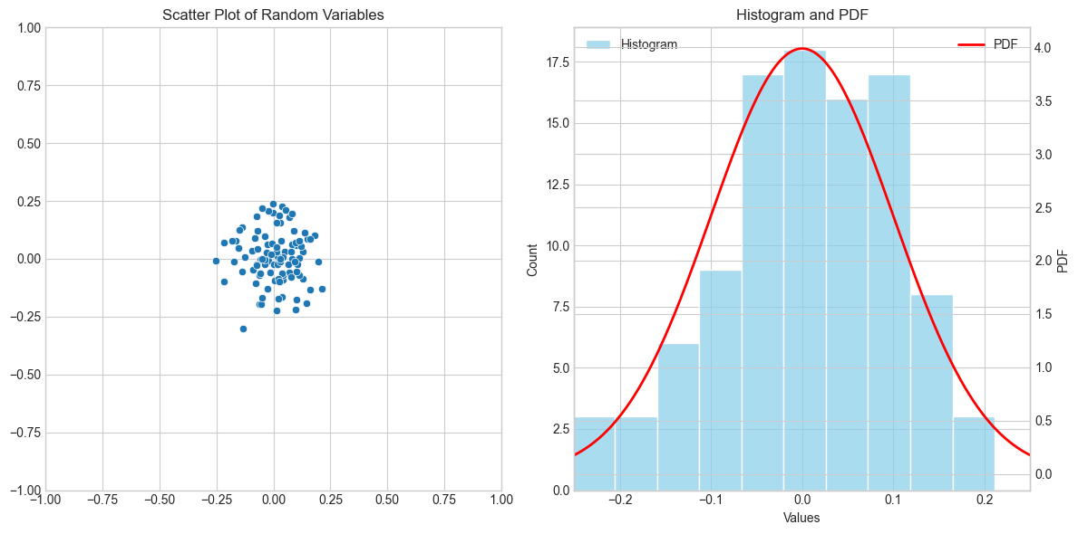
Short Trip Back To Python

Slide 6
Testing🥳
Some Very Important Parameter
Want to test if the expected value of cells treaded with or differ significantly from the control group.
Question: Is the measured difference bigger than you would expect under randomness?
Assume that are normally distributed.
0.75 | 0.38 | … | 0.63
0.15 | 0.89 | … | 0.58
0.3 | 0.90 | … | 0.87
$$X,$$
$Y$and
$$Z$$
A common assumption with real-world data thats comes from the Central Limit Theorem
Does or have a significant effect on ?

Slide 7
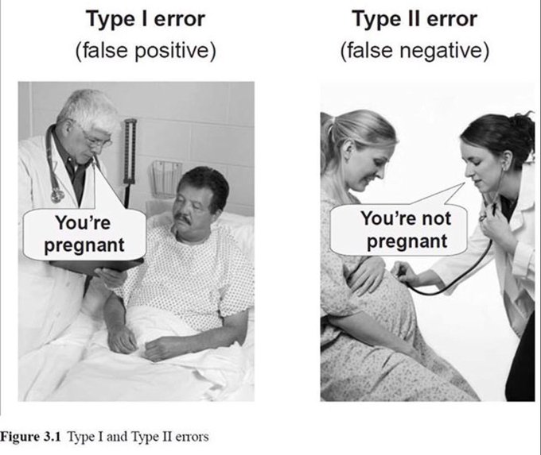


Testing - Errors
Does have a significant effect on ?
Can we reject the Null Hypothesis ?
Null Hypothesis: $μ_{Y}=μ_{Z }$
Alternative hypothesis: $μ_{Y}≠μ_{Z }$
 | Null Hypothesis: True | Alternative Hypothesis: True
Can not reject Null Hypothesis | Correct Decision | Type 2 Error
Have to reject Null Hypothesis | Type 1 Error | Correct Decision
The Type 1 Error is controlled to occure with a probability of at most $100∗α$
($α$is called the significance level of the test )
We reject the Null Hypothesis if the probability $p$ to observe the measured differences or a more extreme one in $μ_{Y} and μ_{Z }$is less than $α.$ $p$ is called the p-value. It is common to set $α=0.05$.
How to calculate the p-value?

Slide 8
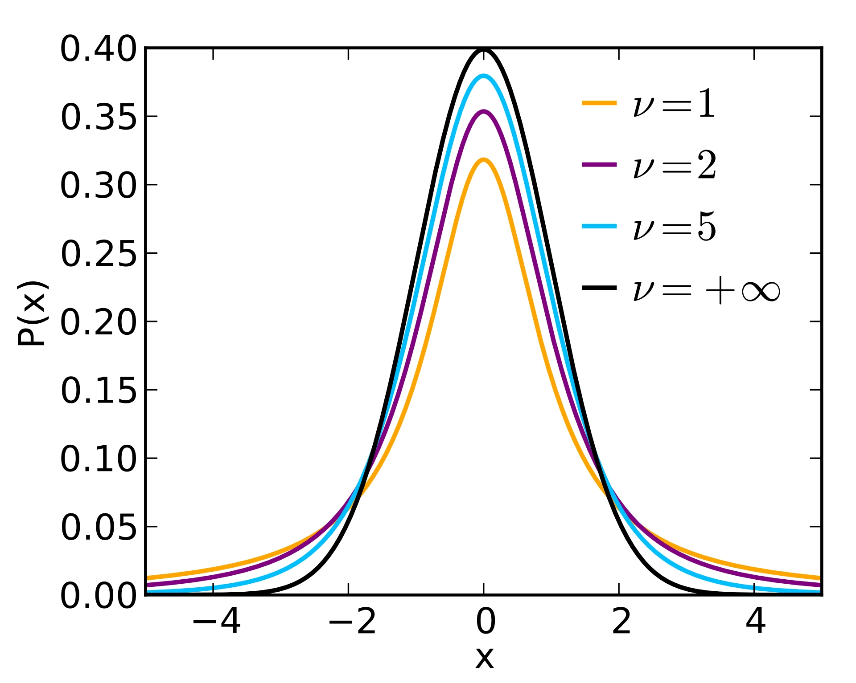
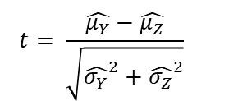
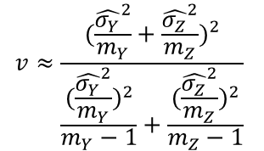

Testing - Welch‘s t-Test
How to calculate the p-value?
The test statistic transforms the observed data into a space that follows a known distribution.
This allows us to calculate the probability of obtaining the observed value or a more extreme one under the null hypothesis (p-value 🥳)
Student‘s t-distribution
$$v≈\frac{{(\frac{{\hat{σ_{Y}}}^{2}}{m_{Y}}+\frac{{\hat{σ_{Z}}}^{2}}{m_{Z}})}^{2}}{\frac{{(\frac{{\hat{σ_{Y}}}^{2}}{m_{Y}})}^{2}}{m_{Y}−1}+\frac{{(\frac{{\hat{σ_{Z}}}^{2}}{m_{Z}})}^{2}}{m_{Z}−1}}$$
$$t= \frac{\hat{μ_{Y}}−\hat{μ_{Z}}}{\sqrt{{\hat{σ_{Y}}}^{2}+{\hat{σ_{Z}}}^{2}}}$$
This test statistic $t$ follows a student‘s t-distribution
with $v$ degrees of freedome
Let us try this in python! 🐍

Slide 9
Testing - A very small excerpt
The correct test depends on your data and your knowlege
Test Name | Parametric/Non-Parametric | Distributional Assumptions | Data Level/Requirements | Application
Student’s t-test (independent samples) | Parametric | Data in both groups are normally distributed, equal variances | Continuous data, homogeneous variances | Comparing the means of two independent groups
Welch’s t-test (independent samples) | Parametric | Data in both groups are normally distributed, unequal variances allowed | Continuous data, no homogeneity of variance required | Comparing the means of two independent groups when variances differ
Mann-Whitney U-test (Wilcoxon rank-sum) | Non-Parametric | No normality assumption, similar shape of distributions recommended | Ordinal or continuous data not necessarily normally distributed | Comparing central tendencies of two independent groups
Wilcoxon signed-rank test (paired) | Non-Parametric | No normality assumption, data are paired | Ordinal or continuous data, paired measurements | Comparing two measurements from the same individuals (e.g., before and after)

Slide 10
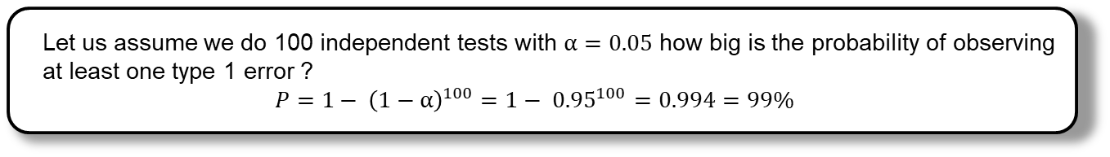
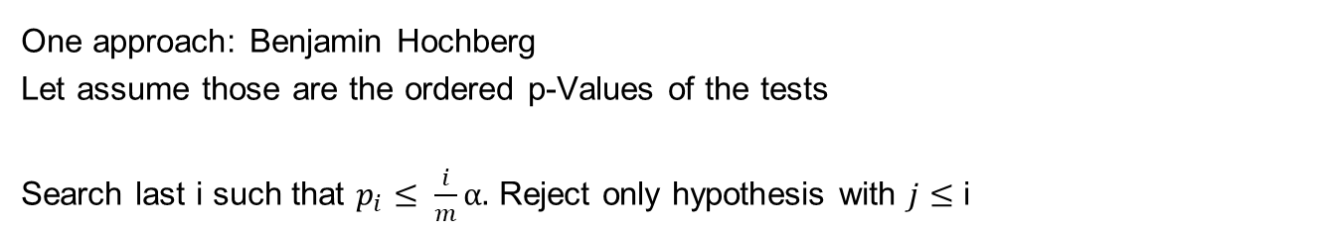
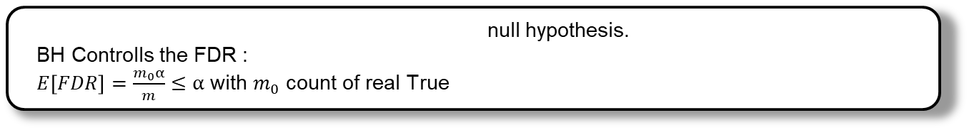
Multiple Hypothesis Testing
Let us assume we do 100 independent tests with $α=0.05$ how big is the probability of observing at least one type 1 error ?
$$P={1− \left(1−α\right)}^{100}={1− 0.95}^{100}=0.994=99\%$$
One approach: Benjamin Hochberg
Let assume those are the ordered p-Values of the tests
Search last i such that $p_{i}≤ \frac{i}{m}α.$ Reject only hypothesis with $j≤$ i
$$p_{1}≤p_{2 }≤p_{3}≤ …≤p_{m−1}≤p_{m}$$
BH Controlls the FDR :
$E\left[FDR\right]=\frac{m_{0}α}{m}≤α$ with $m_{0}$ count of real True null hypothesis.

