Slide 1
Learning Analytics
State of the Art, Trends and Future Aleksander Dietrichson, PhD

Slide 2
State of the Art
Review Articles
Viberg et al. (2018)
Vieira, Parsons, and Byrd (2018)
Interviews with Researchers
Questionnaires
60+ Recent Publications
LAK 2018 conference presentations

Slide 3
Review I
Viberg et al. (2018)
252 Papers published between 2012-2018
Four research questions:
Does LA improve outcomes?
Does it support Learning and Teaching?
Is it widely deployed?
Is it used ethically?

Slide 4
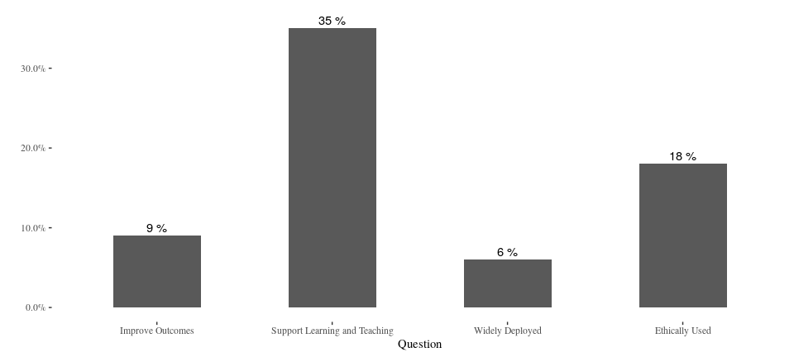
Review I
Viberg & al.(2018)

Slide 5
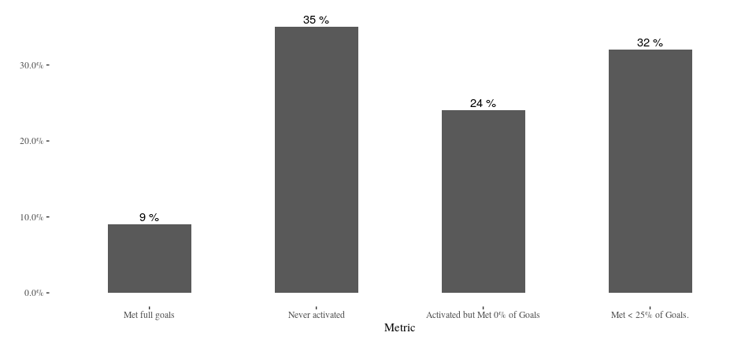
Compare to Ed-Tech
Lea(R)n, Inc.

Slide 6
Review I
Viberg & al.(2018)

Slide 7
Review I
“However, the analysis of the existing evidence for learning analytics indicates that there is a shift towards a deeper understanding of students’ learning experiences for the last years.”
–Viberg et al. (2018)

Slide 8
Review II
Lack of to bring visual learning analytics tools into classroom settings
Few consider background information such as demographics or prior performance;
Traditional statistical visualization techniques, such as bar plots and scatter plots, are still the most commonly used in learning analytics contexts;
Lack of studies that both employ sophisticated visualizations and engage deeply with educational theories.
–Vieira, Parsons, and Byrd (2018)

Slide 9
Review III
LAK 2018
Only 7 out of 70 articles on “At-Risk” students
Unit of analysis is changing
Goals are changing
More/different data is being analyzed

Slide 10
Interviews
Improving the educational experience beyond academic achievement is now a stated goal
Field is mature on the research side, industry struggling to catch up
Adoption is still a huge problem
Scalability and generalization not trivial

Slide 11
Interviews
Have we solved the problem of identifying students at risk?

Slide 12
Interviews
Have we solved the problem of identifying students at risk?
– Yes and No!

Slide 13
Interviews
Have we solved the problem of identifying students at risk?
– Yes and No!
Statistical techniques are there, tested and validated.

Slide 14
Interviews
Have we solved the problem of identifying students at risk?
– Yes and No!
Statistical techniques are there, tested and validated.
Generalizations are problematic.

Slide 15
Context is Important
“Learning analytics should not promote one size fits all: The effects of instructional conditions in predicting academic success.”
–Gašević et al. (2016)

Slide 16
Example: Nudge Wars
National Bureau of Economics: “Study Finds Large-Scale ‘Nudging’ Misses the Target”
Persistence Plus: Not so!

Slide 17
Example: Nudge Wars
National Bureau of Economics: “Study Finds Large-Scale ‘Nudging’ Misses the Target”
Persistence Plus: Not so!
“The researchers emphasized that there were”some limitations" in using this method of measuring. Those who choose not to engage in support services ‘may differ’ from those who are willing to take help. And those who opted out from the nudging may have simply chosen not to continue in college."

Slide 18
Example: Nudge Wars
National Bureau of Economics: “Study Finds Large-Scale ‘Nudging’ Misses the Target”
Persistence Plus: Not so!
“The researchers emphasized that there were”some limitations" in using this method of measuring. Those who choose not to engage in support services ‘may differ’ from those who are willing to take help. And those who opted out from the nudging may have simply chosen not to continue in college."

Slide 19
Example: Nudge Wars
The researchers proved that those students who chose to receive nudges, responded better than those who did not.
This is a classic case of confounded variables.
It might be surmised that the conclusions were biased by the institutions for-profit status.

Slide 20
Example: Nudge Wars
“It was also found that the effect was stronger for people of color […] and people over 25 years of age.”
Asserted without any explanatory model
Probably irrelevant as we are already dealing with confounded variables.

Slide 21
Some trends
Advantages are better understood
Additional data-sources
Social Network Analysis, Linguistic Analysis
More attention paid to the connection between LA and learning design

Slide 22
Some trends
Push to extend to an institutional level
Taking LA to emerging coutries (EU funded)
Privacy, ethics and equity
Longitudinal studies
K-12 included
Taking on the task of providing data-literacy

Slide 23
Data Literacy

Slide 24
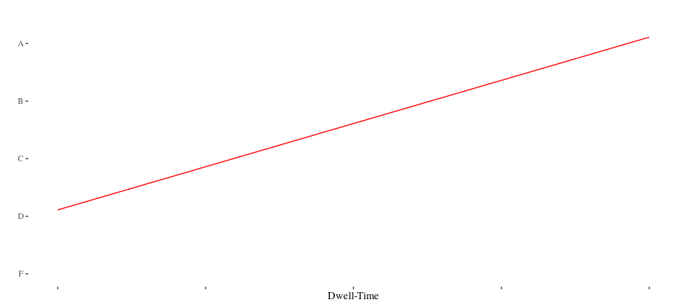
Cognitive Bias: Causal Flow
Dwell-time by Grade

Slide 25
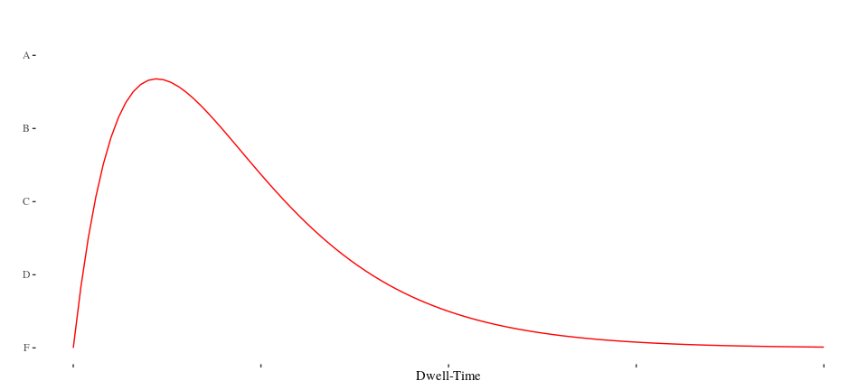
Cognitive Bias: Causal Flow
Dwell-time by Grade

Slide 26
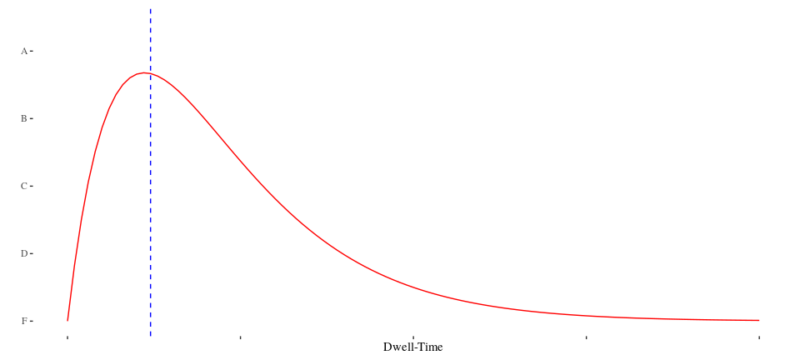
Cognitive Bias: Causal Flow
Dwell-time by Grade

Slide 27
Cognitive Bias: Survival Bias

Slide 28
Social Network Analysis

Slide 29
Linguistic Analysis

Slide 30
Learning Path Analysis

Slide 31
References
Gašević, Dragan, Shane Dawson, Tim Rogers, and Danijela Gasevic. 2016. “Learning Analytics Should Not Promote One Size Fits All: The Effects of Instructional Conditions in Predicting Academic Success.” The Internet and Higher Education 28: 68–84. https://doi.org/https://doi.org/10.1016/j.iheduc.2015.10.002.
Viberg, Olga, Mathias Hatakka, Olof Bälter, and Anna Mavroudi. 2018. “The Current Landscape of Learning Analytics in Higher Education.” Computers in Human Behavior 89 (July). https://doi.org/10.1016/j.chb.2018.07.027.
Vieira, Camilo, Paul Parsons, and Vetria Byrd. 2018. “Visual Learning Analytics of Educational Data: A Systematic Literature Review and Research Agenda.” Computers & Education 122: 119–35.

