Slide 1
Learning Analytics
State of the Art, Trends and Future Aleksander Dietrichson, PhD

Slide 2
State of the Art
Review Articles
Viberg et al. (2018)
Vieira, Parsons, and Byrd (2018)
Interviews with Researchers
Questionnaires
60+ Recent Publications
LAK 2018 conference presentations

Slide 3
Review I
Viberg et al. (2018)
252 Papers published between 2012-2018
Four research questions:
Does LA improve outcomes?
Does it support Learning and Teaching?
Is it widely deployed?
Is it used ethically?

Slide 4
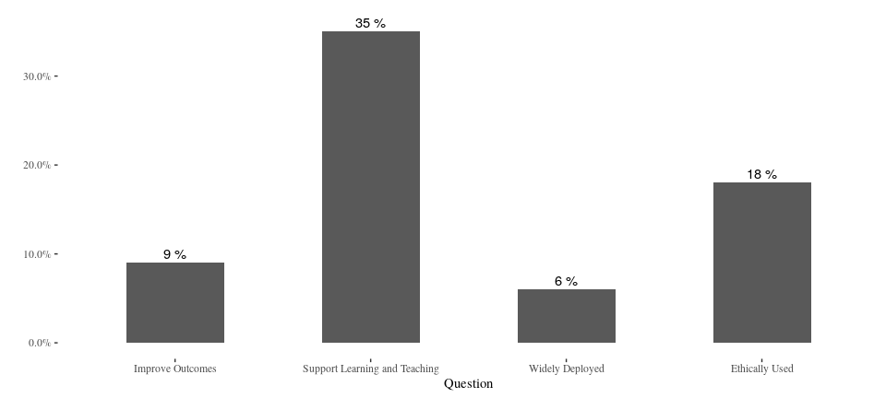
Review I
Viberg & al.(2018)

Slide 5
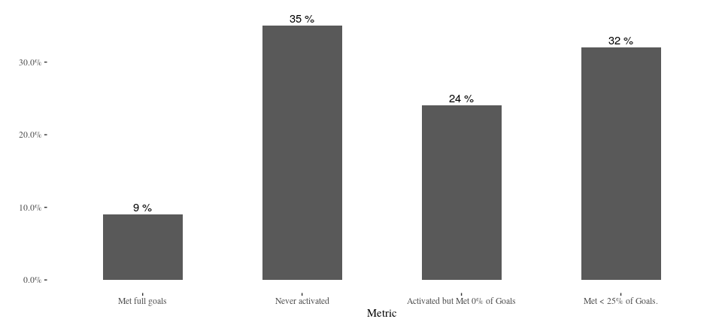
Compare to Ed-Tech
Lea(R)n, Inc.

Slide 6
Review I
Viberg & al.(2018)

Slide 7
Review I
“However, the analysis of the existing evidence for learning analytics indicates that there is a shift towards a deeper understanding of students’ learning experiences for the last years.”
–Viberg et al. (2018)

Slide 8
Review II
Lack of visual learning analytics tools in classroom settings;
Few consider background information such as demographics or prior performance;
Traditional statistical visualization techniques, such as bar plots and scatter plots still predominant in learning analytics contexts;
Lack of studies that both employ sophisticated visualizations and engage deeply with educational theories.
–Vieira, Parsons, and Byrd (2018)

Slide 9
Review III
LAK 2018
Only 7 out of 70 articles on “At-Risk” students
Unit of analysis is changing
Goals are changing
More/different data is being analyzed

Slide 10
Interviews
Improving the educational experience beyond academic achievement is now a stated goal
Field is mature on the research side, industry struggling to catch up
Adoption is still a huge problem
Scalability and generalization not trivial

Slide 11
Interviews
Have we solved the problem of identifying students at risk?

Slide 12
Interviews
Have we solved the problem of identifying students at risk?
– Yes and No!

Slide 13
Interviews
Have we solved the problem of identifying students at risk?
– Yes and No!
Statistical techniques are there, tested and validated.

Slide 14
Interviews
Have we solved the problem of identifying students at risk?
– Yes and No!
Statistical techniques are there, tested and validated.
Generalizations are problematic.

Slide 15
Context is Important
“Learning analytics should not promote one size fits all: The effects of instructional conditions in predicting academic success.”
–Gašević et al. (2016)

Slide 16
Example: Nudge Wars
National Bureau of Economics: “Study Finds Large-Scale ‘Nudging’ Misses the Target”
Persistence Plus: Not so!

Slide 17
Example: Nudge Wars
National Bureau of Economics: “Study Finds Large-Scale ‘Nudging’ Misses the Target”
Persistence Plus: Not so!
“The researchers emphasized that there were”some limitations" in using this method of measuring. Those who choose not to engage in support services ‘may differ’ from those who are willing to take help. And those who opted out from the nudging may have simply chosen not to continue in college."

Slide 18
Example: Nudge Wars
National Bureau of Economics: “Study Finds Large-Scale ‘Nudging’ Misses the Target”
Persistence Plus: Not so!
“The researchers emphasized that there were”some limitations" in using this method of measuring. Those who choose not to engage in support services ‘may differ’ from those who are willing to take help. And those who opted out from the nudging may have simply chosen not to continue in college."

Slide 19
Example: Nudge Wars
The researchers proved that those students who chose to receive nudges, responded better than those who did not.
This is a classic case of confounded variables.
It might be surmised that the conclusions were biased by the institutions for-profit status.

Slide 20
Example: Nudge Wars
“It was also found that the effect was stronger for people of color […] and people over 25 years of age.”
Asserted without any explanatory model
Probably irrelevant as we are already dealing with confounded variables.

Slide 21
Some trends
Advantages are better understood
Additional data-sources
Social Network Analysis, Linguistic Analysis
More attention paid to the connection between LA and learning design

Slide 22
Some trends
Push to extend to an institutional level
Taking LA to emerging countries (EU funded)
Privacy, ethics and equity
Longitudinal studies
K-12 included
Taking on the task of providing data-literacy

Slide 23
Data Literacy
Measures of central tendency
Desciptive, inferential, predictive
Correlation is not causation
Confusion Matrix
Accuracy vs. Interpretability
Too much “dumbing down” renders the analysis useless

Slide 24
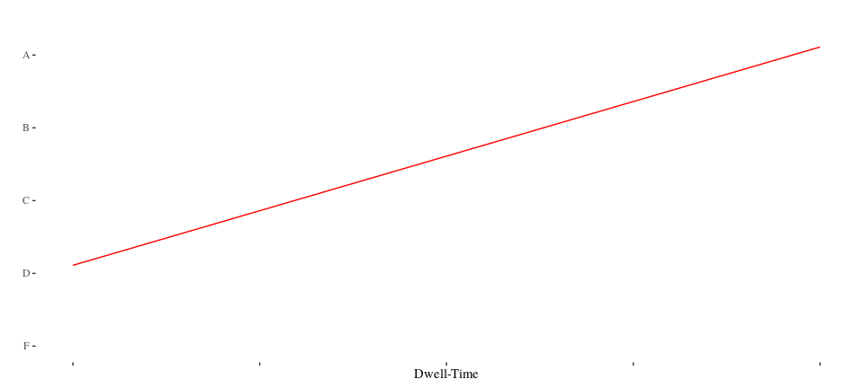
Cognitive Bias: Causal Flow
Dwell-time by Grade

Slide 25
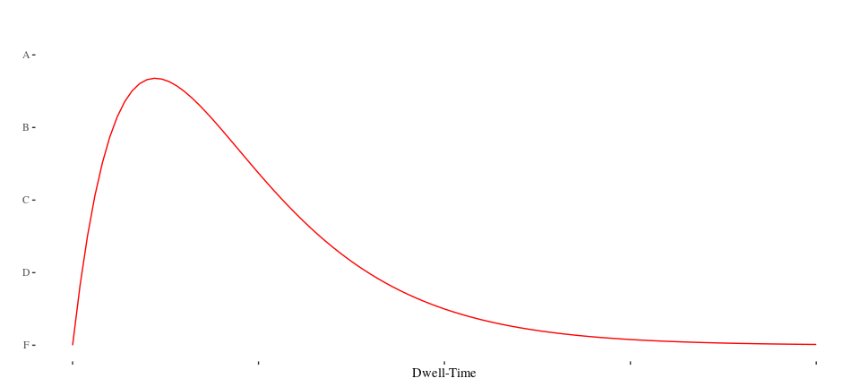
Cognitive Bias: Causal Flow
Dwell-time by Grade

Slide 26
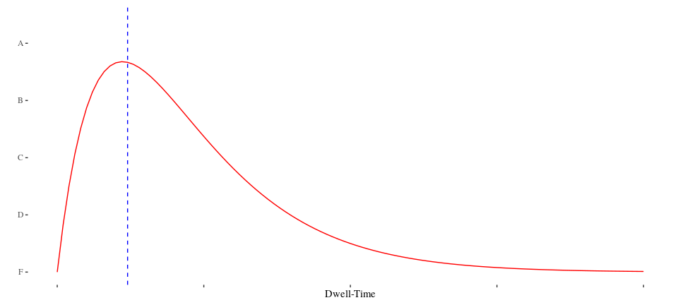
Cognitive Bias: Causal Flow
Dwell-time by Grade

Slide 27
Cognitive Bias: Survival Bias
“Our first-year drop-out rates are sky-high compared to later years”

Slide 28
Bias: Procrastinationism

Slide 29
Bias: Procrastinationism
Study Habits
“Binging” seen as negative
Easy to detect, especially in an LMS (entropy)
Causal link unclear (e.g. context needed)
Self-reporting shows low/no correlation between perception and behavior

Slide 30
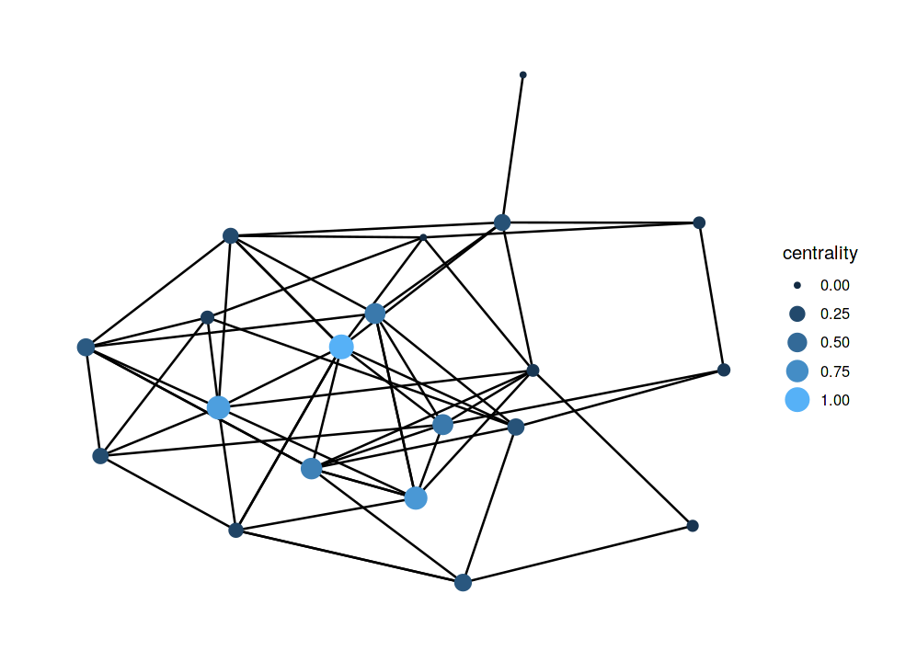
On the rise: Social Network Analysis
Social Network Analysis

Slide 31
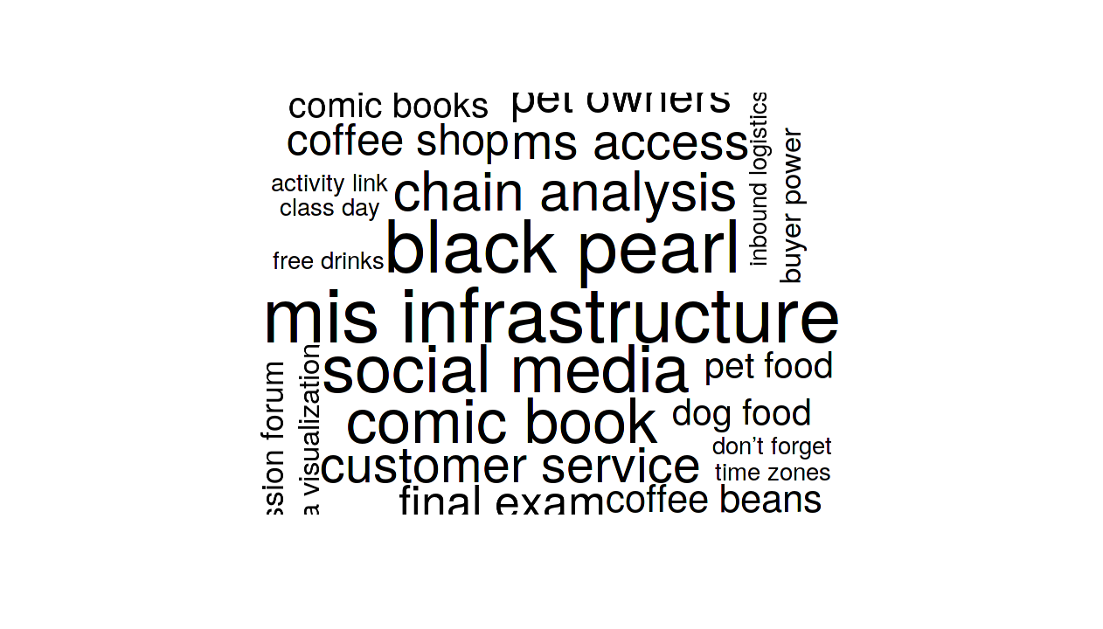
On the rise: Linguistic Analysis
Bigram Analysis

Slide 32
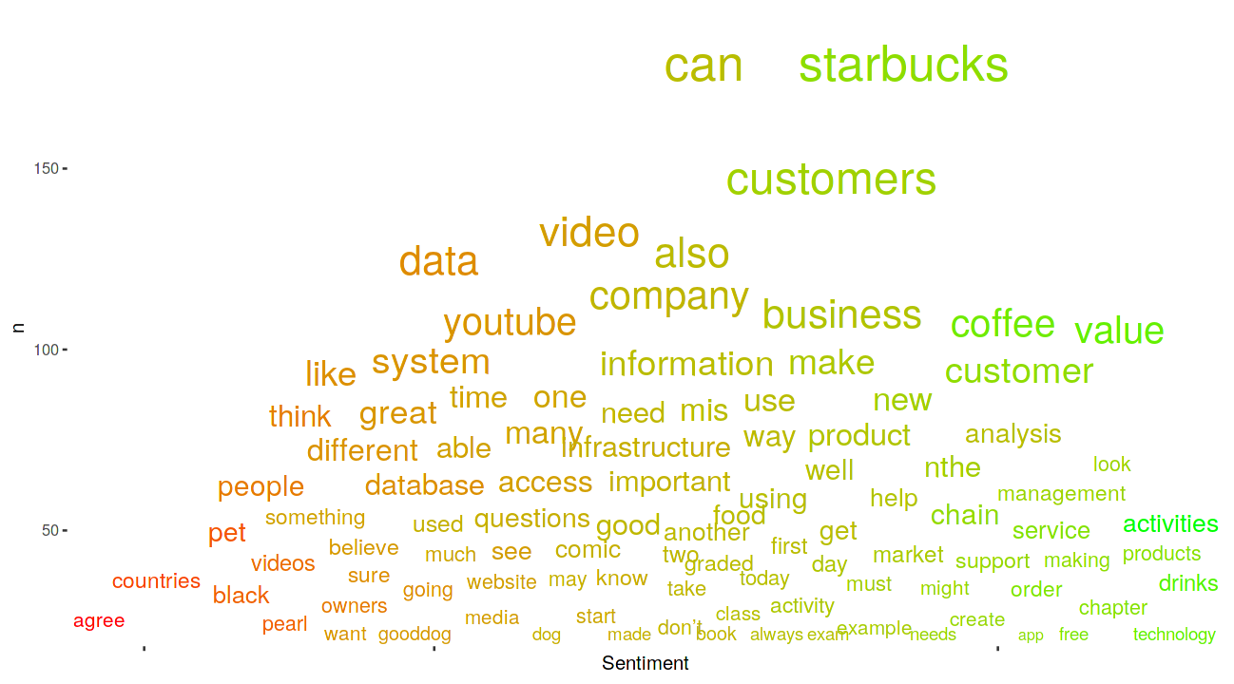
On the rise: Linguistic Analysis
Sentiment Analysis

Slide 33
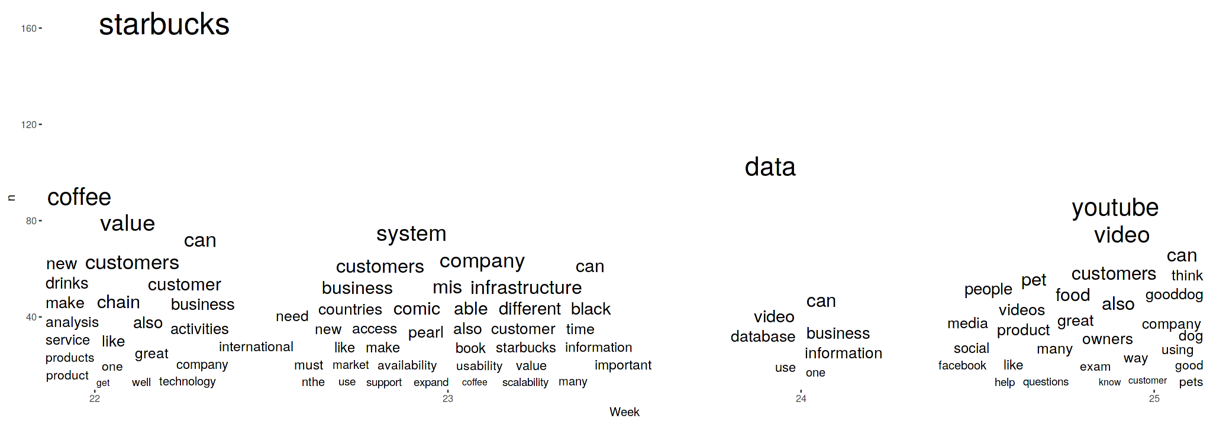
On the rise: Linguistic Analysis
Topic Modeling

Slide 34
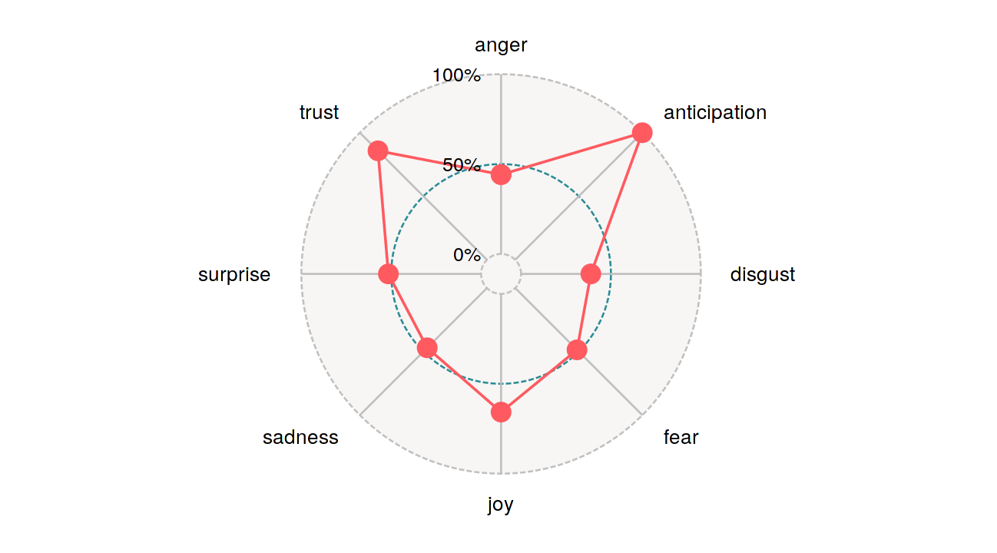
On the rise: Linguistic Analysis
Multidimensional Sentiment Analysis

Slide 35
LMS Data Standards Lagging
Caliper data collected on e.g. Discussion Posts do not include the actual text.
Closest “Linguistic” measure is post-length.
This effectively eliminates 85% of the data (Dietrichson (2013))

Slide 36
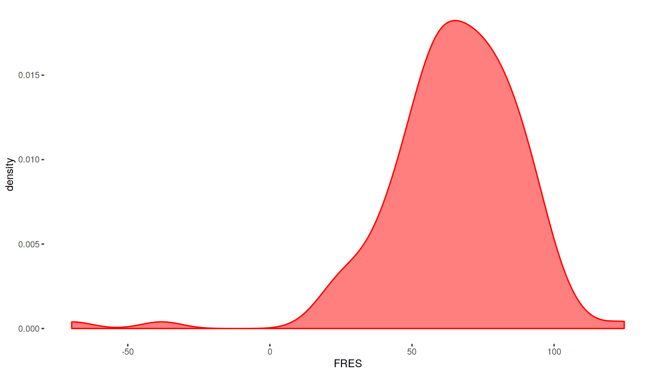
Example: FRES
Fleach Reading Ease Score

Slide 37
Example: Post-length vs. FRES
FRES r-squared –> .3
Post-length r-squared –> .005

Slide 38
Example: Post-length vs. other Metrics
Beating Post-length are:
Word-count,
TTR (lexical density)
CTC
even MSS

Slide 39
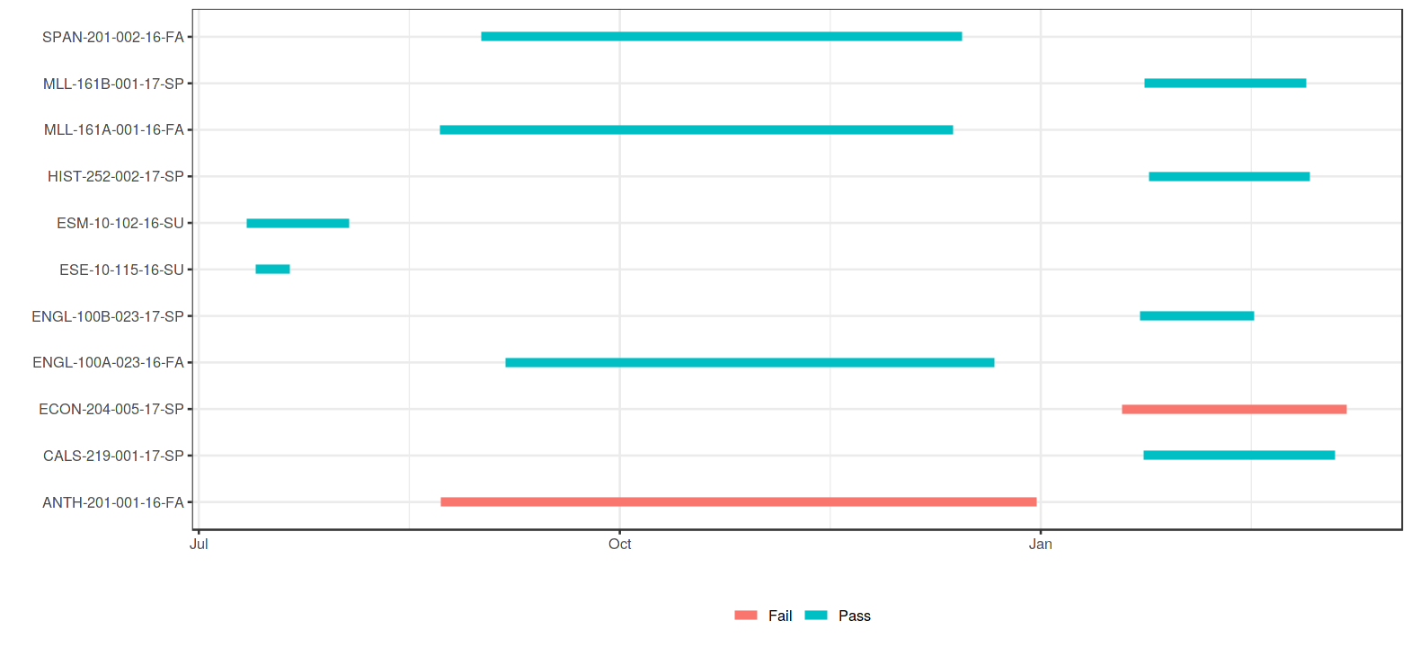
On the rise: Learning Path Analysis
Course Timeline

Slide 40
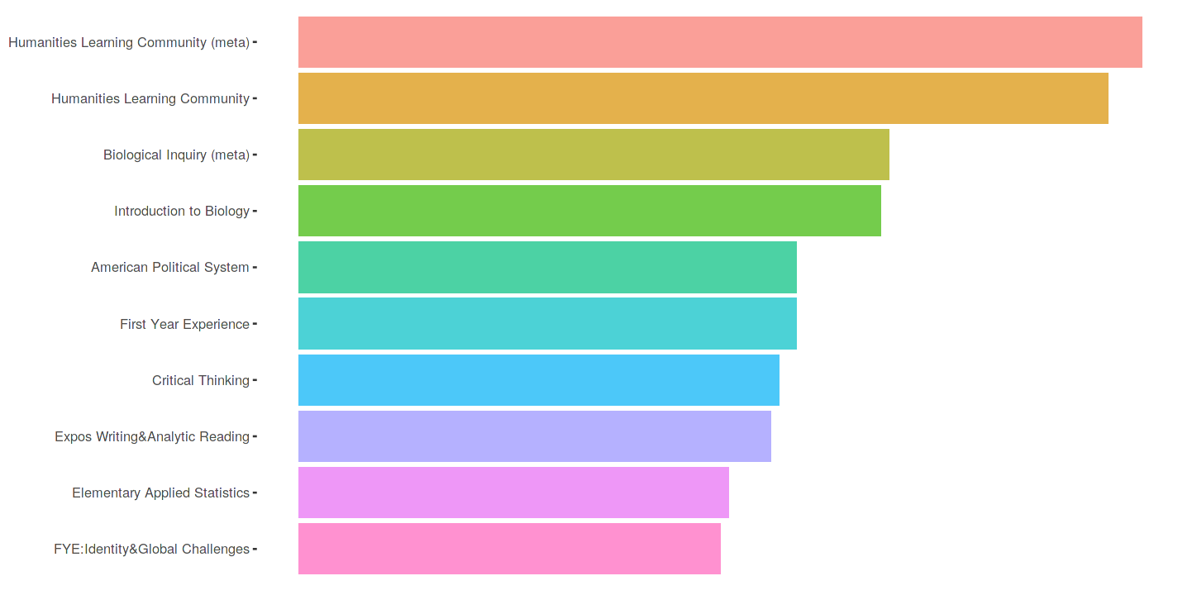
On the rise: Learning Path Analysis
Course Recommendations

Slide 41
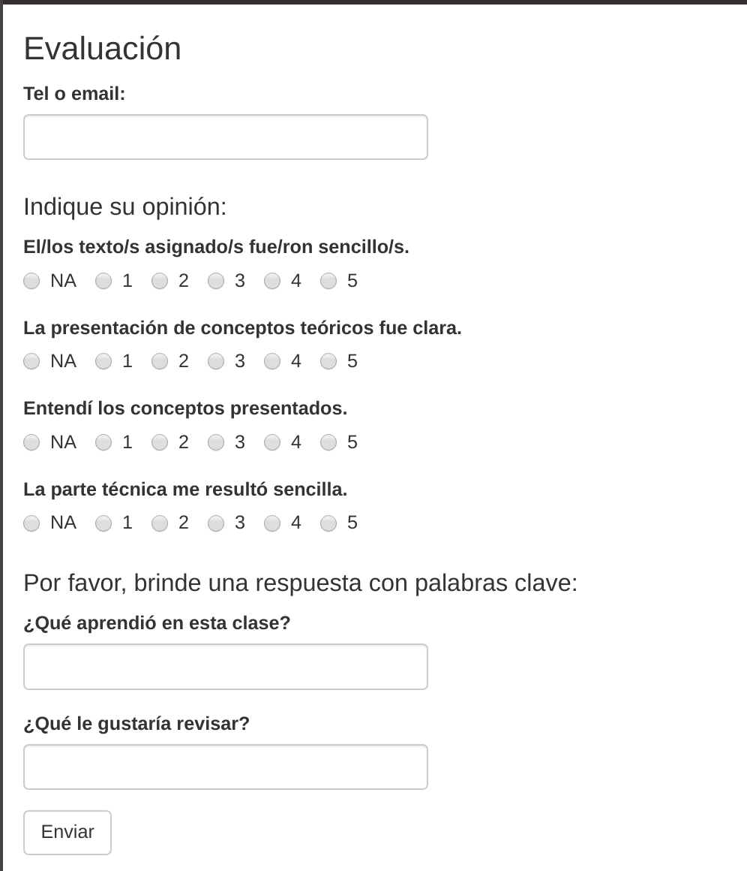
On the rise: Analytics in the classroom
Analytics in the Classroom

Slide 42
# Aspirations for the Future
More rigor
Describe impact (better)
Research into practice
Generalizability

Slide 43
References
Dietrichson, Aleksander. 2013. “Beyond Clickometry: Analytics for Constructivist Pedagogies.” International Jl. On E-Learning 12: 333–51.
Gašević, Dragan, Shane Dawson, Tim Rogers, and Danijela Gasevic. 2016. “Learning Analytics Should Not Promote One Size Fits All: The Effects of Instructional Conditions in Predicting Academic Success.” The Internet and Higher Education 28: 68–84. https://doi.org/https://doi.org/10.1016/j.iheduc.2015.10.002.
Viberg, Olga, Mathias Hatakka, Olof Bälter, and Anna Mavroudi. 2018. “The Current Landscape of Learning Analytics in Higher Education.” Computers in Human Behavior 89 (July). https://doi.org/10.1016/j.chb.2018.07.027.
Vieira, Camilo, Paul Parsons, and Vetria Byrd. 2018. “Visual Learning Analytics of Educational Data: A Systematic Literature Review and Research Agenda.” Computers & Education 122: 119–35.

