Slide 1
Prediction of Breast Cancer Using Data Mining and Multi Variate Techniques
Advisor: Dr. Lu TA: Mohammad Batanieh Maryam Soltanpour Dieudonne Ouedraogo Syed Haider May 2017
Systems Science and Industrial Engineering Department

Slide 2
Outline
Introduction
Literature Review
Objective
Data Set Description
Data Pre-processing
Feature Selection Techniques
Classification Methods
Results
Conclusion

Slide 3
Introduction
Breast cancer is one of the leading cancer among women
It diagnosis involves series of medical tests including:
Initial breast exam
Mammograph
Biopsy
Ultrasound
MRI
The correct diagnosis at early stage significantly increases the survival rate of the patient
The biomedical researchers are exploring ways to determine the automatic data driven diagnosis

Slide 4
Introduction (Cont’d)
The purpose of this project:
Reducing the number of features using:
Principle Component Analysis
Discriminant Analysis
Logistic Regression
Lasso
Predicting and Classifying using:
Support Vector machine
Naive Bayes
Decision Tree
Artificial Neural Network
Logistic Regression

Slide 5
Objective
Build various models to accurately classify Breast Cancer patients based on their health parameters
Prediction of Breast Cancer using Classification algorithms:
Decision tree
Logistic Regression
Naive Bayes
Support Vector Machine
Artificial Neural Network
Evaluating the performance based on accuracy, sensitivity, specificity and AUC

Slide 6
Introduction (Cont’d)
Data mining is extensively used in the diagnosis of the breast cancer
The information hidden in data can be utilized to help the doctors in correctly diagnosing the disease at an early age
Mammography is one of the most extensively used method in detecting breast tumor
If the tumor is detected by the mammography, further diagnostic or invasive technique is required to determine whether the tumor is malignant or benign

Slide 7
Introduction (Cont’d)
The breast cancer data consist of large number of features. Some features are irrelevant or multicollinear that may cause the classification model to decrease its precision [2].
Feature selection is a very important preprocessing step in data mining and machine learning [3].Feature selection is performed to reduce the number of variables and determine the significant factors in the diagnostic step.

Slide 8

Data Set Description
Source: UC Irvine Machine Learning Repository (Year:)
Data collected: University of Wisconsin, Clinical Sciences Center MadisonDate Donated: 1995-11-01
Missing values: Yes
Number of features: 9
Number of observations: 700
Data Set Characteristics: Multivariate
Associated Tasks: Classification

Slide 9
Literature Review
Statistically only 20-30 percent biopsy cases are found to be actual cancerous. Hence a lot of research has been conducted in last years to classify the tumor correctly. Vural and Wang proposed classification of breast cancer thru somatic mutation profiles by examining the exome sequencing data [4].

Slide 10
Literature Review (Con’t)
Artificial intelligence techniques such as artificial neural network has been used in breast cancer diagnosis with a great success [5] [6].
Carlos Andre et al. [9] uses fuzzy-genetic approach to automatically produce systems for diagnosis.
Tamil Selvi et al. [10] worked on new classification approach for breast cancer tumors in n digital mammograms using Particle Swarm Optimized Wavelet Neural Network.
Nauck and Kruse [11] applied rule based neuro fuzzy classification approach.

Slide 11
Literature Review (Con’t)
Subasi et al. [12] perform genetic algorithm based feature selection and classify the data using logistic regression, Bayesian network, multilayer perceptron, random forest and support vector machines.
Fatih et al. [13] perform support vector machine method coupled with feature reduction.

Slide 12
Data Processing
Filling missing values with appropriate values
Studying the distribution of each variable in the dataset and input the missing data based on those distributions
Minimizing the effect of bias in the results
Using a heuristic algorithm to impute missing values in a dataset without inserting much bias

Slide 13
Correlation Between Features
 | ClumpThickness | UniformityOfCellSize
ClumpThickness | 1 | 0.6449
UniformityOfCellSize | 0.6449 | 1
UniformityOfCellShape | 0.6546 | 0.9069
MarginalAdhesion | 0.4864 | 0.7056
SingleEpithelialCellSize | 0.5218 | 0.7518
BareNuclei | 0.5941 | 0.6925
BlandChromatin | 0.5584 | 0.7557
NormalNucleoli | 0.5358 | 0.7229
Mitosis | 0.35 | 0.4587
 | UniformityOfCellShape | MarginalAdhesion
ClumpThickness | 0.6546 | 0.4864
UniformityOfCellSize | 0.9069 | 0.7056
UniformityOfCellShape | 1 | 0.6831
MarginalAdhesion | 0.6831 | 1
SingleEpithelialCellSize | 0.7197 | 0.5996
BareNuclei | 0.7132 | 0.6713
BlandChromatin | 0.7359 | 0.6667
NormalNucleoli | 0.7194 | 0.6034
Mitosis | 0.4389 | 0.4176

Slide 14
Correlation Between Features
 | SingleEpithelialCellSize | BareNuclei
ClumpThickness | 0.5218 | 0.5941
UniformityOfCellSize | 0.7518 | 0.6925
UniformityOfCellShape | 0.7197 | 0.7132
MarginalAdhesion | 0.5996 | 0.6713
SingleEpithelialCellSize | 1 | 0.5874
BareNuclei | 0.5874 | 1
BlandChromatin | 0.6161 | 0.6828
NormalNucleoli | 0.6289 | 0.5881
Mitosis | 0.4791 | 0.3361
 | BlandChromatin | NormalNucleoli | Mitosis
ClumpThickness | 0.5584 | 0.5358 | 0.35
UniformityOfCellSize | 0.7557 | 0.7229 | 0.4587
UniformityOfCellShape | 0.7359 | 0.7194 | 0.4389
MarginalAdhesion | 0.6667 | 0.6034 | 0.4176
SingleEpithelialCellSize | 0.6161 | 0.6289 | 0.4791
BareNuclei | 0.6828 | 0.5881 | 0.3361
BlandChromatin | 1 | 0.6659 | 0.3442
NormalNucleoli | 0.6659 | 1 | 0.4283
Mitosis | 0.3442 | 0.4283 | 1

Slide 15
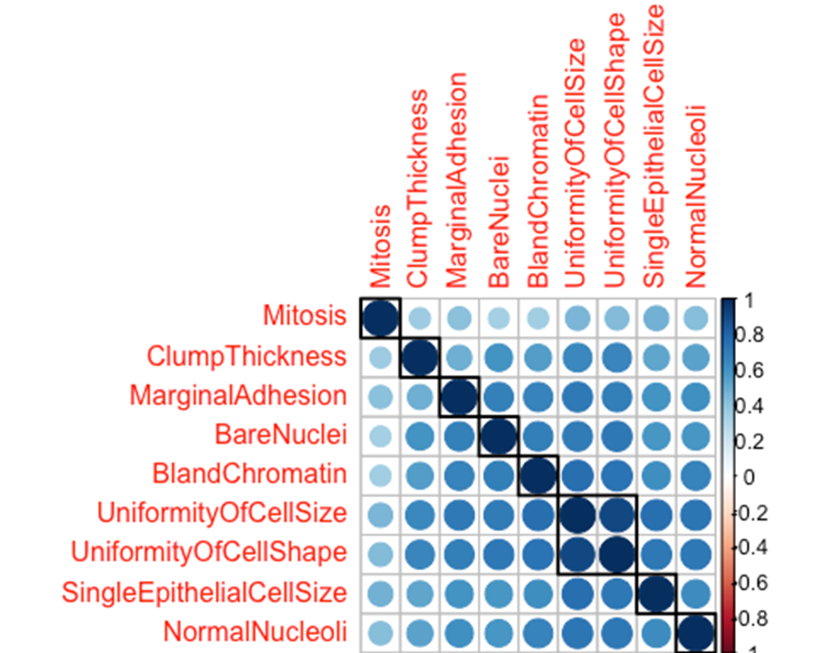
Correlation Between Features
The correlation between variable
Darker means more correlated
Uniformity of cell Size and uniformity of cell shape are highly correlated

Slide 16
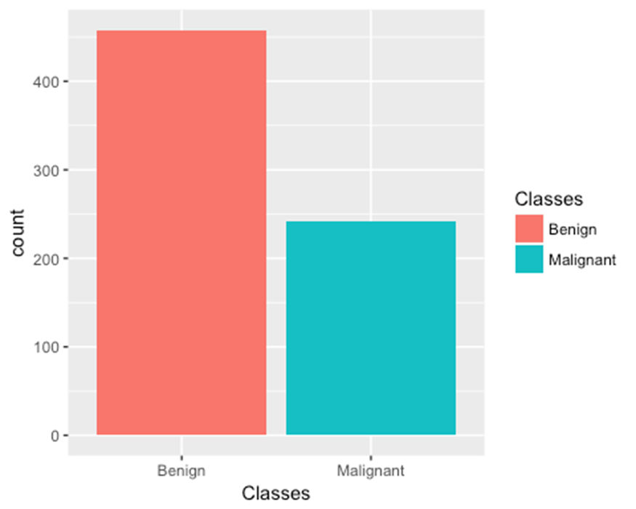
Unbalanced Data Set
There are total of 444 benign cases and 239 malignant cases, hence the data is not balanced.

Slide 17
Pre-Processing Data Set
Unbalanced data lead to prediction bias ,the model will tend to predict the class with more observations
Accuracy measure in that case could not be fully trusted
Reading the confusion matrix or the roc curve is advised
Dataset variable have the same scale (from 1 to 10 )
Since the variables have same scale, it's not necessary to mean corrected the data or scaled

Slide 18
Feature Selection
The breast cancer patient can either have malignant or benign tumor
The multivariate analysis can be used to reduce the number of independent variables
Identify the variables that contribute most toward the classification or identification of diseases type
In order to explore the variable reduction, various multivariate techniques are applied including principle component analysis, discriminant analysis, logistic regression and cluster analysis
Remove highly variable and use this as dimension reduction technique (correlation is above 0.85)

Slide 19
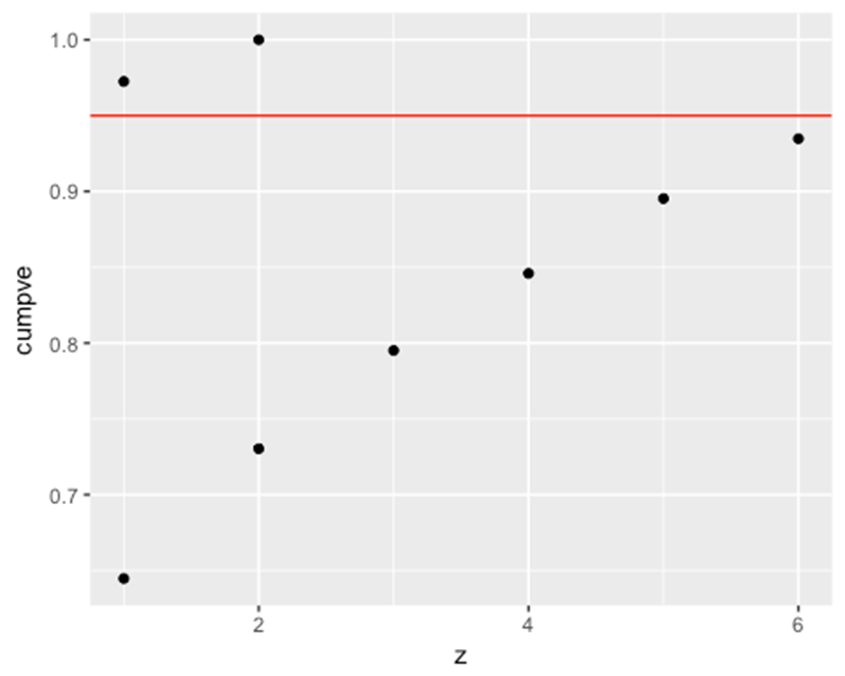
Principal Component Analysis (Con’t)
The number of points above the red line determine the right number of PC: 2 PCs mainly explain the variance of the dataset

Slide 20
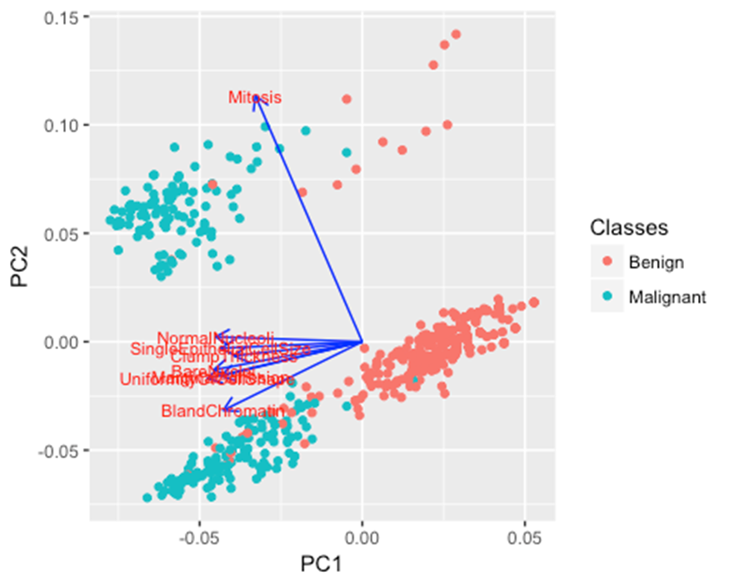
Principal Component Analysis (Con’t)
The loadings and the PCs

Slide 21
Principal Component Analysis (Con’t)
The objective of the principle component analysis is to discover or reduce the dimensionality of the dataset.
2 PCs are suitable for the dataset
Any data point in our set could be projected into a 2 dimension orthogonal space with PC1 and PC2 as components and be clearly clustered (separated )

Slide 22
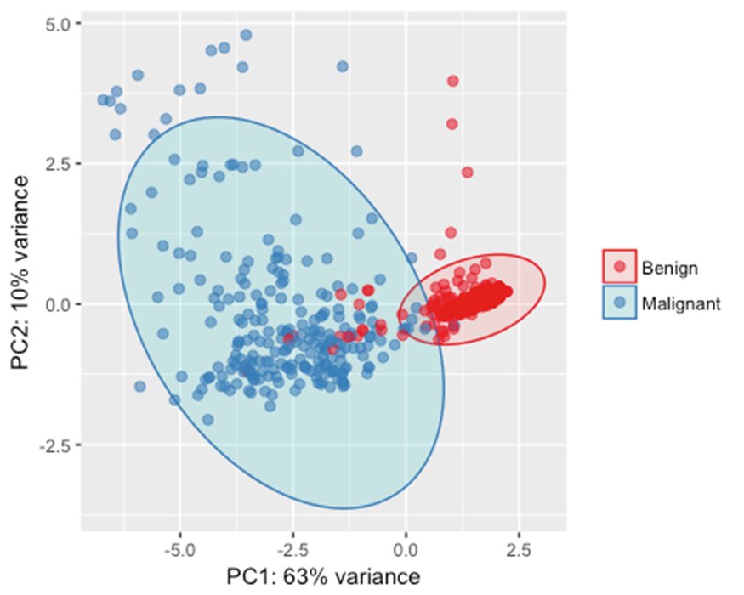
Principal Component Analysis (Con’t)
Clustering Benign and Malignant

Slide 23
Principle Component analysis (Con’t)
The correlation matrix indicates multicollinearity among certain variables.
The first three principle component explains the 80 % of the variance but the loadings are almost the same and hence didn’t provide enough motivation to do dimension reduction.
The principle component consists of a portion of all variables.
The Eigen vectors also known as loading, demonstrate how much each variable contribute in the principle component.
Higher the Eigenvector (loading), higher will be the contribution of that variable in the principle component.

Slide 24
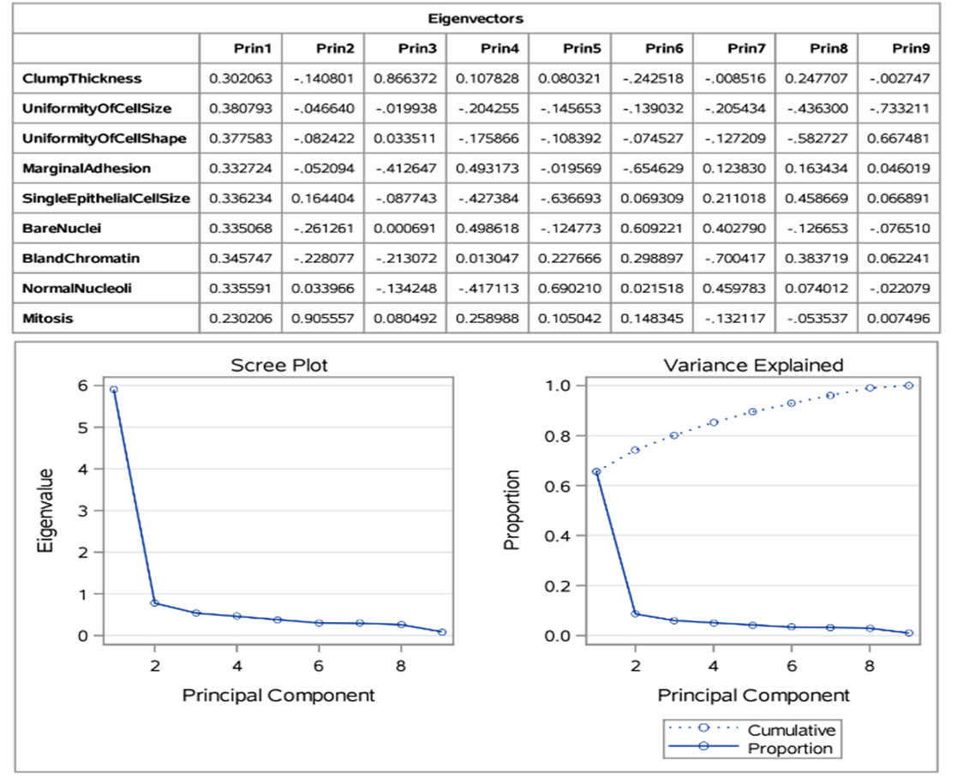
Principle Component analysis (Con’t)

Slide 25
Principle Component analysis (Con’t)
The PCA is not helpful in reducing the number of independent variables, though a result does indicate the presence of multicollinearity.
The presence of multicollinearity interferes the precise effect of each predictor and makes the estimates very sensitive to minor changes in the model.

Slide 26
Logistic Regression (Con’t)
The logistic regression is recommended when the independent variables do not satisfy the multivariate normality test
The model converges with relative gradient convergence criterion (GCONV) with default precision in SAS.
The stepwise logistic regression is applied with 0.05 significance level for entry
The model fit statistics Akaike Information and Schwarz Criterion are report.
The chi-square test for likelihood ratio, Score and Wald p-value should be within the acceptable significance value.

Slide 27
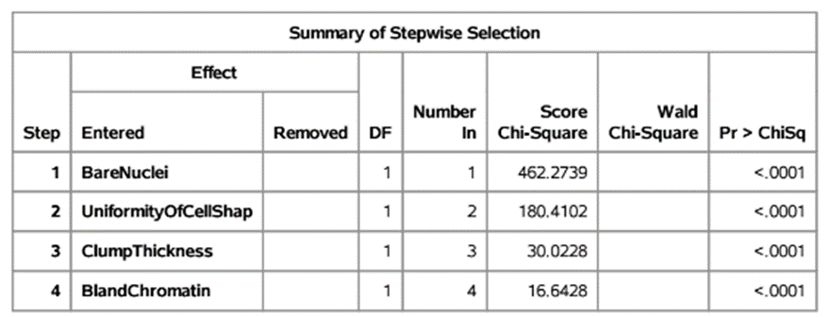
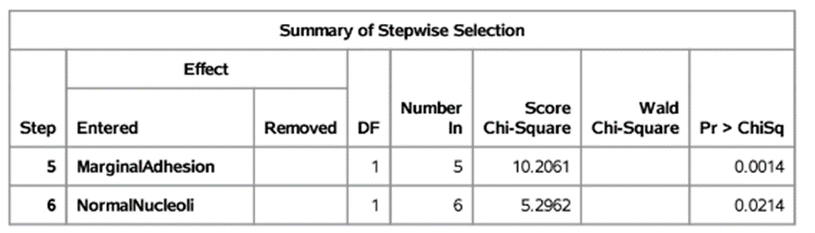
Logistic Regression (Con’t)

Slide 28
Logistic Regression (Con’t)
The logistic regression analysis suggests that six variables are important that classify best between malignant and benign cases.
If 0.01 significance level for entry is used, than four variables will be selected in the logistic regression model.
Unlike discriminant analysis, the logistic regression didn’t include the variable “UniformityOfCellSize”, instead it selected the “UniformityOfCellShape”.
This could be explained by the fact that the both variables are highly collinear (0.9) so only one variable is needed to classify the dependent variable

Slide 29
Discriminant Analysis
The discriminant analysis has the multivariate normality assumption.
If the data is the mixture of independent and dependent variables, the multivariate normality assumption will not hold.
The objective of discriminant analysis is to identify the variables that discriminate best between the two groups.
The stepwise discriminant analysis is applied with significance level of entry and stay is set to 0.01. The variable with the largest F-statistics is selected first.

Slide 30
Discriminant Analysis (Con’t)
There are total of six variables entered and at each step Wilks' lambda is calculated that determines how well each function separates cases into groups.
Smaller values indicate greater discriminatory ability of the function.
With each variable entered, the Wilk Lambda statistics value is evaluated and is found to be decreased as shown below.

Slide 31
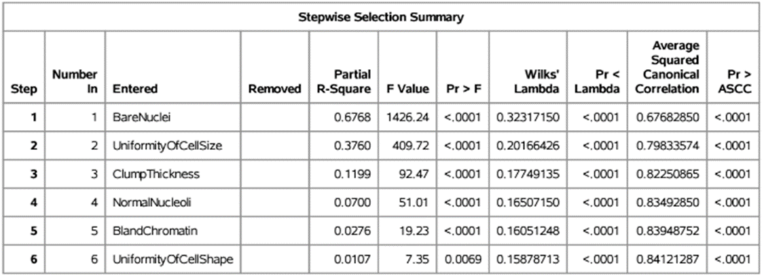
Discriminant Analysis (Con’t)
The variables are entered in the following order.

Slide 32
Discriminant Analysis (Con’t)
The DA analysis reported that 6 variables meet the 0.01 significance level of entry.
If the 7th variable is entered, the model will not meet the significance level of entry.
Note: 0.01 is pretty strict - We can increase up to 0.15 but then it will include all variable and will not justify variable reduction.

Slide 33
Discriminant Analysis (Con’t)
The discriminant analysis suggests that six variables discriminate best between the malignant and benign cases.
The order of the variables is determined by the F-statistic score.
The variables entered in the stepwise discriminant analysis will stay if their p-value is less than the significance level of entry.
Similarly, the variables entered in the model will stay if their p-value of the overall model is less than the significance level of stay.

Slide 34
Classification Methods
Decision Tree, Logistic Regression, Naive Bayes, Support Vector Machine , Artificial Neural Network and Random Forest
Original data with all features
Original data with selected features
Performance measurements:
Accuracy, Sensitivity, Specificity
Area Under Curve (AUC) for Receiver Operating Characteristic (ROC) Curve (True Positive Rate against False Positive Rate)

Slide 35
Classification Methods
To visually look into the distribution of each variable and separate the case of training and testing (70% training and 30% testing)
Split the dataset into training and testing and you build the model on training and validate the results using testing dataset

Slide 36
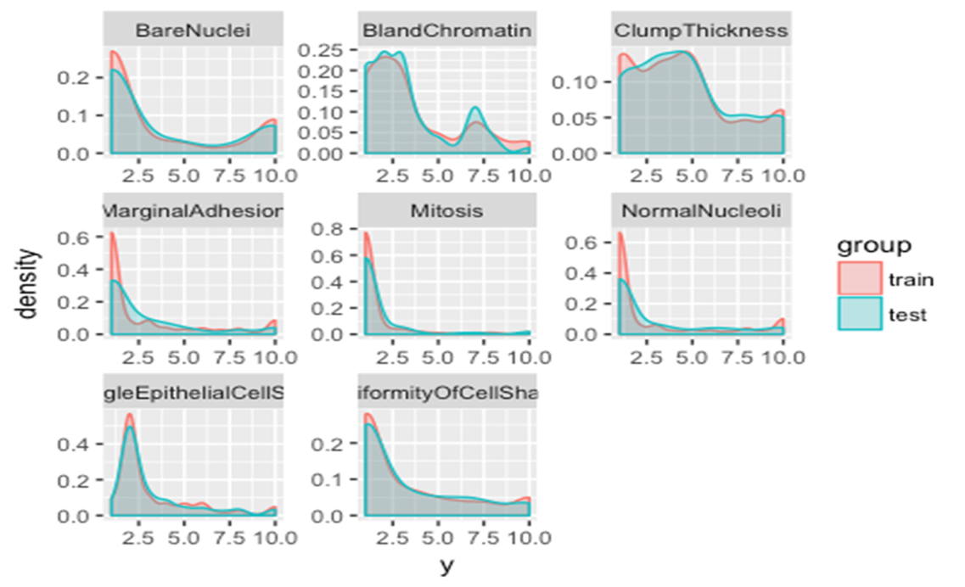
Distribution of Test and Train Data

Slide 37
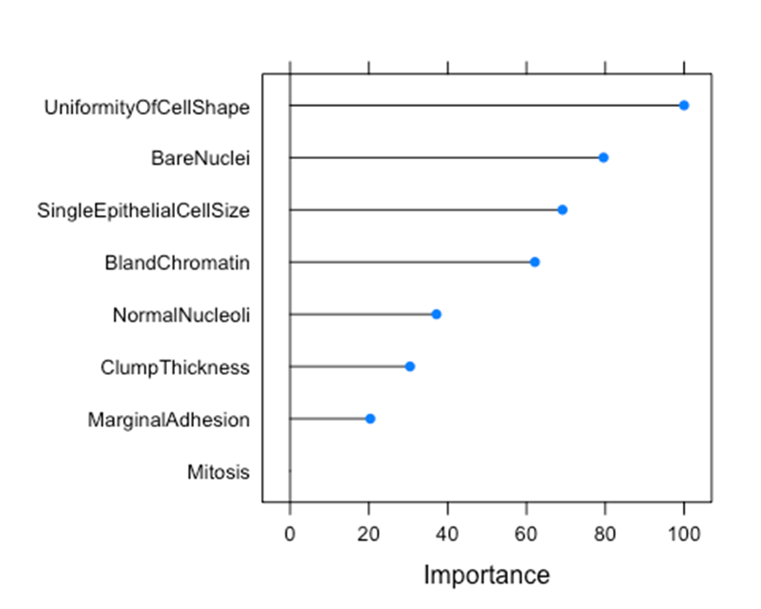
Random Forest
To explore the importance of the feature using random forest

Slide 38
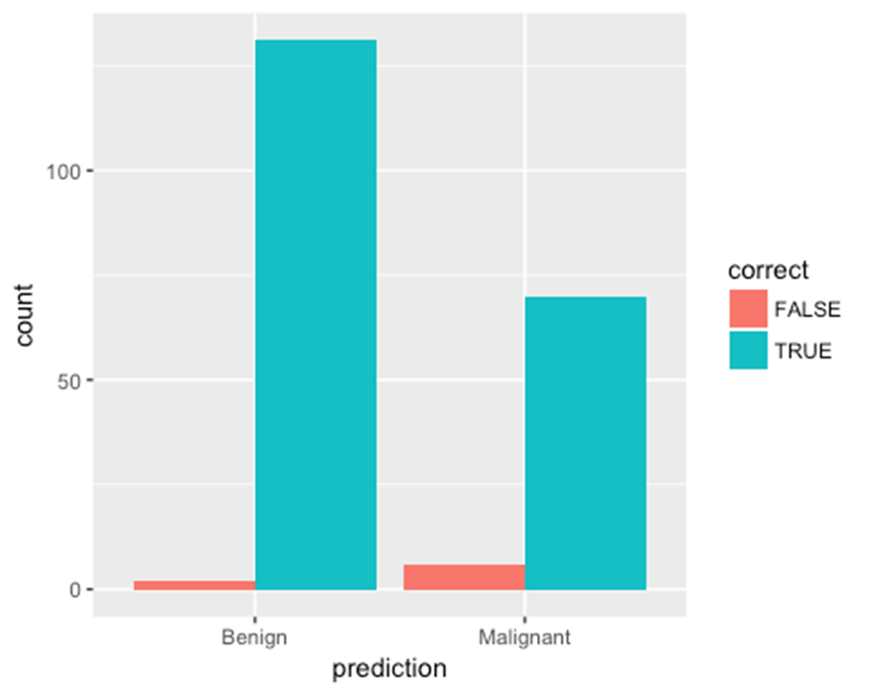
Random Forest
Accuracy : 0.9617 Sensitivity : 0.9562 Specificity : 0.9722
The misclassification results beside the corrected classification

Slide 39
Classification with all Features
Method | Accuracy | Sensitivity | Specificity | AUC
NB | 0.961 | 0.970 | 0.958 | 0.964
DT | 0.952 | 0.865 | 0.993 | 0.933
LR | 0.966 | 0.910 | 0.993 | 0.951
SVM | 0.971 | 0.955 | 0.979 | 0.967
ANN | 0.680 | 0.0 | 1.0 | 0.5

Slide 40
Classification with LASSO Features
SingleEpithelialCellSize (Feature 5)
Method | Accuracy | Sensitivity | Specificity | AUC
NB | 0.866 | 0.701 | 0.944 | 0.822
DT | 0.890 | 0.910 | 0.881 | 0.895
LR | 0.866 | 0.701 | 0.944 | 0.822
SVM | 0.890 | 0.910 | 0.811 | 0.895
ANN | 0.890 | 0.910 | 0.811 | 0.895

Slide 41
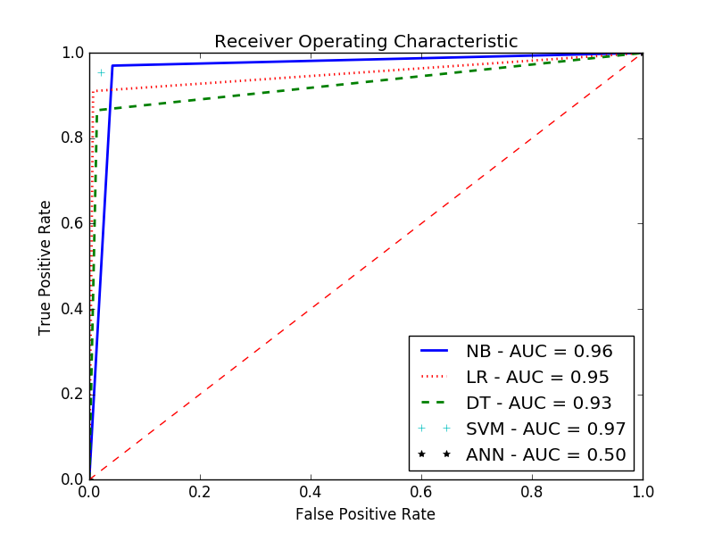
Classification with all Features

Slide 42
Classification with LR Selected Features
From logistic regression following variables are selected:
BareNuclie
Uniformity of Cell Shape
Clump Thickness
Bland Chromotin
MarginalAdhension

Slide 43
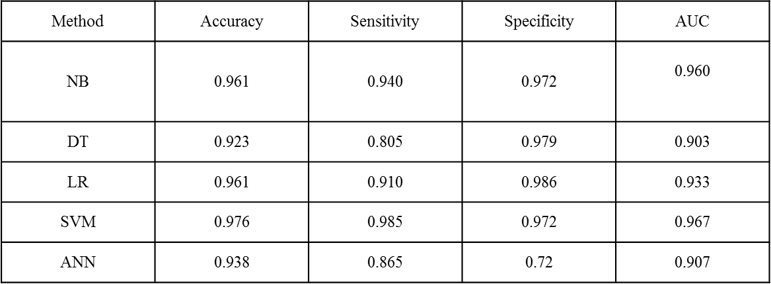
Classification with LR Selected Features

Slide 44
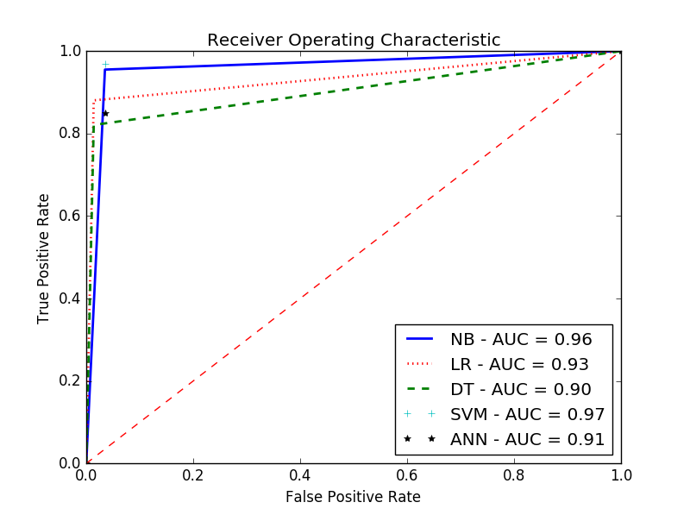
Classification with LR Selected Features

Slide 45
Classification with DA Selected Features
From Discriminant analysis, the following variables are found.
BareNuclie
Uniformity of Cell Size
Clump Thickness
Normal Nuclie

Slide 46
Classification with DA Selected Features
Method | Accuracy | Sensitivity | Specificity | AUC
NB | 0.961 | 0.985 | 0.951 | 0.968
DT | 0.928 | 0.850 | 0.965 | 0.900
LR | 0.957 | 0.895 | 0.986 | 0.940
SVM | 0.971 | 1.0 | 0.958 | 0.979
ANN | 0.323 | 1.0 | 0.006 | 0.503

Slide 47
Classification with DA Selected Features

Slide 48
Classification with Hybrid Selected Features
BareNuclie
Uniformity of Cell Size
Clump Thickness
Bland Chromotin
MarginalAdhension
Normal Nuclie

Slide 49
Classification with Hybrid Selected Features
Method | Accuracy | Sensitivity | Specificity | AUC
NB | 0.966 | 0.985 | 0.985 | 0.971
DT | 0.923 | 0.805 | 0.958 | 0.911
LR | 0.961 | 0.910 | 0.986 | 0.948
SVM | 0.961 | 1.0 | 0.986 | 0.972
ANN | 0.680 | 0.0 | 1.0 | 0.5

Slide 50
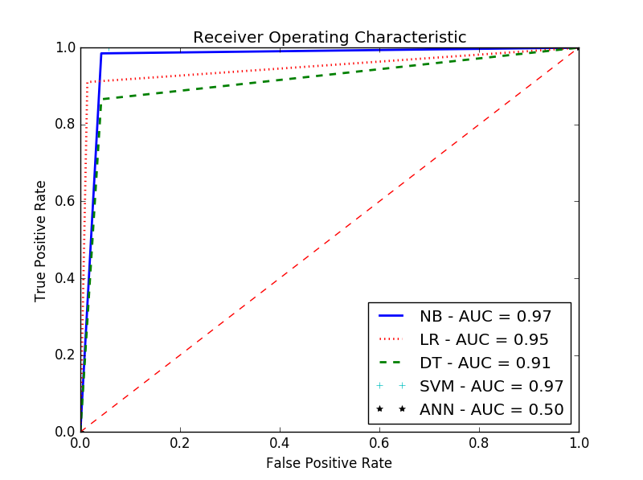
Classification with Hybrid Selected Features

Slide 51
Conclusion
Data mining methods can be helpful in diagnosing diseases.
All techniques have very good performance in classifying data
Results of classification using all features, features selected by LR and DA and hybrid method are close.
Just two features are highly correlated.
SVM is the best classifier.
NB and SVM outperforms are methods.

Slide 52
References
A. JD1, S. RC, H. E and G. RE, "Follow-up of abnormal screening mammograms among low-income ethnically diverse women: findings from a qualitative study.," Patient Educ Couns, vol. 72(2), pp. 283-92, 2008 Aug.
N. Abe, M. Kudo, J. Toyama and a. M. Shimbo, "A Divergence Criterion for Classifier-Independent Feature Selection.," Springer, pp. 668-676, 2000.
A. E. Guyon, "An introduction to variable and features election," J. Mach. Learn. Res, vol. 3, pp. 1157-1182, 2003.

Slide 53
References
S. Vural, X. Wang and C. Guda, "Classification of breast cancer patients using somatic mutation profiles and machine learning approaches," The International Conference on Intelligent Biology and Medicine (ICIBM), 2015.
A. HA, "An evolutionary artificial neural networks approach for breast cancer diagnosis," Artif Intell Med, vol. 25(3), p. 265–281, 2002.
A. P and M. S. e. a. Buadu LD, "Neural network analysis of breast cancer from MRI findings," Radiat Med, vol. 15(5), p. 283–293, 1997.

Slide 54

Thank You!

