Slide 1
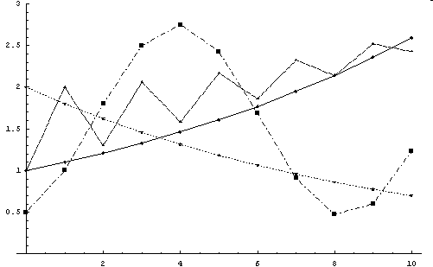
Fundamentals of Dynamical Systems
/ Discrete-Time Models
Hiroki Sayama
sayama@binghamton.edu

Slide 2
Dynamical systems theory
Considers how systems autonomously change along time
  Ranges from Newtonian mechanics to modern nonlinear dynamics theories
  Thinks about underlying dynamical mechanisms, not just static properties of observations
  Forms the theoretical basis for most of complex systems studies

Slide 3
What is a dynamical system?
A system whose state is uniquely specified by a finite set of variables and whose behavior is uniquely determined by predetermined rules
  Simple population growth
  Simple pendulum swinging
  Motion of celestial bodies
  Behavior of two “rational” agents in a negotiation game

Slide 4
Mathematical formulations of dynamical systems
Discrete-time model:
x_{t} = F(x_{t-1}, t)
Continuous-time model: (differential equations)
dx/dt = F(x, t)
  x_{t}: State variable(s) of the system at time t
  F: Some function that determines the rule that the system’s behavior will obey
  Including x in F( ) means “feedback loops”
(difference/recurrence
equations; iterative maps)

Slide 5
Discrete-Time Models

Slide 6
Discrete-time model
Easy to understand, develop and simulate
  Doesn’t require an expression for the rate of change (derivative)
  Can model abrupt changes and/or chaotic dynamics using fewer variables
  Directly translatable to stepwise simulation in a computer
  Experimentally, we often have samples of system states at specific points of time

Slide 7
Difference equation and time series
Difference equation
x_{t} = F(x_{t-1}, t)
produces series of values of variable x starting with initial condition x₀:
{ x₀, x₁, x₂, x₃, … } “time series”
  A prediction made by the above model (to be compared to experimental data)

Slide 8
Exercise
Components A & B takes either red or blue Interaction rules are defined as follows:
  A tries to be the same color as its partner
  B tries to be the opposite color to its partner
Write the state-transition functions { F_{i} } of this system
A
B

Slide 9
Linear vs. nonlinear
Linear:
  Right hand side is just a first-order polynomial of variables
x_{t} = a x_{t-1} + b x_{t-2} + c x_{t-3} …
Nonlinear:
  Anything else
x_{t} = a x_{t-1} + b x_{t-2}² + c x_{t-1} x_{t-3} …

Slide 10
1st-order vs. higher-order
1st-order:
  Right hand side refers only to the immediate past
x_{t} = a x_{t-1} ( 1 – x_{t-1} )
Higher-order:
  Anything else
x_{t} = a x_{t-1} + b x_{t-2} + c x_{t-3} …
(Note: this is different from the order of terms in polynomials)

Slide 11
Autonomous vs. non-autonomous
Autonomous:
  Right hand side includes only state variables (x) and not t itself
x_{t} = a x_{t-1} x_{t-2} + b x_{t-3}²
Non-autonomous:
  Right hand side includes terms that explicitly depend on the value of t
x_{t} = a x_{t-1} x_{t-2} + b x_{t-3}² + sin(t)

Slide 12
Things that you should know (1)
Non-autonomous, higher-order equations can always be converted into autonomous, 1st-order equations
  x_{t-2} → y_{t-1}, y_{t} = x_{t-1}
  t → y_{t}, y_{t} = y_{t-1} + 1, y₀ = 0
Autonomous 1st-order equations can cover dynamics of any non-autonomous higher-order equations too!

Slide 13
Exercise
Convert each of the following equations into autonomous, 1st-order form:
x_{t} = x_{t-1} + x_{t-2}
x_{t} = x_{t-1} + x_{t-2} sin(t)

Slide 14
Things that you should know (2)
Linear equations
  are analytically solvable
  show either equilibrium, exponential growth/decay, periodic oscillation (with >1 variables), or their combination
Nonlinear equations
  may show more complex behaviors
  do not have analytical solutions in general

Slide 15
Simulating Discrete-Time Models

Slide 16
Simulating discrete-time models
Simulation of a discrete-time model can be implemented by iterating updating of the system’s states
  Every iteration represents one discrete time step

Slide 17
Exercise
Implement simulators of the following models and produce time series for t = 1~10
  x_{t} = 2 x_{t-1} + 1, x₀ = 1
  x_{t} = x_{t-1}² + 1, x₀ = 1

Slide 18
Exercise
Simulate the following set of equations and see what happens if the coefficients are varied
  x_{t} = 0.5 x_{t-1} + 1 y_{t-1}
  y_{t} = -0.5 x_{t-1} + 1 y_{t-1}
  x₀ = 1, y₀ = 1

Slide 19
Building Your Own Model Equation

Slide 20
Mathematical modeling tips
Grab an existing model and tweak it
Implement each assumption one by one
Find where to change, replace it by a function, and design the function
Adopt the simplest form
Check the model with extreme values

Slide 21
Example: Saturation of growth
Simple exponential growth model:
x_{t} = a x_{t-1}
Problem: How can one implement the saturation of growth in this model?
Think about a new nonlinear model:
x_{t} = f(x_{t-1}) x_{t-1}
  Coefficient replaced by a function of x

Slide 22
Modeling saturation of growth
x_{t} = f(x_{t-1}) x_{t-1}
f(x) should approach 1 (no net growth) when x goes to a carrying capacity of the environment, say K
f(x) should approach the original growth rate a when x is very small (i.e., with no saturation effect)

Slide 23
What should f(x) be?
f(x)
a – 1
f(x) = – x + a
a
K
1
x
0
K

Slide 24
A new model of growth
x_{t} = f(x_{t-1}) x_{t-1}
= ( – (a – 1) x_{t-1} / K + a ) x_{t-1}
Using r = a – 1:
x_{t} = ( – r x_{t-1} / K + r + 1 ) x_{t-1}
= x_{t-1} + r x_{t-1} ( 1 – x_{t-1} / K )
Net growth

Slide 25
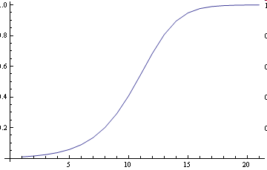
Example: Logistic growth model
N: Population
r: Population growth rate
K: Carrying capacity
Discrete-time version:
N_{t} = N_{t-1} + r N_{t-1} ( 1 – N_{t-1}/K )
Continuous-time version:
dN/dt = r N ( 1 – N/K )
Nonlinear
terms

Slide 26
Exercise
Simulate the behavior of the logistic growth model with 0 < r < 3, K = 1, N₀ = 0.01
Consider if the same behavior can be achieved by a linear model
  If not, how is it different?

Slide 27
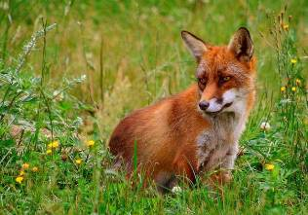
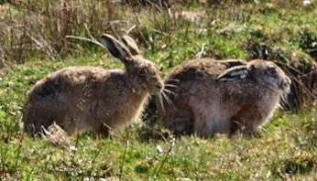
Modeling with multiple variables
Problem: Develop a nonlinear model of a simple ecosystem made of predator and prey populations

Slide 28
Think about how variables behave in isolation
Rabbit
Population : x
Fox
Population : y
+
-
Naturally grows
to carrying capacity
if isolated
Naturally decays
if isolated

Slide 29
Initial assumptions
Rabbits will grow based on the logistic growth model, with carrying capacity = 1 for simplicity
Foxes will decay exponentially
Rabbit: x_{t} = x_{t-1} + a x_{t-1} (1 – x_{t-1})
Fox: y_{t} = b y_{t-1}
(0<a, 0<b<1)

Slide 30
Think about how variables interact with each other
Positive influence
Foxes’ growth rate
increases with
increasing rabbits
Rabbit
Population : x
+
Fox
Population : y
-
Negative influence
Rabbits’ survival rate
decreases with
increasing foxes
+
-
Naturally grows
to carrying capacity
if isolated
Naturally decays
if isolated

Slide 31
Revised model
Introduced coefficient (1 – c y_{t-1}) (0<c) to the first term of x
  Negative influence of foxes on rabbits’ survival rate
Replaced b with (b + d x_{t-1}) (0<d)
  Positive influence of rabbits on foxes’ growth rate
Rabbit: x_{t} = (1 – c y_{t-1}) x_{t-1}
+ a x_{t-1} (1 - x_{t-1})
Fox: y_{t} = (b + d x_{t-1}) y_{t-1}
(0<a, 0<b<1, 0<c, 0<d)

Slide 32
Exercise
Rabbit: x_{t} = (1 – c y_{t-1}) x_{t-1}
+ a x_{t-1} (1 - x_{t-1})
Fox: y_{t} = (b + d x_{t-1}) y_{t-1}
Simulate the behavior of this model
Try using several different values for a, b, c, and d, to see what kind of dynamics are possible

Slide 33
FYI: Lotka-Volterra model
This model can be rewritten as:
x_{t} – x_{t-1} = α x_{t-1} (1-x_{t-1}) – β x_{t-1} y_{t-1}
y_{t} – y_{t-1} = - γ y_{t-1} + δ x_{t-1} y_{t-1}
  Known as the “Lotka-Volterra” equations (of discrete-time version with carrying capacity)
  Models predator-prey dynamics in a general form
  One of the most famous nonlinear systems with multiple variables

Slide 34
Modeling Exercises

Slide 35
Exercise: Two competing species
Develop a discrete-time mathematical model of two species competing for the same resource, and simulate its behavior

Slide 36
Exercise: Public opinions (1)
Conservative, liberal and neutral
  No asymmetry between conservative and liberal with regard to attractiveness
People will change ideological states at each election poll according to their relative popularities in previous poll
Complete a discrete-time model that describes this system and simulate its behavior

Slide 37
Exercise: Public opinions (2)
Revise the model so that the conservative and liberal political parties run a campaign to promote voters’ switching to their ideologies from their competitions, at a rate inversely proportional to their current popularity
See how such political campaigning changes the dynamics of the system

Slide 38
Analysis of Discrete-Time Models

Slide 39
Equilibrium point
A state of the system at which state will not change over time
  A.k.a. fixed point, steady state
Can be calculated by solving
x_{t} = x_{t-1}

Slide 40
Exercise
Calculate equilibrium points in the following models
N_{t} = N_{t-1} + r N_{t-1} ( 1 – N_{t-1}/K )
x_{t} = 2x_{t-1} – x_{t-1}²
x_{t} = x_{t-1} – x_{t-2}² + 1

Slide 41
Phase Space Visualization

Slide 42
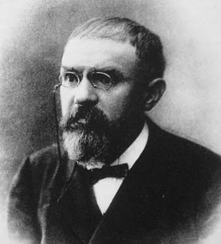
Geometrical approach
Developed in the late 19C by J. Henri Poincare
Visualizes the behavior of dynamical systems as trajectories in a phase space
Produces a lot of intuitive insights on geometrical structure of dynamics that would be hard to infer using purely algebraic methods

Slide 43
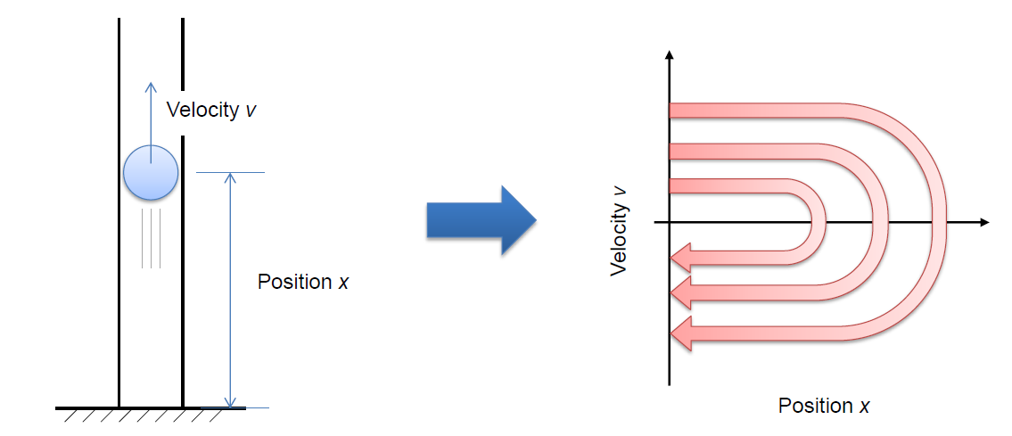
Phase space (state space)
A theoretical space in which every state of a dynamical system is mapped to a spatial location

Slide 44
Phase space (state space)
Created by “orthogonalizing” state variables of the system
Its dimensionality equals # of variables needed to specify the system state (a.k.a. degrees of freedom)
Temporal change of the system states can be drawn in it as a trajectory

Slide 45
Attractor and basin of attraction
Attractor:
A state (or a set of states) from which no outgoing edges or flows running in phase space
  Static attractors (equilibrium points)
  Dynamic attractors (e.g. limit cycles)
Basin of attraction:
A set of states which will eventually end up in a given attractor

Slide 46
Phase space of continuous-state models
E.g. a simple vertical spring oscillator
State can be specified by two real variables (location x, velocity v)
x
Trajectory
(orbit)
v
Dynamics of continuous models can be
depicted as “flow” in a continuous phase space

Slide 47
Exercise
Draw the phase space and sample trajectories of the following model:
  x_{t} = 0.5 x_{t-1} + 1 y_{t-1}
  y_{t} = -0.5 x_{t-1} + 1 y_{t-1}
  x₀ = 1, y₀ = 1

Slide 48
Cobweb plot
A visual tool to study the behavior of 1-D iterative maps
Take x_{t-1} and x_{t} for two axes
Draw the map of interest (x_{t}=F(x_{t-1})) and the “x_{t}=x_{t-1}” reference line
  They will intersect at “equilibrium points”
Trace how time series develop from an initial value by jumping between these two curves

Slide 49
Exercise
Manually draw a cobweb plot for each of the following models:
x_{t} = x_{t-1} + 0.1, x₀ = 0.1
x_{t} = 1.1 x_{t-1} , x₀ = 0.1

Slide 50
Exercise
Manually draw a cobweb plot of the logistic growth model with r=1, K=1, N₀=0.1:
N_{t} = N_{t-1} + r N_{t-1} ( 1 – N_{t-1}/K )

Slide 51
Phase space of discrete-state models
E.g. a simple blinking light
State can be specified by one binary variable (on or off)
on
off
Dynamics of discrete-state models can be depicted as a directed graph (“state-transition diagram”) whose nodes/edges represent states/transitions
(For stochastic systems one node may have multiple outgoing edges)

Slide 52
Exercise
Components A & B takes either red or blue Interaction rules are defined as follows:
  A tries to be the same color as its partner
  B tries to be the opposite color to its partner
Draw a phase space and trajectories of this model
A
B

Slide 53
Exercise: Three-person majority game
There is a group made of three persons
Each person takes either option X or Y
Each person makes his/her choices open to the other two, then they simultaneously switch their choices to the major option within the group
This process repeats indefinitely
Illustrate geometrical structure of the phase space of this system and identify attractors and basins of attractions in it

Slide 54
Exercise
Illustrate geometrical structure of the phase space of a three-person minority game (i.e., each person switches his/her choice against the major option within the group)

Slide 55
Rescaling Variables

Slide 56
Rescaling variables
Dynamics of a system won’t change qualitatively by linear rescaling of variables (e.g., x → α x’)
You can set arbitrary rescaling factors for variables to simplify the model equations
If you have k variables, you may eliminate k parameters

Slide 57
Exercise
Simplify the logistic growth model by rescaling x → α x’
x_{t} = x_{t-1} + r x_{t-1} (1 - x_{t-1}/K)

Slide 58
Exercise
Simplify the following model by rescaling x → α x’
x_{t} = a / (x_{t-1} + b)

Slide 59
Linear Systems

Slide 60
Dynamics of linear systems
Some systems can be modeled as linear systems
  Their dynamics is described by a product of matrix and state vector
  Either in continuous or discrete time
Dynamics of such linear systems can be studied analytically

Slide 61
Linear systems
Linear systems are the simplest cases where states of nodes are continuous-valued and their dynamics are described by a time-invariant matrix
Discrete-time: x_{t} = A x_{t-1}
  A is called a “coefficient” matrix
  We don’t consider constants (as they can be easily converted to the above forms)

Slide 62
Example: An “averaging” network
A discrete-time dynamical network where the next state of each node is an average of its neighbors’ states (including its own) :
s¹
s¹
s²
s⁵
s¹_{t} = { s¹_{t-1} + s²_{t-1} + s³_{t-1} + s⁵_{t-1} } / 4
s³
s⁴

Slide 63
Exercise
Write down the state-transition function of the following “averaging” network by completing its coefficient matrix
s¹
s¹
s²
s⁵
s = {s¹, s², s³, s⁴, s⁵}
s_{t} = (???) s_{t-1}
s³
s⁴

Slide 64
Asymptotic Behavior of Linear Systems

Slide 65
Where will the system go eventually?
x_{t} = A x_{t-1}
This equation gives the following exact solution:
x_{t} = A^{t} x₀

Slide 66
Where will the system go eventually?
x_{t} = A x_{t-1}
What happens if the system starts from non-equilibrium initial states and goes on for a long period of time?
Let’s think about their asymptotic behavior lim _{t->∞} x_{t}

Slide 67
Considering asymptotic behavior (1)
Let { v_{i} } be n linearly independent eigenvectors of the coefficient matrix
  (They might be fewer than n, but here we ignore such cases for simplicity)
Write the initial condition using eigenvectors, i.e.
x₀ = b₁v₁ + b₂v₂ + ... + b_{n}v_{n}

Slide 68
Considering asymptotic behavior (2)
Then:
x_{t} = A^{t} x₀
= λ₁^{t} b₁v₁ + λ₂^{t} b₂v₂ + … + λ_{n}^{t} b_{n}v_{n}

Slide 69
Dominant eigenvector
If |λ₁| > |λ₂|, |λ₃|, …,
x_{t} = λ₁^{t} { b₁v₁ + (λ₂/λ₁)^{t} b₂v₂ + ... + (λ_{n}/λ₁)^{t} b_{n}v_{n} }
lim _{t->∞} x_{t} ~ λ₁^{t} b₁v₁
If the system has just one such dominant eigenvector v₁, its state will be eventually along that vector regardless of where it starts

Slide 70
What eigenvalues and eigenvectors can tell us
An eigenvalue tells whether a particular “state” of the system (specified by its corresponding eigenvectors) grows or shrinks by interactions between parts
  | λ | > 1 -> growing
  | λ | < 1 -> shrinking

Slide 71
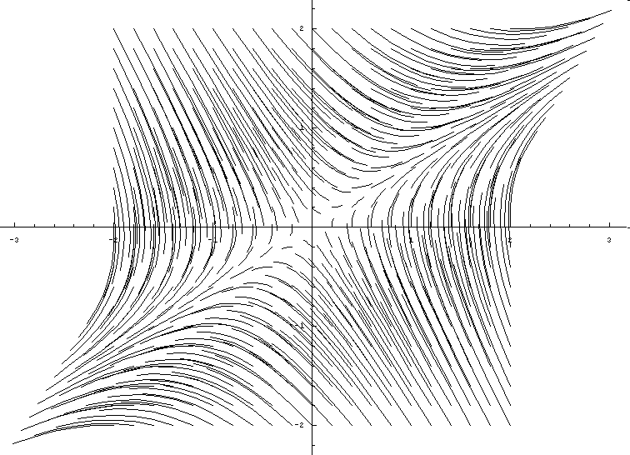
Example
Phase space of a two-variable linear difference equation with (a, b, c, d) = (1, 0.1, 0.1, 0.9)
y
Along these lines (called invariant lines), the dynamics can be understood as simple exponential growth/decay
|λ₁|>1
|λ₂|<1
v₁
x
v₂

Slide 72
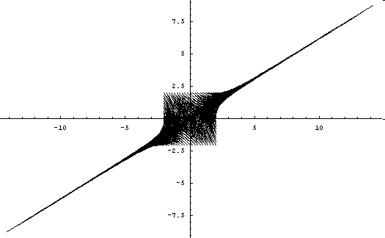
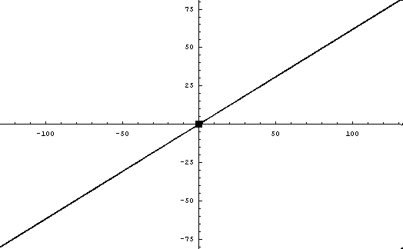
Example
y
x
This could be regarded as a very simple form of self-organization (though completely predictable);
Order spontaneously emerges in the system as time goes on

Slide 73
Exercise
Study asymptotic behavior of the following dynamical network (numbers denote symmetric coefficients in A) in a discrete-time case
1
0
-1
1
1
-3

Slide 74
Linear Stability Analysis of Nonlinear Systems

Slide 75
Stability of equilibrium points
If a system at its equilibrium point is slightly perturbed, what happens?
The equilibrium point is called:
  Stable (or asymptotically stable) if the system eventually falls back to the equilibrium point
  Lyapunov stable if the system doesn’t go far away from the equilibrium point
  Unstable otherwise

Slide 76
Question
What is the stability of each of the following equilibrium points?

Slide 77
Linear stability analysis
Studies whether a nonlinear system is stable or not at its equilibrium point by locally linearizing its dynamics around that point
Linearization
Linearization

Slide 78
Local linearization (1)
Let Δx be a small difference between the system’s current state x and its equilibrium point x_{e}, i.e. x = x_{e} +Δx
Plug x = x_{e} + Δx into differential equations and ignore quadratic or higher-order terms of Δx (hence the name “linearization”)

Slide 79
Local linearization (2)
This operation does the trick to convert the dynamics of Δx into a product of a matrix and Δx
By analyzing eigenvalues of the matrix, one can predict whether x_{e} is stable or not
  I.e. whether a small perturbation (Δx) grows or shrinks over time

Slide 80
Mathematically speaking…
This operation is similar to “linear approximation” in calculus
Taylor series expansion:
F(x) = Σ_{n=0~∞} F^{(n)}(a)/n! (x-a)^{n}
Let x → x_{e}+Δx and a→x_{e} , then
F(x_{e}+Δx) = F(x_{e}) + F’(x_{e}) Δx
+ O(Δx²)
Ignore

Slide 81
Linearizing discrete-time models
For discrete-time models:
x_{t} = F(x_{t-1})
Left = x_{e} + Δx_{t}
Right = F(x_{e} + Δx_{t-1})
~ F(x_{e}) + F’(x_{e}) Δx_{t-1}
= x_{e} + F’(x_{e}) Δx_{t-1}
Therefore,
Δx_{t} = F’(x_{e}) Δx_{t-1}

Slide 82
First-order derivative of vector functions
Discrete-time: Δx_{t} = F’(x_{e}) Δx_{t-1}
This can hold even if x is a vector
What corresponds to the
first-order derivative in
such a case:
F’(x_{e}) = dF/dx_{(x=xe)} =
∂ F₁ ∂ F₁ ∂ F₁
∂ x₁ ∂ x₂ ∂ x_{n}
∂ F₂ ∂ F₂ ∂ F₂
∂ x₁ ∂ x₂ ∂ x_{n}
∂ F_{n} ∂ F_{n} ∂ F_{n}
∂ x₁ ∂ x₂ ∂ x_{n}
…
Jacobian matrix at x=x_{e}
…
…
…
…
…
(x=x_{e})

Slide 83
Eigenvalues of Jacobian matrix
A Jacobian matrix is a linear approximation around the equilibrium point, telling you the local dynamics: “how a small perturbation will grow, shrink or rotate around that point”
  The equilibrium point serves as a local origin
  The Δx serves as a local coordinate
  Eigenvalue analysis applies

Slide 84
With real eigenvalues
If all the eigenvalues indicate that Δx will shrink over time
-> stable point
If all the eigenvalues indicate that Δx will grow over time
-> unstable point
If some eigenvalues indicate shrink and others indicate grow of Δx over time
-> saddle point (this is also unstable)

Slide 85
With two complex conjugate eigenvalues (for 2-D systems)
If both eigenvalues indicate that Δx will shrink over time
-> stable spiral focus
If both eigenvalues indicate that Δx will grow over time
-> unstable spiral focus
If both eigenvalues indicate neither shrink nor growth of Δx
-> neutral center (but this may or may not be true for nonlinear models; further analysis is needed to check if nearby trajectories are truly cycles or not)

Slide 86
With real and complex eigenvalues mixed (for higher-dimm. systems)
Each eigenvalue (or a pair of complex conjugate eigenvalues) tell you distinct dynamics simultaneously seen at the equilibrium point:
1 real eigenvalue indicates growth; other 2 indicates rotation (complex conjugates with no growth or shrink)
All real eigenvalues (1 indicates growth; other 2 indicates shrink)

Slide 87
Exercise
Find all equilibrium points of the following model, and study their stability
x_{t} = x_{t-1} y_{t-1}
y_{t} = y_{t-1} (x_{t-1} – 1)

Slide 88
Exercise: Two competing species
Develop a mathematical model of the system below, draw its phase space, and study the stability of its equilibrium points
Negative influence
Carnivores’ survival rate
decreases with
increasing humans
Human
Population : x
-
Carnivore
Population : y
-
Negative influence
Humans’ survival rate
decreases with
increasing carnivores
+
+
Naturally grows
if isolated
Naturally grows
if isolated
(assume plenty of
prey are available)

