Slide 1
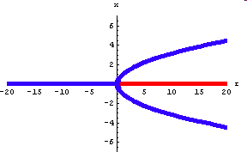
Bifurcations
Hiroki Sayama
sayama@binghamton.edu

Slide 2
Bifurcation
Topological change of phase space that occurs when some control parameter is varied
  Local bifurcation (change in stability of equilibrium points)
  Global bifurcation (collision of invariant sets; not covered in this course)

Slide 3
Bifurcations in nature
Often play important roles as a switching mechanism that causes abrupt changes of systems’ behavior from one to another
  Conformation switching of proteins and other biopolymers
  Neural switching (resting/excited)
  Pattern formation in morphogenesis (will be discussed later)

Slide 4
When bifurcation occurs in nonlinear systems
{ λ_{i} }: eigenvalues of Jacobian matrix at equilibrium point x_{e}
x_{e} is:
  Stable if |λ_{i}| < 1 for all i (discrete-time)
  or if Re(λ_{i}) < 0 for all i (continuous-time)
  Unstable if |λ_{i}| > 1 for some i (discrete-time)
  or if Re(λ_{i}) > 0 for some i (continuous-time)
Bifurcation occurs when the above inequalities become equations, i.e., when the stability of an equilibrium point changes
  |λ_{i}| = 1 or Re(λ_{i}) = 0, for some i
  (discrete-time) (continuous-time)

Slide 5
Bifurcations in 1-D Systems

Slide 6
Bifurcations in 1-D systems
Phase space of a 1-D system is given by the locations of equilibrium points and directions of flows between them
Bifurcation occurs when equilibrium points appear, disappear or change their stabilities
  E.g. saddle-node bifurcation of a 1-D system

Slide 7
When bifurcation occurs in 1-D nonlinear systems
Equilibrium point x_{e} is:
  Stable if |∂F/∂x_{(x=xe)}| < 1 (discrete-time)
  or if ∂F/∂x_{(x=xe)} < 0 (continuous-time)
  Unstable if |∂F/∂x_{(x=xe)}| > 1 (discrete-time)
  or if ∂F/∂x_{(x=xe)} > 0 (continuous-time)
    No need to take Re() because complex conjugate eigenvalues require at least two dimensions
Bifurcation occurs when the above inequalities become equations
  |∂F/∂x_{(x=xe)}| = 1 or ∂F/∂x_{(x=xe)} = 0
  (discrete-time) (continuous-time)

Slide 8
Bifurcation diagram
x
Vertical axis: location(s) of equilibrium points
Horizontal axis:
control parameter
r
Can be used only for 1-D systems, but still conceptually helpful
Here stable equilibrium points shown in blue lines; unstable ones in red lines

Slide 9
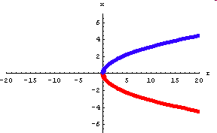
Saddle-node bifurcation
A pair of stable and unstable equilibrium points emerge (or vanish)
Phase space
Example: dx/dt = r – x²
Control parameter

Slide 10
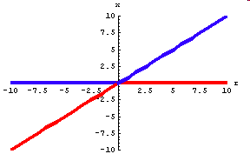
Transcritical bifurcation
One equilibrium point passes through another, exchanging the stabilities
Phase space
Example: dx/dt = rx – x²
Control parameter

Slide 11
Pitchfork bifurcation
A stable point splits into two (with one unstable point also emerging)
Phase space
Example: dx/dt = rx – x³
Control parameter

Slide 12
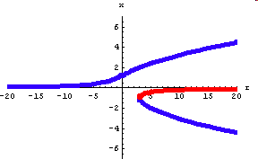
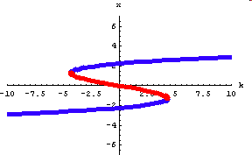
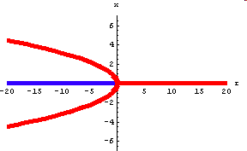
Other bifurcations
Example: dx/dt = k + rx – x³
(left: k=2; right: r=5)
Bifurcation with two control parameters
  This type of bifurcation is important in studying catastrophic behavior
Subcritical pitchfork bifurcation
Example: dx/dt = rx + x³

Slide 13
Exercise: Two competing species
Two species “x” and “y” compete for a finite resource or habitat
Total population is assumed constant
x + y = K (i.e., the systems is 1-D)
Growth is influenced by their relative population difference:
dx/dt = a x (1 - x/K) (x – y)/K
Obtain equilibrium points of this system and their stabilities

Slide 14
Exercise: Two competing species
Assume this system is connected to a much larger population where their ratio of x is always maintained to p:
dx/dt = a x (1 - x/K) (x – y)/K
+ r (p – x/K)
(r: strength of connection, or diffusion coefficient)
Determine when bifurcation occurs in this system and draw its bifurcation diagram over varying r (and p)

Slide 15
Limit Cycles and Hopf Bifurcations in Higher-Dimensional Systems

Slide 16
Limit cycle
A cyclic (closed) trajectory in phase space defined as an asymptotic limit of other spiral trajectories nearby
  Stable (or attracting) limit cycle
  Unstable limit cycle
  Metastable

Slide 17
Example: van der Pol oscillator
A dynamical model that appears in electric circuit theory
d²x/dt² + λ(x² – 1) dx/dt + x = 0
  Convert this model into a first-order form
  Obtain an equilibrium point and its stability
  Draw phase portraits with values of λ varied from -1 to 1

Slide 18
Example: Cycles in Lotka-Volterra models
Original model:
dx/dt = a x – b x y
dy/dt = - c y + d x y
  This does have cyclic trajectories, but they are NOT limit cycles
Revised model:
dx/dt = a x (1-x/K) – b Jx/(J+x) y
dy/dt = - c y + d Jx/(J+x) y
  This may have a stable limit cycle depending on parameter values

Slide 19
Example: Limit cycle in the revised Lotka-Volterra model
Draw a phase portrait of the revised Lotka-Volterra model with a=1, b=1.5, c=0.5, d=1, J=1, K=4
Analyze the stability of its non-zero equilibrium point with the parameter values given above

Slide 20
Hopf bifurcation
Typical scenario: A stable equilibrium point “explodes” to create a limit cycle; only possible in 2-D or higher dimensions
Occurs when |λ_{i}| = 1 (discrete-time) or Re(λ_{i}) = 0 (continuous-time) for some i and when these λ’s have imaginary parts

Slide 21
Exercise: Hopf-bifurcation in the revised Lotka-Volterra model
Analyze the stability of the non-zero equilibrium point of the revised Lotka-Volterra model with a=1, b=1.5, c=0.5, d=1, K=4, while leaving J as a variable (control parameter)
Figure out at what value of J the system undergoes Hopf bifurcation
Plot several phase portraits with varying J near its critical value

Slide 22
Period-Doubling Bifurcations in Discrete-Time Models

Slide 23
Stability of equilibrium points
The slope of function F (∂F/∂x) at an equilibrium point determines whether the system can converge to or diverge from that point
∂F
-1
0
1
∂x
Unstable
Stable
Unstable
With oscillation
No oscillation

Slide 24
Exercise
Obtain the equilibrium points of the logistic map as a function of a:
x_{t} = F(x_{t-1}) = a x_{t-1} (1 – x_{t-1})
Examine their stability and its dependence on the value of a

Slide 25
Summary of stability analysis
Range Equil. of a points | 0 < a < 1 | 1 < a < 3 | 3 < a
x = 0 | Stable | Unstable
x = 1-1/a | (Doesn’t exist within positive range) | Stable | Unstable
Impossible in 1-D continuous models!!

Slide 26
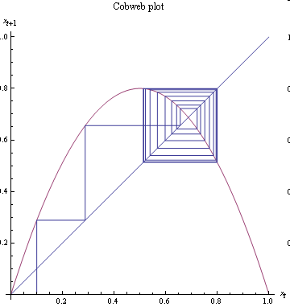
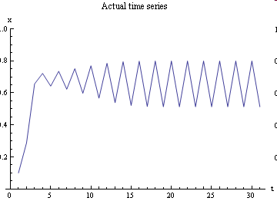
What is going on for a > 3?
Example: a = 3.2
Period-doubling bifurcation
  Both equilibrium points lose stability
  System starts to oscillate with a doubled period

Slide 27
Period-doubling bifurcations
In discrete-time models, “period-doubling” bifurcations may occur when
∂F/∂x_{(x=xe)} = -1
  The equilibrium point x_{e} is about to destabilize in an oscillatory manner
  Also possible in multi-dimensional continuous-time models (which will not be covered in class)

Slide 28
Exercise: Stability analysis of F²(x)
That the system flips back and forth between two points means that they should be equilibrium points of a composite function F²(x) (= F(F(x)) )
Obtain the equilibrium points of F²(x) and examine their stability and its dependence on the value of a
What is happening at a=3?

Slide 29
FYI: General condition for stability of periodic trajectories
Consider a periodic trajectory:
{ x₀, x₁, x₂, …, x_{t} }
= { x₀, F(x₀), F(F(x₀)), … F^{t}(x₀) }
  (x_{t} = x₀)
This trajectory is stable if & only if:
|∂F^{t}/∂x_{(x=x0)} | < 1, or
|∂F/∂x_{(x=x0)} ∂F/∂x_{(x=x1)} … ∂F/∂x_{(x=xt-1)} | < 1

Slide 30
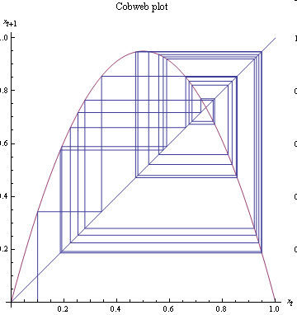
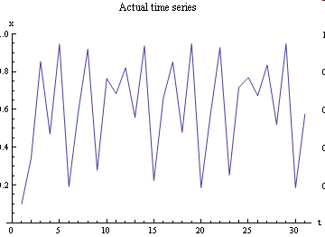
What is going on for a > 3.6?
Example: a = 3.8
Chaos
  The system loses periodicity after a cascade of period doubling events

