Slide 1
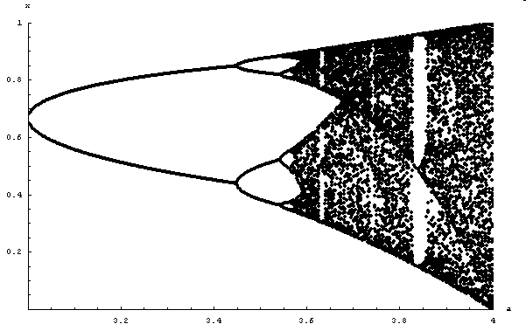
Chaos
Hiroki Sayama
sayama@binghamton.edu

Slide 2
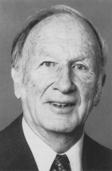
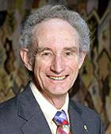
Discovery of chaos
Discovered in early 1960’s by Edward N. Lorenz (in a 3-D continuous-time model)
Popularized in 1976 by Sir Robert M. May as an example of complex dynamics caused by simple rules (he used a 1-D discrete-time logistic map)

Slide 3
Chaos in dynamical systems
A long-term behavior of a dynamical system that never falls in any static or periodic trajectories
Looks like a random fluctuation, but still occurs in completely deterministic simple systems
Exhibits sensitivity to initial conditions
Can be found everywhere

Slide 4

Example

Slide 5
Chaos in Discrete-Time Models

Slide 6
Simple example: Logistic map
A simple difference equation used by Robert M. May in his paper in 1976
x_{t} = a x_{t-1} ( 1 – x_{t-1} )
  Similar to (but not quite the same as) the discrete-time logistic growth model (missing first x_{t} on the right hand side)
  Shows quite complex dynamics as control parameter a is varied

Slide 7
Exercise
Plot time series produced by the logistic map for a = 0.5, 1.5 and 2.5

Slide 8
Exercise
Draw cobweb plots of the logistic map for a = 0.5, 1.5 and 2.5

Slide 9
Drawing bifurcation diagrams using numerical results
For systems with periodic (or chaotic) long-term behavior, it is useful to draw a bifurcation diagram using numerical simulation results instead of analytical results
  Plot actual system states sampled after a long period of time has passed
  Can capture period-doubling bifurcation by a “set” of points

Slide 10
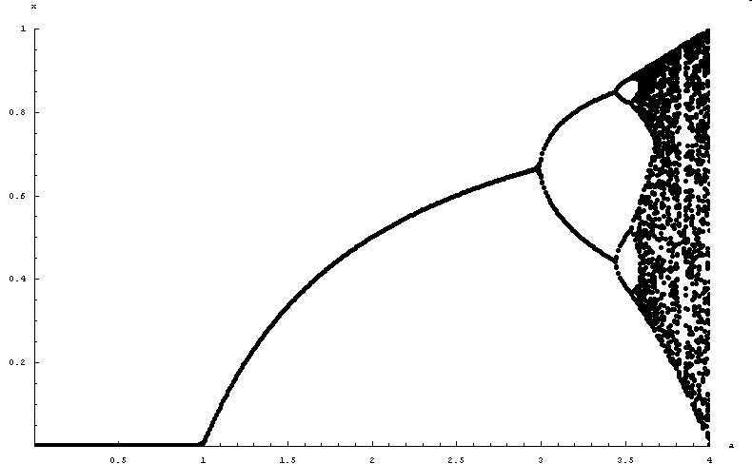
Cascade of period-doubling bifurcations leading to chaos
Period-
doubling
bifurcation
Period-doubling
bifurcation
Period-doubling
bifurcation
Period-
doubling
bifurcation
Period-
doubling
bifurcation
Chaos
Period-doubling
bifurcation
Period-
doubling
bifurcation
Transcritical
bifurcation
Doubling periods diverge
to ∞ at a ≈ 3.599692…!

Slide 11
Reinterpreting chaos
Where a period diverges to infinity
  Periodic behavior with infinitely long periods means “aperiodic” behavior
Where (almost) no periodic trajectories are stable
  No fixed points or periodic trajectories you can sit in (you have to always deviate from your past course!!)

Slide 12
Exercise
Draw a more detailed bifurcation diagram for the chaotic regime and see how those chaotic trajectories are structured there
Can you find any “order” in chaos?

Slide 13
Exercise
What happens if you try plotting cobweb plots and bifurcation diagrams of the logistic map for negative a?
Determine the range of a where chaotic dynamics occurs

Slide 14
Characteristics of Chaos

Slide 15
Common mechanism of chaos:
Stretch and folding in phase space
In chaotic systems, it is generally seen that a phase space is stretched and folded, like dough kneading
0
1
1
0
0
1
0.8
0.6
0.4
0.2
1
0
0.2
0.4
0.6
0.8
1
1

Slide 16
Other examples of stretching and folding: tent map, saw map
1
1
0.8
0.8
0.6
0.6
0.4
0.4
0.2
0.2
0.2
0.4
0.6
0.8
1
0.2
0.4
0.6
0.8
1
These maps also have chaotic dynamics if the initial condition is an irrational number
What kind of numerical operation is carried out when one applies either of these maps to a number?

Slide 17
Sensitivity to initial conditions
Stretching and folding mechanisms always dig out microscale details hidden in a system’s state and expand them to macroscale visible levels
This causes chaotic systems very sensitive to initial conditions
Think about where a grain in a dough will eventually move during kneading

Slide 18
Lyapunov exponent (1)
A quantitative measure of a system’s sensitivity to small differences in initial condition
Characterizes how the distance between initially close two points will grow over time
| F^{t}(x₀+ε) - F^{t}(x₀) | ~ ε e^{tλ} (for large t)

Slide 19
Lyapunov exponent (2)
| F^{t}(x₀+ε) - F^{t}(x₀) | ~ ε e^{tλ} (for large t)
λ = lim_{t→∞} log
= lim_{t→∞} log
= lim_{t→∞} Σ_{i=0~t-1} log |F’(x_{i})|
1
F^{t}(x₀+ε) - F^{t}(x₀)
_{ε→0}
t
ε
1
d
F^{t}(x₀)
t
dx
1
t

Slide 20
Exercise
Plot how the Lyapunov exponent of the logistic map changes over varying a
Compare the result with its bifurcation diagram

Slide 21
Chaos in Continuous-Time Models

Slide 22
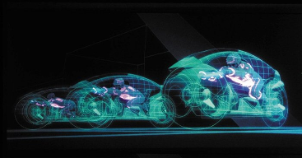

Chaos in continuous-time models
Requires three or more dimensions
  Because in 1-D or 2-D phase space, every trajectory works as a “wall” and thus confines where you can go in the future; stretching and folding are not possible in such an environment
TRON / © Walt Disney Pictures

Slide 23
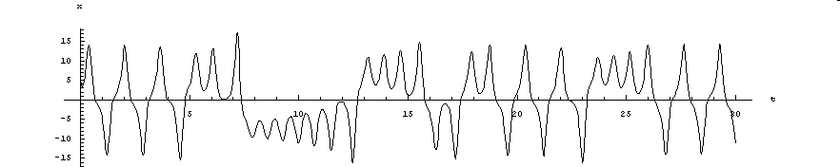
Edward N. Lorenz’s model
A model of fluid convection:
dx/dt = s (y – x)
dy/dt = r x – y – x z
dz/dt = x y – b z
(s, r and b are positive parameters)
Typical behavior (x plotted over time):

Slide 24
Exercise
Obtain the equilibrium points of the Lorenz model as a function of r while keeping s = 10 and b = 8/3
Examine their stability and its dependence on the value of r
When do bifurcations occur?

Slide 25
Exercise
Draw 3-D phase portraits of the Lorenz model
  Not to mess up the plot, it is suggested that you plot only one sample trajectory starting from a single initial condition
Try several different values of r and see what you will get

Slide 26
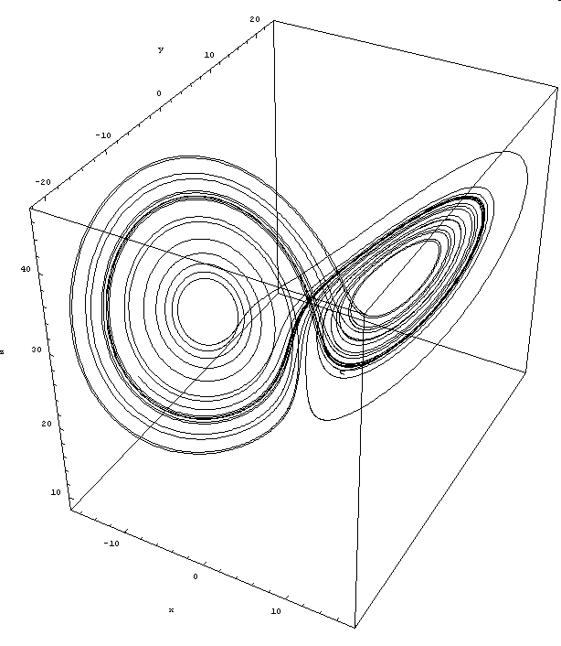
Phase portrait

Slide 27
Strange attractor
A bounded region in a phase space that attracts nearby trajectories but also exhibits sensitive dependence on initial conditions inside it (i.e., no convergence to fixed points or periodic trajectories)
  A.k.a.: chaotic attractor, fractal attractor

Slide 28
Exercise: Finding stretch and folding in the Lorenz model
Interpret the structure of the strange attractor of the Lorenz model and find how “stretch and folding” of phase space is achieved

Slide 29
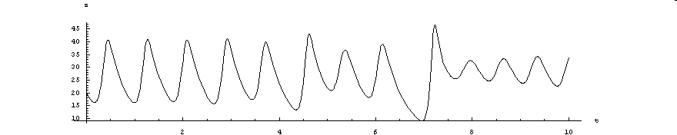
Exercise: Finding hidden order in chaotic systems
Let z_{i} denote the value of i-th peaks of z in the Lorenz model:
Obtain time series data { z_{i} } from numerical results (this may require some programming), draw a “z_{t-1} vs. z_{t”} plot, and discuss what is seen there
z₃
z₄
z₅
z₆
…
z₁
z₂

