Slide 1
Cellular Automata
Hiroki Sayama
sayama@binghamton.edu

Slide 2
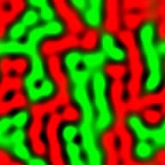
Spatio-temporal patterns
If a system has spatial extension, nonlinear interactions among local parts may spontaneously create patterns from initially uniform conditions
  May be static or dynamic
  Seen in many aspects of biological systems
    Morphogenesis
    Neural/muscular activities
    Population distribution

Slide 3
Cellular Automata

Slide 4
Cellular automata (CA)
A regular grid model made of many “automata” whose states are finite and discrete (→ nonlinearity)
Their states are simulta-neously updated by a uniform state-transition function that refers to states of their neighbors
s_{t+1}(x) = F ( s_{t}(x+x₀), s_{t}(x+x₁), ... , s_{t}(x+x_{n-1}) )

Slide 5
How CA works
Neighborhood
T
L
C
R
B
State set
State-transition function
C
T
R
B
L
C
T
R
B
L
C
T
R
B
L
C
T
R
B
L
{
,
}

Slide 6
Some terminologies
Configuration
  A mapping from spatial coordinates to states (s_{t}(x)); global arrangement of states at time t
Local situation
  A specific arrangement of states within a local neighborhood, to be given to the state-transition function as an input
Quiescent state ( )
  A state that represents “empty” space; never changes if surrounded by other quiescent states
    Some CA have no quiescent state

Slide 7
Boundary conditions
Periodic boundary condition
  Cells at the edge of the space is connected to the cells at the other edge
Cut-off boundary condition
  Cells at the edge of the space do not have neighbors outside the space
Fixed boundary condition
  Cells at the edge of the space are fixed to specific states

Slide 8
Exercise: 1-D majority rule
Each cell looks at its own and two nearest neighbors’ states, and then change to the local majority state
Periodic boundary conditions assumed
Complete time evolution of this CA
t=0
t=1
t=2
t=3

Slide 9
Typical 2-D neighborhood shapes
von Neumann neighborhood
Moore neighborhood

Slide 10
Exercise: 2-D parity rule
Each cell looks at states of cells in its von Neumann neighborhood, and then change to the state whose number was odd
Quiescent states assumed outside the space
Complete time evolution of this CA
t=0
t=1
t=2

Slide 11
Modeling example: Panic in a gym

Slide 12
Fire alarm causes initial panics

Slide 13
Rules of local interaction
With four or more panicky persons around you
With two or fewer panicky persons around you

Slide 14
Exercise
What happens if you change the initial ratio of panicky people?
What happens if you change the state transition rules?
Can you modify the code so that it produces time series of the number of panicky people as well as the visual plot?

Slide 15
Exercise
Implement the simulator of “majority” CA (each cell turns into a local majority state) and see what kind of patterns arise
What will happen if:
  Number of states are increased
  Size of neighborhoods is increased
  “Minority” rule is adopted

Slide 16
Exercise
Implement the simulator of the “Game of Life” CA and see what kind of patterns arise
State transition rule:
  ‘0’ turns into ‘1’ iff exactly three ‘1’s surround it
  ‘1’ remains ‘1’ iff two or three other ‘1’s surround it (otherwise it turns into ‘0’)

Slide 17
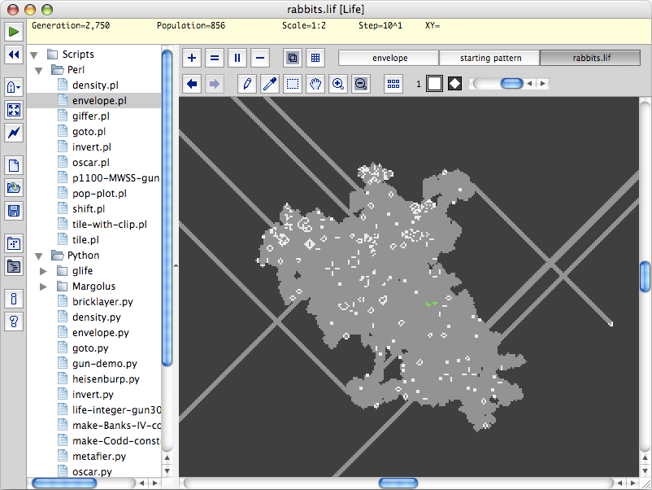
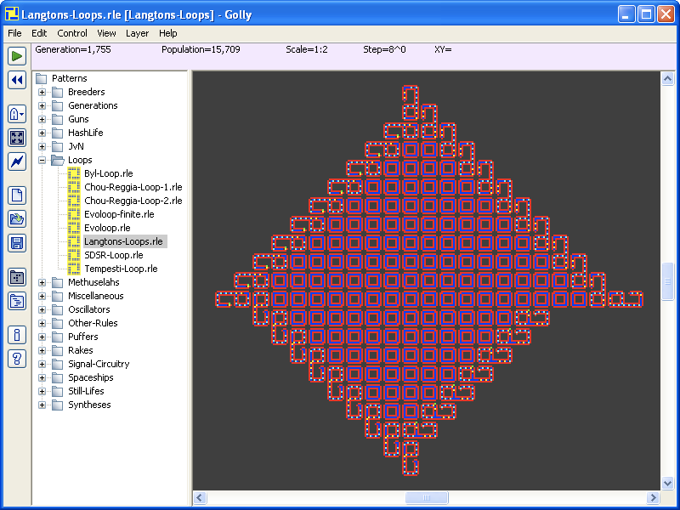
FYI: “Golly”
Golly: Game of Life Simulator is free software that can simulate very large-scale CA space in a very fast and efficient way

Slide 18
Other Extensions of Cellular Automata

Slide 19
Stochastic CA
CA with stochastic state-transition functions
  Stochastic growth models
  Ecological/epidemiological models
(1-p)^{k}
1-(1-p)^{k}

Slide 20
Multi-layer CA
CA whose cells have composite states
  Multiple “layers” in a state
  Similar to vector states, but each layer can have non-numerical values as well
  Represents multiple CA spaces interacting with each other
State for layer 1
State for layer 2
State for layer 3
…

Slide 21
Multi-layer CA
Examples
  Models of spatially distributed agents with complex internal states
  Models of interaction between agents and environment
  CA that depend on more than one step past configurations

Slide 22
Asynchronous CA
CA where cells are updated asynchronously
  Random updating, sequential updating, etc.
  Can simulate any synchronous CA
  Global synchrony is not strictly required for the dynamics of CA!!

Slide 23
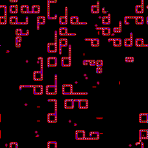
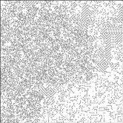
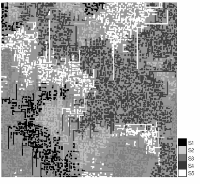
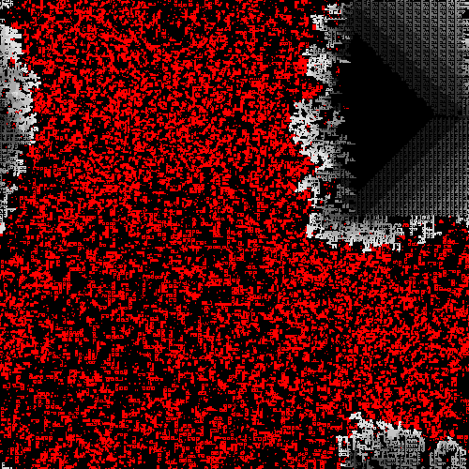
FYI: Emergent evolution on CA
Evoloops (Sayama 1998)
Self-replicating worms (Sayama 2000)
Ecology of self-replicating worms (Suzuki et al. 2003)
Genetic evolution of self-replicating loops (Salzberg et al. 2003, 2004)
  http://bingweb.binghamton.edu/~sayama/

Slide 24
Biological Models on CA

Slide 25
Several biological models on CA
Turing patterns
Waves in excitable media
Host-pathogen models
Epidemic / forest fire models

Slide 26
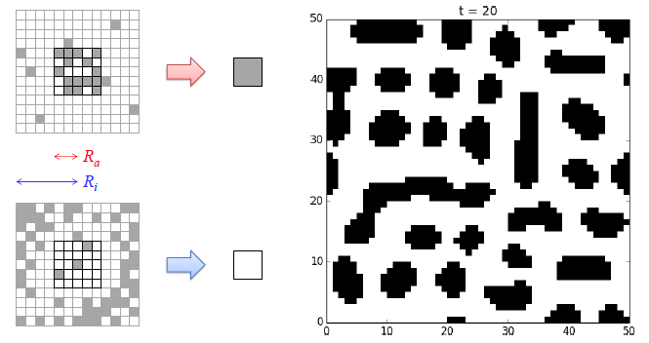
Turing patterns
Chemical pattern formation proposed by Alan Turing (original model in PDEs)
  Strong short-range activation
  Relatively weak long-range inhibition

Slide 27
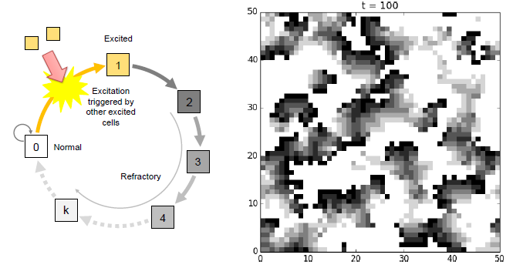
Waves in excitable media
Propagation of signals over excitable neural/muscular tissues
  Excitation of resting cells by neighbors
  Excitation followed by refractory states

Slide 28
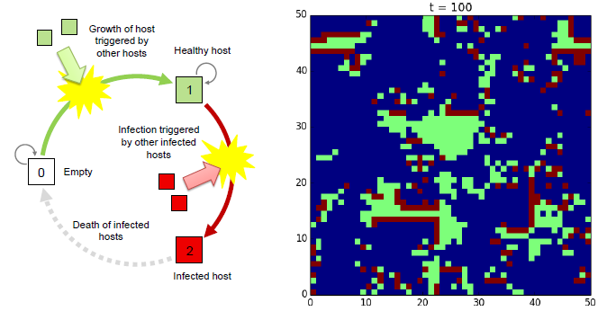
Host-pathogen models
Propagation of pathogens over dynamically growing hosts
  Spatial growth of hosts
  Infection of pathogens to nearby hosts

Slide 29
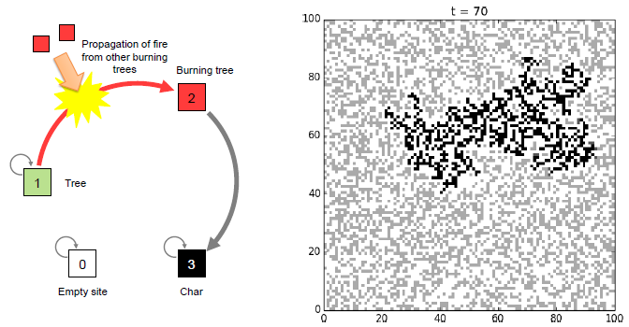
Epidemic/forest fire models
Propagation of disease or fire over statically distributed hosts
  Propagation of disease to nearby hosts
  Death of hosts caused by propagation

Slide 30
Phase Space of Cellular Automata

Slide 31
Phase space of cellular automata
For a fixed number of cells, the total number of possible configurations is also fixed and finite: k^{n}
  k: Number of states
  n: Number of cells
For deterministic CA, each configuration is always mapped to just one configuration
  You can draw a state-transition diagram

Slide 32
Counting #s of possibilities
Dimensions of space: D
Length of space in each dimension: L
Radius of neighborhood: r
Number of states for each cell: k
# of configurations: k^{L^{D}}
# of possible rules: k^{k^{(2r+1)^{D}}}

Slide 33
Exercise
Draw a phase space of the binary-state 1-D majority CA with 5 cells and periodic boundary conditions
  Use symmetries to reduce the number of configurations

Slide 34
Features in phase space
Self-loop → fixed point
Cycle → periodic attractor
Configuration with no predecessor
→ “Garden of Eden” states
Just one big basin of attraction
→ Initial configurations don’t matter
Many separate basins of attraction
→ Sensitive to initial configurations

Slide 35
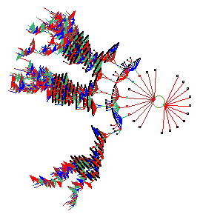
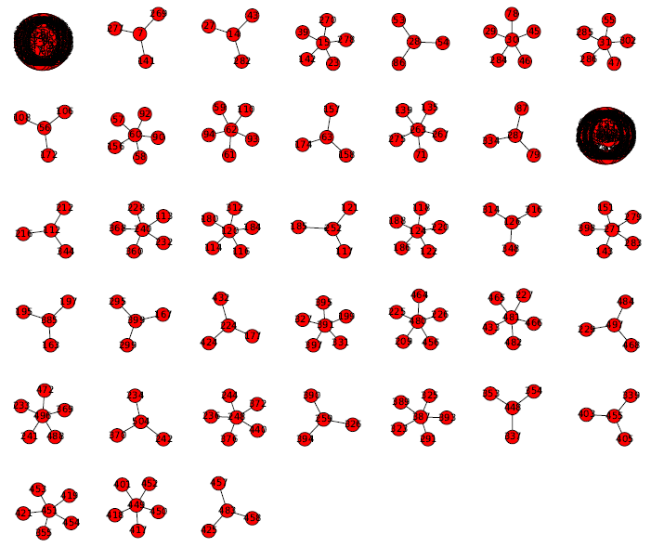
Phase space visualization
Visualization in Python
Visualization by DDLab

Slide 36
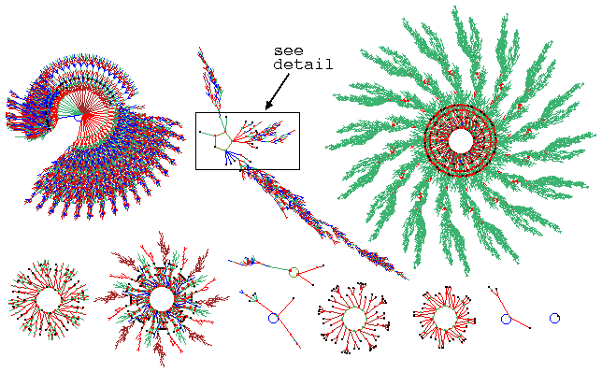
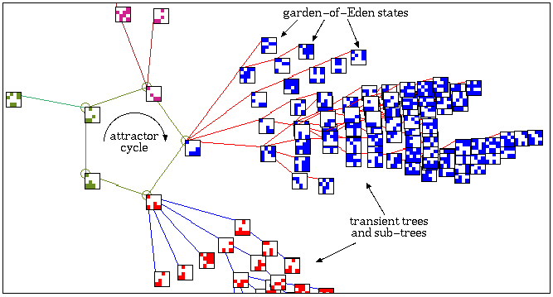
Example
k=2, n=16
© Andy Wuenshe
http://www.ddlab.com/

Slide 37
FYI: Wolfram’s classification
Wolfram (1984) classified binary-state 1-D CA based on their typical attractors’ properties
  I: Fixed point of homogeneous states
  II: Fixed point or small cycle involving heterogeneous states
  III: Chaotic attractor (very long cycle)
  IV: Complex, long-lived localized structures (attractor preceded by very long tree-like basins of attraction)

Slide 38
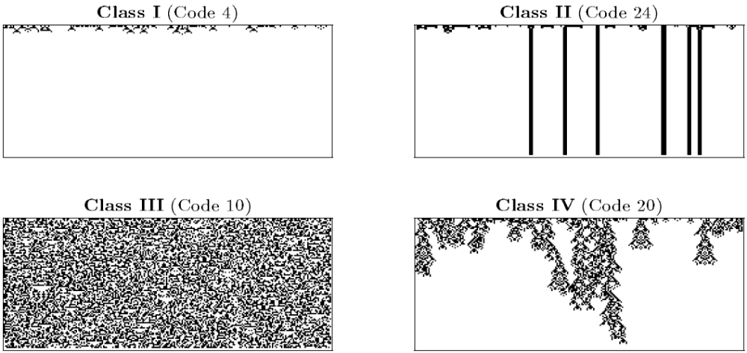
FYI: Wolfram’s classification

Slide 39
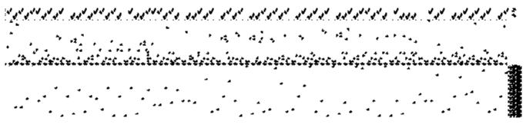
FYI: Computational universality
Some CA are computationally universal as a Universal Turing Machine can be built on those CA spaces
Minsky Register Machine implemented on GoL CA (P. Chapman 2002)
You can’t predict the behavior of CA more efficiently than explicit simulation!!

Slide 40
Mean-Field Approximation

Slide 41
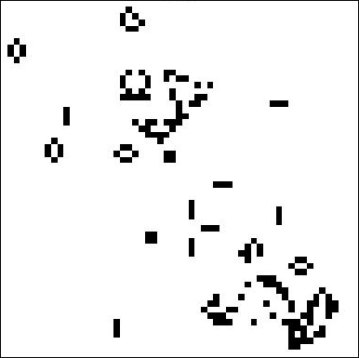
Mean-field approximation
An approximation to drastically reduce the dimensions of the system by reformulating the dynamics in terms of “a state of one part” and “the average of all the rest (= mean field)”
0
MFA
A cell
1

Slide 42
How MFA works
0
MFA
A cell
1
Make an approximated description about how one part changes its state through the interaction with the average of all the rest (= mean field)
Assume this approximation applies to all the parts, and analyze how the mean field itself behaves

Slide 43
Mathematical description of MFA (difference equations)
Original equations:
x^{i}_{t} = F^{i}( { x^{i}_{t-1} } )
Approximate equations with MFA:
x^{i}_{t} = F’^{i}(x^{i}_{t-1}, <x>_{t-1})
<x>_{t} = Σ_{i} x^{i}_{t-1} / n
Each state-transition function takes only two arguments:
its own state and the “mean field”

Slide 44
Exercise
Describe the dynamics of average density of states, p_{t}, in majority CA
Consider the following:
  For each state ‘0’ or ‘1’, what is the probability for the cell to stay in the same state?
  Based on the results above, how does the “mean field” p_{t} change over time?

Slide 45
Exercise
Describe the dynamics of average density of states, p_{t}, in the Game of Life CA
Compare the analytical estimate of state density obtained with MFA with the actual simulation results
Do they match or not? Why?

Slide 46
Applicability of MFA
MFA works quite well for systems whose parts are well-connected or randomly interacting
MFA does not work (a) if interactions are local or non-homogeneous, and/or (b) if the system has a non-uniform “pattern” as its macroscopic state
Use MFA as a preliminary approximation, but not to derive a final conclusion

Slide 47
Critical Behavior in CA-Based Models

Slide 48
Critical behavior in CA-based models
Contact processes on CA-based models may show critical behavior
  Drastic changes of macroscopic properties when some local parameter value is varied
  Called “phase transition” – bifurcation of macroscopic properties occurring in aggregates
  Many interesting phenomena occur at a critical parameter value

Slide 49
Example: Epidemic / forest fire models
Propagation of disease or fire over statically distributed hosts with initial density p:
  Propagation of disease or fire to nearby hosts
  Death or breakdown of hosts caused by propagation

Slide 50
Exercise
Implement the forest fire model in Python
  Use the Moore neighborhoods
Compare the results for different p
Plot the total burned area and the time required to complete the fire as a function of p
  Where is the percolation threshold?

Slide 51
Analytical estimation of threshold
Percolation threshold may be estimated analytically by renormalization group analysis
Key idea:
Critical behavior arises when local dynamics and global dynamics are nearly identical
  Similar percolation process occurs at every scale, from micro to macro

Slide 52
Renormalization group analysis
Obtain the relationship between percolation probabilities at lowest level (p₁) and at one-step higher level (p₂ = Φ(p₁))
Obtain p that satisfies p = Φ(p)
Single cell level:
p₁ = p
2x2 block level:
p₂ = Φ(p₁)

Slide 53
Example: Forest fire model with Moore neighborhoods
2x2 block level:
p₂ = Φ(p₁)
= p₁⁴ + 4p₁³(1-p₁)
+ 4p₁²(1-p₁)²
Single cell level:
p₁ = p

Slide 54
At a larger scale…
4x4 block level:
p₄ = Φ(p₂)
= Φ(Φ(p₁))
2x2 block level:
p₂ = Φ(p₁)
(Note: This is an approximation, not an exact calculation)

Slide 55
Thinking even larger…
Percolation probability at 2^{n}x2^{n} block level:
p₂n = Φ^{(n)}(p₁)
Percolation probability at macroscopic level (n→∞):
p∞ = lim_{n→∞} Φ^{(n)}(p₁)

Slide 56
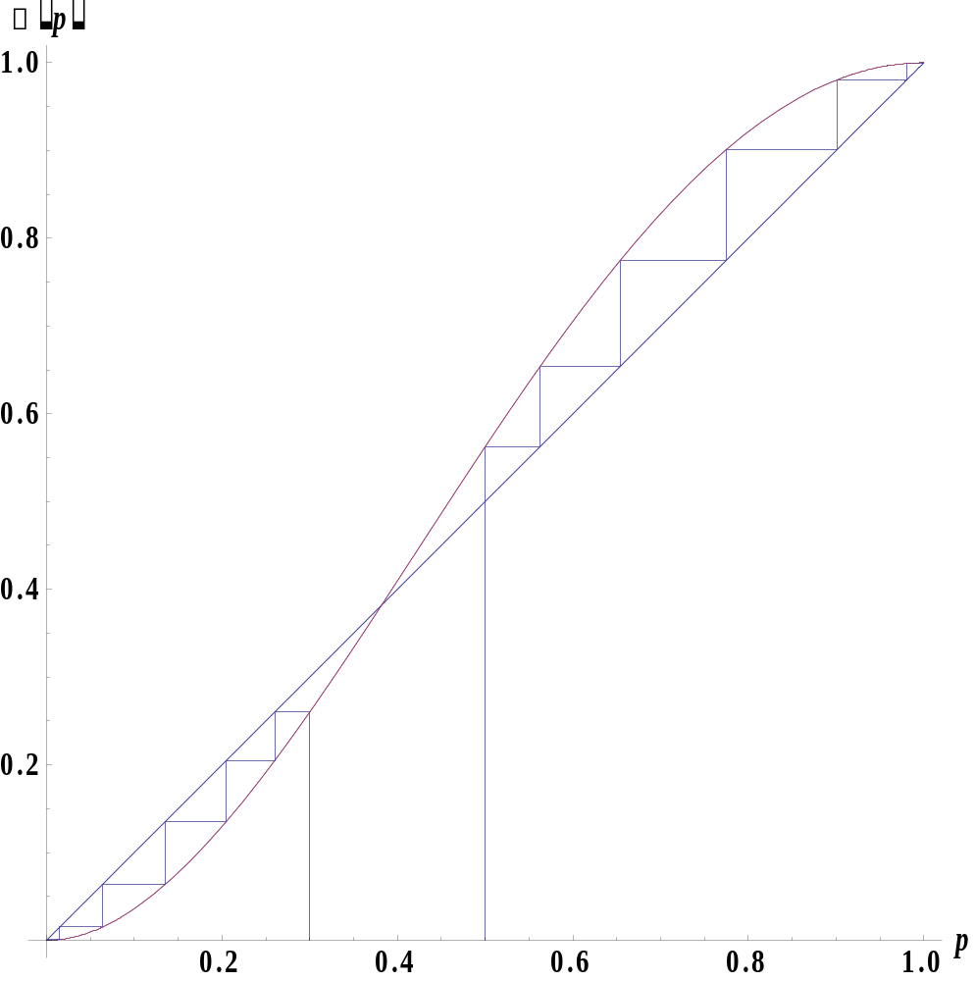
Fixed point of Φ(p)
lim_{n→∞} Φ^{(n)}(0.5)
= 1
Percolation occurs at macroscopic scale
Φ(p_{c}) = p_{c}
Critical behavior
Macroscopic percolation probability
lim_{n→∞} Φ^{(n)}(0.3)
= 0
Percolation does not occur at macroscopic scale
Microscopic percolation
probability

Slide 57
Therefore…
Solving p = Φ(p) gives an analytical estimate of percolation threshold p_{c}

Slide 58
Exercise
Estimate the percolation threshold for the same forest fire model but with von Neumann neighborhoods
Confirm the analytical result by conducting simulations

Slide 59
Exercise
What would happen if the space of the forest fire propagation is 1-D?
Do the renormalization group analysis to see what happens

