Slide 1
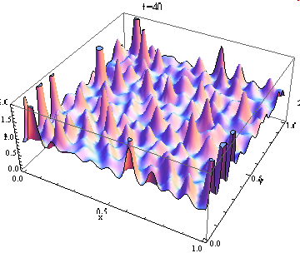
Continuous Field Models
Hiroki Sayama
sayama@binghamton.edu

Slide 2
Continuous Field Models

Slide 3
Increasing the number of variables
Models with small degrees of freedom
  No spatial extension
Models with large degrees of freedom
  Spatial extension
Continuous field models
  Infinite number of variables -> Functions
  Continuous spatial extension
Fewer
variables
More
variables

Slide 4
Continuous field models
A system’s state is represented by a function that maps each spatial location to a local state value/vector
Dynamics are described typically using partial differential equations (PDEs)
Analytical treatments may still be possible; may give us important solutions and insights

Slide 5
Spatial function as a “state”
The state of a PDE-based system is defined by a function f(x,t)
  A field made of local states defined over a continuous spatial domain
x: spatial location (vector)
f(x,t): local state (scalar or vector)
  Population density (scalar)
  Chemical concentration (scalar or vector)
  Local flow (vector)

Slide 6
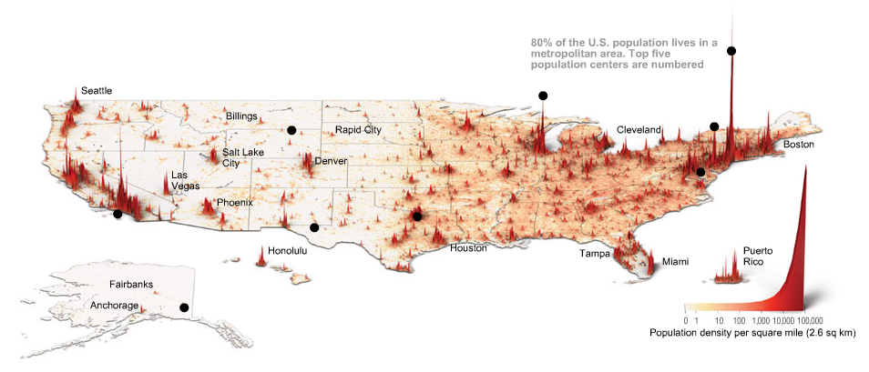
Example of a scalar field
2006 © TIME.com

Slide 7
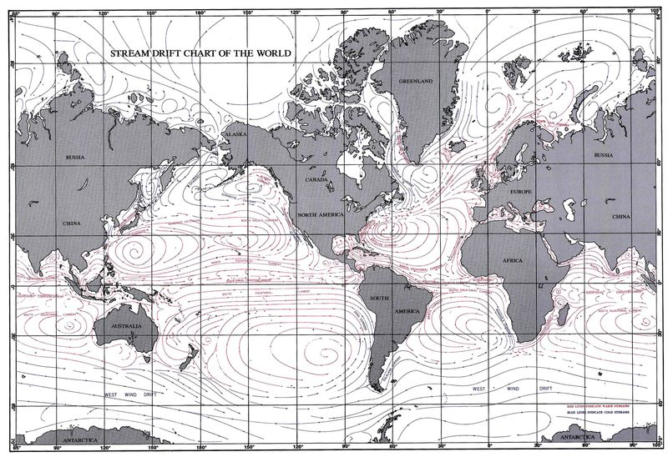
Example of a vector field
Global ocean current in 2004. Source: National Geospatial intelligence agency

Slide 8
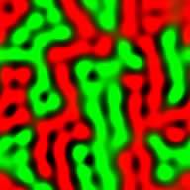
Spatio-temporal patterns
If a system has spatial extension, nonlinear interactions among local parts may spontaneously create patterns from initially uniform conditions
  May be static or dynamic
  Seen in many aspects of biological systems
    Morphogenesis
    Neural/muscular activities
    Population distribution

Slide 9
A couple of fundamentals (1)
Contour (aka. level curve/surface):
  a set of points x that satisfy f(x) = constant for a scalar field f
Gradient:
  a vector locally defined by ∇f = (∂f/∂x₁, ∂f/∂x₂, … ) for a scalar field f
    ∇ is read “del” or “nabla”
    Shows direction of steepest ascending slope
    Magnitude tells the steepness
    Always perpendicular to level curve/surface (unless it is a zero vector at critical points)

Slide 10
A couple of fundamentals (2)
Gradient field:
  a vector field ∇f defined over a scalar field f
Divergence:
  a scalar field
  ∇·v = (∂/∂x₁, ∂/∂x₂, …)·(v₁, v₂, …)
  = ∂v₁/∂x₁+ ∂v₂/∂x₂+… ,
  defined over a vector field v
    Quantifies the tendency of the vector field to diverge from the location (x₁, x₂, … )

Slide 11
What a divergence means
2h * v_{y}(x,y+h)
Divergence > 0 means something is draining out of the point (“divergence”)
Divergence < 0 means something is coming in to the point
2h *
v_{x}(x+h,y)
2h *
v_{x}(x-h,y)
A small spatial area
around (x, y)
Concentration:
# of particles / (2h)²
2h
2h * v_{y}(x,y-h)

Slide 12
A couple of fundamentals (3)
Laplacian:
  a scalar field
  ∇²f = ∇·∇f
  = (∂/∂x₁, ∂/∂x₂, …)·(∂f/∂x₁, ∂f/∂x₂, …)
  = ∂²f/∂x₁² + ∂²f/∂x₂² + … ,
  defined over a scalar field f
    ∇·∇ is sometimes read “div dot grad”
    Is positive and large around valleys of f
    Is negative and small around peaks of f
    Plays an important role in diffusion equations

Slide 13
Exercise
Obtain the gradient field and the Laplacian of:
f(x, y) = x² + xy

Slide 14
Visualizing 2D continuous fields
To visualize a scalar field:
  plot_surface (needs Axes3D)
  contour
  imshow
To visualize a vector field:
  streamplot

Slide 15
Modeling Spatial Movement

Slide 16
Spatio-temporal dynamics in PDEs
The dynamics of a continuous-field model may be given by:
∂f/∂t = F(f, x, t)
  If F doesn’t include t, the system is autonomous
  F may include partial derivatives of f over x₁, x₂, … etc.
  If f is defined as a vector, separate equations should be defined for each f_{i}

Slide 17
Example: Transport equation (1)
∂c
= - ∇·J(x,t) + s(x,t)
∂t
  c: concentration at (x, t) (number of particles per unit of volume)
  J: flux at (x, t) (a vector field that tells the number of moving particles per unit of volume & time and their direction)
  s: source/sink at (x,t)

Slide 18
Example: Transport equation (2)
∂c
= - ∇·(c(x,t) v(x,t) ) + s(x,t)
∂t
  c: concentration at (x, t) (number of particles per unit of volume)
  v: trend at (x, t) (a vector field that tells the velocity of moving particles)
  (i.e. v(x,t) = J(x,t) / c(x,t) )

Slide 19
Deriving diffusion equation (1)
∂c
= - ∇·J(x,t) + s(x,t)
∂t
If the particles obey simple diffusion:
  s(x,t) should be zero (no source/sink)
  J(x,t) should be in the opposite direction of the gradient of c(x,t), because the particles tend to move along steepest descending slopes

Slide 20
Deriving diffusion equation (2)
∂c
= - ∇·J(x,t) + s(x,t)
∂t
= - ∇·( -D ∇c(x,t) )
  (where D is the diffusion coefficient; if D is a constant that doesn’t depend on x or t, this further simplifies to)
= D ∇·∇c(x,t)
= D ∇²c(x,t) (Fick’s law)

Slide 21
Exercise
Develop a PDE model that describes the attraction of particles to each other
  Assume each particle moves toward the regions where there are more particles
  Use the transport equation as a template

Slide 22
Exercise
Develop a two-variable PDE model that describes the spatio-temporal dynamics of the following system:
  People are attracted toward the regions where economy is active
  Economy is activated by having more people in the region
  Economy would diminish without people
  Both populations and economical activities diffuse spatially

Slide 23
Converting PDE Models into CA with Real-Valued States

Slide 24
CA with real-valued states
CA may be used as a discrete analog of PDE-based models
States are extended to real numbers (or even to vectors if PDEs involve multiple state variables)

Slide 25
Discretizing time
Discretize time at interval Δt:
∂f/∂t = F(f, x, t)
f_{t+Δt}(x) = f_{t}(x) + ∂f/∂t Δt
= f_{t}(x) + F(f_{t}, x, t) Δt
  Spatial derivatives in F should also be replaced with their discrete equivalents

Slide 26
Discretizing spatial derivatives
∂f/∂x = lim_{h→0} ( f(x+h,t) – f(x,t) ) / h
If we make a discrete analog of this by letting h = Δx:
∂f/∂x ~ ( f_{t}(x+Δx) – f_{t}(x) ) / Δx
If both sides of neighbors are used:
∂f/∂x ~ ( (f_{t}(x+Δx) – f_{t}(x)) +
(f_{t}(x) – f_{t}(x-Δx)) ) / 2Δx
= ( f_{t}(x+Δx) – f_{t}(x-Δx) ) / 2Δx

Slide 27
Discretizing Laplacians (1)
∂²f/∂x² = lim_{h→0} ( f’(x+h,t) – f’(x-h,t) ) / 2h
= lim_{h→0} { lim_{k→0} (f(x+h+k,t) – f(x+h-k,t)) / 2k
– lim_{k→0} (f(x-h+k,t) – f(x-h-k,t)) / 2k } / 2h
= lim_{h→0} ( f(x+2h,t) + f(x-2h,t) – 2f(x,t) ) / (2h)²
If we make a discrete analog of this by letting h = Δx/2:
∂²f/∂x²
~ ( f_{t}(x+Δx) + f_{t}(x-Δx) – 2f_{t}(x) ) / Δx²

Slide 28
Discretizing Laplacians (2)
Similarly, for 2-D space:
∇²f = ∂²f/∂x² + ∂²f/∂y²
~ ( f_{t}(x+Δx,y)+f_{t}(x-Δx,y)–2f_{t}(x,y) ) / Δx²
+( f_{t}(x,y+Δy)+f_{t}(x,y-Δy)–2f_{t}(x,y) ) / Δy²
= ( f_{t}(x+Δk,y) + f_{t}(x-Δk,y) + f_{t}(x,y+Δk)
+ f_{t}(x,y-Δk) – 4f_{t}(x,y) ) / Δk²
(if Δx = Δy = Δk)

Slide 29
Exercise
Simulate the following continuous field models in a 2-D space:
  Diffusion: ∂c/∂t = D ∇²c(x,t)
  Transport: ∂c/∂t = -∇·(c(x,t) v)
    v is a constant vector that represents the velocity of a homogeneous trend

Slide 30
Exercise
Extend the Lotka-Volterra (predator-prey) model to a 2-D space by introducing diffusion terms
Convert it into CA with vector-valued states
Implement the simulation code and conduct simulations

Slide 31
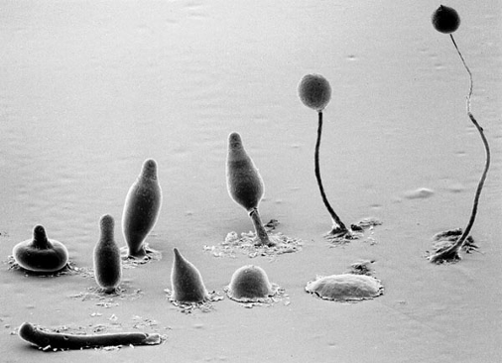
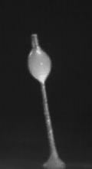

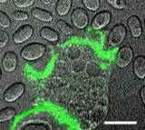
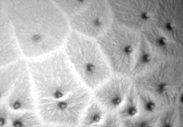
Biological example: Cellular slime mold aggregation
Model organism: Dictyostelium discoideum
© dictyBase and Kyoto University Dictyostelium Group

Slide 32
Model of slime mold aggregation
Developed by Keller & Segel (1970)
Assumptions:
  Initially homogeneous distribution of cells
  Cells undergo random motion (diffusion) and chemotaxis toward cAMP (attractant)
  Cells neither die nor divide
  Each cell constantly produce cAMP
  cAMP shows diffusion and exponential decay

Slide 33
Keller-Segel equations
∂a/∂t = μ∇²a – χa∇²c
∂c/∂t = D∇²c + fa – kc
  a: density of cellular slime molds
  c: concentration of cAMP
  μ: motility of cells
  χ: chemotactic coefficient of cells
  D: diffusion coefficient of cAMP
  f: rate of cAMP secretion by cells
  k: rate of cAMP degradation

Slide 34
Exercise
Implement a simulator code of the Keller-Segel slime mold aggregation model
Conduct simulations with μ=10⁻⁴, D=10⁻⁴, f=1, k=1, while varying χ as a control parameter (0<χ<10⁻³)
Use a=1, c=0 as initial conditions but add slight random perturbations

Slide 35
Exercise
Try several different initial conditions and parameter variations and see how they affect the pattern formation process
  What happens if initial conditions are:
    Completely flat (with no perturbations)?
    Pure sinusoid functions?
  What happens if diffusion is faster?

Slide 36
Reaction-Diffusion Equations

Slide 37
Reaction-diffusion equations
Continuous field models whose dynamical equations are made of reaction terms and diffusion terms:
∂f₁/∂t = R₁(f₁, f₂, …) + D₁ ∇²f₁
∂f₂/∂t = R₂(f₁, f₂, …) + D₂ ∇²f₂ …
  R₁, R₂, …: Reaction functions
  D₁, D₂, …: Diffusion coefficients

Slide 38
Exercise
Extend the following models into a spatial domain as reaction-diffusion equations by adding diffusion terms and simulate their behaviors
  Predator-prey equations
  FitzHugh-Nagumo equations

Slide 39
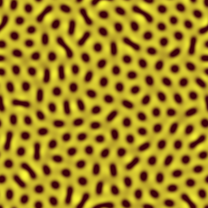
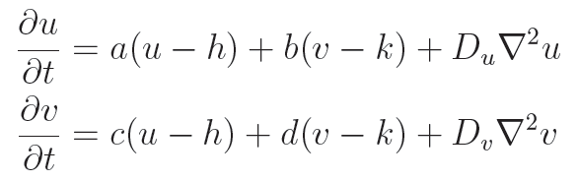
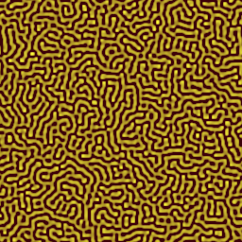
Turing pattern formation
One of the first R-D systems developed by A. M. Turing in early 1950’s
  Explains how animal coat patterns may emerge out of chemical processes
Images generated using online applet by C.G. Jennings at SFU

Slide 40
Exercise
Implement a simulator code of the Turing pattern formation models
Conduct simulations with several different parameter settings
Discuss how the parameters affect the resulting patterns

Slide 41
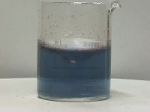
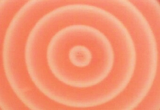
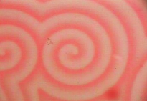
Belousov-Zhabotinsky reaction (1)
An “oscillatory” chemical reaction found by B. P. Belousov and then confirmed by A. M. Zhabotinsky in 1950‘s and 1960’s, respectively
A complex oxidation process of malonic acid (CH₂(COOH)₂) by an acidified bromate solution, involving about 30 different chemicals
© Kyoto University Dept. of Physics

Slide 42
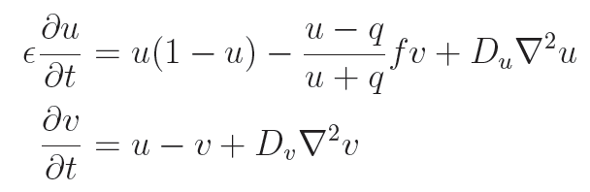
Belousov-Zhabotinsky reaction (2)
A simplified “Oregonator” model with no spatial dimension:
  u: concentration of “activator”
  v: concentration of “inhibitor”

Slide 43
Exercise
Implement a simulator code of the reaction-diffusion version of the model
Conduct simulations with several different parameter settings

Slide 44
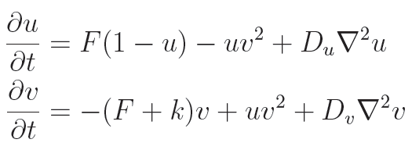
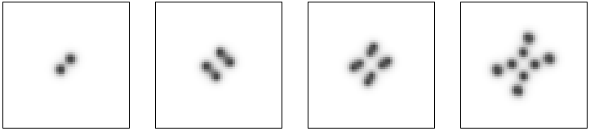
Gray-Scott pattern formation
Another famous R-D model developed by P. Gray and S. K. Scott in 1983; popularized by J. E. Pearson in 1993
  May show biological-looking growth, division & death of “spots”

Slide 45
Exercise
Implement a simulator code of the Gray-Scott pattern formation models
Conduct simulations with several different parameter settings
Discuss how the parameters affect the resulting patterns

Slide 46
Analytical Treatments of Continuous Field Models

Slide 47
Review: Stability of equilibrium points
If a system at its equilibrium point is slightly perturbed, what happens?
The equilibrium point is called:
  Stable (or asymptotically stable) if the system eventually falls back to the equilibrium point
  Lyapunov stable if the system doesn’t go far away from the equilibrium point
  Unstable otherwise

Slide 48
Similar analysis is possible for continuous field models!!
Find equilibrium states (i.e., functions, not just points)
  Homogeneous equilibrium states are often used in analytical treatments
Add small perturbations to the equilibrium states
Linearize the model equations and see if the perturbations added will grow or shrink

Slide 49
Finding homogeneous equilibrium states
If the system is in its homogeneous equilibrium state, i.e, f(x,t)= f_{h}:
  No spatial variation
    Ignore all spatial derivatives
  No temporal variation
    Equate all equations with 0
Solving the resulting equations tells you homogeneous equilibrium states

Slide 50
Exercise
Obtain the homogeneous equilibrium state(s) of the Keller-Segel model:
∂a/∂t = μ∇²a – χa∇²c
∂c/∂t = D∇²c + fa – kc

Slide 51
Rescaling variables
Dynamics of a system won’t change qualitatively by linear rescaling of variables (e.g., x → α x’)
You can set arbitrary rescaling factors for variables to simplify the model equations
If you have k variables (including time t and space x/y/z…), you may eliminate k parameters

Slide 52
Exercise
Simplify the Keller-Segel model by rescaling a → α a’, c → β c’, x → γ x’, (also y → γ y’), and t → δ t’
∂a/∂t = μ∇²a – χa∇²c
∂c/∂t = D∇²c + fa – kc

Slide 53
Linear stability analysis
Let Δf(x,t) be a small, spatially non-homogeneous perturbation between the system’s current state f(x,t) and its homogeneous equilibrium state f_{h}, i.e. f(x,t) = f_{h} + Δf(x,t)
Plug the above form into the model and ignore quadratic terms of Δf(x,t)
Study how Δf(x,t) behaves over time

Slide 54
A trick for linearization
Even after ignoring quadratic terms of Δf(x,t), the model equations may still include differential operators (e.g., ∂²/∂x²)
But if Δf(x,t) is in the shape of an “eigenfunction” of these operators…
→ They will be replaced by scalar values (eigenvalues) and the equations will be in simple, linear form!!

Slide 55
Eigenfunctions
An “eigenfunction” f of an operator L is defined by:
L f = λ f
  Where λ is (again) called an “eigenvalue”
  f is similar to eigenvectors of matrices
  For L = ∂/∂x: f(x) = C e^{λx}
  For L = ∂²/∂x²: f(x) = C₁ e^{λ1/2x} + C₂ e^{-λ1/2x}
    This includes sin and cos functions for λ < 0

Slide 56
What does this mean?
  For L = ∂²/∂x²: f(x) = C₁ e^{λ1/2x} + C₂ e^{-λ1/2x}
    This includes sin and cos functions for λ < 0
This means that sine waves will not change their shape through diffusion

Slide 57
Exercise
Sine waves will not change their shape through diffusion
Show the above fact mathematically in a 1-D space
  Let f(x,0) = sin(qx+p) (initial condition)
  Let ∂f/∂t = D∇²f (dynamics)
  Solve the above equation and show that the solution is still the original sine wave

Slide 58
Linearizing model equations
For 1-D diffusion-based models, the following perturbation is often used:
Δf(x,t) = Δf(t) sin(qx+p)
  Δf(t): amplitude of small perturbation
  q: wavenumber (spatial frequency)
  p: phase offset (you may ignore this)

Slide 59
Exercise
Linearize the 1-D Keller-Segel model
∂a/∂t = μ∇²a – χa∇²c
∂c/∂t = D∇²c + fa – kc
around its homogeneous equilibrium state (a_{h}, c_{h}), by assuming
a(x,t) = a_{h} + Δa(t) sin(qx+p)
c(x,t) = c_{h} + Δc(t) sin(qx+p)

Slide 60
Exercise (continued)
Δc
a
a
a_{h}
a_{h}
x
x
c
c
c_{h}
c_{h}
x
x
Δa
a
a
a_{h}
a_{h}
x
x
c
c
c_{h}
c_{h}
x
x

Slide 61
Exercise (continued)
Then cancel all the sin(qx+p) to obtain linearized dynamical equations
∂ Δa Δa
= M
∂t Δc Δc
(now we get something very familiar!)
Study the properties of matrix M and obtain the conditions for which the perturbation grows or shrinks

Slide 62
Results
Condition for instability of homogeneous equilibrium states (i.e., aggregation of cellular slime molds):
μ(Dq² + k) < χa_{h}f
  Perturbations whose wavenumbers satisfy this inequality will grow over time; confirm this in numerical simulations
  Eigenvectors of matrix M tells the relative speeds of growth/shrink of perturbations of a and c

Slide 63
Exercise
Introduce some additional assumptions to the Keller-Segel model, e.g.:
  Death and/or division of cells
  Non-monotonic effects of cAMP concentration on chemotaxis
Obtain homogeneous equilibrium states of the new model
Conduct linear stability analysis

Slide 64
Linear stability analysis of reaction-diffusion systems
Result of linear stability analysis can be concisely written using Jacobian matrix of reaction terms
∂ Δf₁ Δf₁ D₁ Δf₁
= J - q²
∂t Δf₂ Δf₂ D₂ Δf₂
(Derive the above form yourself)

Slide 65
Exercise
Study the structure of the 2-D u-v phase spaces of BZ reaction / Turing / Gray-Scott models with no spatial distribution assumed
Obtain their equilibrium points and evaluate their stability

Slide 66
Exercise
Conduct linear stability analysis of a 1-D Turing pattern formation model and find the condition for non-homogeneous patterns to form

Slide 67
Diffusion-induced instability
Some systems have homogeneous equilibrium states which are stable if no diffusion is assumed, but which are unstable when diffusion is allowed
Mechanism that accounts for spontaneous emergence of Turing patterns

