Slide 1
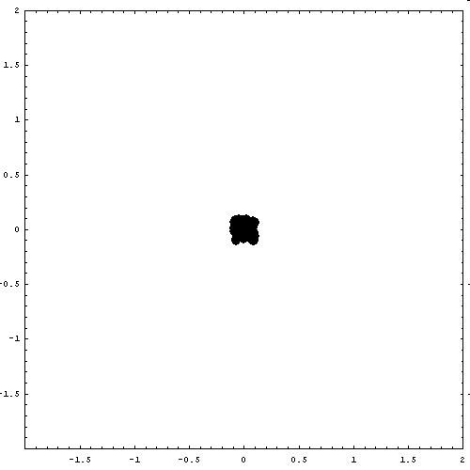
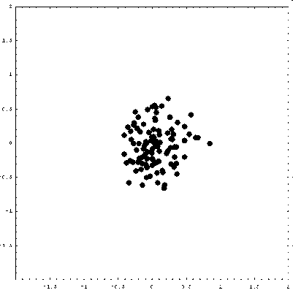
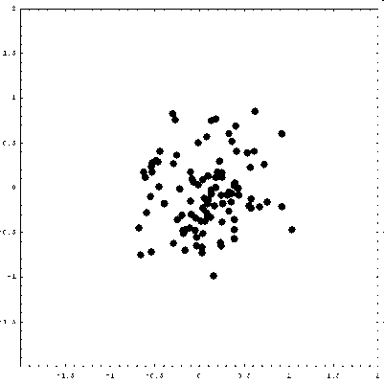
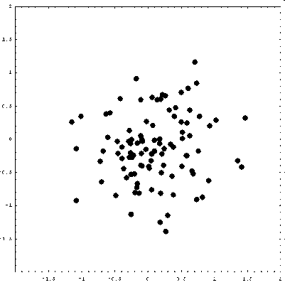
Agent-Based Models
Hiroki Sayama
sayama@binghamton.edu

Slide 2
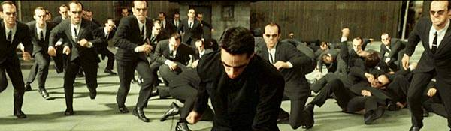
Agent-based modeling
One of the most generalized frameworks for modeling/simulation of complex systems
You construct many virtual individuals, or “agents”, and simulate their behaviors explicitly in a computer

Slide 3
Agents
Discrete entities
Have internal properties
Spatially localized
Perceive and interact with the environment
Locally interact with other agents and behave based on predefined rules
No central supervisor
May learn autonomously
May produce non-trivial “collective behavior” as a whole

Slide 4



Environment
Agents
Agent’s attributes
position
age
gender
knowledge
memory
experience
emotion
etc…

Slide 5
Various uses of ABMs in science
To predict macro-unknowns by simulation using micro-knowns
To explain macro-knowns by simulation using hypothetical micro-unknowns
  Or, to freely explore various collective dynamics models just for fun or learning

Slide 6
Aspects to be considered
Specific problem to be solved by the ABM
Design of agents and their attributes
Design of an environment and the way agents interact with it
Design of agents’ behaviors
Design of agents’ mutual interactions
Availability of data
Method of model validation
(from Macal & North 2010)

Slide 7
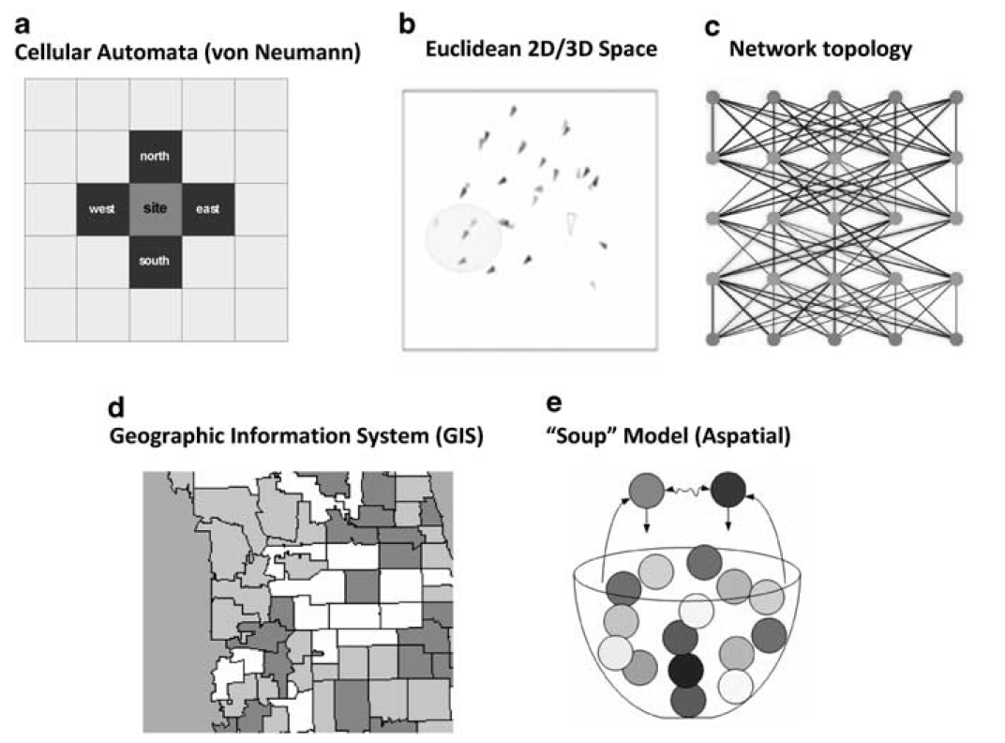
Topologies of agent relationships
(from Macal & North 2010)

Slide 8
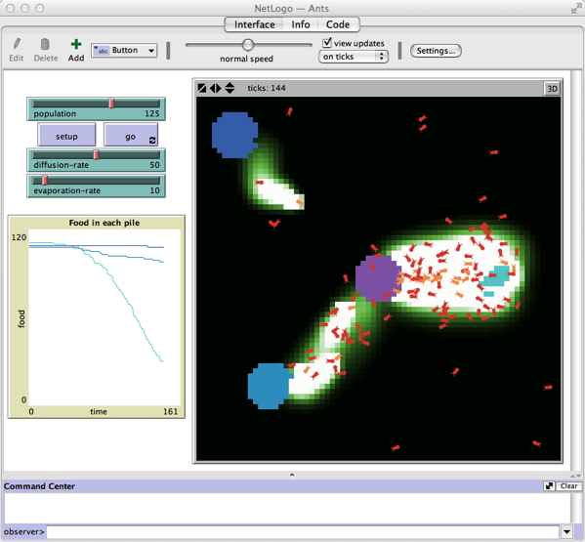
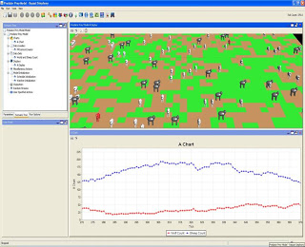
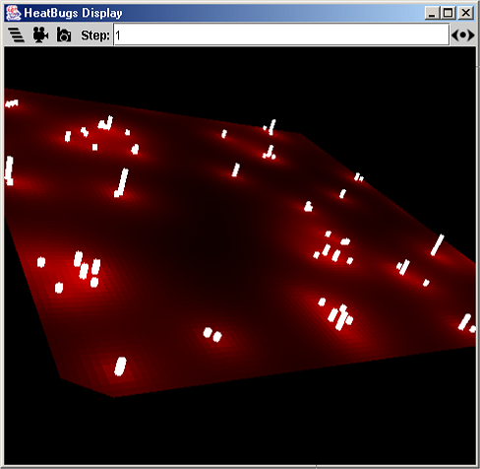
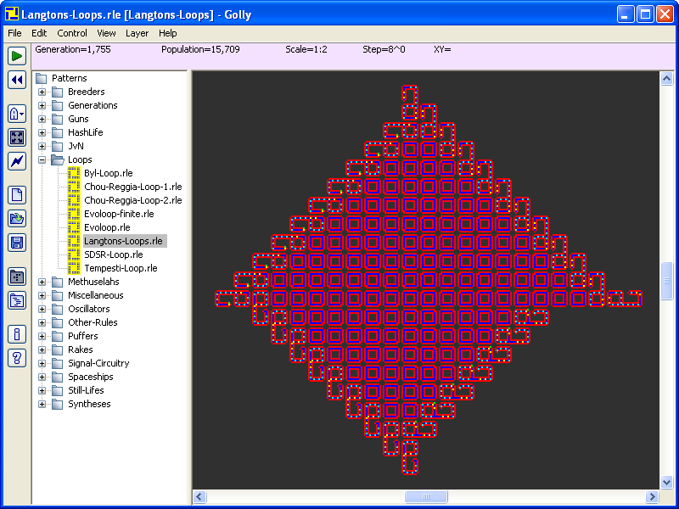
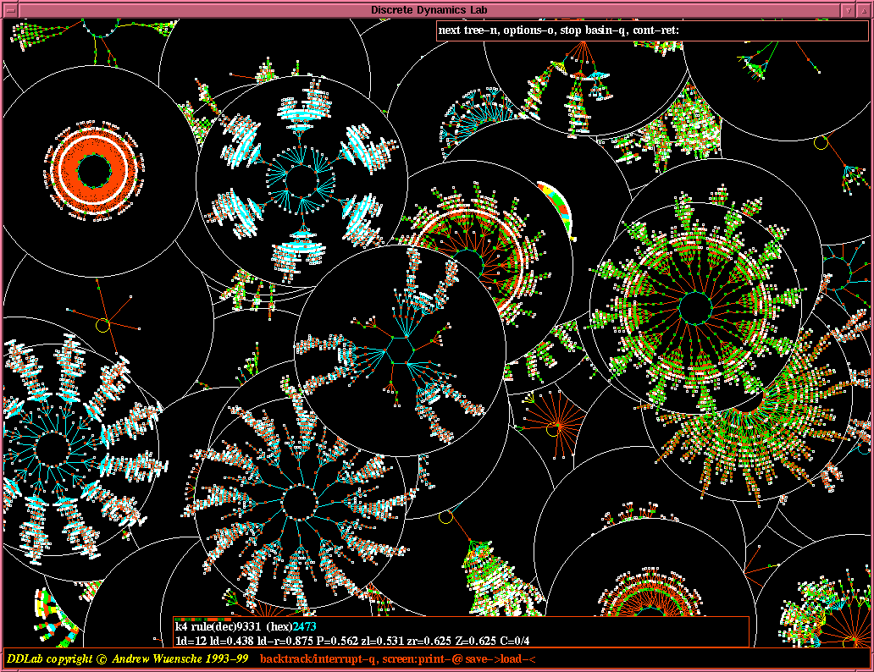
Tools for agent-based modeling
NetLogo
RePast
MASON
Golly
DDLab

Slide 9
To implement agent-based simulation codes yourself
Design data structure of agents
Design data structure of the environment
Describe rules for environment’s inherent dynamics
Describe rules for agents’ interactions with the environment
Describe rules for agents’ inherent dynamics
Describe rules for agents’ mutual interactions

Slide 10
Models with Fixed Number of Agents

Slide 11
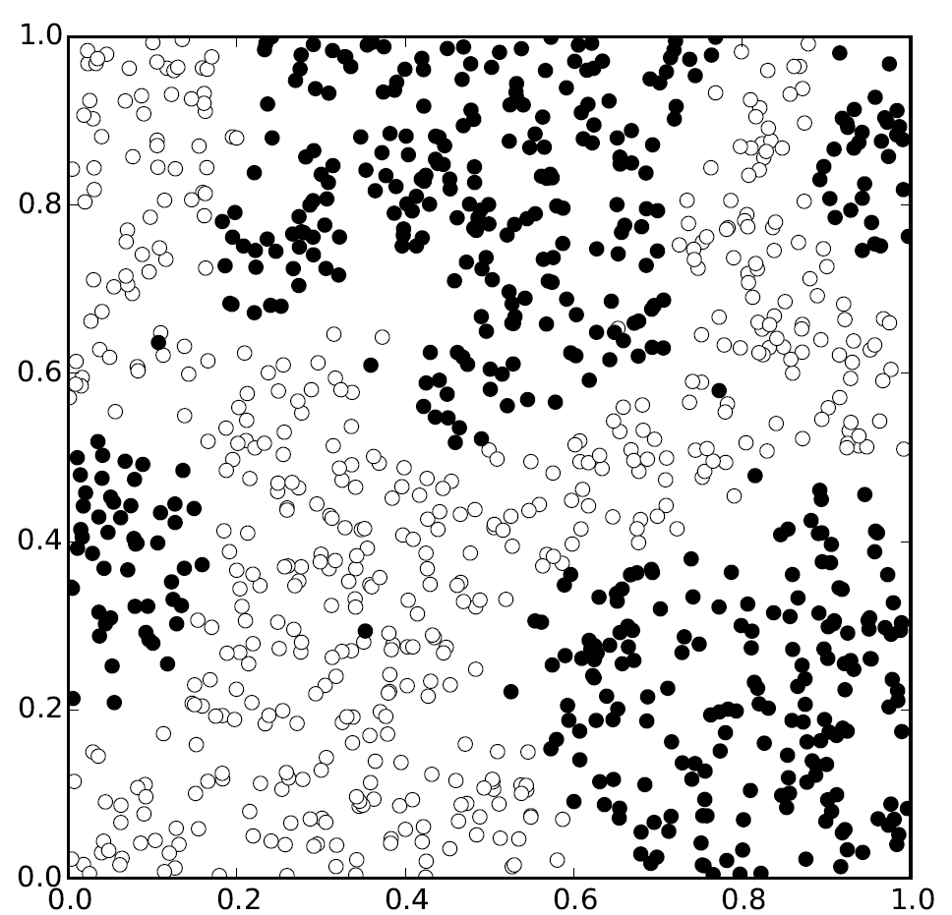
Example: Schelling’s segregation model
“The first ABM”
proposed by Thomas
Schelling in the 70’s
Two types of agents
Agents jump to
another random
location if it is surrounded by many other agents of the different type

Slide 12
Exercise
Conduct simulations of Schelling’s segregation model with the following parameters varied:
  Threshold for moving
  Neighborhood radius
  Population size (density)
Determine the condition in which segregation occurs

Slide 13
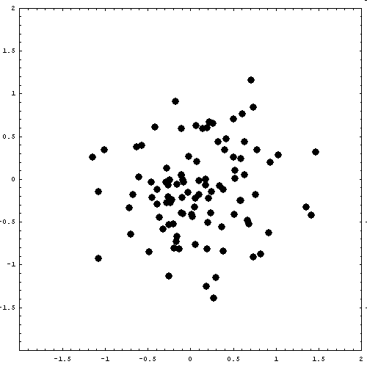
Example: Random walk and diffusion
A small random vector is added to the location of each particle at every time step
Each particle shows a Brownian motion
The collection of random-walking particles show “diffusion” at a macroscopic scale

Slide 14
Exercise
Modify the “random walk” simulator code so that:
  Each particle has its own velocity
  Each particle is accelerated by the attractive force toward the “center of mass” of the population of particles
→ This should create a simple swarming behavior

Slide 15
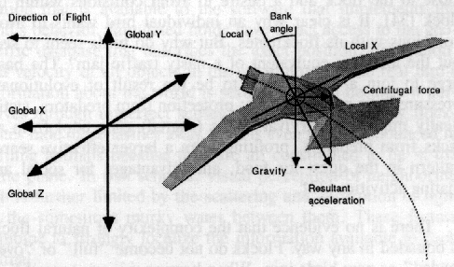
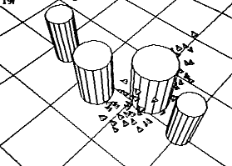
Exercise: Implement the Boids model (Reynolds 1987)
Virtual birds which show natural flocking behaviors
Each boid steers to
  direct toward local center of mass
  align with local average velocity
  avoid collisions

Slide 16
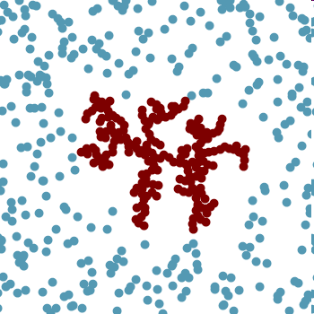
Example: Diffusion limited aggregation (DLA)
Two types of particles, “free” and “fixed”; only free ones can move
When colliding into a fixed one, a free particle becomes fixed and loses mobility
Starting with only one fixed particle, a complex self-similar pattern emerges (called “spatial fractal”)

Slide 17
Exercise
Carry out the DLA simulation runs with multiple “seeds” randomly positioned in the space
Modify the simulator code so that (1) initially no “fixed” particles exist, but (2) the particles that touched the bottom edge of the space turn to “fixed”

Slide 18
Models with Agent-Environment Interaction

Slide 19
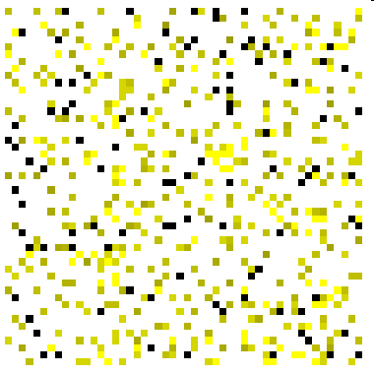
Example: Garbage collection by ants
Ants are wandering in a space where lots of garbage pieces are scattered
When an ant finds garbage:
  If the ant holds nothing, pick up a piece of garbage from there
  If the ant already holds garbage, drop it off there

Slide 20
Exercise
Modify the ants’ garbage collection model so that:
  Each ant produces pheromone where it is
  Pheromone diffuses and evaporates at a constant rate
  Ants are stochastically attracted toward places where there are greater amount of pheromone

Slide 21
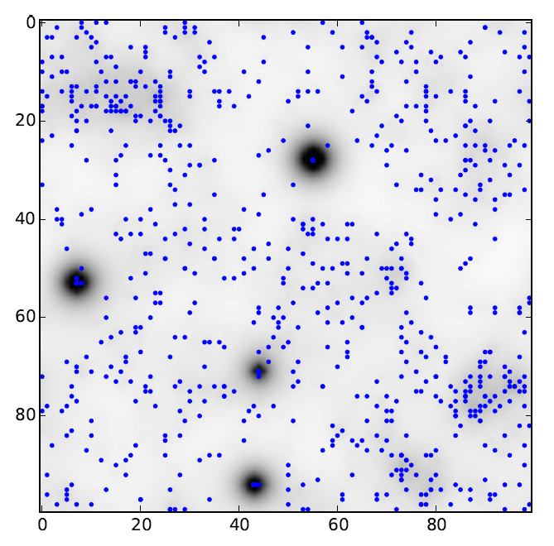
Example: Keller-Segel ABM
Agents are attracted to areas with high concentration of signal chemical (cAMP)
Agents secrete cAMP
cAMP diffuses and evaporates naturally

Slide 22
Results of ABM simulations
Are often more “natural-looking” than those of analytical, low-dimensional dynamical models thanks to:
  Discreteness of agents
  Stochasticity in their behaviors
  Algorithmic, detailed representation of behavioral rules

Slide 23
Models with Agent Replacement

Slide 24
Models with birth/death of agents
The updating procedure should:
  Determine whether or not each of the current agents can survive to the next step
    If yes, the state of the agent will be updated as needed
    If no, the agent will be removed from the list of current agents
  Simulate the birth of new agents
    They will be added to the list at the end

Slide 25
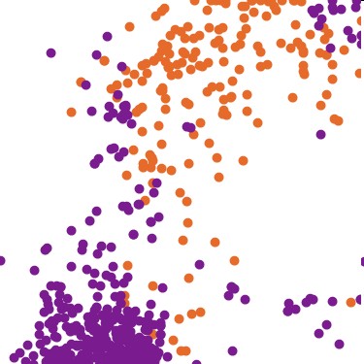
Example: Predator-prey model
Rabbits and foxes wander and reproduce in a space
  Foxes move faster than rabbits
  A rabbit will survive if it is not caught by foxes
  A fox will survive if it ate rabbits not long ago
  Foxes’ reproduction depends on whether they successfully eat rabbits

Slide 26
Exercise
Modify the simulator code so that it outputs the time series plots of rabbit and fox populations next to the visual image of simulation in real time
See if you actually have oscillatory behavior in these plots

Slide 27
Exercise: Sanctuary for preys
Modify the simulator code so that there is a protected area which only preys can move into and out of
Does this change do any good or harm on predators?

Slide 28
Exercise: Evolutionary adaptation
Make the range of motion (motility) a heritable individual property of agents
Introduce mutations of the agent motility in both foxes and rabbits
Make the agent motility visible
See how the agent motilities spontaneously evolve in simulation

Slide 29
Exercise: Evolutionary adaptation
Make the reproduction of agents density-dependent
  Too few neighbors / too many neighbors will result in failure of reproduction
See how the agent motilities spontaneously evolve in simulation

