Slide 1
SSIE 637
Advanced Topics in Healthcare
Lecture #3

Slide 2
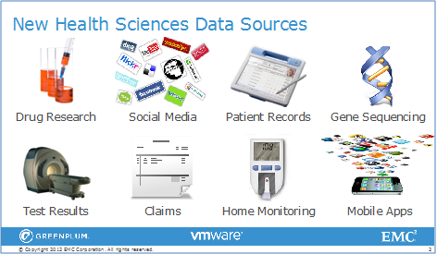
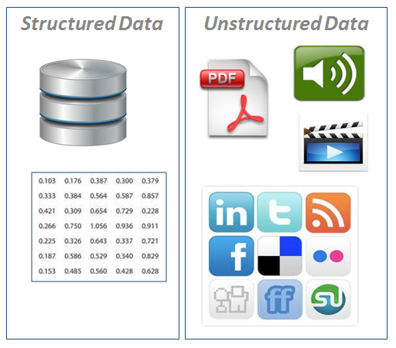
Data Types
Structured data
Set of measurements from an experiments or process
Well-defined tables, feature (aka attribute, column), sample(tuples, rows)
Unstructured data
Either does not have a pre-defined data model or is not organized in a pre-defined manner
Images
World Wide Web ( HTML, XML)
Time series
Genetic information
Videos
https://www.laserfiche.com/ecmblog/4-ways-to-manage-unstructured-data-with-ecm/

Slide 3
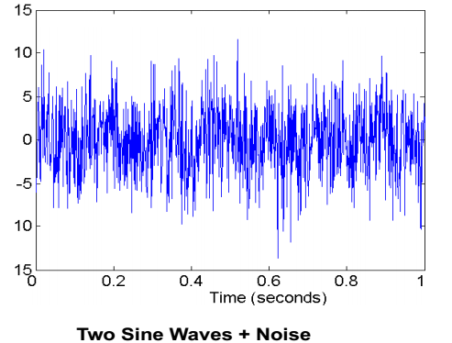
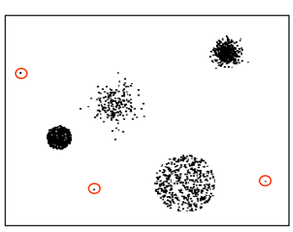
Data Quality
What kinds of data quality problem?
How can we detect problems with data?
What can we do these problems?
Examples
Noisy / outliers
Missing values
Duplicate data
Outliers
Composition of two sine waves + noise

Slide 4
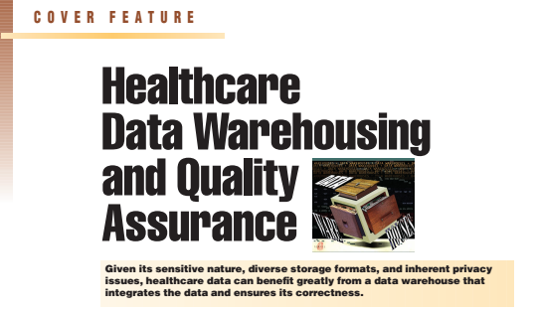
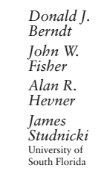
Introduction of data management of the University of South Florida's center for health outcomes research

Slide 5
Data Preprocessing
Data cleaning
Clean the ‘dirty’ data
‘Dirty data’? Incomplete, noisy, incomplete.
Many reasons.
Missing values
Fill in missing values
Noisy data
A random error or variance in a measured variable
Identify outliers and smoothing

Slide 6
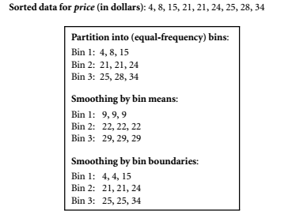
Data Preprocessing
Missing values
Ignore the row (tuple)
Fill in the value manually
Global constraints
Use the feature mean value / feature mean belonging to the same class
Use the most probable (frequent) values
Noisy data
Binning
Regression
Clustering

Slide 7
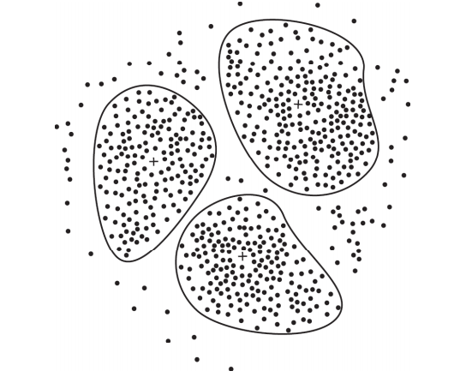
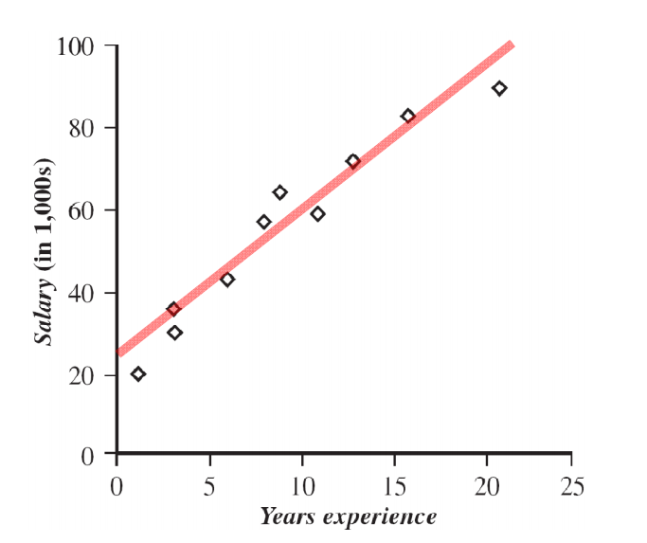
Data Preprocessing
Regression
Clustering

Slide 8
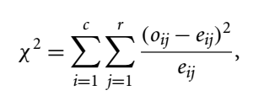


Data Preprocessing
Integration
Entity identification
Sample_Id vs. Sample_Number?
Healthy / Sice vs. 1 / 2 ?
Create meta-data → data of data
Special attention to be paid to the structure of the data
Redundancy
Able to detected by correlation analysis / chi-square test statistics among features
Two features ( or samples) are independent?
$o_{ij}$: observed frequency (= actual count)

Slide 9
Data Transformation / Consolidation
Smoothing
Normalization
Feature construction
New features are constructed from given features and added in order to help improving accuracy and understanding of structure in high-dimension data
Ex) add a ‘area’ feature calculated from ‘height’ and ‘width’ features.

Slide 10
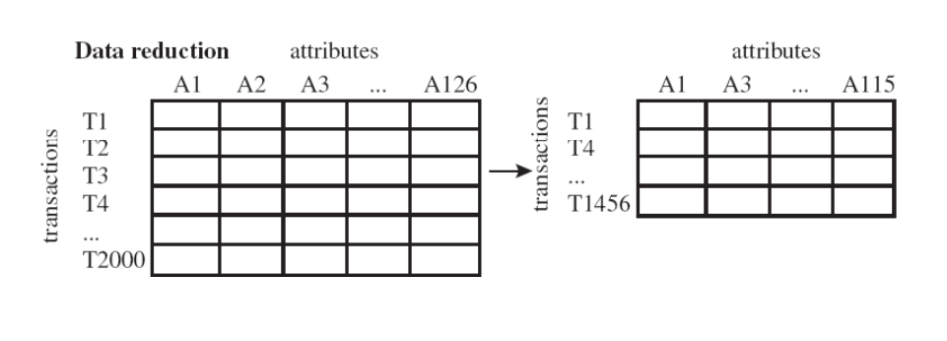
Data Reduction
To obtain a reduced representation of the data set; smaller in volume, yet closely maintains the integrity of the original data
Dimensionality reduction → feature reduction
Overcome “curse of dimensionality”
Reduce ‘cpu’ time / memory usage required by data analysis methods
Easy visualization / eliminate irrelevant/non-informative features
Method: Principle Component Analysis, Singular Value Decomposition, etc
Supervised/ non-linear techniques

Slide 11
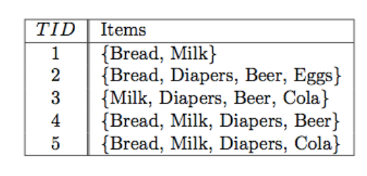

Frequent Pattern Mining
Basically, developed for “Market Basket Analysis” → how items purchased by customer
What you find?

Slide 12
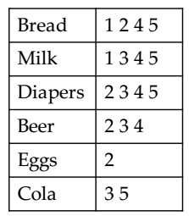
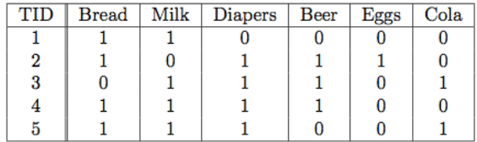
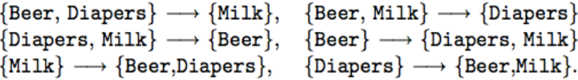
Frequent Pattern Mining : Association Rule Finding
Data Representation
Rules??

Slide 13
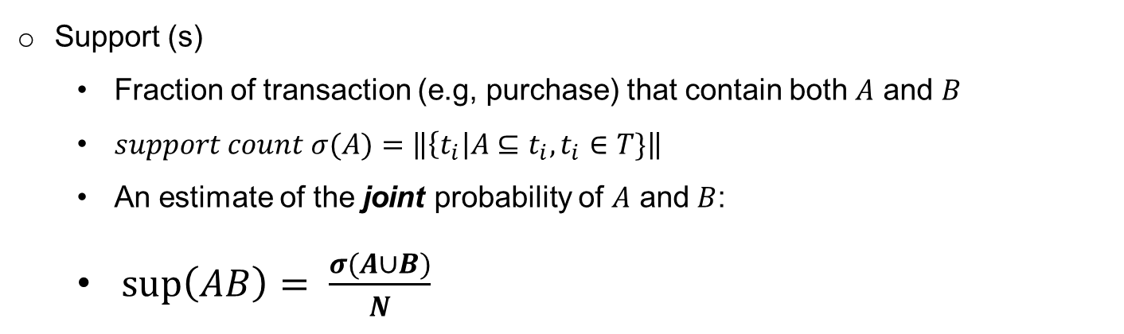
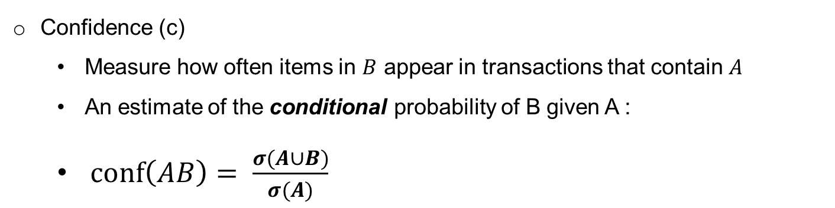
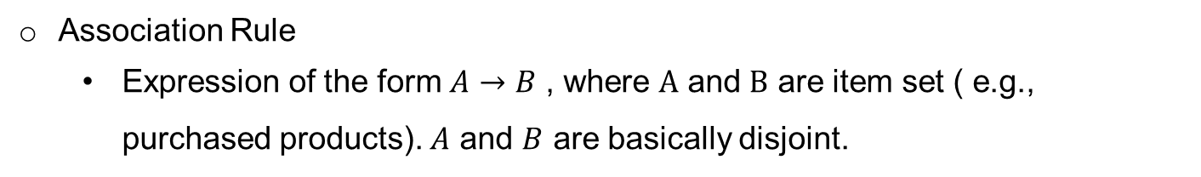
Association Rules : Support & Confidence
Association Rule
Expression of the form $Α→Β$ , where $Α$ and $Β$ are item set ( e.g., purchased products). $Α$ and $B$ are basically disjoint.
Support (s)
Fraction of transaction (e.g, purchase) that contain both $A$ and $B$
$support count σ(A)=\left\|\left\{t_{i}\right|A⊆t_{i},t_{i}∈T\}\right\|$
An estimate of the joint probability of $Α$ and $B$:
$\sup\left(AB\right)= \frac{σ(A∪B)}{N}$
Confidence (c)
Measure how often items in $B$ appear in transactions that contain $A$
An estimate of the conditional probability of B given A :
$\operatorname{conf}\left(AB\right)= \frac{σ(A∪B)}{σ(A)}$

Slide 14
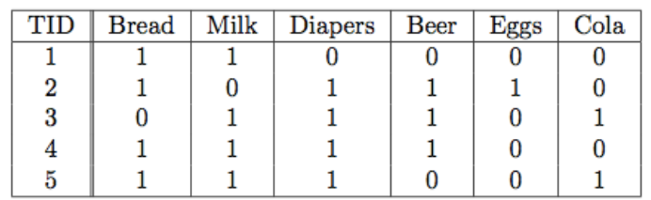
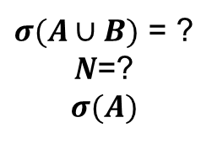
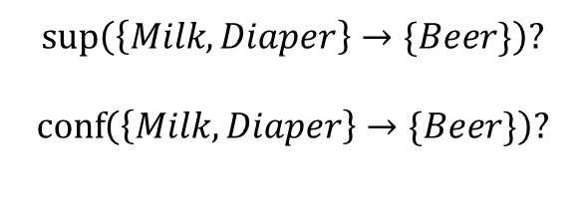
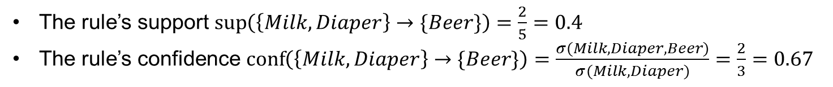
Association Rules : Example
Consider the rule {Milk, Diapers}→ {Beer}
$$\sup\left(\left\{Milk, Diaper\right\}→\{Beer\}\right)?$$
$$\operatorname{conf}\left(\left\{Milk, Diaper\right\}→\{Beer\}\right)?$$
A
B
What we want to know:
$σ(A∪B)$ = ?
$N$=?
$$σ(A)$$
The rule’s support $\sup\left(\left\{Milk, Diaper\right\}→\{Beer\}\right)=\frac{2}{5}=0.4$
The rule’s confidence $\operatorname{conf}\left(\left\{Milk, Diaper\right\}→\{Beer\}\right)=\frac{σ(Milk, Diaper, Beer)}{σ(Milk, Diaper)}=\frac{2}{3}=0.67$

Slide 15
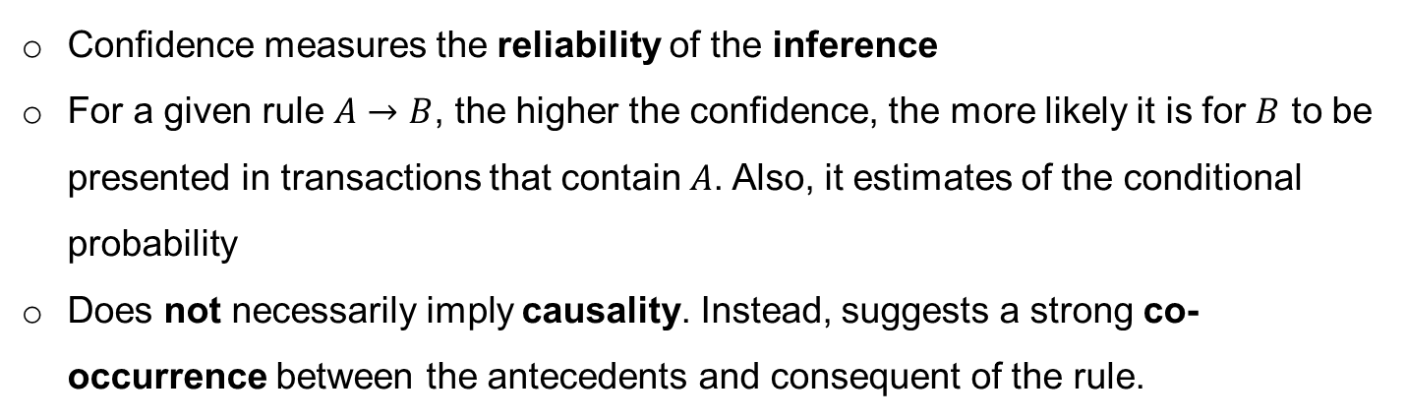
Association Rules : Why use support & confidence?
Support is an important measure because a rule that has very low support may occur simply by chance
A low support rule is likely to be uninteresting / may not be profitable
Often used to eliminate uninteresting rules
Confidence measures the reliability of the inference
For a given rule $Α→Β$, the higher the confidence, the more likely it is for $Β$ to be presented in transactions that contain $Α$. Also, it estimates of the conditional probability
Does not necessarily imply causality. Instead, suggests a strong co-occurrence between the antecedents and consequent of the rule.

Slide 16

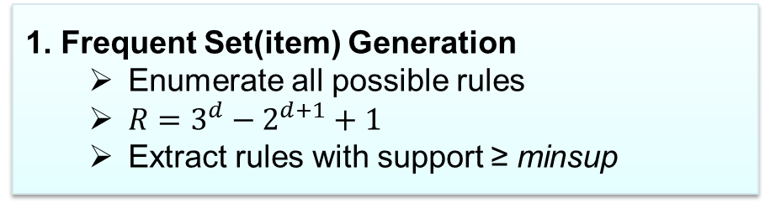
Data Mining with Rule Association
Problem Definition
“ Find frequent and high confidence association rules”
1. Frequent Set(item) Generation
Enumerate all possible rules
$R=3^{d}−2^{d+1}+1$
Extract rules with support ≥ minsup
Expensive computation
Need something more advanced!
2. Rule generation
Generate high confidence rules from each frequent item-set

Slide 17
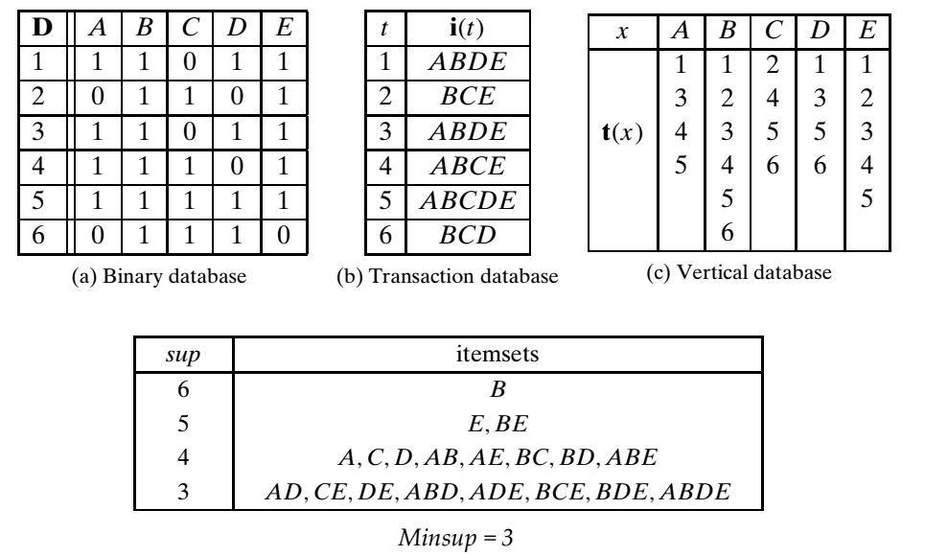
Data Mining with Rule Association: Brute force
Preparation for approach

Slide 18
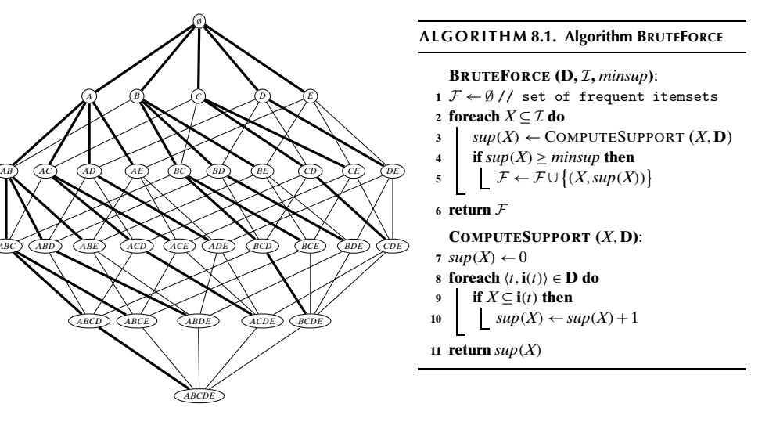
Data Mining with Rule Association: Brute force

Slide 19
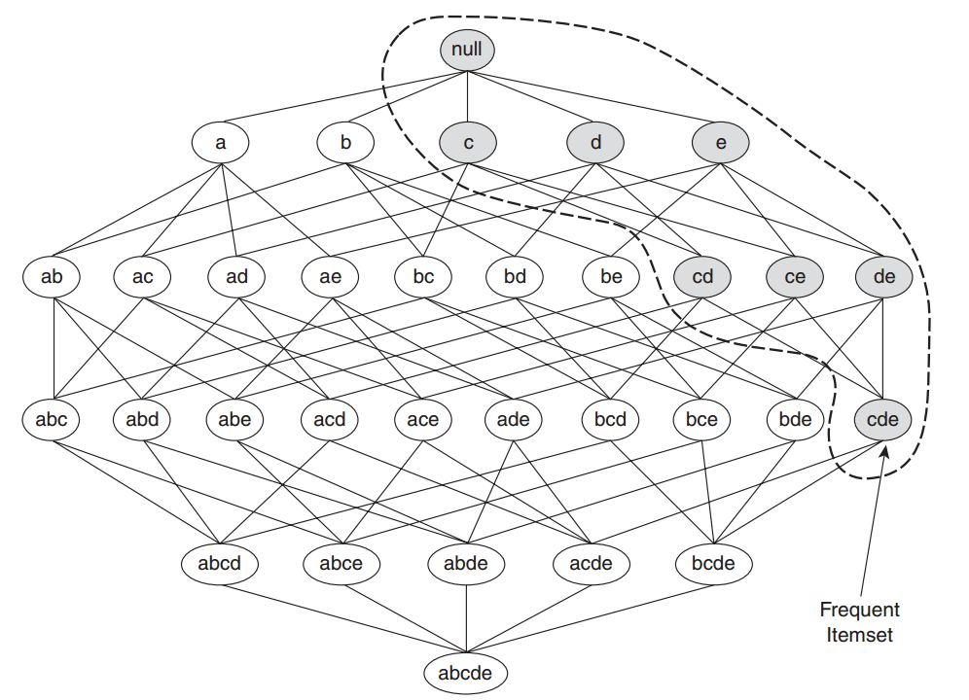

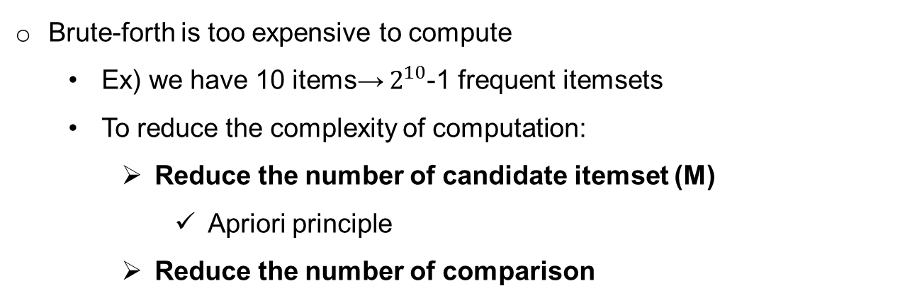
Data Mining with Rule Association: Apriority approach
Brute-forth is too expensive to compute
Ex) we have 10 items→ $2^{10}$-1 frequent itemsets
To reduce the complexity of computation:
Reduce the number of candidate itemset (M)
Apriori principle
Reduce the number of comparison
Apriori principle
If $A⊆B, then sup\left(X\right)≥sup\left(Y\right).$ Anti-monotone property
“ If an itemset is frequent, then all of its subsets must also be frequent”
Ex) if {c,d,e} is frequent, all subjest of this {c,d}, {c,e}, {d,e}, {c}, {d}, {e} are frequent

Slide 20
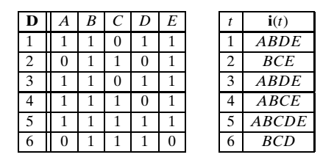
Data Mining with Rule Association: Apriority approach
Level-wise or breadth first search of the itemset search space, and prunes all super-sets of any infrequent candidate
Avoid branching (generating) any candidate that has an infrequent subset
Compute the support of all valid candidate of size k that comprise level k in the tree
Let see:

Slide 21
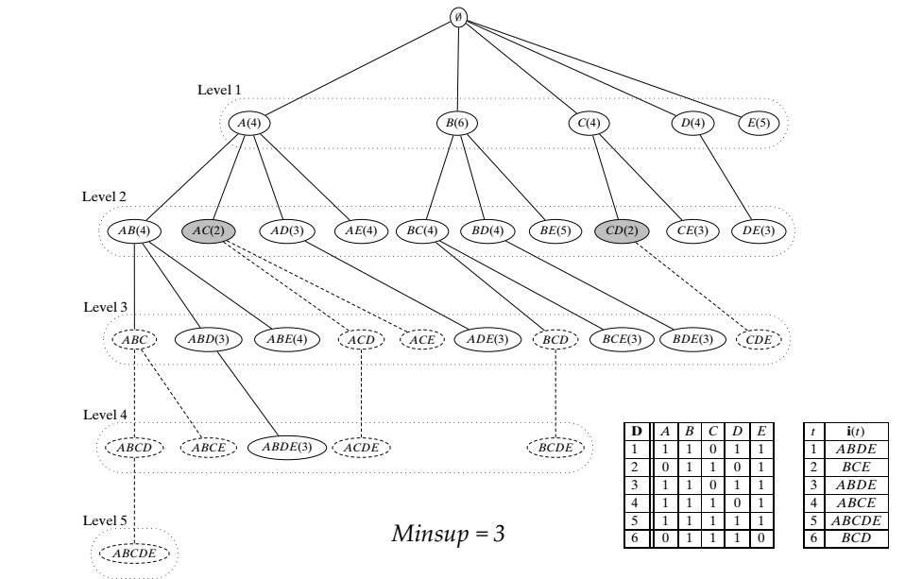
Data Mining with Rule Association: Apriority approach
Check

Slide 22
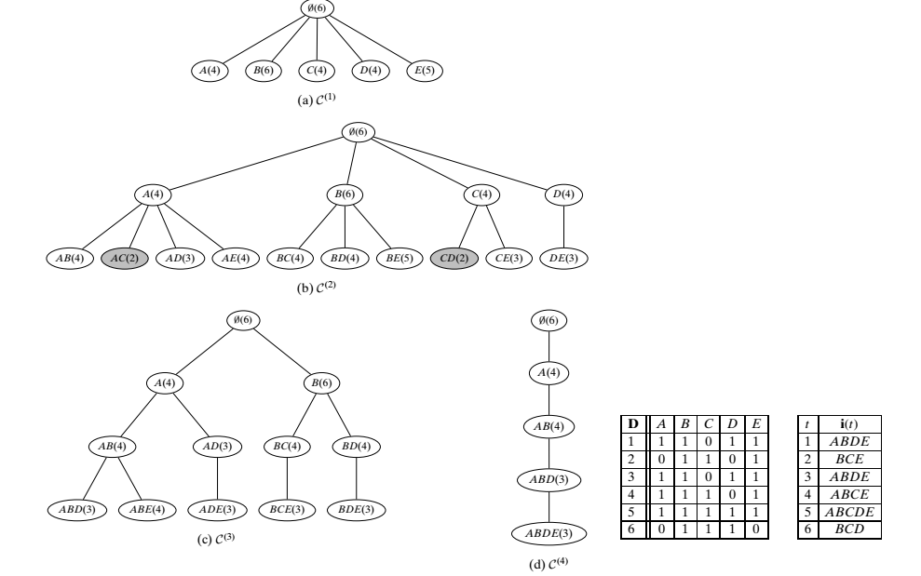
Data Mining with Rule Association: Apriority approach
Depth(level) 1
Depth 2
Depth 4
Depth 3

Slide 23
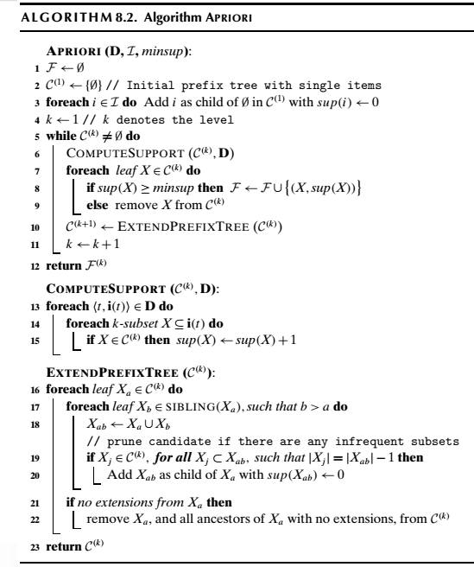
Data Mining with Rule Association: Apriority approach

Slide 24
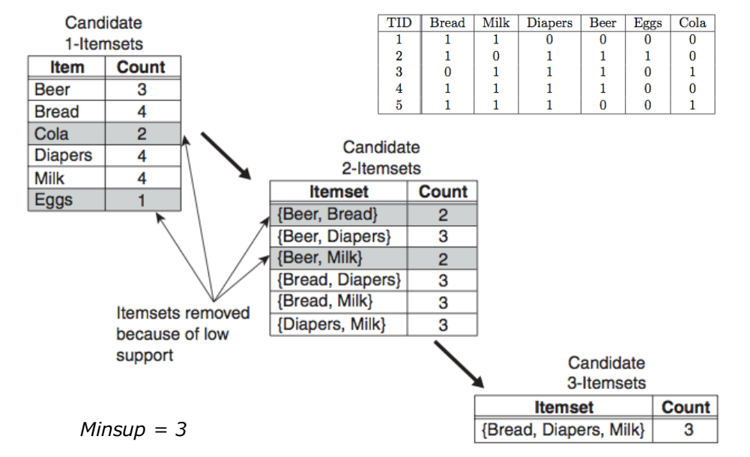
Data Mining with Rule Association: Apriori approach
Illustration of apriori algorithm

Slide 25
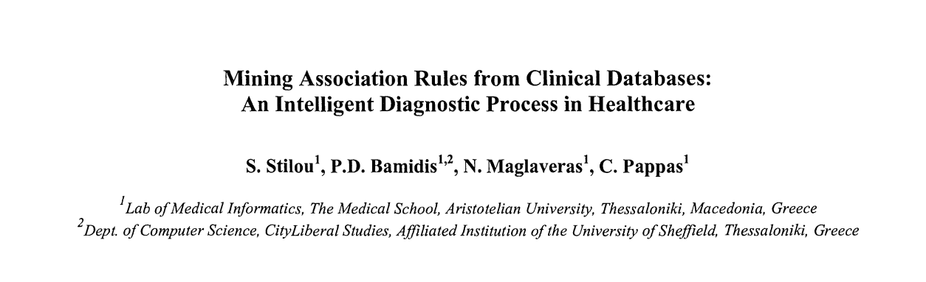
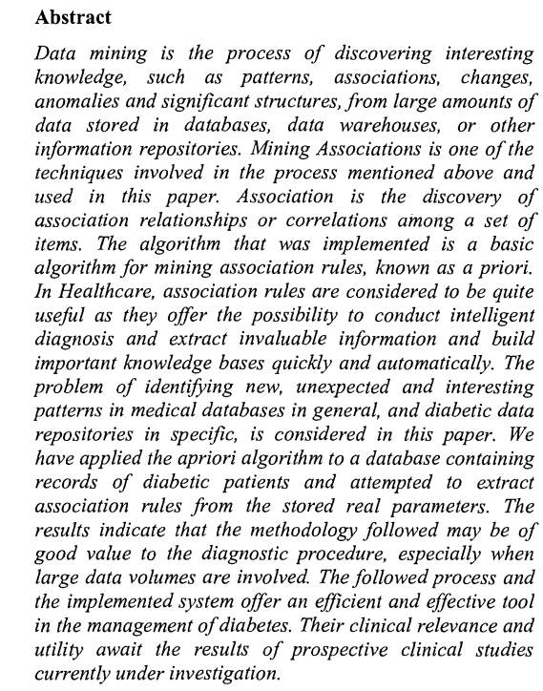
Data Mining with Rule Association: Apriority approach
Simple application of association rule mining in clinical data (diabetic data)
Apriori algorithm was used.

Slide 26
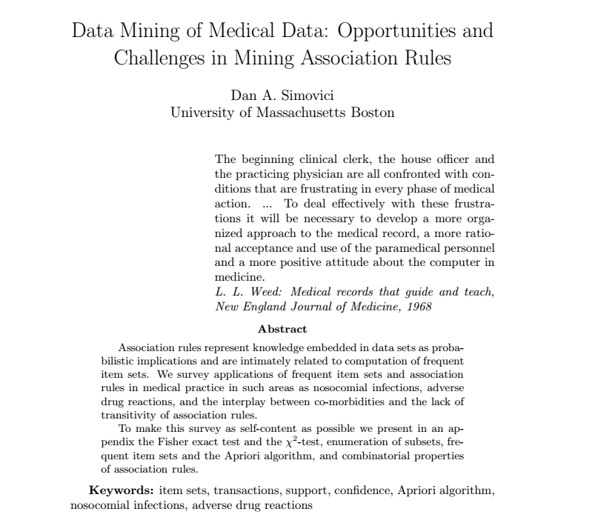
Data Mining with Rule Association: Apriority approach
Survey of association rule mining in medical domain

Slide 27
Questions?

