Slide 1
SSIE 637
Advanced Topics in Healthcare
Lecture #3-1
Python Tutorial

Slide 2
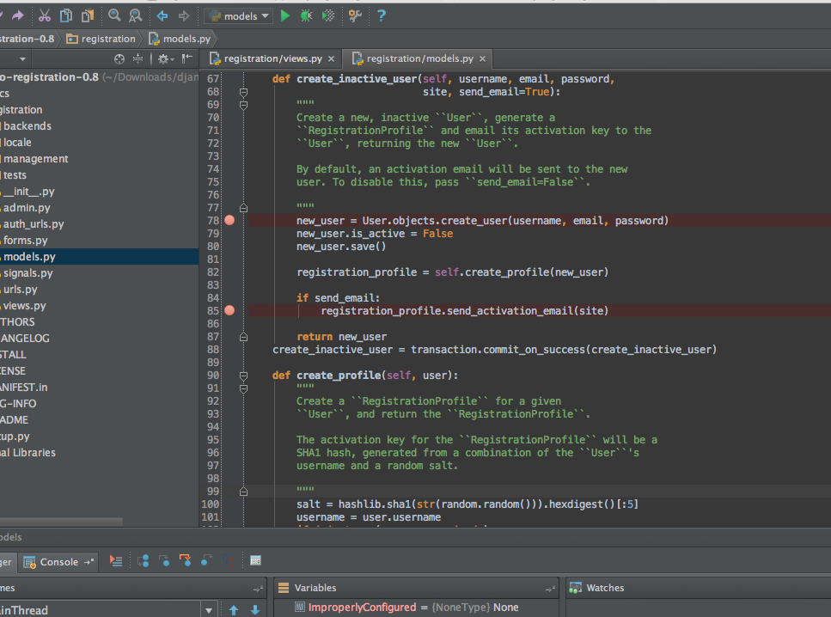
Python tutorial
Install Python
Download the package from: https://www.python.org/downloads/
However, if you are lazy, download Anaconda (Data science platform): https://www.continuum.io/downloads
Version : current 3.5 → new
2.7 → most popular
Install IDLE (= editor)
Python comes with own editor; command prompt version
So many editors, but here I choose “Pycharm” https://www.jetbrains.com/pycharm/download/

Slide 3
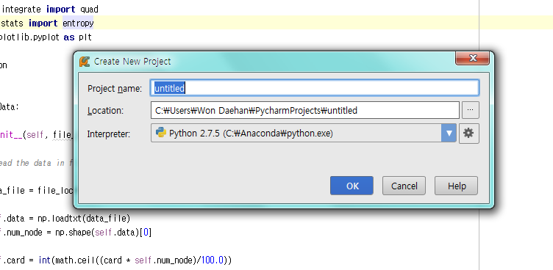
3. Open Pycharm create new project
Don’t forget to set interpreter as python

Slide 4
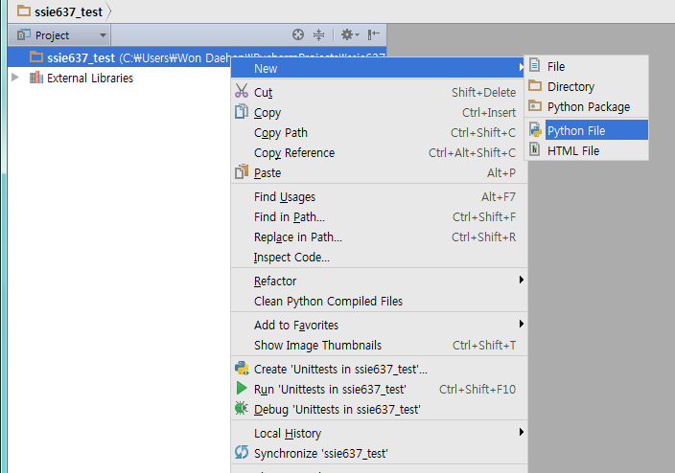
4. Create a running (main) file
Right click

Slide 5
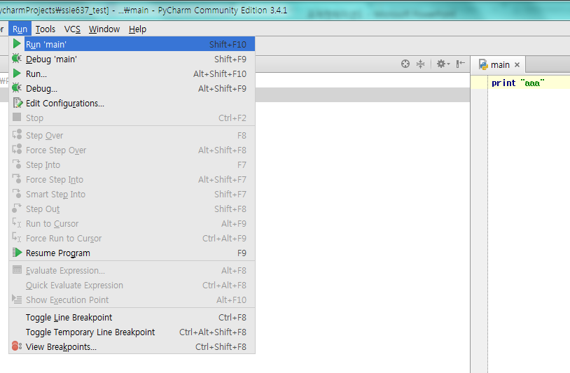
5. Run
Once you create some program, click the run button

Slide 6
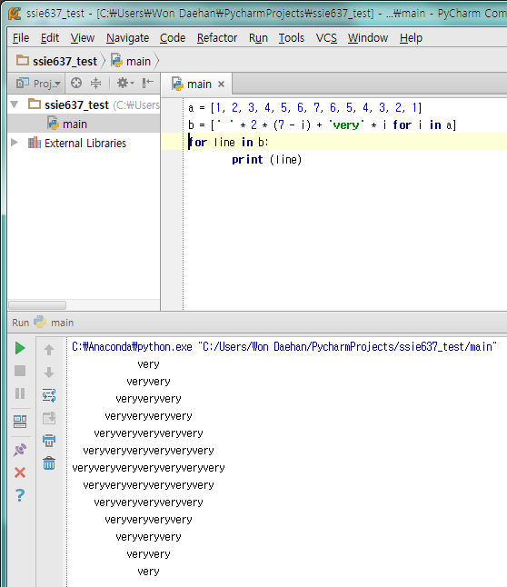
6. Example
a = [1, 2, 3, 4, 5, 6, 7, 6, 5, 4, 3, 2, 1]
b = [' ' * 2 * (7 - i) + 'very' * i for i in a]
for line in b:
print (line)
Variables
Colon!
In python, every command in the loop (if then, for, while) is defined by indentation. No bracket in python
Indent!

Slide 7
7. Example: String
word1 = "Good"
word2 = "morning"
word3 = "to you too!"
print(word1, word2)
sentence = word1 + " " + word2 + " " + word3
print(sentence)
Good morning
Good morning to you too!
8. Example : Augmented operators
Standard form | Augmented
v = v + 5 | v += 5
v = v - 5 | v -= 5
v = v * 5 | v *= 5
v = v / 5 | v /= 5

Slide 8
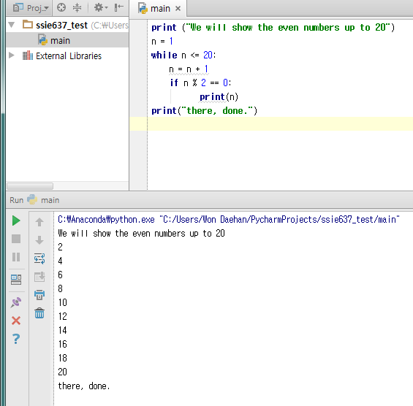
9. While Loop and If statement
a = 0
while a < 10:
a = a + 1
print(a)
'''
if {conditions to be met}:
{do this}
{and this}
{and this}
{but this happens regardless}
{because it isn't indented}
'''
print ("We will show the even numbers up to 20")
n = 1
while n <= 20:
n = n + 1
if n % 2 == 0:
print(n)
print("there, done.")

Slide 9
9. While Loop and If statement (else & elif)
a = 1
if a > 5:
print("This shouldn't happen.")
else:
print("This should happen.")
z = 4
if z > 70:
print("Something is very wrong")
elif z < 7:
print("This is normal")

Slide 10
10. Function
def function_name(parameter_1, parameter_2, …):
{this is the code in the function}
{more code}
return {value to return to the main program}
{this code isn't in the function}
{because it isn't indented}
remember to put a colon ":" at the end
#of the line that starts with 'def'
def goodmorning(time):
print ("hello")
print (time)
return 1234
goodmorning(10)

Slide 11
11. Data Structure
List : a list of values. Add / remove. → []
Tuples : just like a list but you can’t change the values → ()
Dictionaries : Hash-map. key-value pair →{}
Ex) List
cats = ['Tom', 'Snappy', 'Kitty', 'Jessie', 'Chester']
Print cats[2] →? Kitty
Cats.append(‘Bob’) → ['Tom', 'Snappy', 'Kitty', 'Jessie', 'Chester‘, ‘Bob’]
Del cats[1]
Ex) Dictionary
phonebook = {'Andrew Parson':8806336, \ 'Emily Everett':6784346, \ 'Peter Power':7658344, \ 'Lewis Lame':1122345}
Add → phonebook['Gingerbread Man'] = 1234567
Name → we say a ‘key’, phone number → we say a ‘value’
Phonebook.has_key(‘Daehan Won’) → No

Slide 12
12. For loop
newList = [45, 'eat me', 90210, "The day has come, the walrus said, \
to speak of many things", -67]
for value in newList:
print(value)
13. Module
A module is a Python file that (generally) has only definitions of variables, functions, and classes. Ex) Numpy, Matplotlib, Scikt-learn, Pandas
Import Numpy as np
Using np.xxx() is to use funtions in Numpy
From Numpy import *
Do not need to use np
Mean(xxx)

Slide 13
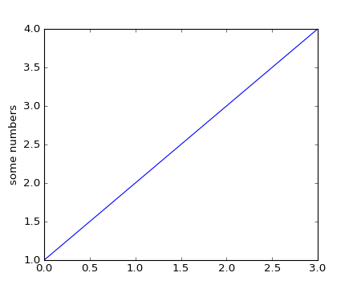
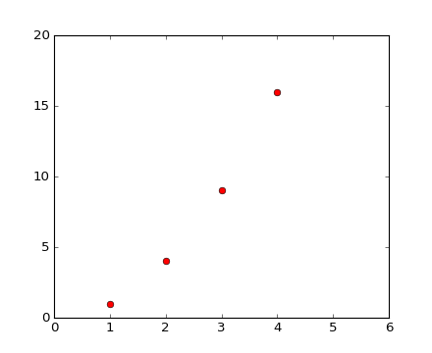
14. Plotting
import matplotlib.pyplot as plt
plt.plot([1,2,3,4])
plt.ylabel('some numbers')
plt.show()
import matplotlib.pyplot as plt
plt.plot([1,2,3,4], [1,4,9,16], 'ro')
plt.axis([0, 6, 0, 20])
plt.show()

Slide 14
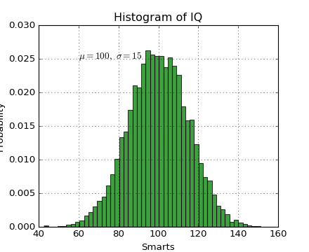
import numpy as np
import matplotlib.pyplot as plt
mu, sigma = 100, 15
x = mu + sigma * np.random.randn(10000)
# the histogram of the data
n, bins, patches = plt.hist(x, 50, normed=1, facecolor='g', alpha=0.75)
plt.xlabel('Smarts')
plt.ylabel('Probability')
plt.title('Histogram of IQ')
plt.text(60, .025, r'$\mu=100,\ \sigma=15$')
plt.axis([40, 160, 0, 0.03])
plt.grid(True)

Slide 15
15. Data load via Numpy
5.1,3.5,1.4,0.2,Iris-setosa
4.9,3.0,1.4,0.2,Iris-setosa
5.8,2.7,4.1,1.0,Iris-versicolor
6.2,2.2,4.5,1.5,Iris-versicolor
6.4,3.1,5.5,1.8,Iris-virginica
6.0,3.0,4.8,1.8,Iris-virginica
Input_data.txt
values
Classes
Values = np.loadtxt(‘Input_data.txt', delimiter=',', usecols=[0,1,2,3])
Labels = np.loadtxt(‘Input_data.txt', delimiter=',', usecols=[4], dtype = np.str)

Slide 16
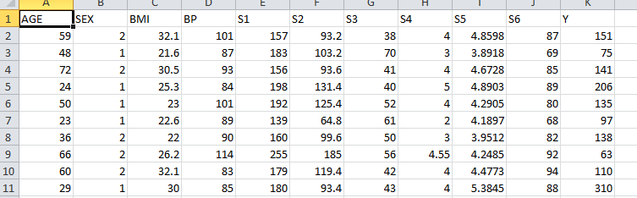
16. CSV with header load via Numpy
data1 = np.genfromtxt(path_to_csv, dtype=None, delimiter=',', names=True)
Load data with header
data2 = np.genfromtxt('diabetes.csv', dtype=None, delimiter=',',skip_header=1)
Load data without header
print data1['AGE'].mean() → mean of column ‘AGE’

Slide 17
17. CSV with header load via Pandas
import pandas as pd
df = pd.read_csv('diabetes.csv')
print df['AGE'].values
df.as_matrix() #extract only a data array

