Slide 1
Customer Cliff Dive
Dieudonne Ouedraogo
03-01-2019

Slide 2
Problem Statement
Yammer is a social network for communicating with coworkers. Individuals share documents, updates, and ideas by posting them in groups. Yammer is free to use indefinitely, but companies must pay license fees if they want access to administrative controls, including integration with user management systems like Active Directory.
You sit in their centralized Analytics team, which sits in the Engineering organization. You show up to work Tuesday morning, September 2, 2014. The head of the Product team walks over to your desk and asks you what you think about the latest activity on the user engagement dashboards. You fire them up, and something immediately jumps out:

Slide 3
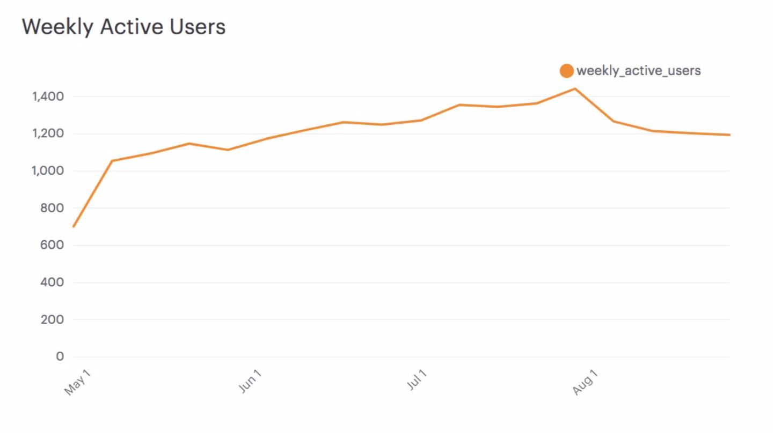
THE DROP

Slide 4
Question
What caused the drop in user engagement? Based on what you observe in the data, what recommendations would you make to the organization?

Slide 5
DATA SETS
Users
This table includes one row per user, with descriptive information about that user’s account.
Events
This table includes one row per event, where an event is an action that a user has taken on Yammer. These events include login events, messaging events, search events, events logged as users progress through a signup funnel, events around received emails.

Slide 6
DATA SETS
Email Events
This table contains events specific to the sending of emails. It is similar in structure to the events table
Rollup Periods
The final table is a lookup table that is used to create rolling time periods. You won't necessarily need to use this table, but the column descriptions are provided here nonetheless.

Slide 7
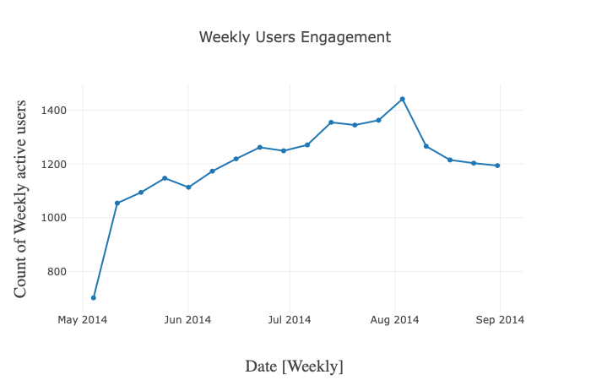
INITIAL INVESTIGATION

Slide 8
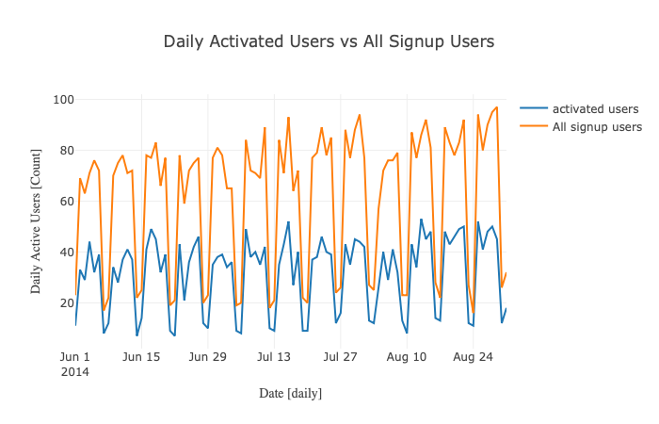
Activated users Vs all sign up users

Slide 9
TAKE AWAY
The plot shows that the number of signup users and activated increase and decrease regularly on the week basis. Although the number of all signup users drops a little bit around Aug 10, the number of activated users remain almost constant. So the drop of users engagement did not come from activated users.

Slide 10
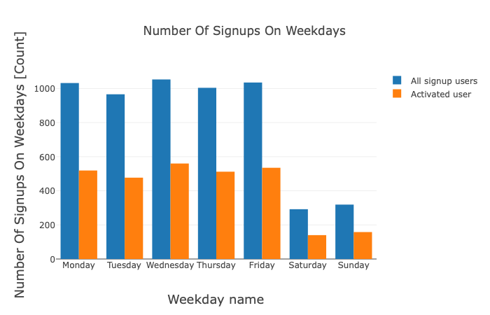
Exploring the weekday usage

Slide 11
When we zoom into the daily usage we can see that on average both signed-up users and activated users on weekday are much higher than weekends.

Slide 12
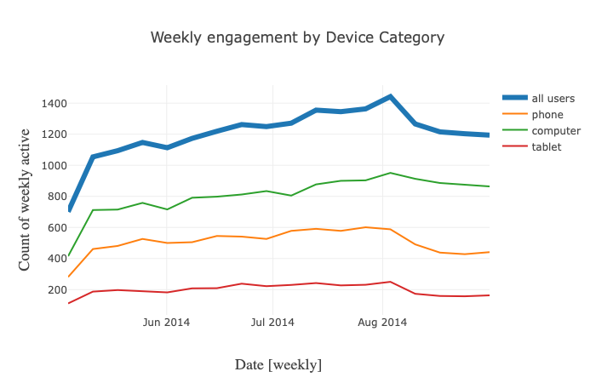
The phone engagement has more drop

Slide 13
POSSIBLE PROBLEMS WITH APP
The above chart shows that there’s a pretty steep drop in phone engagement rates. So it’s likely that there’s a problem with the mobile app related to new signed up user retention.

Slide 14
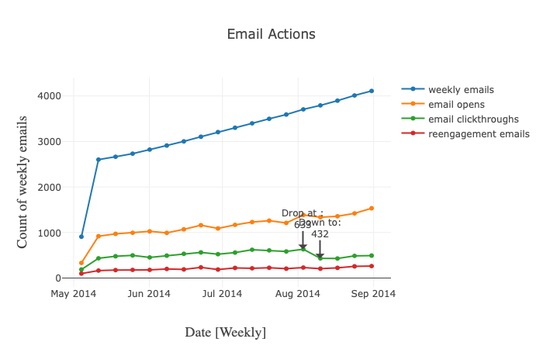
Checking the emails process

Slide 15
Conclusion
We can see from the green line email clickthroughs, there was a drop from Aug 3. So now we found the reason why to get connected with new signed up users, the email clickthroughs experienced a decrease on the corresponding user engagement drop weeks. So I suggest we can dig dipper on the emails sent out to check whether there are some changes on the format/content or send-out time.
Other possibilities to explore in the future
Sign up process, Age

