Slide 1
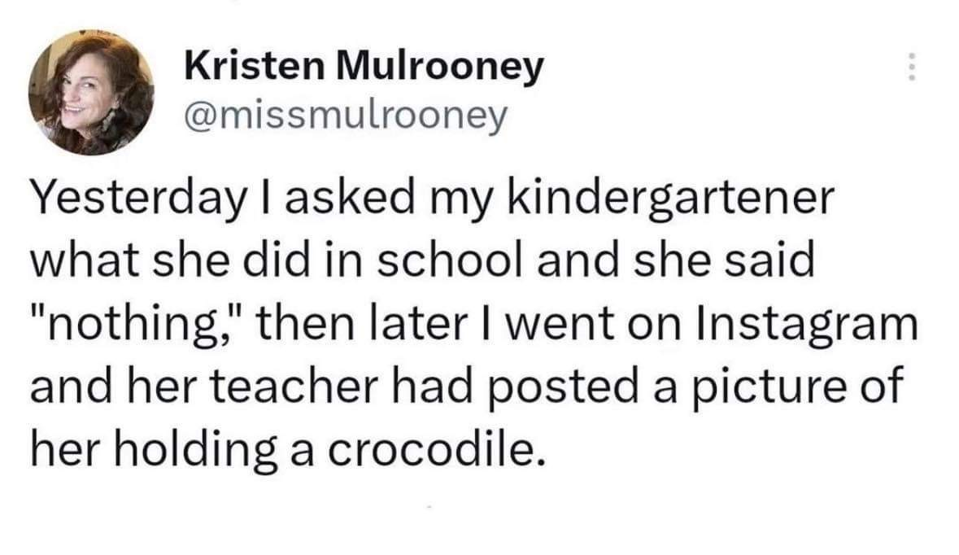
Notes:
This is a problem faced by most parents. Whether it is something huge, like a guest appearance or out of the ordinary activity, or something more mundane, like how a child may have really enjoyed that one book on dinosaurs, or building blocks in the playground, parents miss out on key moments of their child’s development due to gaps in communication. This is where we come in.

Slide 2

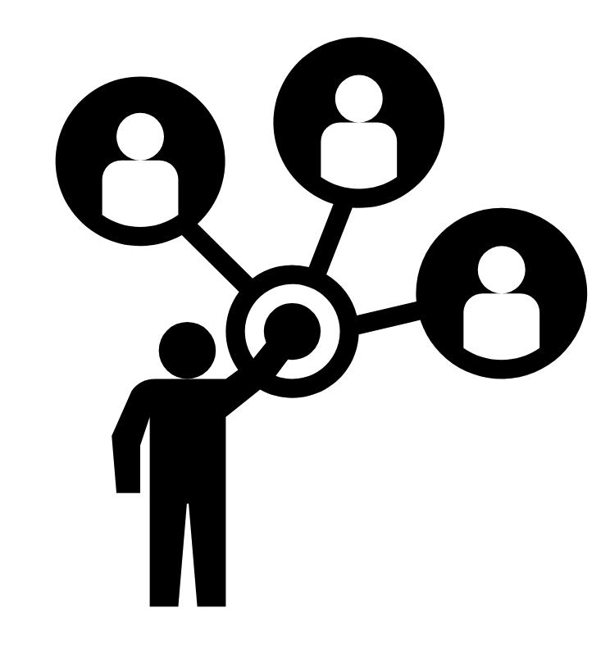
Little Listener
Team 2
Linh Dinh, Rebecca Zhang, Nick Dow
Notes:
We are Little Listener.

Slide 3
The Problem, Defined
Disconnect between families
Children can be unreliable communicators
Teachers can miss details
Notes:
Currently, we see a great disconnect between families with children of all ages. Parents want to know what their kids are up to, but whether it is because the child forgets, isn’t willing to share, or too tired or busy to talk, parents start to miss out. As for teachers, no matter how attentive you are, it is hard to spot every little moment and detail when you have to manage an entire classroom.

Slide 4
Current Solution
The Problems
Parent-Teacher communication
Children communicate as best they can
Teachers send newsletters home
Not directly from children
Inaccurate, lack details
Infrequent, after the fact
Notes:
The current solution is as follows. Parents and teachers catch up briefly during drop off or pick up. Children try to communicate as best they can. Or teachers will sometimes send updates home. But these are all flawed methods. Parent teacher communication rarely includes the child, so every big moment or exciting milestone feels impersonal. As children may be inaccurate communicators, their memories of the events may lack crucial detail. Not to mention, newsletters can be very infrequent.

Slide 5
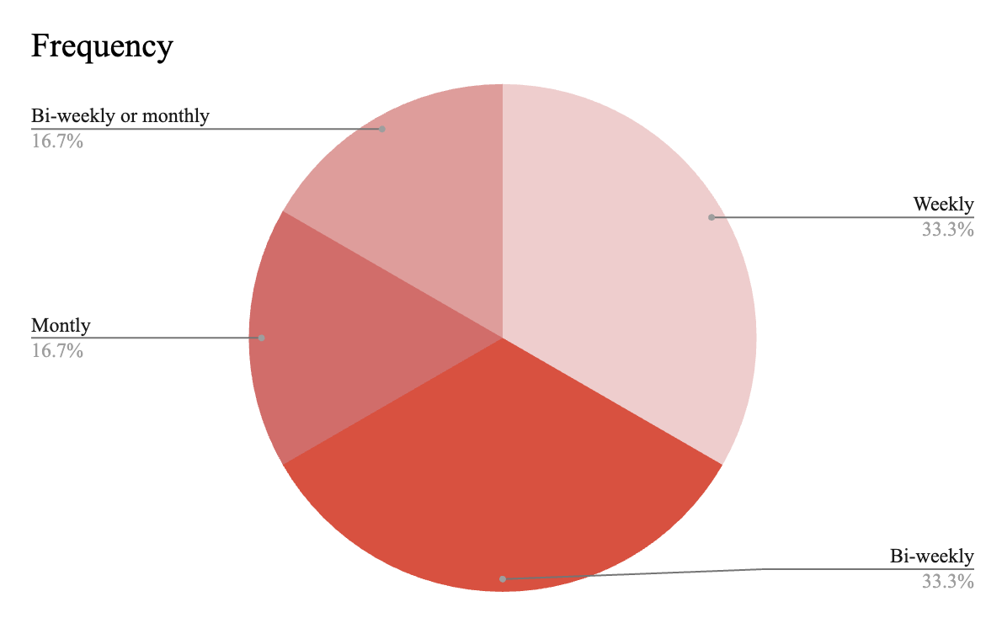
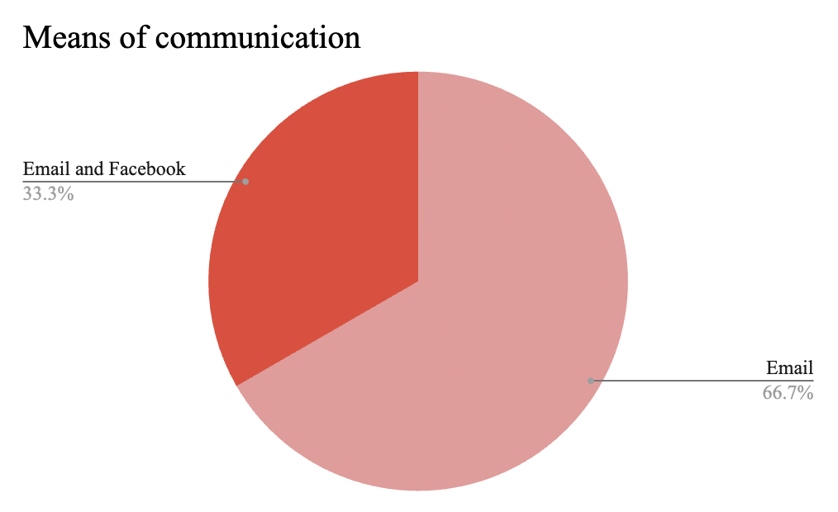
Notes:
When we asked teachers how often is a full update sent to parents, the answers skewed towards being bi-weekly and even monthly. And that’s a lot of days to miss out on.

Slide 6
Reconnect families through echoing the joys of learning

Slide 7
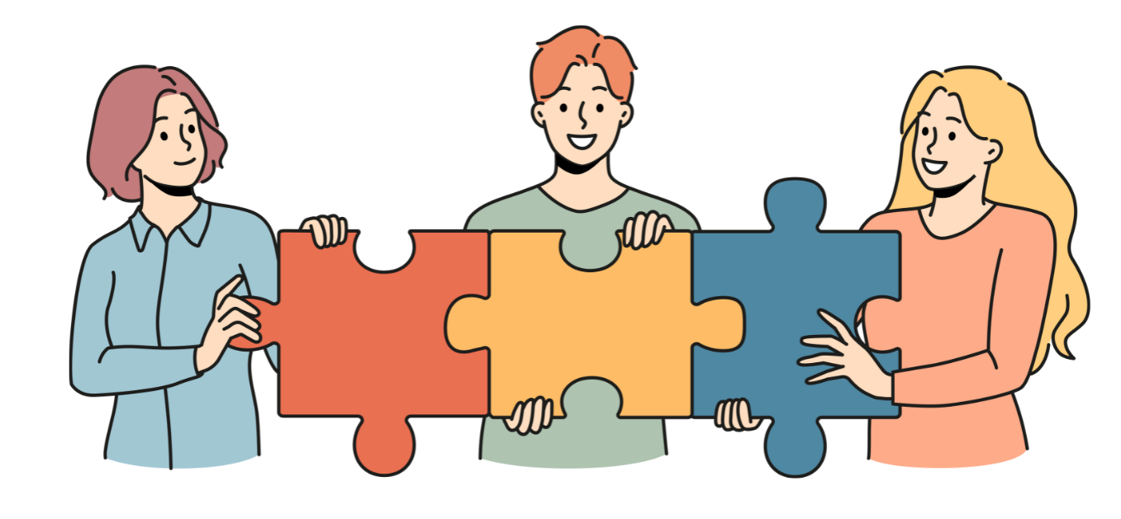
Mission
Vision
Helping parents and teacher become more active participants in their children’s growth
Allowing families to be more connected
Enhancing bonds between teachers and families
Aiding children in fostering communication skills and means of self expression
Notes:
Rebecca
Our goal is to reconnect families through echoing the joys of learning. Our mission is to help parents and teachers become more active participants in their children’s growth. Little Listener aims to bridge the gap between children and parents. By providing a way for children to share what they did as soon as they want to share, children can be excited to share because they know their parents can listen later. Through Little Listener, parents can get to know their children’s joys in school. Teachers are given the chance to listen to their students’ thoughts so they can shape the curriculums in ways that would best fit the children. JOY

Slide 8
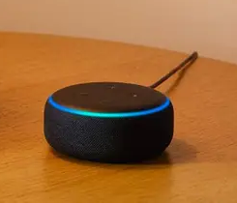
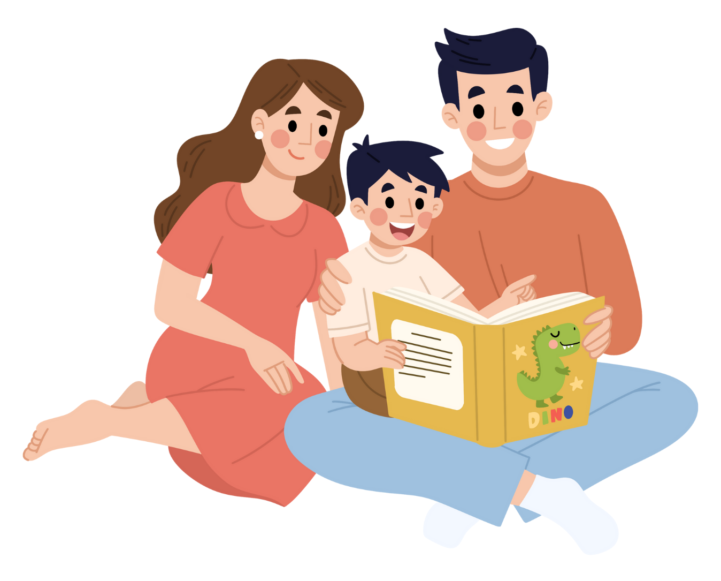


Our Solution!
1
2
3
Help Kids Share Their Stories…
…by Giving Them
a Little Listener…
…to Share for Them Later!
Notes:
Rebecca

Slide 9
Our Program
Part 1: Child’s Path
Child prompted
Direct comments from children
Sent to both teachers and parents
Notes:
Rebecca
Children initiates and records the fun– freedom and flexibility in sharing what they want when they want (multiple times a day),
direct comments – authentic bonding moment
Learning opportunity to shape curriculum and understand students
Our program comes in two main interactive segments. The student path prompts students with simple questions, asking them to share a fun thing they did that day and who they did it with.

Slide 10

Hello! Are you a student or a teacher? Please just say 'student' or 'teacher'

Slide 11
Hello! Are you a student or a teacher? Please just say 'student' or 'teacher'
Student

Slide 12
Hi there!
What's your name?

Slide 13
Hi there!
What's your name?
Aliana

Slide 14
Thank you, Aliana!
What’s something fun
you did in class today?

Slide 15
Thank you, Aliana!
What’s something fun
you did in class today?
I won a Kahoot!

Slide 16
That sounds awesome! Did you do this alone,
yes or no?

Slide 17
That sounds awesome! Did you do this alone,
yes or no?
No

Slide 18
Who did you do it with, what is their name?

Slide 19
Who did you do it with, what is their name?
My teacher,
her name is Christina

Slide 20
Sounds like a wonderful day! Thank you for sharing!

Slide 21
Our Program
Part 2: Teacher’s Path
Learn things they may have missed
Hear direct feedback from their students
Adjust curriculum as needed
Notes:
Rebecca
Interactive for teachers, too
The teacher path allows teachers to access this data that the students have shared to Little Listener, and they can choose to send this home to parents.
Our program also program — same alexa to retrieve information for students - -small snippet of teacher’s path can sound like

Slide 22
Aliana said:
I won a Kahoot with
my teacher, Christina

Slide 23
Would you like to send this data from Aliana to their parent using the number on file for them? Say “yes” or “no”
Notes:
lil pause before start

Slide 24
Little Listener provides a
better solution
Flexible communication
Direct comments from children
Parents feel more connected
Helpful feedback to teachers
Brings joy and positivity
Notes:
Rebecca
summary

Slide 25
Current Solution
The Problems
Parent-Teacher communication
Children communicate as best they can
Teachers send newsletters home
Not directly from children
Inaccurate, lack details
Infrequent, after the fact
Notes:
Nick

Slide 26
The Process
Hazards & Limitations
Usability Testings
Other findings
Look ahead
Notes:
Nick

Slide 27
Hazards & Limitations
Will children interact with Little Listener?
How well will they interact?
How simple must Little Listener be?
Will children remain engaged?
Will VoiceFlow allow us to implement encounters as we wish?
Notes:
Nick

Slide 28
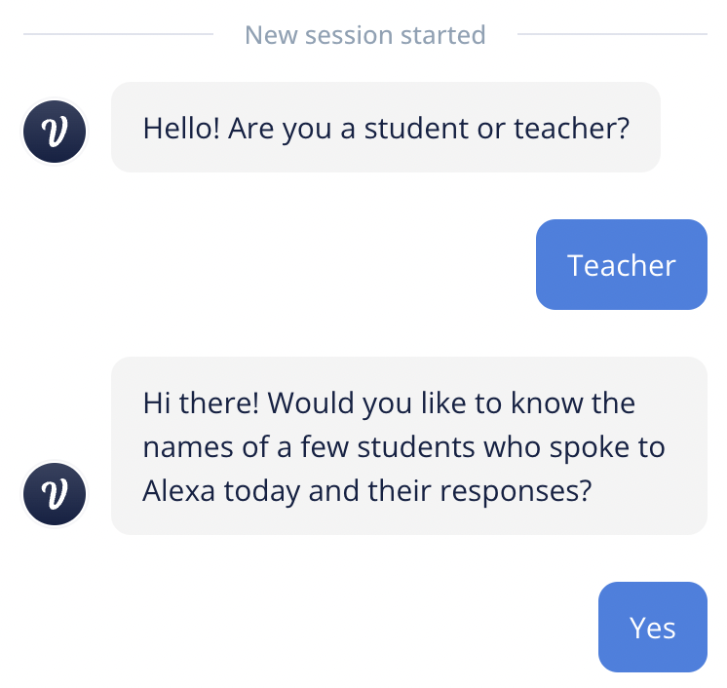
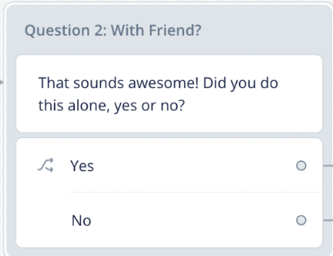
Lessons from Users
Prompting is KEY
This response is ideal, some users response with “Thank you” or “Please”
Realized had to “Prompt” user responses
Notes:
Nick

Slide 29
Lessons from Users
Flow was essential
Responses should be succinct
Pauses could help or hinder
Teachers could enhance little listener
Allow teachers to add comments
Use responses to track learning progress
Notes:
Nick

Slide 30
Other findings
Making teachers more involved
Helping children in more ways than we thought
Notes:
Some of the other findings we stumbled across includes how teachers would love a function where they could also add on additional detail for each child’s answer. For instance, a child’s response of “I played in the sandbox today” could have more dimension if a teacher could add “They were at the sandbox for the entire recess period”. Furthermore, some teachers we interviewed suggested that Little Listener logs could help them track the child’s progress with language, from semantics to sentence structure, and even pronunciation. We’re really thrilled that they saw the potential in Little Listener.

Slide 31
Future Developments
Safety and confidentiality of answers
Add option for students to remove answers,
or only send to parents
Streamline process for teachers to access all answers
Notes:
Rebecca

Slide 32
Echo the joys of learning.
Little Listener
Team 2
Linh Dinh, Rebecca Zhang, Nick Dow
Notes:
We are Little Listener.

