Slide 1








Dynamic Admission Control on Kubernetes with Azure Functions
ANZ 2020
Admit eligible Kubernetes deployments & dispatch SMS alerts
Rahul Rai
thecloudblog.net
@rahulrai_in
Thanks to our sponsors

Slide 2


Admission Control
API Server
AuthN &
AuthZ
Mutating Admission
Schema Validation
Validation Admission
etcd
Admission review
Admission response
Admission review
Admission response
Webhook
Webhook
Notes:
1m
Handles by small teams
Easy to maintain
Independent release cycle
Can be scaled indepednently
Error management at services level
Different technology stack

Slide 3
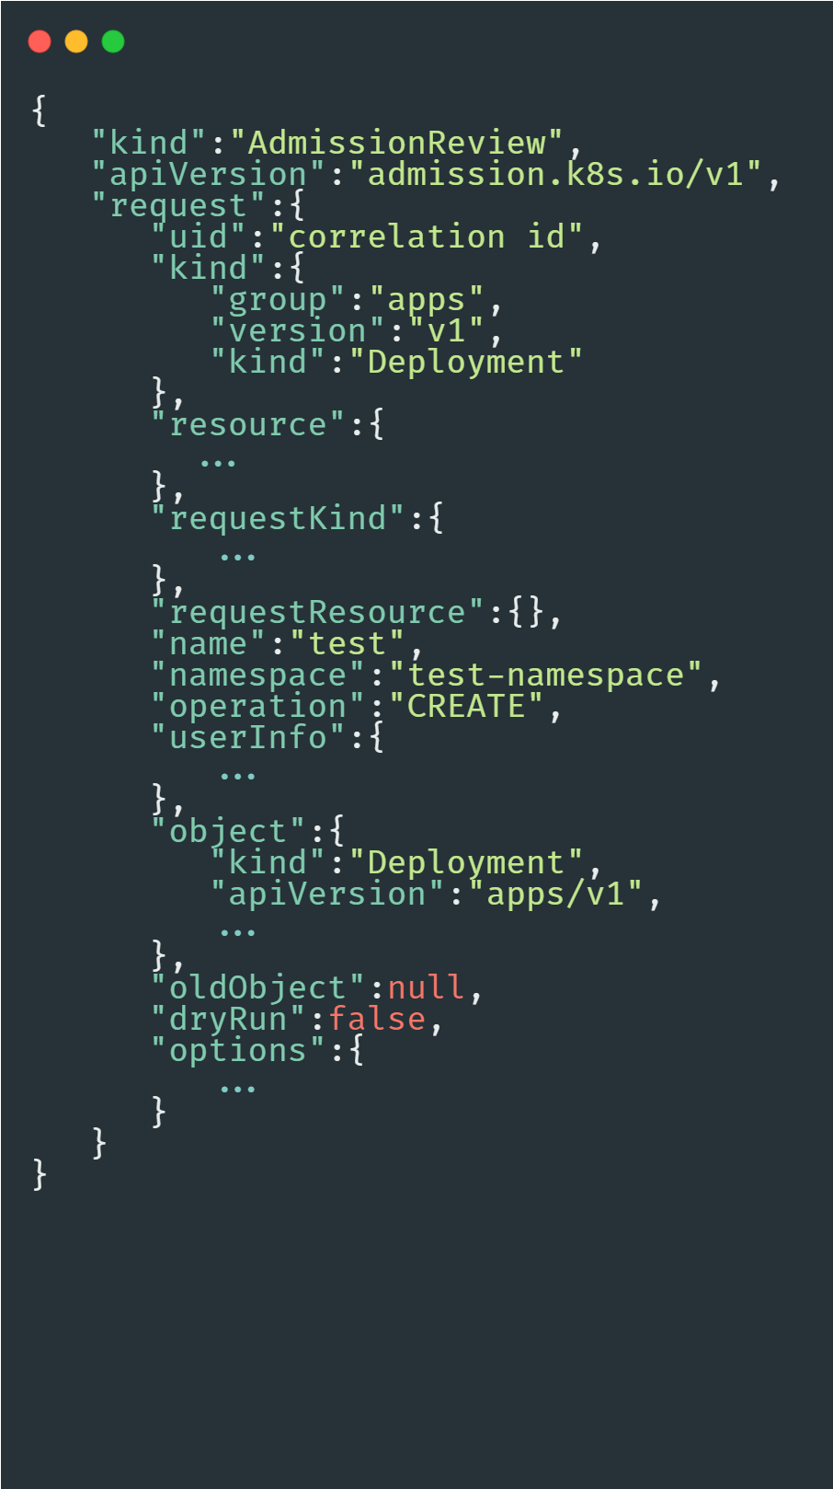


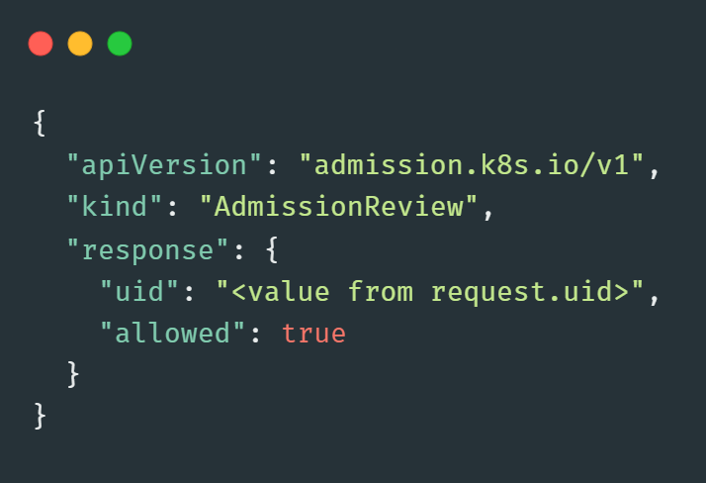

Admission Review & Admission Response
Response
Request
Notes:
1m
Handles by small teams
Easy to maintain
Independent release cycle
Can be scaled indepednently
Error management at services level
Different technology stack

Slide 4










Serverless Admission Webhook
1
2
3
5
4
Developer
kube-apiserver
Azure Function
6
Operations/SRE
Notes:
1m
Handles by small teams
Easy to maintain
Independent release cycle
Can be scaled indepednently
Error management at services level
Different technology stack

Slide 5
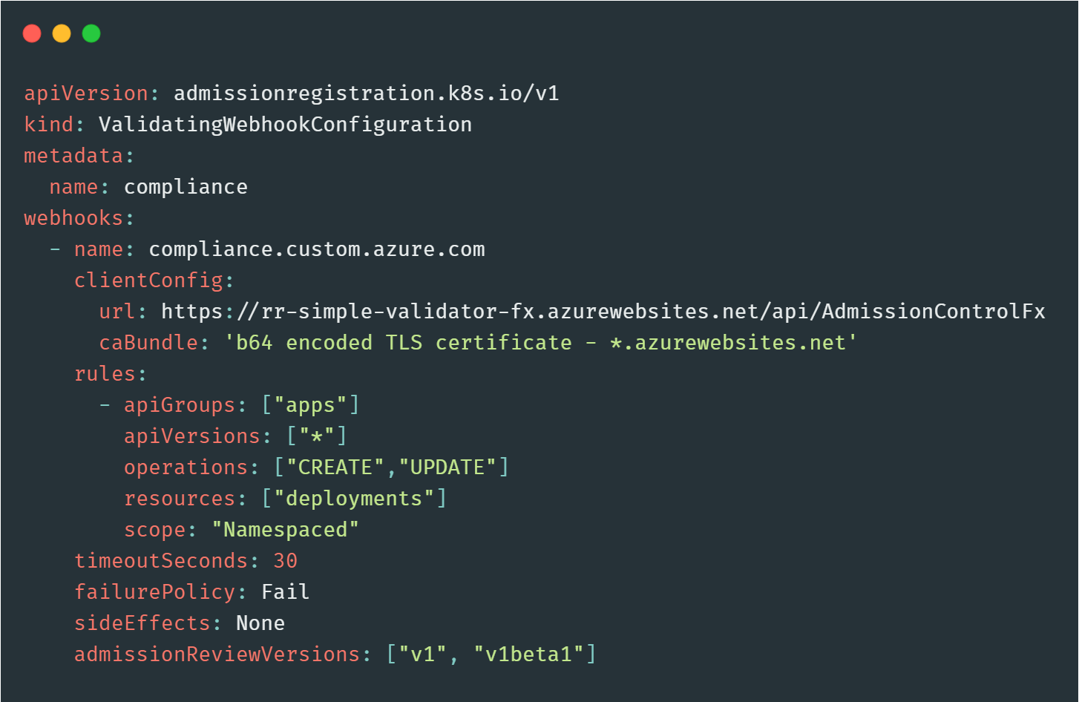
Validating Webhook
Notes:
1m
Handles by small teams
Easy to maintain
Independent release cycle
Can be scaled indepednently
Error management at services level
Different technology stack

Slide 6
Learn more
Demo and slides: https://bit.ly/serverless-dac
Dynamic admission control: https://kubernetes.io/docs/reference/access-authn-authz/extensible-admission-controllers/
Azure Function Twilio binding: https://docs.microsoft.com/en-us/azure/azure-functions/functions-bindings-twilio

Slide 7
Dynamic Admission Control on Kubernetes with Azure Functions
ANZ 2020
Admit eligible Kubernetes deployments & dispatch SMS alerts
Rahul Rai
thecloudblog.net
@rahulrai_in
Thanks to our sponsors

