Slide 1

Just Do It
Diffa Dhania Arfani
Fajar Rahman Hakim

Slide 2

Backgroud
1
A list of task that must be done in a time span is also called to do list. Usually made daily, weekly or monthly. This is
part of planning.
To do list can be made for teams or for personal. Of course this list does not have to be written in writting. Our project is to facilitate everything about to do list by creating an
application called Just Do It.

Slide 3



Application that we used

Slide 4
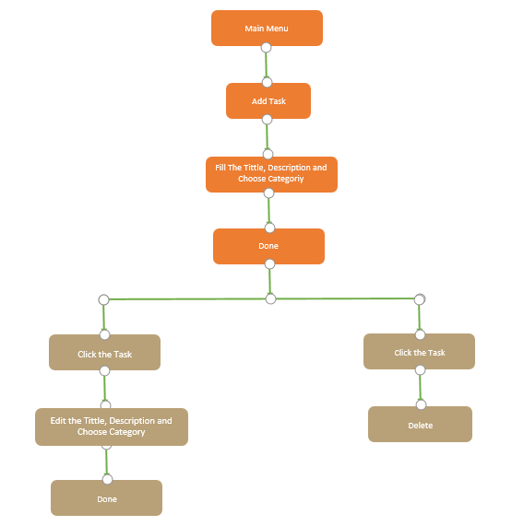
Flow Design Application

Slide 5

Preview
01
02
Our Splash Screen
04

Slide 6
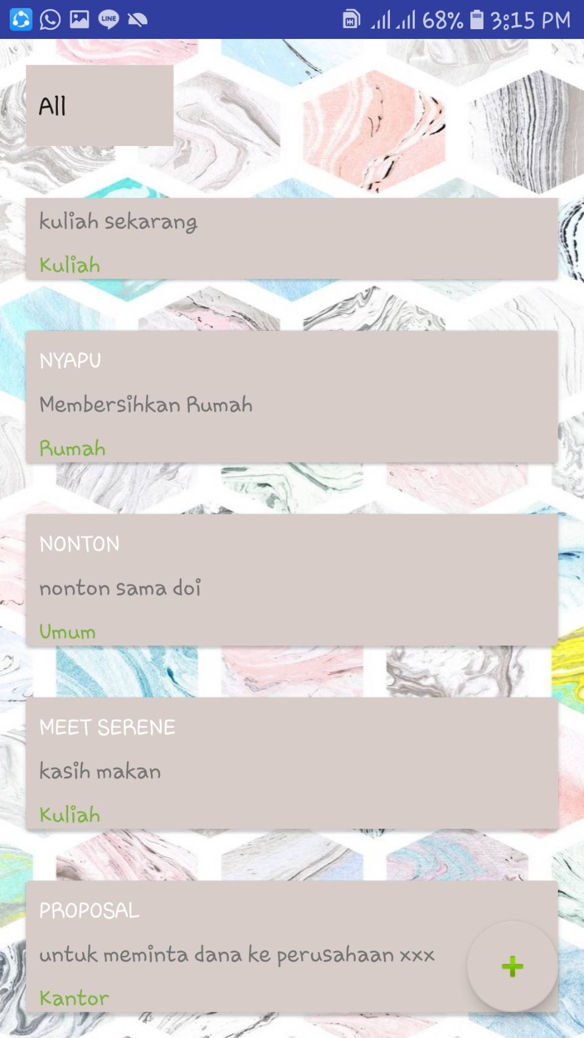
Preview
01
02
Display of main page
04

Slide 7
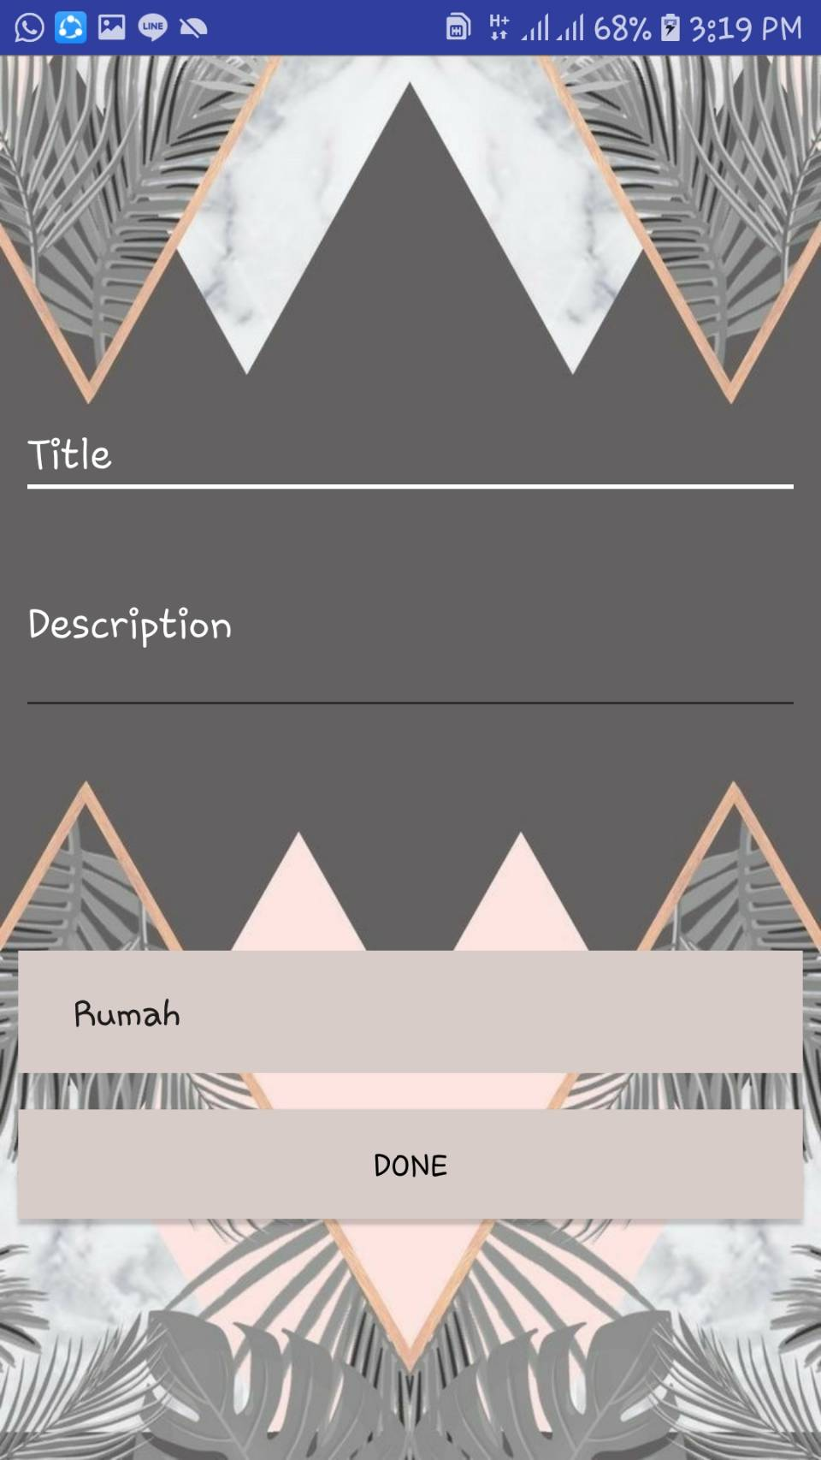
Preview
01
02
For add and edit the task
04

Slide 8
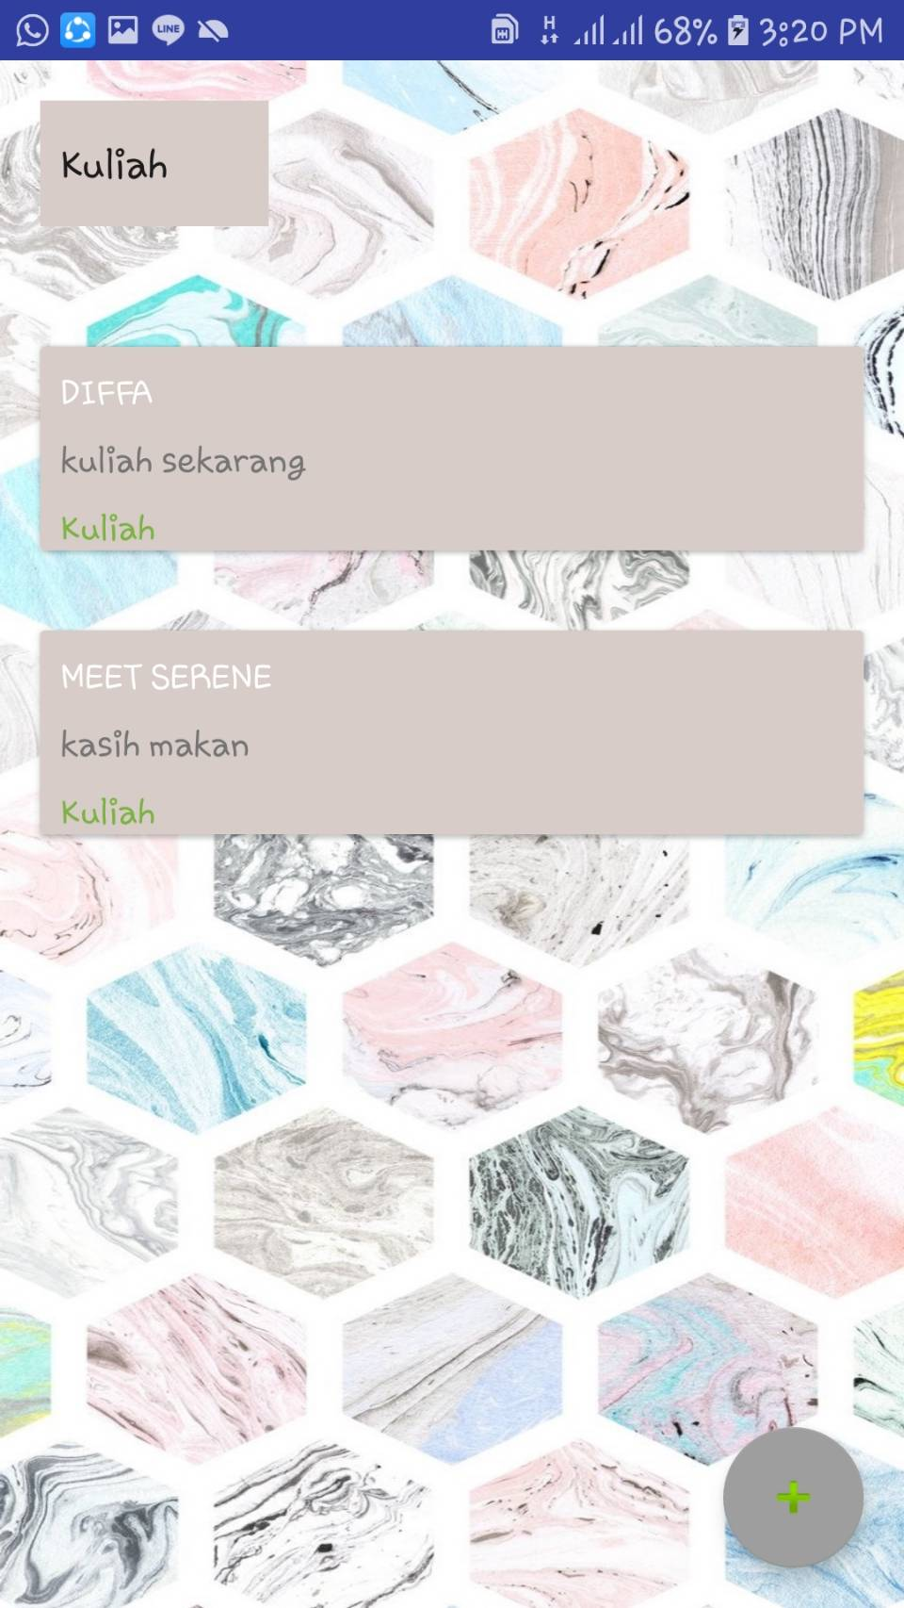
Preview
01
02
Display of main page if we choose the categories
04

Slide 9
DEMO

Slide 10
Thankyou!
Time For Question!!!

