Slide 1
IEP-E
Brian Chen (bc604)
Christmas Vacation, 12/2023-01/2024

Slide 2
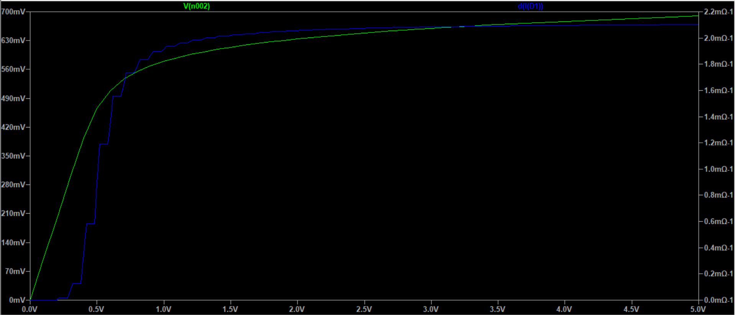
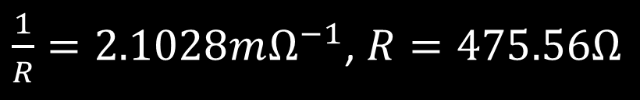
Exercise E1
$\frac{1}{R}=2.1028mΩ^{−1}$, $R=475.56Ω$

Slide 3
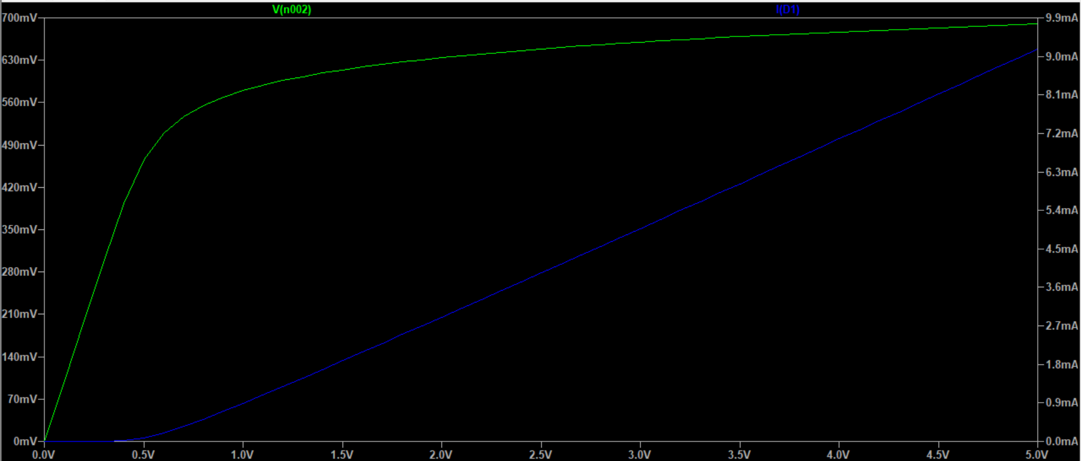
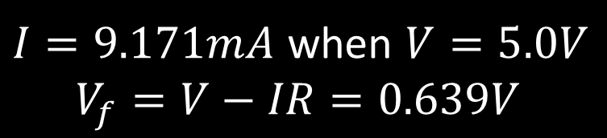
Exercise E1
$I=9.171mA$ when $V=5.0V$
$$V_{f}=V−IR=0.639V$$

