Slide 1
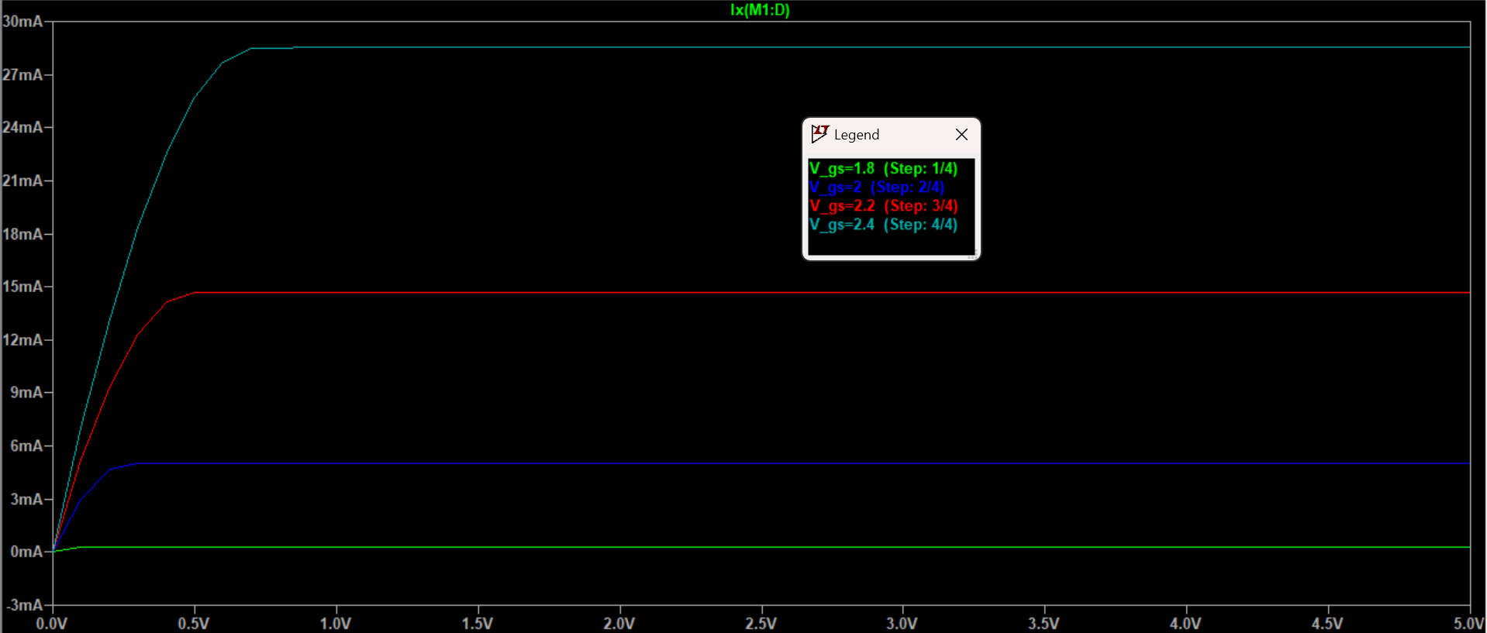
Exercise E10

Slide 2
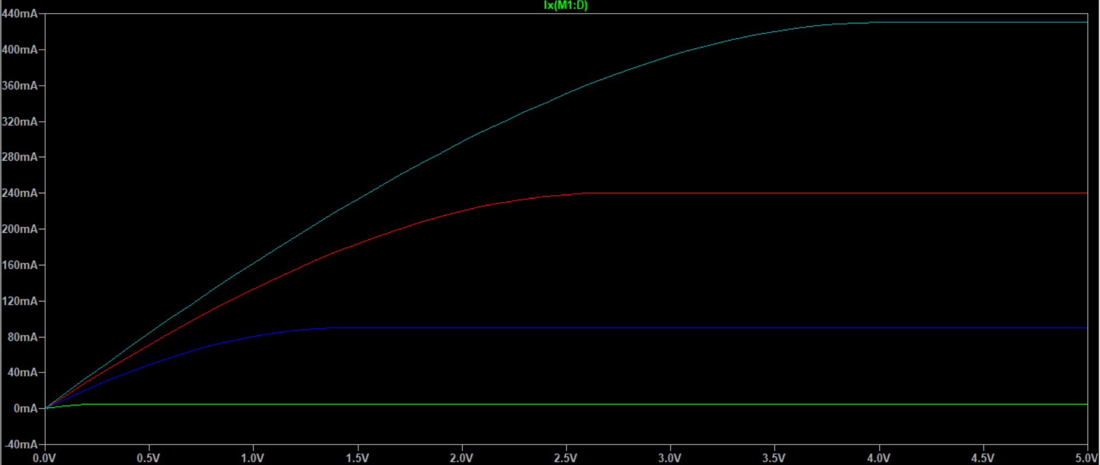
Exercise E10

Slide 3
Exercise E10
When gate-source voltage (V_GS) is quite large, it takes a significantly larger drain-source voltage (V_DS) to reach the max current (I_DS).
Beside this, there are no significant differences between the two sweeps.

