Slide 1
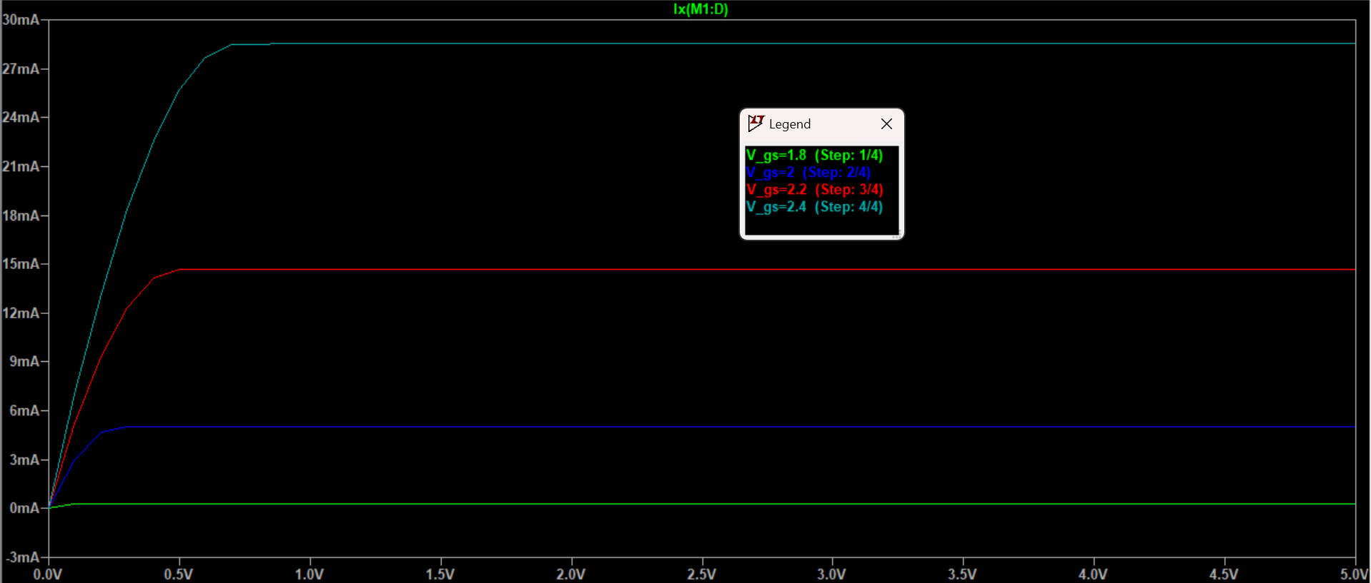
Exercise E11
Load Line?
(Does the load line always intercept the X axis at V_DD?)

Slide 2

Exercise E11
Max voltage swing at drain: $V_{D}=0.5V_{DD}=2.5V$
Thus $R_{S}=\frac{V_{D}−V_{DS}}{I_{D}}=33.33Ω$, and $R_{D}=\frac{V_{DD}−V_{D}}{I_{D}}=166.67Ω$
$V_{G}=V_{GS}+V_{S}=V_{GS}+I_{D}R_{S}=2.7V$
Since also $V_{G}=\frac{R_{2}}{R_{1}+R_{2}}V_{DD}$, given $R_{2}=1MΩ$, we have $R_{1}=0.852MΩ$
Presumably 1MΩ is just chosen because it has a large resistance, and thus eliminating any current at gate.

