Slide 1

Exercise E13
Two equations always apply to this circuit:
$I_{D}\left(R_{D}+R_{S}\right)=V_{DD}−V_{DS}$
$\frac{R_{2}}{R_{1}+R_{2}}V_{DD}=V_{GS}+I_{D}R_{S}$
While changing the resistors, $V_{GS}$ should stay from 1.8 to 2.4; $V_{DD}=5V$. Also, according to the available resistors, we have $R_{1}=0.67MΩ$, $R_{2}=1MΩ$ and $R_{D}=168Ω$.
Ideally, $V_{DS}$ should be larger than $1V$ so it’s guaranteed to stay in the “safe zone”.

Slide 2

Exercise E13
After simplifying things further, we have:
$2+I_{D}R_{S}=2.994$
$I_{D}\left(168+R_{S}\right)=5−V_{DS}$
One solution would be letting $R_{S}=68Ω$. Then we have
$I_{D}=14.62mA$
$V_{DS}=1.550V$

Slide 3
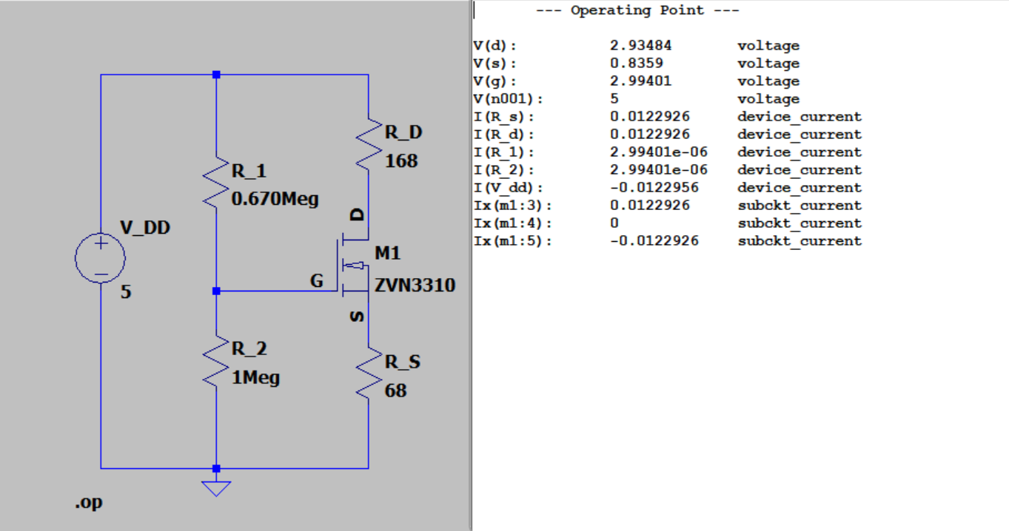
Exercise E13

Slide 4

Exercise E13
Operating Point:
$V_{DS}=2.09894V$
$I_{D}=12.2926mA$

Slide 5
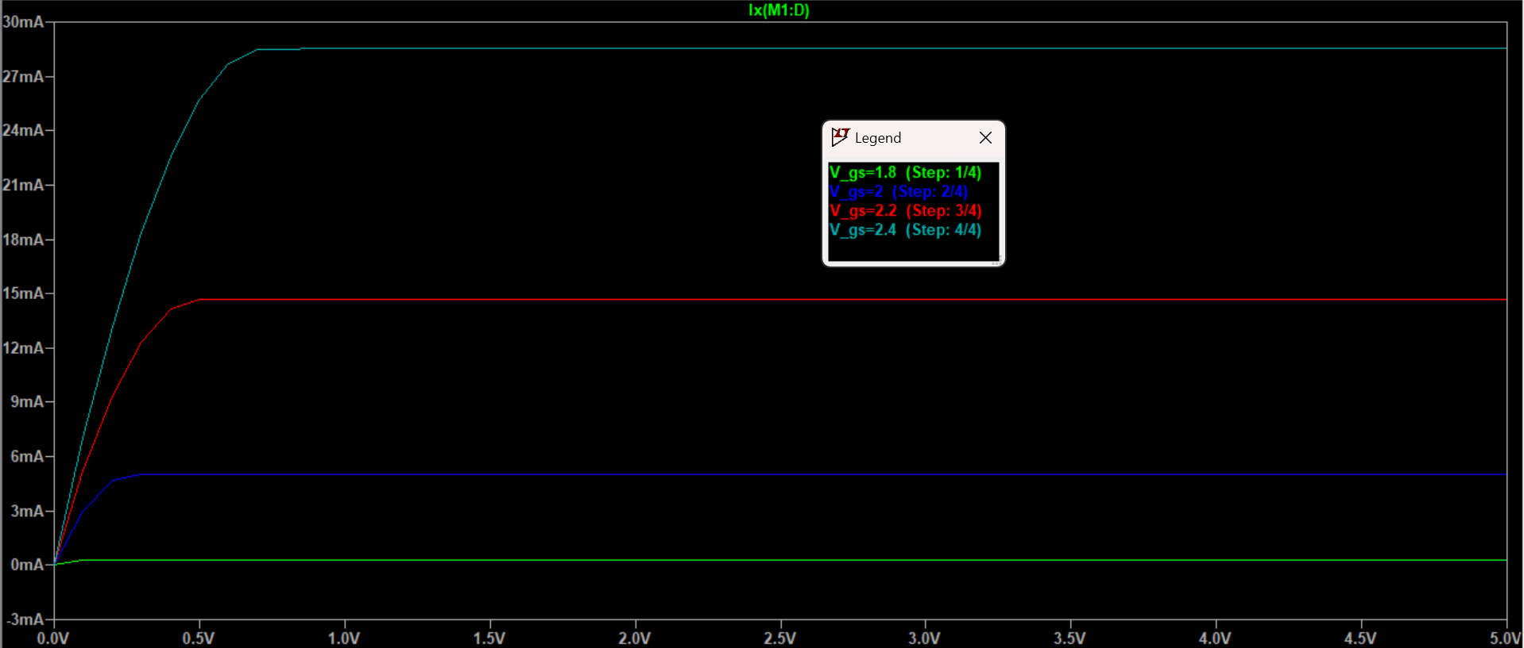
Exercise E13: Revision Acceptable

Slide 6
Exercise E13
At time of submission, the circuit was unable to be built due to lack of equipment (ZVN3310 MOS FET)

