Slide 1
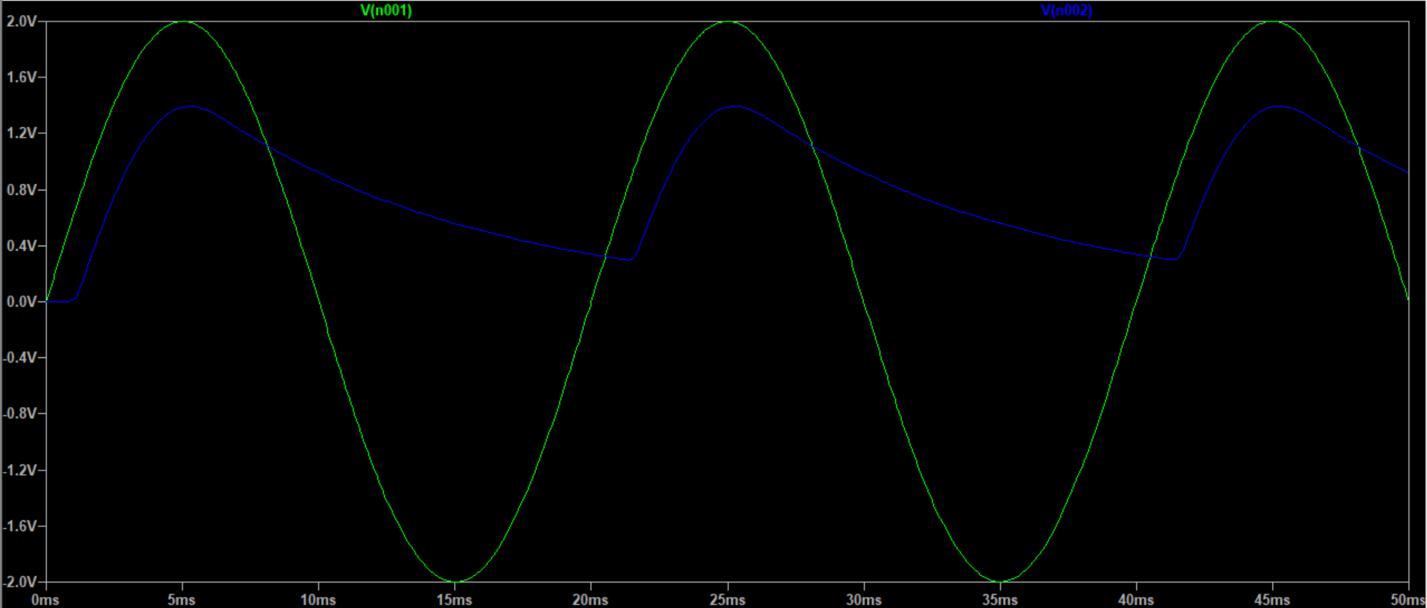
Exercise E8

Slide 2
Exercise E8
As can be seen in the image above, the capacitor slows down the voltage decrease across the parallel resistor&capacitor (and make it a shape similar to a e^x curve). This also results in the minimum voltage being 297mV instead of 0 after the initial charging.

Slide 3
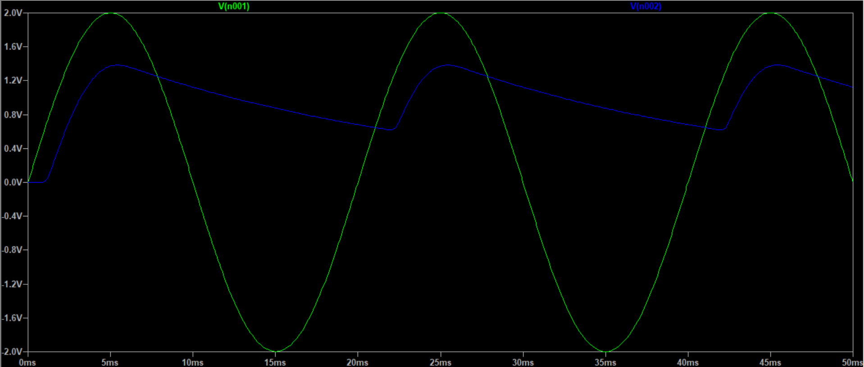
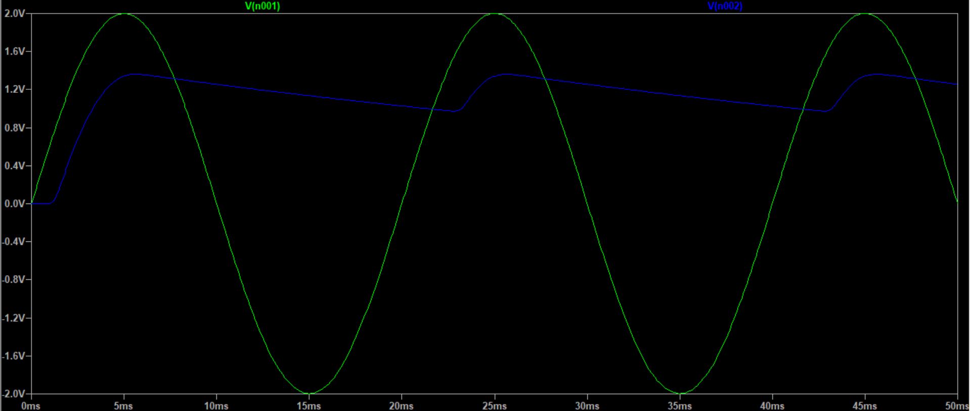
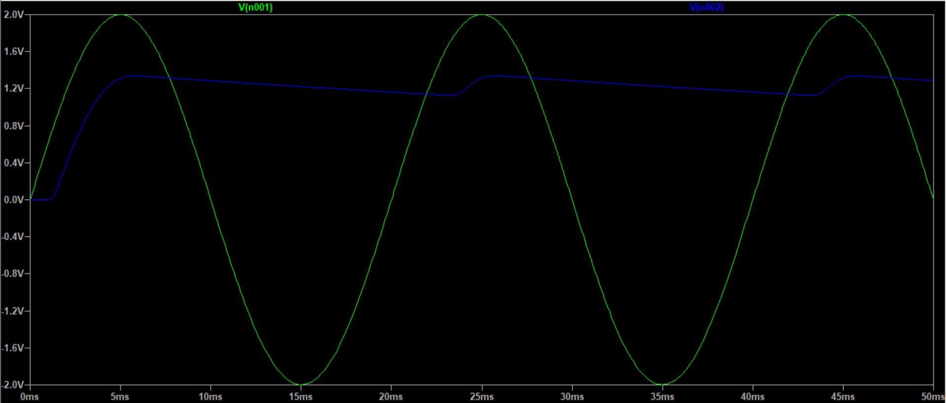
Exercise E8
20uF
50uF
100uF

Slide 4
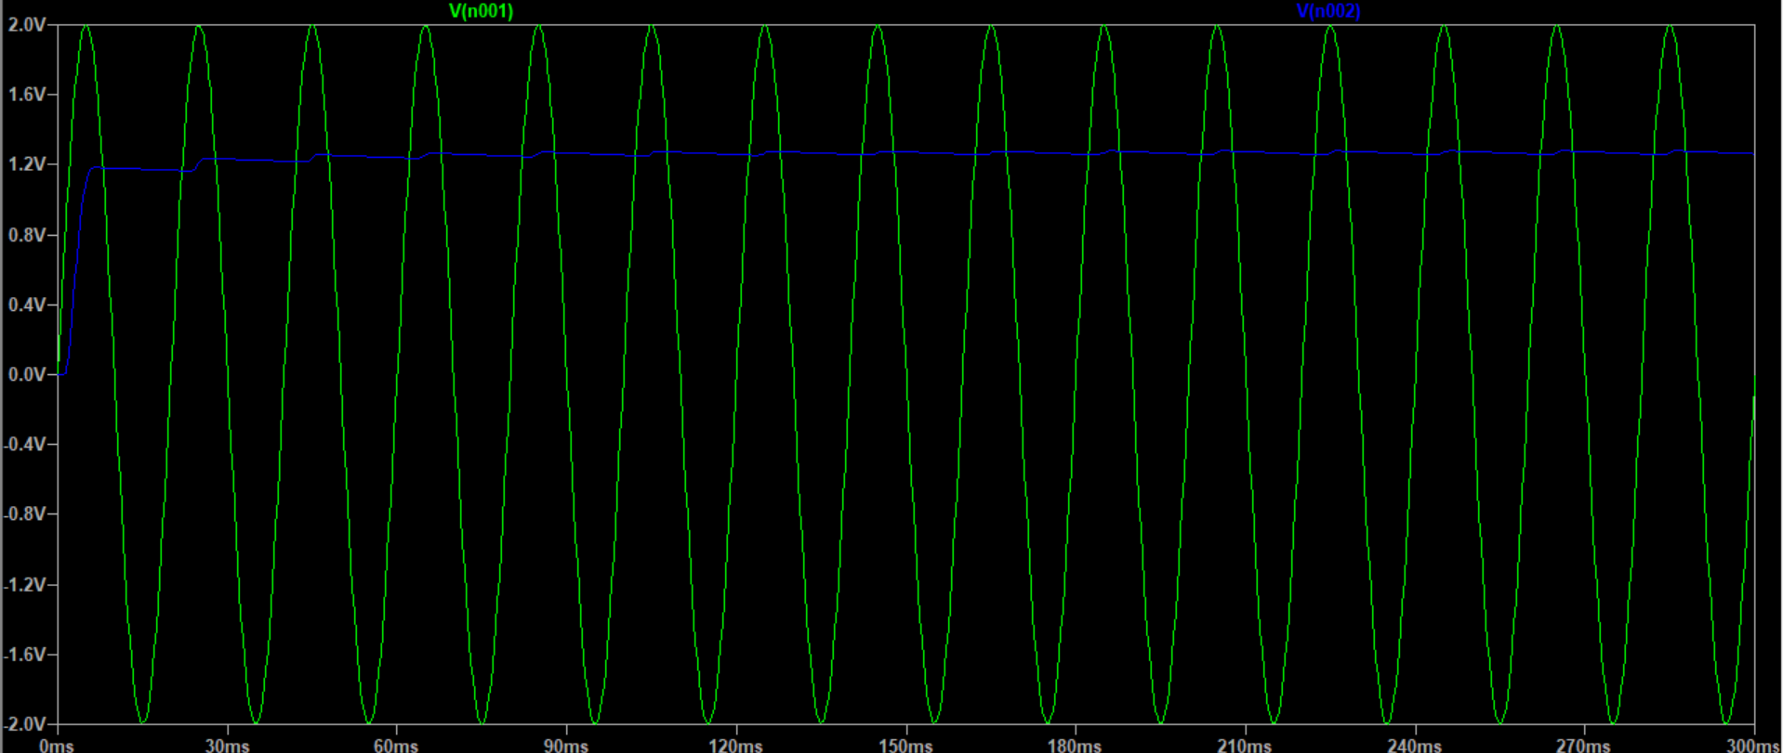
Exercise E8
When C = 1mF, the “delay” of increase of voltage caused by the capacitor becomes so significant that it takes several times for the voltage to reach its peak.
Due to the capacitor also countering voltage decrease, the voltage changes are nearly negligible.

Slide 5
Exercise E8
From the previous images, we can see that between 50-100 uF * is a decent range where the AC ripple should be around 1/10 of their DC offset.
[*] Data manipulation using an Excel spreadsheet shows that it should be 100uF-500uF. Mistake caused by intuition.
The final result would be around 170uF.
500u | 3.45%
300u | 5.73%
200u | 8.58%
170u | 10.08%
160u | 10.71%
150u | 11.41%
100u | 16.94%
50u | 33.15%

Slide 6
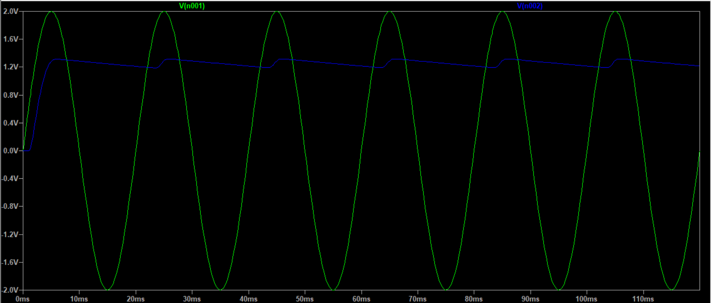
Exercise E8

Slide 7
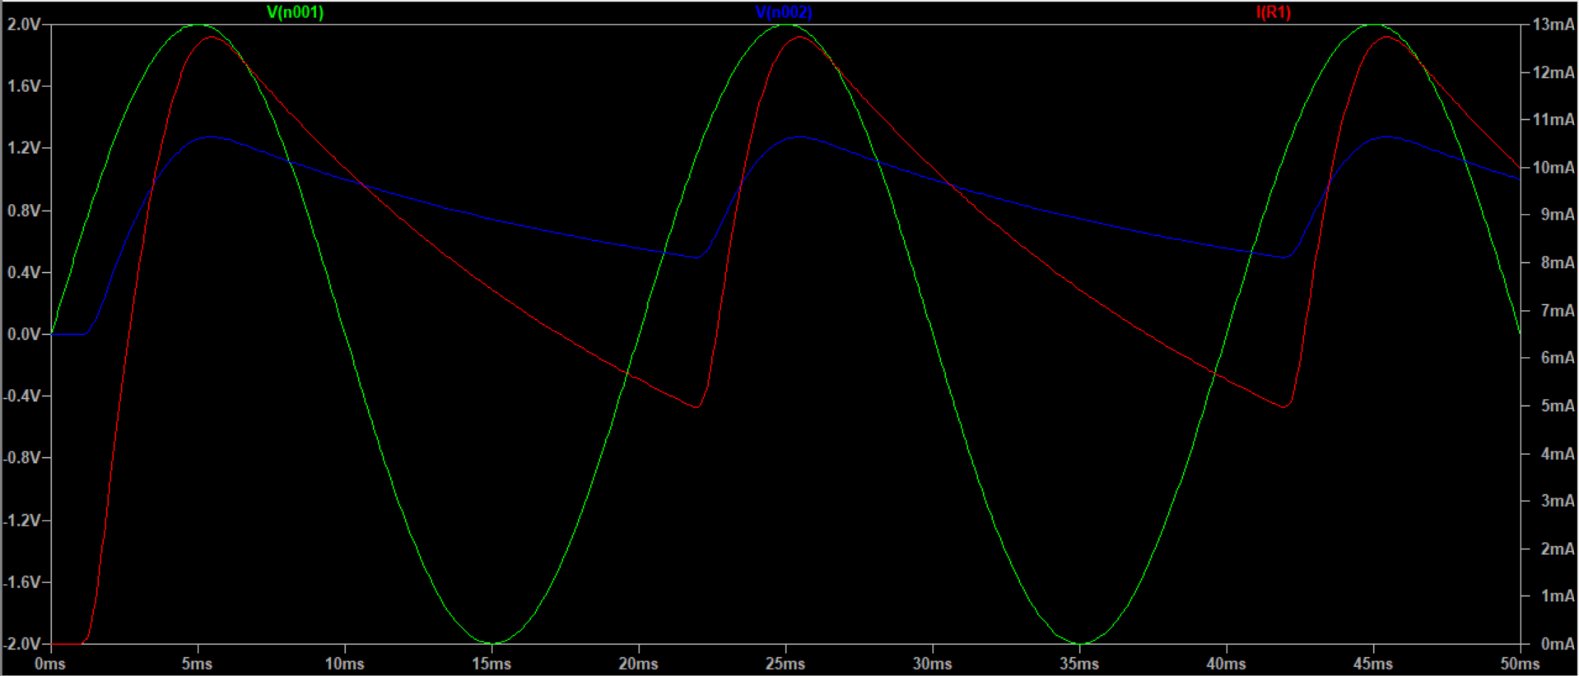
Exercise E8
(When R=100Ω)

Slide 8
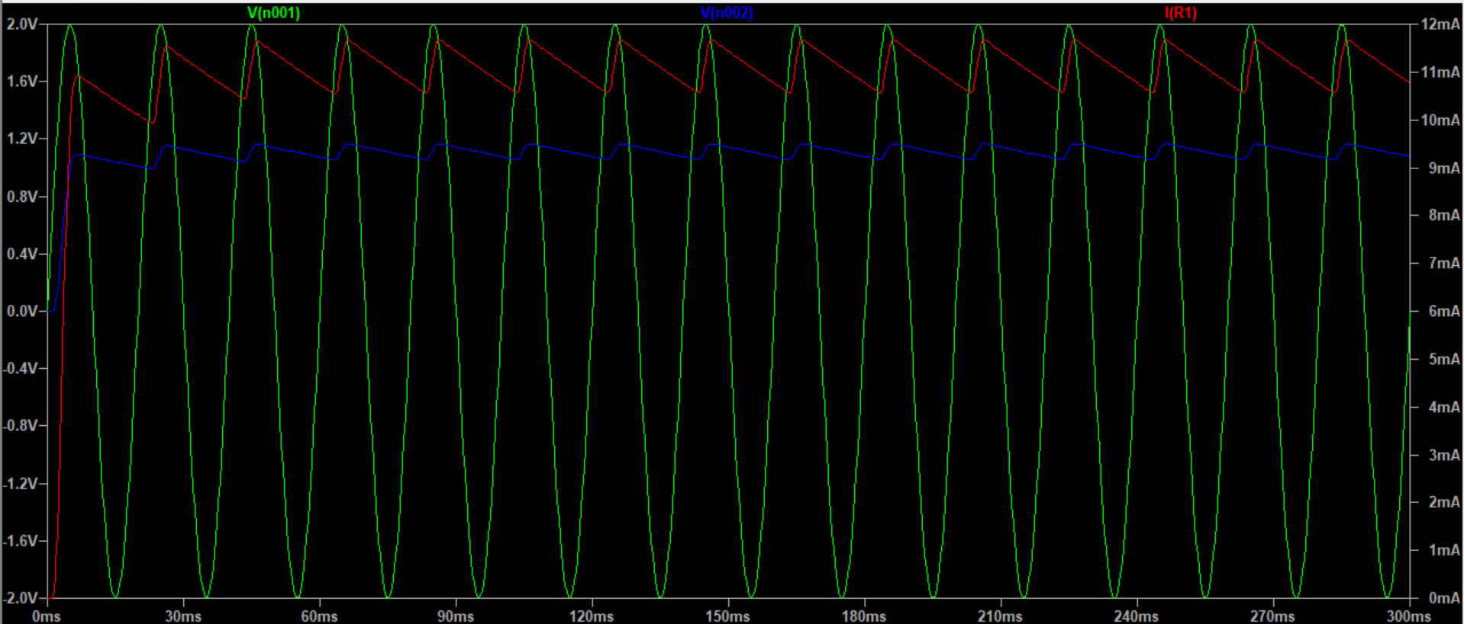
Exercise E8
Note: The red plot here is current through the resistor.
2m | 8.42%
1.7m | 9.90%
1.68m | 10.01%
1.65m | 10.20%
1.6m | 10.51%
1.5m | 11.21%
1m | 16.76%
500u | 32.93%
170u | 87.46%
When R=100Ω, C=1.68mF makes it (almost) exactly 10%. This is an extremely significant and roughly 10 times difference.
Considering that the difference between 100Ω and 1kΩ is also 10 times, these two data might have something to do with each other. My guess would be that the voltage through the parallel part of the circuit has little to do with its overall impedance, but as long as the resistor and capacitor increase/decrease in the same ratio, the “current divider” circuit will work as normal.

Slide 9
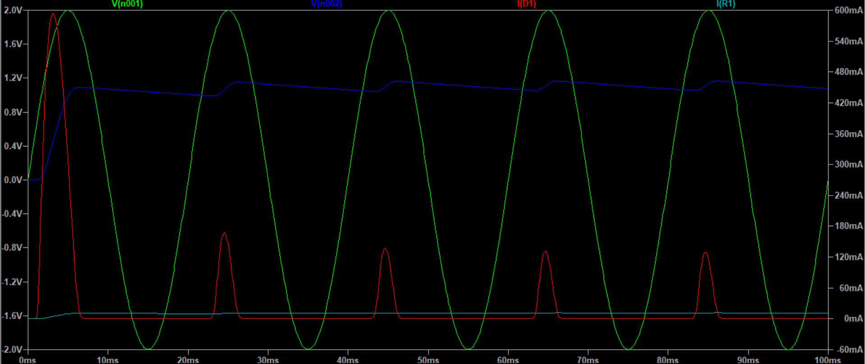
Exercise E8
Note: The red plot here is the total current (i.e. current through diode), and the cyan plot is the current through the resistor.
A mistake I made is comparing this with the voltage around diodes in previous exercises. This is the current.
The initial current through the diode is weirdly large, but the peak keep decreasing until it remains stable, presumably when the capacitor enters its fully charged cycle.

