Slide 1
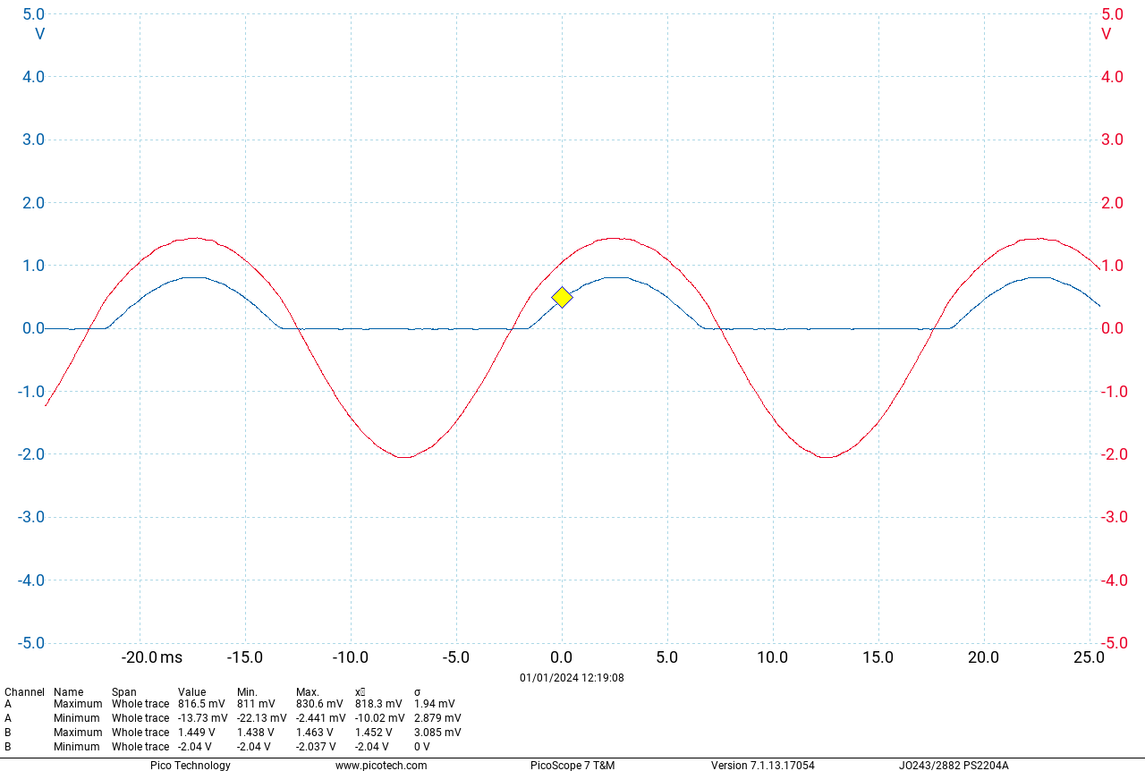
Exercise 9

Slide 2
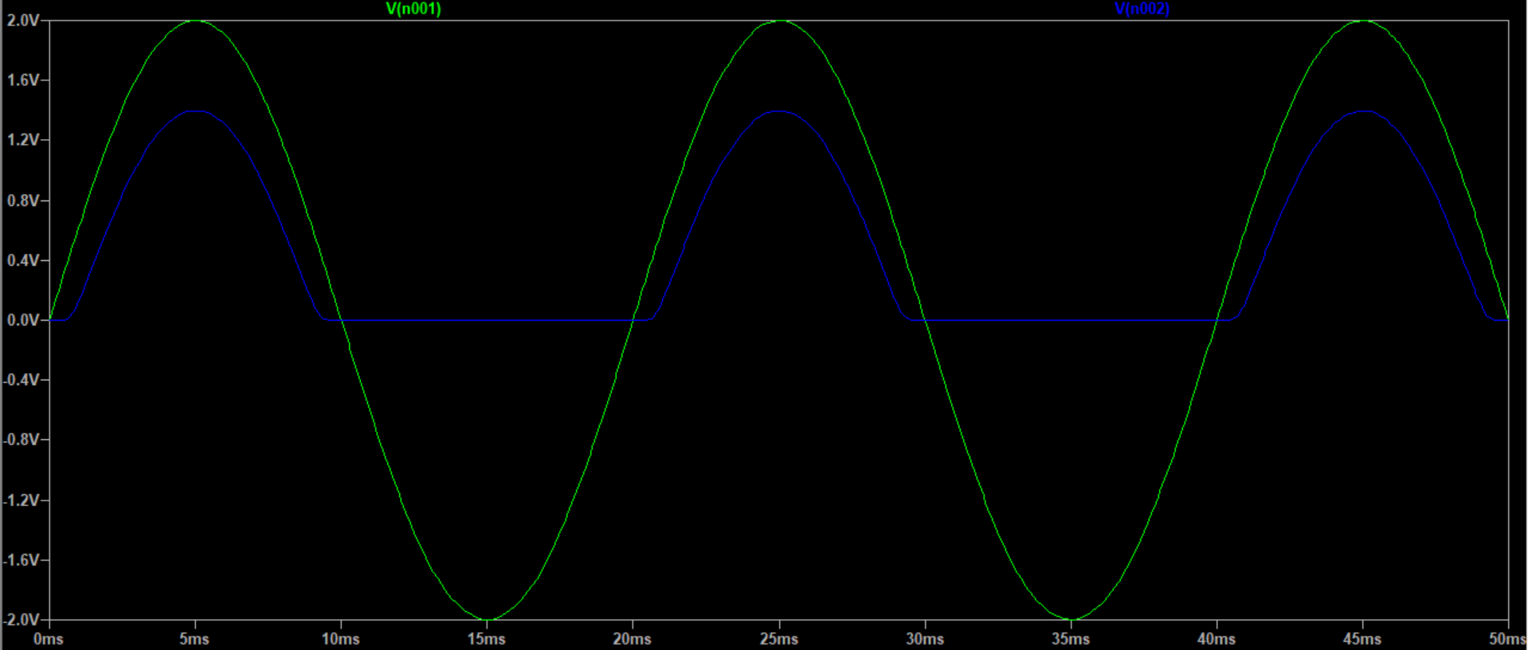
Exercise 9
LTSpice V_R:
Max 1.398V
Min 0
Experiment V_R:
Max 819.1mV
Min -9.603mV
LTSpice V_All:
Max 2V
Min -2V
Experiment V_All:
Max 1.450V
Min -2.040V
The experiment voltages are significantly lower than the simulation ones. This is presumably due to source impedance or some other impedance.

Slide 3
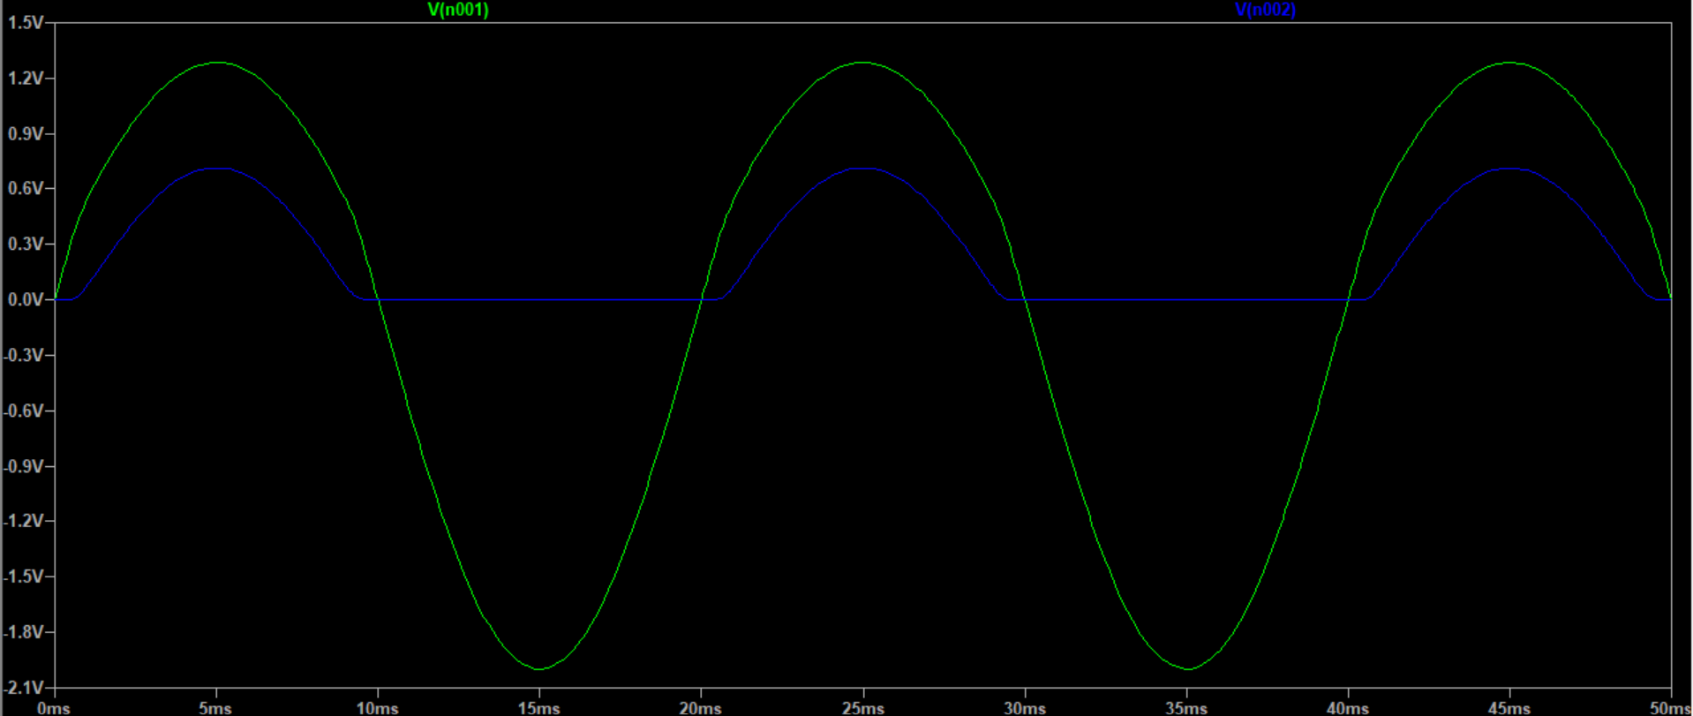
Exercise 9
When the series resistance of the source is set to 1kΩ, the results are quite similar to what we saw from the experiment results.

Slide 4
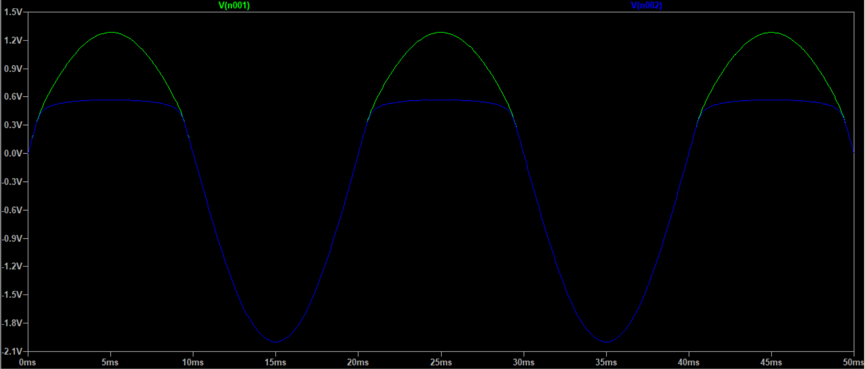
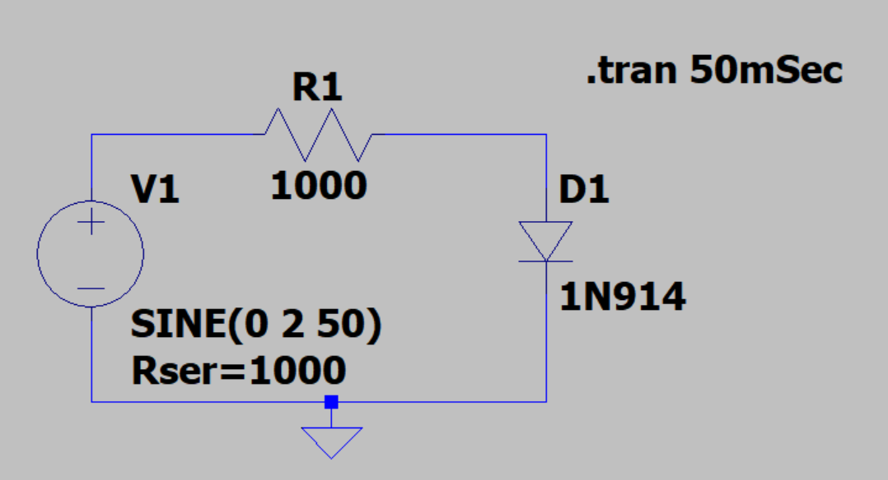
Exercise 9
The blue trace in this graph is the voltage across the diode.
The schematic can be found below, but this graph can also be achieved by using V(n001) – V(n002) in the original circuit.

Slide 5
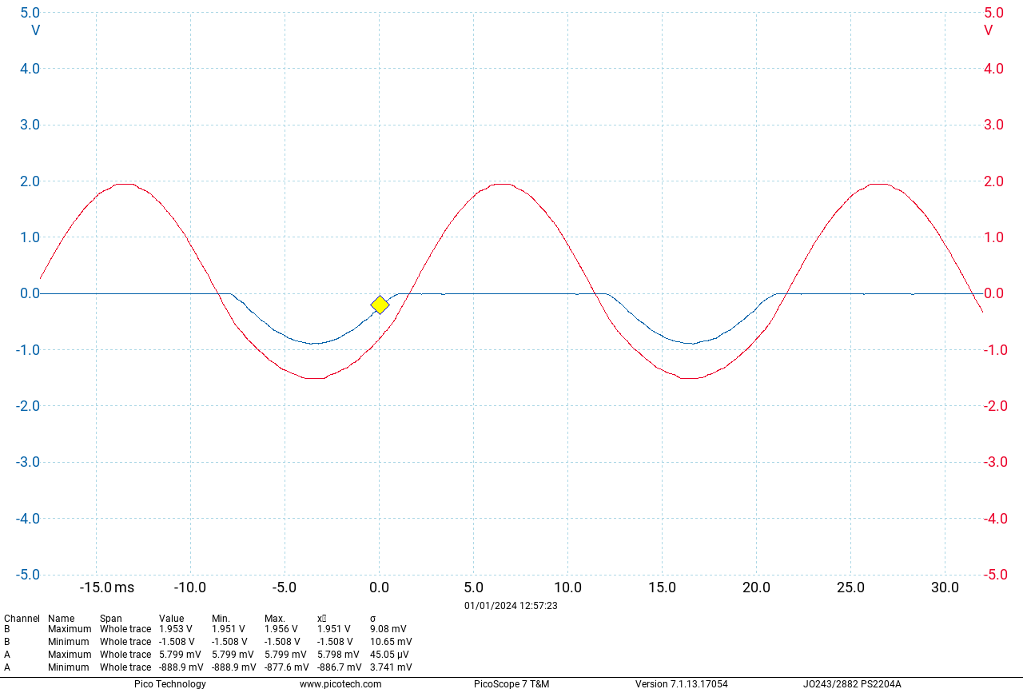
Exercise 9
As expected, reversing the diode has little effect on the voltages besides reversing them.

Slide 6
Exercise 9a
Placeholder for now
Left for finish after revision.

