Slide 1
Alexis’ Slides
Note: Please take a look at the notes section of each slide if you have any questions.
This does not flow that well without the integration of Pragya’s slides. You will see how it flows in the presentation rough draft ☺

Slide 2
Example:
1990 World Cup Semi Final – West Germany v England
Power demand: 2800 MW
When England was defeated in a toe-curling penalty shootout, our hearts sunk as we waved goodbye to a tearful Gazza and the gang. Only a nice cup of tea could console the nation. The resulting power surge was the equivalent of 1.12 million kettles being switched on at the same time.
Note: This example will come after Pragya defines tv pickup
Notes:
These examples will come after Pragya defines tv pickup
I wanted to quickly showcase some examples of other phenomenon detected by other researchers.
https://www.britishgas.co.uk/the-source/our-world-of-energy/surprising-world-of-energy/power-surge

Slide 3
Example:
2013 Andy Murray wins Wimbledon Men’s Final
Power demand: 1110 MW
The first British male to win Wimbledon since Fred Perry saw thousands of us celebrate by reaching for that celebratory jug of Pimms that was chilling in the fridge.
Note: This example will come after Pragya defines tv pickup
Notes:
https://www.britishgas.co.uk/the-source/our-world-of-energy/surprising-world-of-energy/power-surge

Slide 4

What’s the tea?
The real question is, can TV Pickup be detected and, if so, how?
Notes:
After this slide, Pragya will briefly go over our hypothesis

Slide 5




Detecting TV Pickup
Power/Usage
TV Ratings
Detecting Pickup
Spurious Factors
Notes:
Power/Electricity Usage
Analyzing electricity usage at times of major sporting events or soap operas may show a trend for an uptick in energy usage
TV Ratings
Pulling ratings for large sports events/ soap operas may help us to find events with large audience samples to better analyze power usage at that time
Detecting Pickup
We need to look for “spikes” in power usage within specific dates and time frames that correlate with large sports events or soap operas
Spurious Factors
At first glance, TV Pickup was typically accredited to large audiences making kettles of tea, however, there may be other factors to consider such as opening a fridge or flushing a toilet.

Slide 6
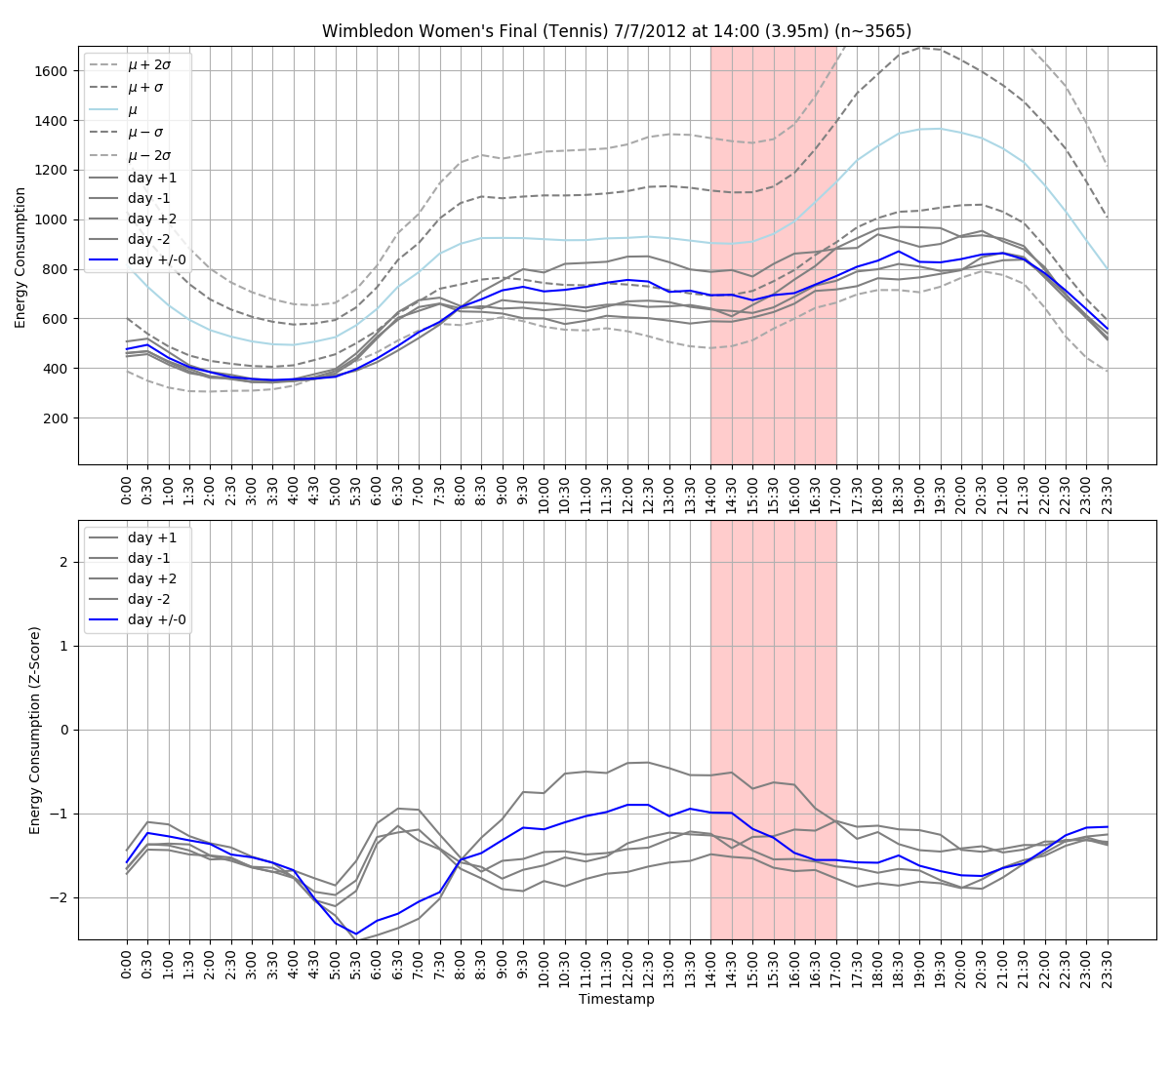
Detecting Pickup Example:
Notes:
Explain that you would look at this graph to find “pickup” in power usage at the time of the event specified for this date

Slide 7
Detecting TV Pickup
Power/Usage
TV Ratings
Detecting Pickup
Spurious Factors
Notes:
Power/Electricity Usage
Analyzing electricity usage at times of major sporting events or soap operas may show a trend for an uptick in energy usage
TV Ratings
Pulling ratings for large sports events/ soap operas may help us to find events with large audience samples to better analyze power usage at that time
Detecting Pickup
We need to look for “spikes” in power usage within specific dates and time frames that correlate with large sports events or soap operas
Spurious Factors
At first glance, TV Pickup was typically accredited to large audiences making kettles of tea, however, there may be other factors to consider such as opening a fridge or flushing a toilet.

Slide 8
Can we break this down even further?
Notes:
Lead into acorn groups by Pragya

