Slide 1
Are Graphs and Anecdotes About Tea Enough?

Slide 2
Great Britain Vs. South Korea (again)
Seems like the perfect candidate for an observation of ‘pickup’ using our dataset.
About 12.36 million Brits. watched.
Occurred as part of the 2012 London Olympics.
Peak power usage for that entire day coincided exactly with half-time.
To actually provide some substance to the idea that this is an observation of pickup, we should compare that day’s power consumption with neighboring days.

Slide 3
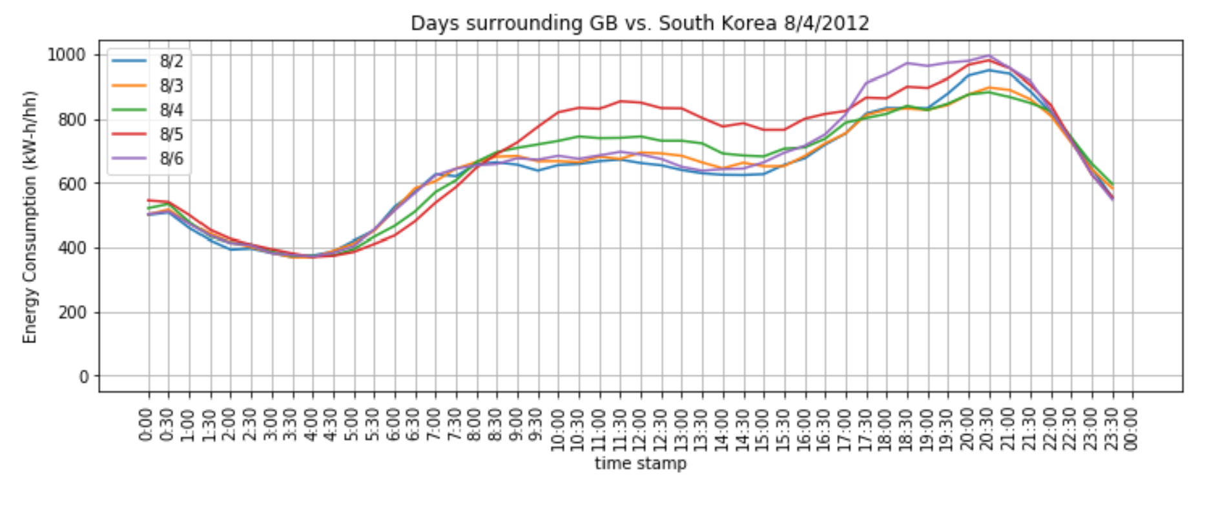
Hmmmmm. It’s the min… ( ͠° ͟ʖ ͡°).

Slide 4
Maybe it’s still larger than most other days at the same time?
(☉ ͜ʖ☉)… That’s gotta be it.

Slide 5
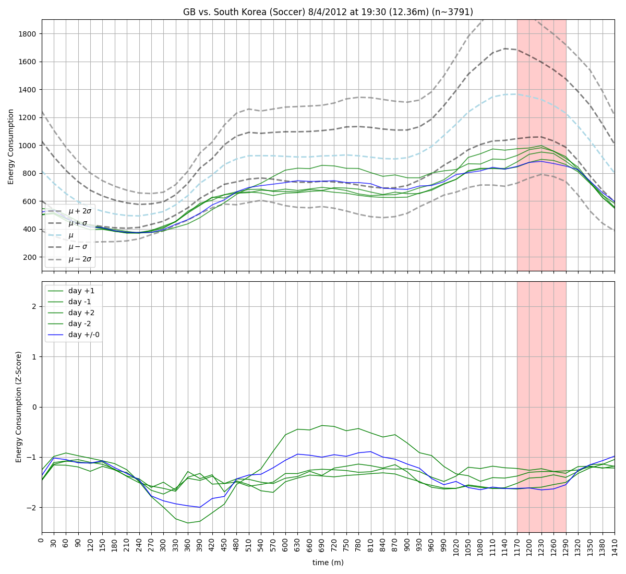
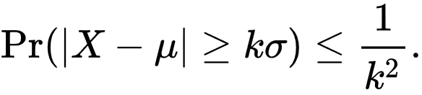
Recall Chebyshev's inequality:
Estimate ‘k’:
it’s bigger than 1.5.
Draw Conclusion:
At least 55% of days have larger power usage during the same time.
ಠ_ಠ
This might require more effort than initially anticipated…
… need to look at more examples

Slide 6
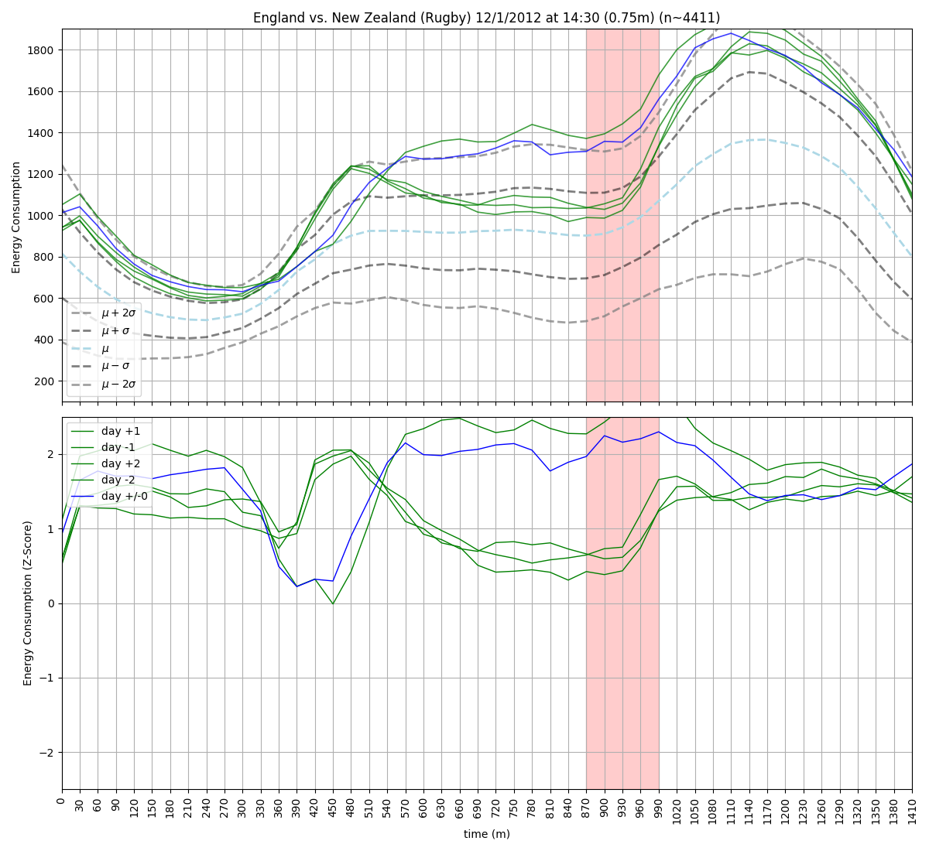
New Sport:
Rugby
Viewership:
< 0.75 million
Power Usage:
Greater than at least %75 of other days at the same time.
ヽ(ಠ▃ಠ)ﾉ the &%@% is this….

Slide 7
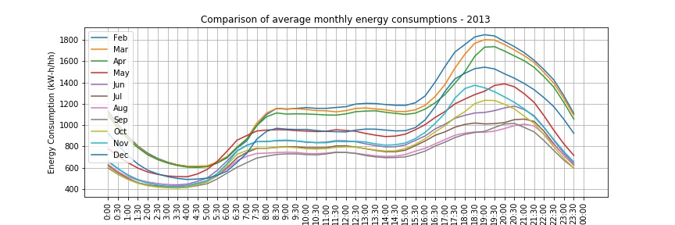

Slide 8
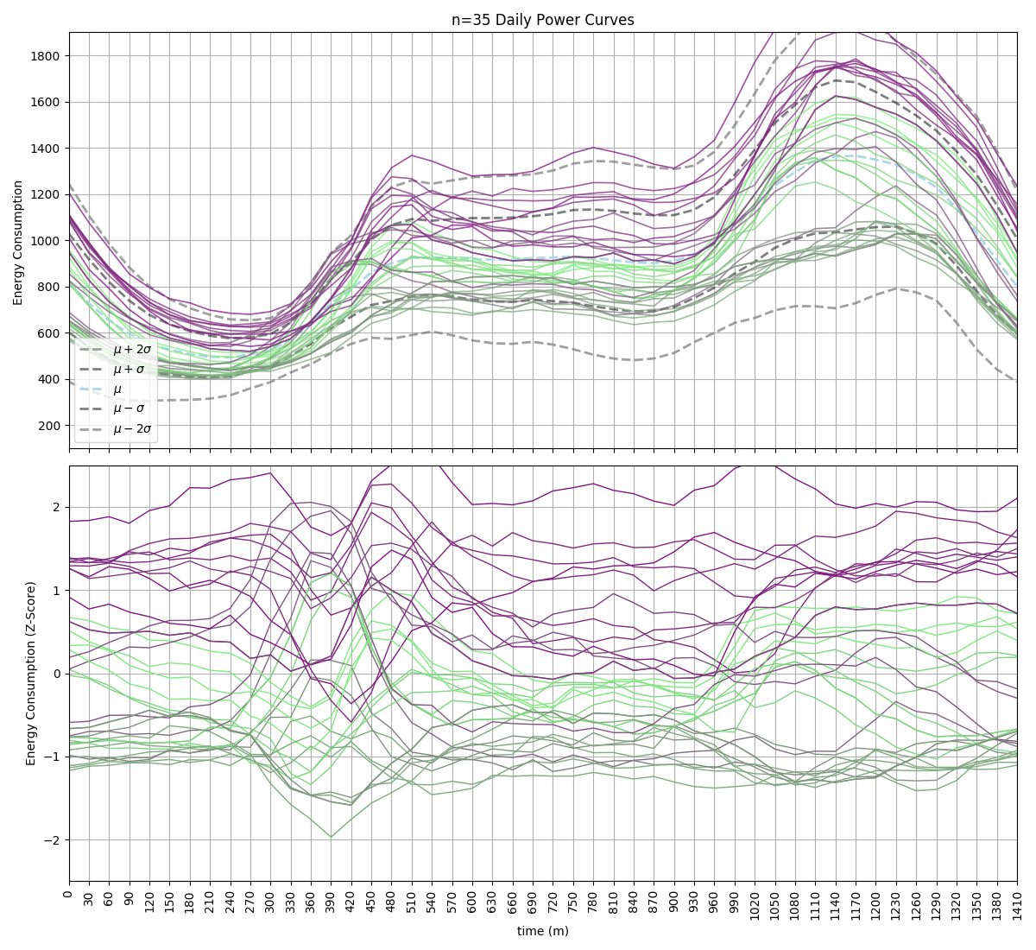
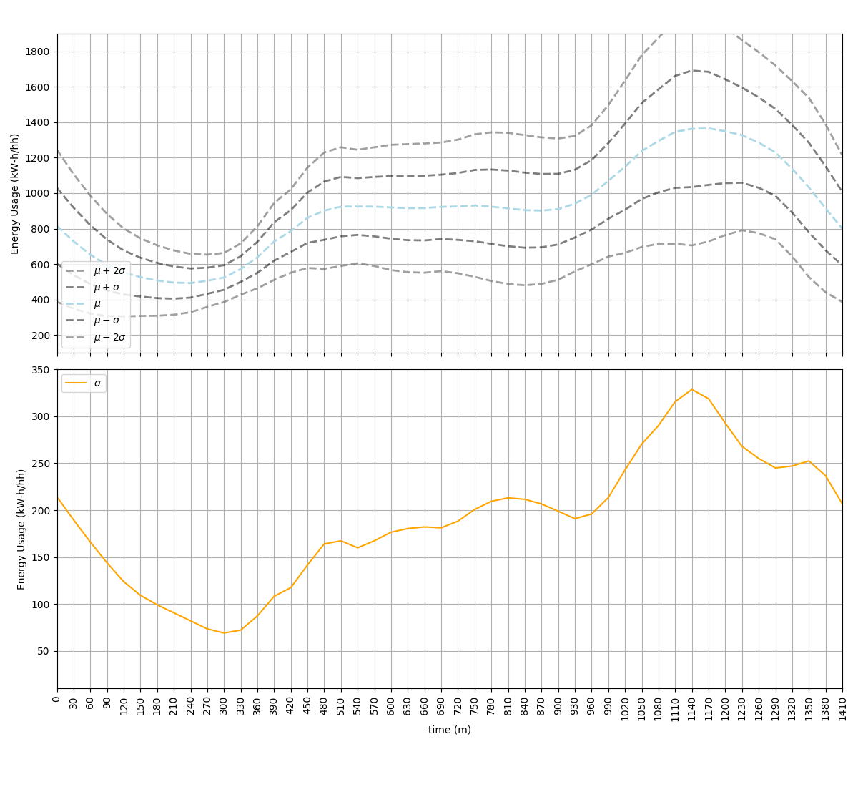
(╭ರ_•́) hmm...
…. more latent conditioning than expected.
ಠل͜ಠ this is going to be fun to screw around with…

Slide 9
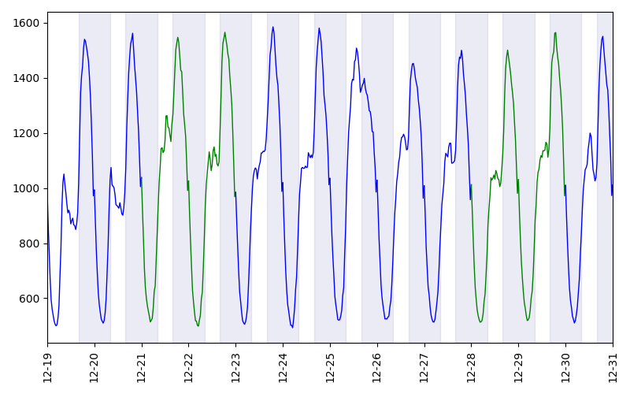
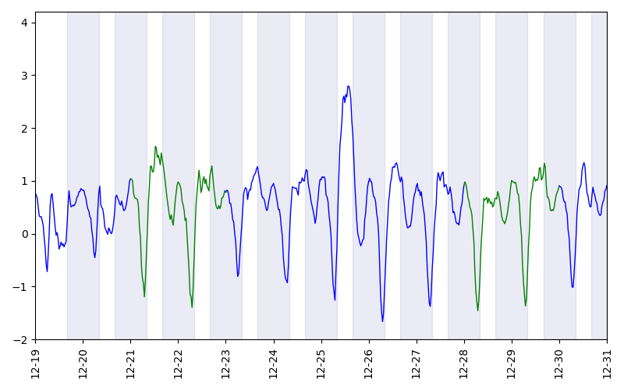
before I get distracted..
Christmas
Raw Signal
Z-Score

