Slide 1
2. Discussion on ‘pickup’. How pickup might be detected.
3. Main questions: Can we detect pickup? If so, can it be measured and predicted. If not, why not? Can it be detected for certain Acorn groups?

Slide 2
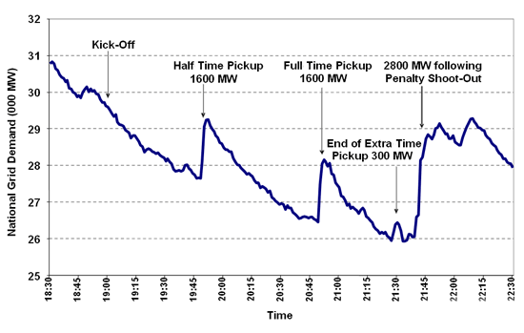
What is TV Pick Up?
The sudden surge in demand for electricity which is unique to Britain
Occurs during breaks of popular TV program or sports
Caused by millions of people collectively switching on kettles, opening the fridge, or flushing the toilets

Slide 3

Can We Detect TV Pick Up?
Hypothesis: The TV Pick Up can be detected for the major sports and popular soaps
Various examples throughout the history
5 April 2001 : EastEnders – Lisa admits shooting Phil 2290MW
21 June 2002 : England Vs Brazil World Cup 2570MW
4 July 1990 : England Vs W Germany World Cup 2800MW

Slide 4
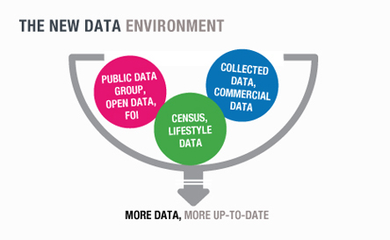

What is Acorn?
A powerful consumer classification
Analyzed using demographic data, social factors, population, and consumer behavior

Slide 5
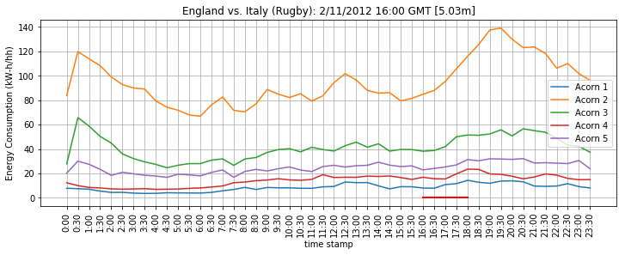
Acorn & TV Pick Up
The Acorn groups are specified by different colors of lines in the graph

Slide 6
Sources
https://www.geek.com/geek-cetera/tea-time-in-britain-causes-predictable-massive-surge-in-electricity-demand-1535023/
http://news.bbc.co.uk/2/hi/uk_news/magazine/6981356.stm
https://acorn.caci.co.uk/what-is-acorn
https://www.telegraph.co.uk/news/earth/energy/7819443/National-Grid-anticipates-power-surges-during-World-Cup.html
https://en.wikipedia.org/wiki/EastEnders

