Slide 1
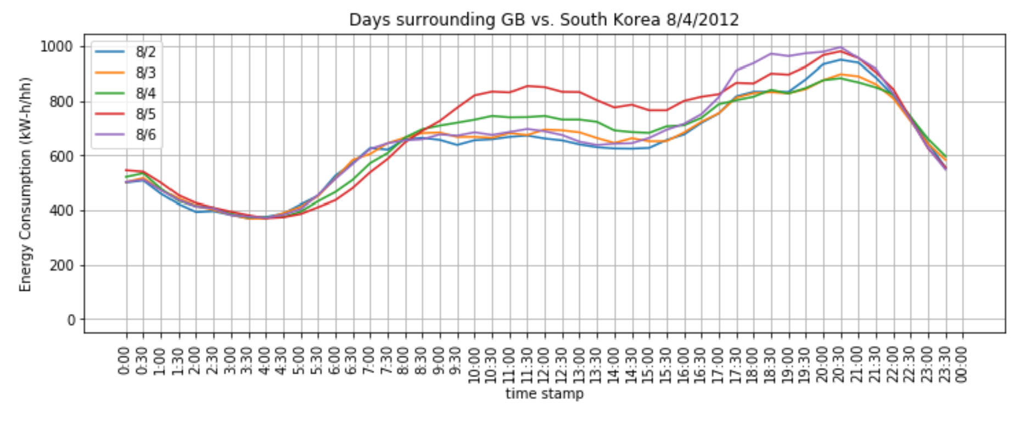
Data Preparation & Processing
MAC000003,Std,2012-02-29 22:30:00.0000000, 0.168 ,ACORN-P,Adversity
MAC000003,Std,2012-02-29 23:00:00.0000000, 0.183 ,ACORN-P,Adversity
MAC000003,Std,2012-02-29 23:30:00.0000000, 0.21 ,ACORN-P,Adversity
MAC000006,Std,2012-02-01 00:00:00.0000000, 0.04 ,ACORN-Q,Adversity
…
…
UK Power Networks
LCL Project
5,567 customers
Energy usage per half-hr.
Measured 2012, 2013
CSV file, 10 GB
167 million rows

Slide 2




Data Preparation Flow
10 GB
CSV
24 ‘raw’
CSV
pandas
24 ‘clean’
CSV
complete
CSV
Separate giant csv file into 24 months.
grep Std,2012-04- 10gb.csv > 2012-04.csv
Create new columns from datetime:
‘year’
‘month’
‘day’
‘hour’
‘minute’
Combine data into one file.
Clean – filter out Null.
groupby(['datetime','acorn’])
For each datetime:
Sum energy over each rec. in Acorn group
Count records in each Acorn group
Total energy and counts over all Acorn Groups

Slide 3
Example

