Slide 1
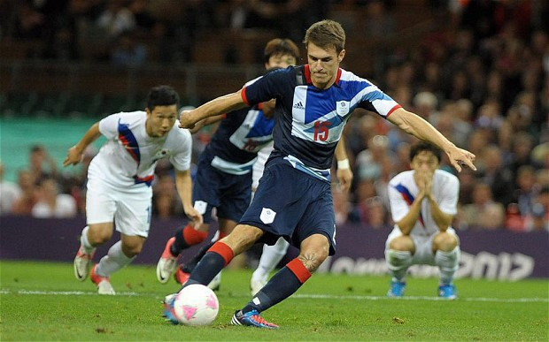
GB Vs South Korea Soccer game on 04 August 2012
The 2012 summer Olympics , was an international multi-sport event that held from 27 July to 12 August in London , United Kingdom. Talking about these Olympics game, We are going to be interested in the quarter final game between GB Vs South Korea started exactly around 22:48 at the Millennium Stadium on Saturday August 4, 2012 because it was the most watched game , the most broadcast by British TV channels and even the most reviewed, in order to get out what was its impact on the power of electricity in the GB’s household.

